Slide 1
Ch 4: Monitoring and Detecting Security Breaches
Updated 2-24-15

Slide 2
Monitoring
Four useful types of data
  Log data
  Network flow data
  Packet data
  Application level metadata

Slide 3
Log data

Slide 4
Types of Log Data
Format errors in queries
Lame delegations
  Referral from a parent zone to an invalid name server for the child zone
Queries for nonexistent domains

Slide 5
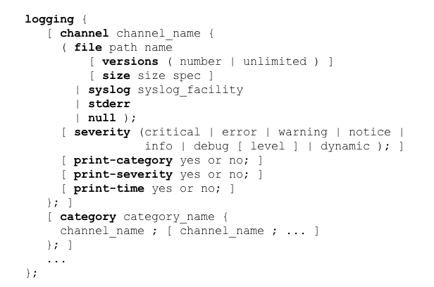
BIND's Logging in named.conf

Slide 6
Clauses
Channel
  Defines output medium, such as files, syslog, stderr, or null to eliminate output
Versions
  Max. number of files that can be used
  Files are rolled when "size" is reached
Severity
  "critical" logs only critical events
  "info" stores much more
Print
  print-time, print-severity, print-category
  Controls what is printed (link Ch 4a)

Slide 7

Categories
queries
  Logs client IP & port, question name, type and class of query
  Useful to record which hosts are querying for what domains
  + indicates recursive query
  S indicates signed query
  E indicates Extended DNS (EDNS)

Slide 8
Categories
security
  Requests that were denied
  Rejected by access control lists (ACLS) that define which hosts are allowed to send queries, zone transfers, etc.
  ACLs are set using these options statements
    allow-query
    allow-recursion
    allow-transfer

Slide 9
Categories
update-security
  Denied requests to update DNS zone data dynamically, because of ACLs or policies
  ACLs and policies defined with
    allow-update
    allow-update-forwarding
    update-policy
  BIND tool "nsupdate" generates dynamic updates

Slide 10
Categories
dnssec
  Only works if DNS server supports DNSSEC and is configured to perform record validation
  DNSSEC statements
    dnssec-enable
    dnssec-validation

Slide 11
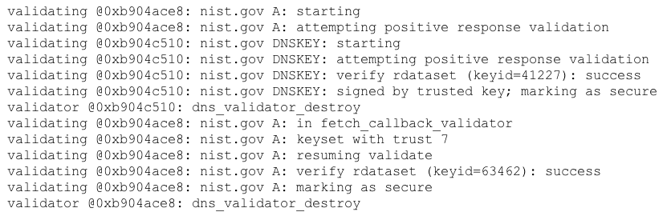
DNSSEC Example
Every line prefixed with
  Date dnssec: debug 3:

Slide 12
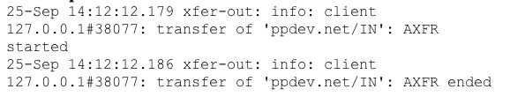
Categories
xfer-in
xfer-out
  Report zone transfers

Slide 13
Packet data

Slide 14
SPAN Port
Capture packets with tcpdump or Wireshark
From a SPAN port on a router or switch
  Provides a copy of every packet
Or use an optical or electronic splitter
  Or a hub
Data sent to a server that captures and stores all the packets
Usually uses libpcap or WinPcap with standard pcap format

Slide 15
Network flow data

Slide 16
Flow Data
Summarized record of a network traffic session
Packets with common characteristics
  Source and destination IP, Port, and Protocol
Each flow typically goes in only one direction
NetFlow
  Originally developed by Cisco
  Standardized by IETF as IP Flow Information Export (IPFIX)

Slide 17
Packet Grouping
TCP sessions
  Export flow as soon as session ends with FIN or RST
UDP traffic
  Must guess when flow ends
  Activity timer expiration exports after a period of time, even if flow is still in progress
  Inactivity times generates a flow record when there is inactivity for a period of time

Slide 18
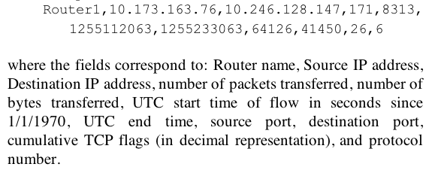
Flow Records
Don't contain a complete summary of a session between two hosts
Very long sessions, or sessions with periods of inactivity, may appear in multiple flow records

Slide 19
Application level metadata

Slide 20
Metadata
Flow records provide very little information
Packet data are overwhelming, containing too much data
  Also raise privacy concerns
Application layer metadata
  Keeps some packet fields from application and other layers

Slide 21
Detection

Slide 22
Cache Poisoning Attack Detection
Brute force attempts to guess Transaction ID and Source Port
Of a query from a recursive DNS server to an authoritative server
First attacker makes a request for a record that is not cached
Then blasts server with spoofed responses with many Transaction ID and Source Port values

Slide 23
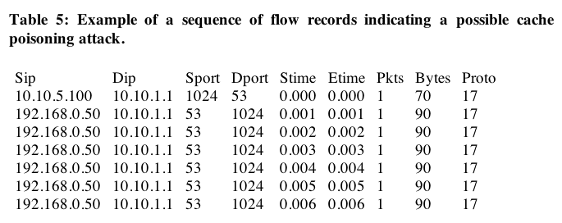
Flow Records
Keep flows with source or destination port 53 (TCP or UDP) and source or destination IP of the DNS server

Slide 24
Limitations of Flow Records
No Layer 7 data
  Such as the DNS request
Cannot pinpoint the domains being targeted
Or the addresses being injected

Slide 25
Selecting Relevant Data
DNS requests are irrelevant
Poisoning is performed by replies
Data needed
  Source & destination IP
  Domain name in the question section
  Answer, authority, and additional sections
  Transaction ID
  Timestamp
  Only include authoritative replies (AA set)

Slide 26
Transient Domains
Resolve to a small number of IP addresses
Change over hours or days
IP addresses are not owned by the same autonomous system (AS)
Typically they are botnet controllers, malware downloads, or file drop sites
Could be an innocent software bug, or a security research site

Slide 27
Identifying Transient Domains
Collect DNS traffic with
  Small TTLs
  Collect at peering links to other AS networks
Record
  Domain that was queried
  Answer given
  Timestamp
  Exclude client IP address for privacy

Slide 28
Round-Robin DNS
If there's more than one A record
  The order changes for each request
    Link Ch 4b
This is the default for most DNS servers
Demo:
  dig a google.com
  Repeat a few times

Slide 29
Fast Fluxing Domains
TTLs set to a few seconds
IP changes rapidly

Slide 30
Example from Conficker
Answer at time 0
www.refaourma.info. 60 IN A 65.54.40.75
www.refaourma.info. 60 IN A 65.118.223.203
www.refaourma.info. 60 IN A 65.130.228.46
Answer 28 sec. later
www.refaourma.info. 32 IN A 65.130.228.46
www.refaourma.info. 32 IN A 65.54.40.75
www.refaourma.info. 32 IN A 65.118.223.203

Slide 31
Example from Conficker
Answer at 56 sec.
www.refaourma.info. 4 IN A 65.118.223.203
www.refaourma.info. 4 IN A 65.130.228.46
www.refaourma.info. 4 IN A 65.54.40.75
Answer at 83 sec.
www.refaourma.info. 32 IN A 209.17.184.203
www.refaourma.info. 32 IN A 209.228.250.75
www.refaourma.info. 32 IN A 209.229.142.35
When cache expires, IP addresses are all new

Slide 32
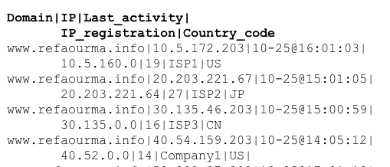
Detecting Fast-Flux Domains

Slide 33
Phantom Domains
Register a domain
Use it for only a few hours or days
Defends malware against sinkholing
  Resolving to an address that offers no service
Works best with domain registrars who offer a free trial period

Slide 34
Detecting Phantom Domains
Find domains that have been active recently
Find current addresses
Find domains with no matching historical IP addresses
Find records with very different IP addresses for the same domain

Slide 35
Corrupted Local DNS Server Settings
(DNS Changer)
Redirect victims to evil DNS server
Most resolutions are correct
Some lead to fake websites
  Such as banking sites, antivirus sites, etc.

Slide 36
Detecting DNS Changers
Recursive DNS requests to suspicious remote addresses
  Not in ISP's address range
  Not a known public DNS server
  Are in an IP address blacklist
  Associated with transient, fast-flux, phantom, sinkholed or blacklisted domain
  Located more than 1000 miles away
  Have no forward DNS domains

Slide 37
Tunneling
Firewalls allow port 53 through
Malware can phone home via port 53
Covert channels via DNS traffic
  Even embedded in fields of legitimate-looking DNS packets, such as DNSSEC keys or signatures

Slide 38
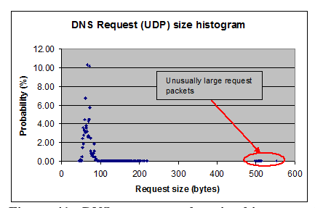
Detecting Tunneling
Large UDP Request packets (>300bytes)

Slide 39
DoS Attacks
Attacks against the DNS server
  TCP or UDP flood
  SYN flood
  Spoofed source addresses or botnets

Slide 40
DoS Attack Detection
Watch for these to be different from baseline
  Incoming bits/sec and outgoing bits/sec
    Imbalance indicates an attack
  DNS requests/sec (TCP and UDP)
  TCP SYN/sec
  Incoming TCP and UDP packets/sec
  ICMP incoming and outgoing packets/sec and bits/sec

