Slide 1
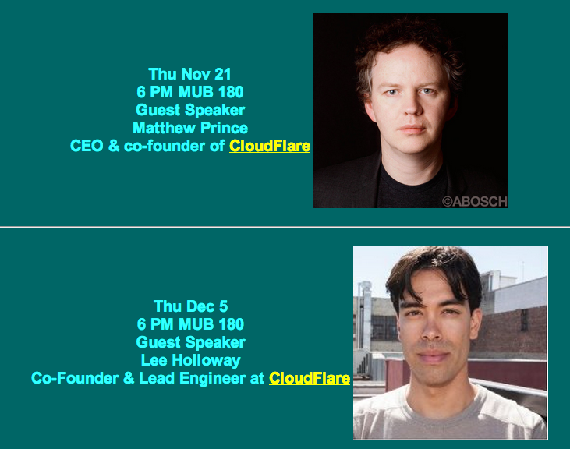
Guest Speakers

Slide 2
Ch 5: Prevention, Protection and Mitigation of DNS Service Disruption

Slide 3
Prevention of DNS Service Disruption

Slide 4
Architecture to Resist DoS
Authoritative servers typicallty need to accept queries from every device on the Internet
A network distributed system places authoritative servers in multiple networks
  Small scale: different subnets with different gateways
  Large scale: different Autonomous Systems (AS)
Geographically distributed systems are in different regions or countries

Slide 5
Types of DoS Protection
Host authoritative DNS servers at an ISP or Content Distribution Network (CDN)
Purchase caching acceleration service and delegate DNS resolution with a CNAME record
  Risky because the authoritative server is still needed to provide the CNAME record
Direct delegation from the TLD to the ISP's or CDN's authoritative servers

Slide 6
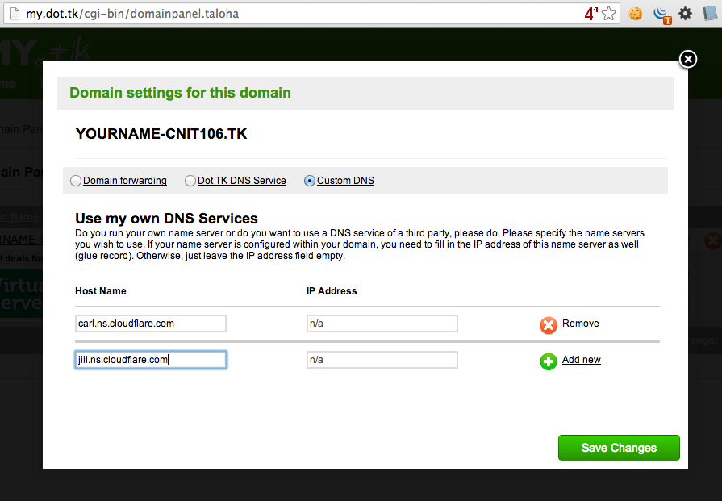
Project 6x
Protecting a domain with Cloudflare

Slide 7
Anycast
Multiple geographically separated servers use the same IP address
This spreads attacks over the whole network
Used by the root DNS servers and Cloudflare

Slide 8
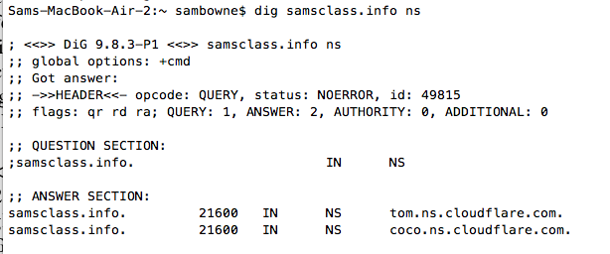
NS Delegation

Slide 9
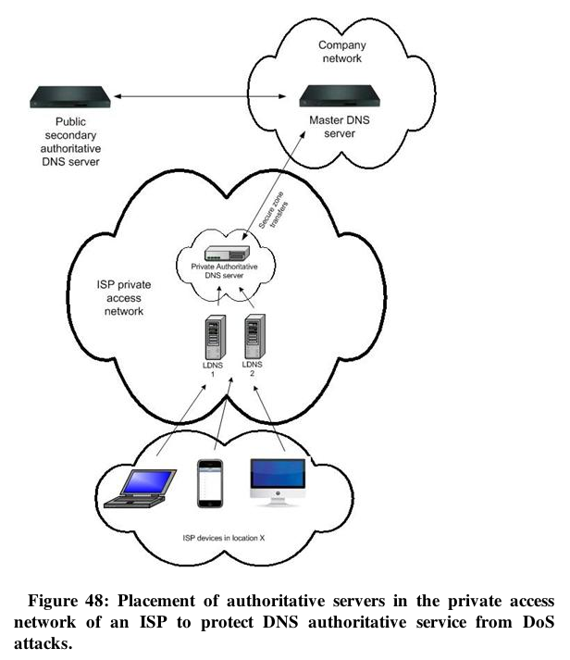

Slide 10
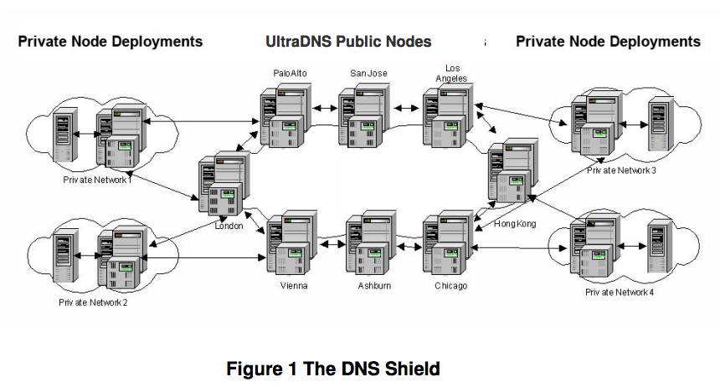
UltraDNS DNS Shield
Link Ch 5a

Slide 11
Software
Whatever you use, keep it updated
Bind
  The standard
djbdns
  Intended to be more secure than bind, but no longer centrally maintained (links Ch 5b)
There are many others (link Ch 5c)

Slide 12
DNS Security Extensions
DNSSEC

Slide 13
Purpose of DNSSEC
Ensure authenticity of data origin
And integrity of data received by a resolver from an authoritative DNS server
Done by signing Resource Record (RR) sets
  With a private key
  And including the signature (RRSIG) with the record

Slide 14
Chain of Trust
Resolver can verify the RRSIG with the server's Public Key
  Published by the server in its zone file
  Vouched for by the parent zone
  Vouched for by its parent...
  Unbroken chain of trust up to the root zone
Only works if all higher-level zones are signed

Slide 15
DNSSEC Chain of Trust
Root
key self-signed
.org
key signed by root
ietf.org
key signed by .org

Slide 16
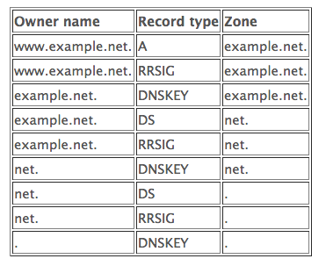
Detailed Chain of Trust
Link Ch 5d

Slide 17

Root Signed in 2010
Link Ch 5e

Slide 18
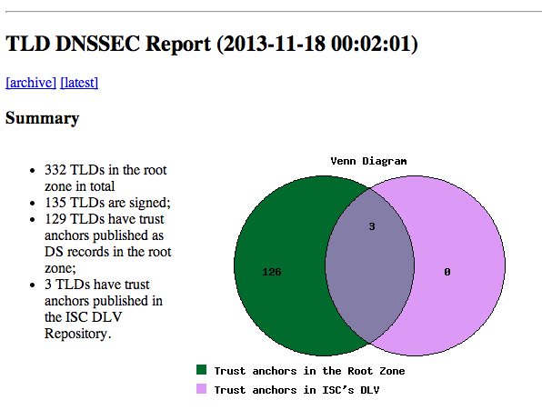
Link Ch 5f

Slide 19
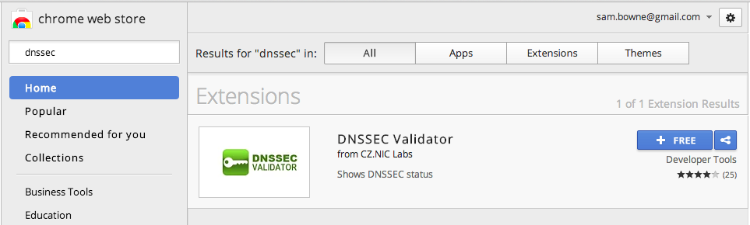
DNSSEC Validator
Chrome Extension

Slide 20
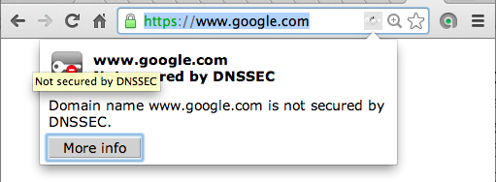
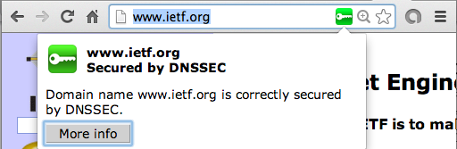

Slide 21
DNSSEC Issues
Protocol still changing
Only secures record to resolver, not traffic from resolver to client
Another reason to disallow external DNS servers like 8.8.8.8
  To keep all resolver traffic local

Slide 22
Transaction Signatures: TSIG
Maintains integrity of DNS messages between two severs
Cryptographically signs messages with TSIG
  Calculates a Message Authentication Code
  Encrypts it with a secret key
  Key shared by the two end-nodes
  Includes the time, to prevent replay attacks
  TSIG expires after the "time fudge factor"
You must generate secret key and securely transmit it to the other server

Slide 23
Transaction Signatures: SIG(0)
Alternative signature method using public key cryptography
Public key stored in a KEY record

Slide 24
Transaction Keys (TKEY)
Establishes a shared secret using
  Diffie-Hellman key exchange, or
  General Security Service API (based on Kerberos)
TKEY record contains the keying material required
Vulnerable to man-in-the-middle attacks
  Should be secured with SIG(0) (shared secret)

Slide 25
Software Diversification
Most root servers use Bind
K and H servers use NSD from NLnetlabs

Slide 26
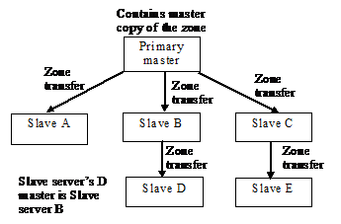
Master-Slave Setup
Changes are made at the master
Replicate to the slaves
Slaves can be masters of lower-level slaves

Slide 27
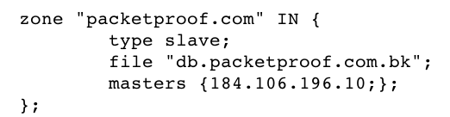
Configuring a Slave Server in Bind

Slide 28
Limitation of 512 Bytes
Running many slave servers is good for fault-tolerance
  But they all need to be listed as authoritative servers in DNS responses
  Limited to 512 bytes in legacy systems
Failover via multiple NS records is slow
  Requires several seconds for timeout of a bad server

Slide 29
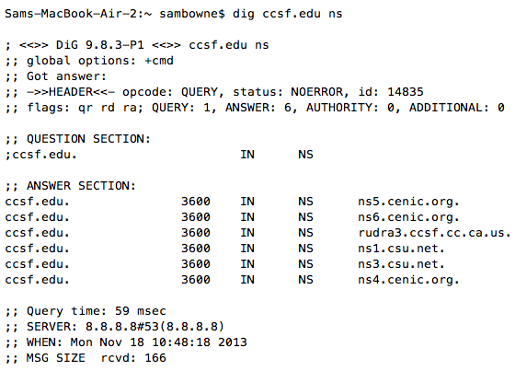
CCSF.EDU has 6 NS Records

Slide 30
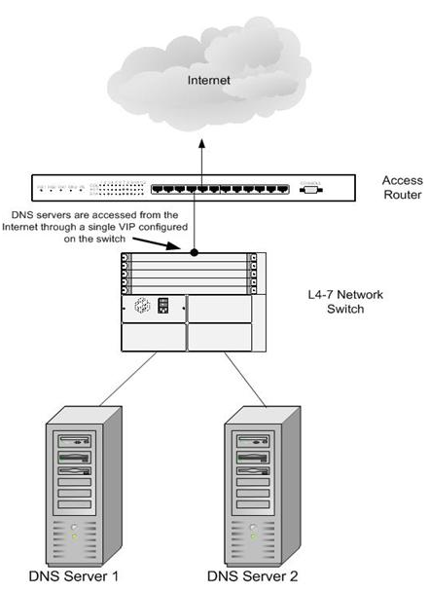
Automatic Failover
Use a load balancer
Appears to be a single server to external nodes

Slide 31
Protection of DNS Service

Slide 32
Firewalls, IDS/IPS
Run on hardened systems
Port 53 UDP/TCP open
Management ports only open to internal hosts
IDS/IPS blocks known attacks by signatures
Firewalls limit traffic with Access Control Lists (ACLs)
Older firewalls limit DNS packets to 512 bytes
  Now obsolete; EDNS0 allows UDP packets up to 4096 bytes (link Ch 5i)

Slide 33
Scrubbers
DDoS attacks look like many legitimate customers
Scrubbers block packets that meet DDoS criteria
  Not usually fully automated
When under attack, BGP updates are sent to redirect traffic to the scrubbers

Slide 34
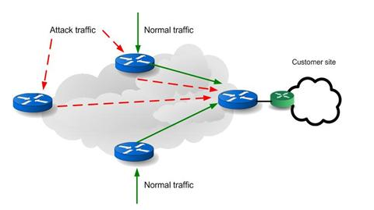
Normal Networking

Slide 35
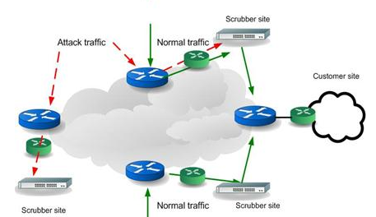
Using Scrubbers

Slide 36
Service Monitoring and Restoration

Slide 37
Monitoring
Send periodic probes from multiple ISPs and geographic regions
  Such as DNS requests
  Send directly to monitored servers
  Verify that responses are accurate

Slide 38
Backups
Regular backups of the DNS servers are essential
Can be full or incremental
Could back up whole OS, or just DNS configuration files
Cloud DNS servers must be backed up too
  Using backup tools appropriate for the cloud service
MUST TEST YOUR BACKUPS

Slide 39
Slow DNS Response
If a DNS server is down, it slows responses
Because the dead server must time out before another server is queries
Remove NS and A records for failed server to avoid this

