Slide 1
Ch 6: DNSSEC and Beyond
Updated 4-28-15

Slide 2
DNSSEC

Slide 3
Objectives of DNSSEC
Data origin authentication
  Assurance that the requested data came from the genuine source
Data integrity
  Assurance that the data have not been altered

Slide 4
Development of DNSSEC
Record signatures use public-key cryptography to verify authenticity of DNS records
RFC 2065 (1997): SIG and KEY records
RFC 2535 (1999): NXT record – denial of existence of a record
2003: DS (Delegation Signer) record
  Allows secure delegation to child zones
  SIG, KEY, NXT evolved to RRSIG, DNSKEY, NSEC

Slide 5
Development of DNSSEC
RFC 3757 (2004)
  Zone-Signing Key (ZSK)
  Key-Signing-Key (KSK)
  Secure Entry Point (SEP)
    A flag used to identify a KSK
2005
  NSEC replaced by NSEC3

Slide 6
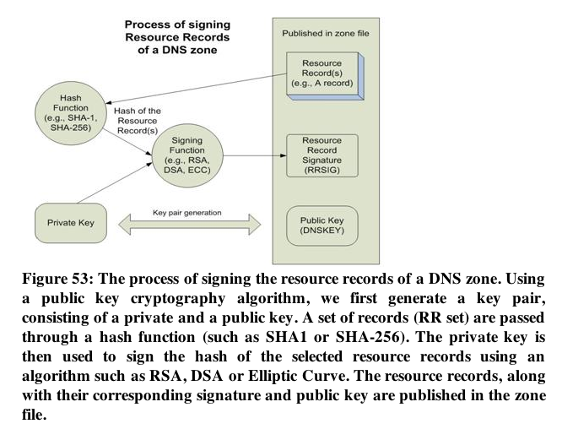

Slide 7
Man-in-the-Middle Attack
Victim
Attacker
Server
  Attacker generates two “false” key pairs
  Attacker intercepts the genuine keys and send false keys out
  Client trusts the Attacker's data
Trusted third party prevents this attack
  The root of DNS

Slide 8
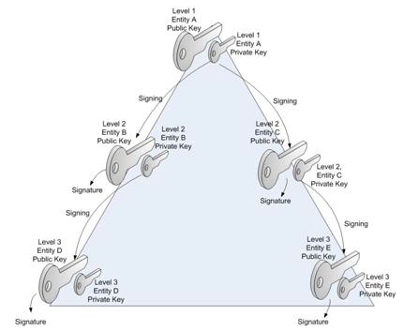
Hierarchical Chain of Trust

Slide 9
The Delegation Signer (DS) Record
Links in the chain of trust
DS record contains a hash of a zone's public key
To make performance better, the zone key may be separated into
  Zone Signing Key (ZSK) and
  Key Signing Key (KSK)

Slide 10
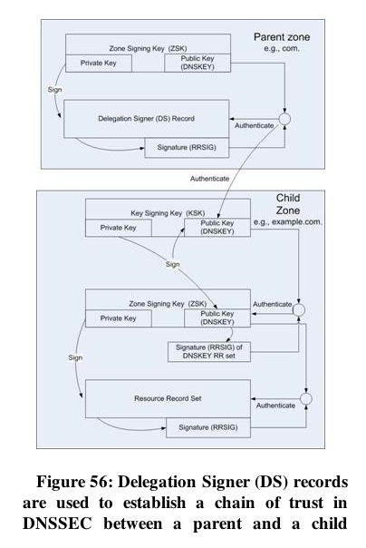

Slide 11
Authenticated Denial of Existence
NSEC and NSEC3 Records
Sort all domain names in zone in alphabetical order
  a.example.com with A, AAAA, RRSIG
  c.example.com
NSEC Record
  a.example.com TTL IN NSEC c.example.com A AAAA RRSIG
  Nothing between a.example.com and c.example.com
This record proves there is no b.example.com

Slide 12
Example
Proves there is no *.us
Proves there is no d.us

Slide 13
NSEC Information Disclosure
Easy to find all domains in a zone
Like a zone transfer
dig *.se +dnssec
  Reveals first valid hostname
Dig for valid hostname* to find next one
NSEC3 fixes this problem

Slide 14
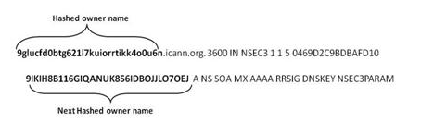
NSEC3 Hostnames are Hashed and Salted
Can be hashed many times

Slide 15
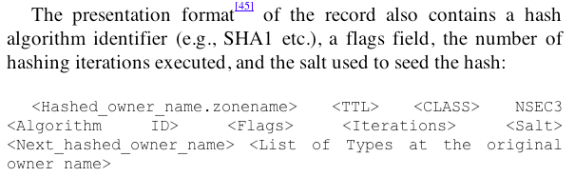
Algorithm and Salt in Record

Slide 16
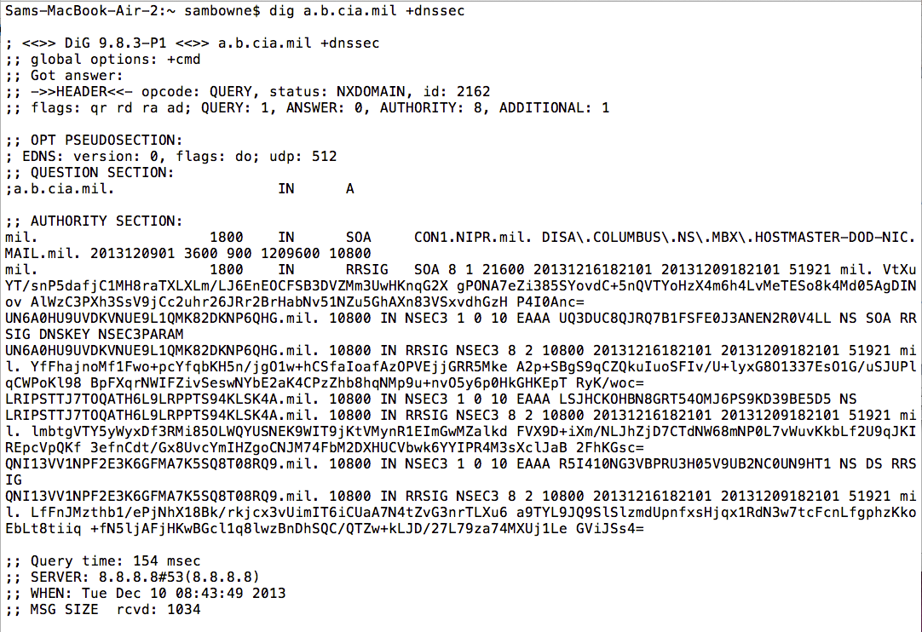

Slide 17
Making a Validating Resolver
See Proj 7x

Slide 18
Weaknesses of DNSSEC

Slide 19

Lack of Protection Between User Devices and Resolvers
Attacker in the middle has enough info to perfectly forge responses
  Unless DNSSEC is enforced in the client's browser
Not protected
Protected by DNSSEC
User
DNS Resolver
DNS SOA

Slide 20
Lack of Protection of Glue Records
DNSSEC only protects Resource Records if they are authoritative in the zone
Glue records are resource records that facilitate a resolution that is delegated from a parent zone to a child zone
They are owned by the child zone but appear in the parent zone
So they are non-authoritative
Not protected by DNSSEC

Slide 21
Key Changes Don't Propagate
Keys can
  Roll over
  Be Revoked
  Signatures can expire
These events do not propagate down the DNS tree

Slide 22
NSEC3 Denial of Service
If a zone is insecurely delegated to another zone
And it includes NSEC3 records
A MITM can block resolution of a domain
Or delegate the resolution to another server and change the A record
Enabling spoofing, cookie-stealing, etc.

Slide 23
Re-Addressing Replay Attack
If a server moves to a new hosting provider
The old IP address can be used until the signatures expire
Because there's no way to push signature expiration from authoritative servers to resolvers

Slide 24
NSEC3 Still Allows Zone Walking
An offline dictionary attack can be used to guess the hashes
It's the same as cracking password hashes

Slide 25
No Protection of DNS or Lower Layer Header Data
The AD flag is part of the DNS header
  Authenticated Data flag, indicating that the response data was verified by DNSSEC
  Can't be trusted, because
Can be changed by a MITM
DNSSEC won't detect that

Slide 26
DNSSEC Data Inflate Zone Files and DNS Packet Sizes
Small requests lead to large responses
UDP allows spoofing the source IP address
Target
Open DNS Resolver
Attacker

Slide 27
DNSSEC Increases Computational Requirements on Validators and Servers
Verifying signatures
Calculating hashes for NSEC3 records

Slide 28
DNSCurve

Slide 29
Encrypted Packets
Operates at layer 2 (Data Link)
Uses Elliptic Curve Cryptography
Each request and response packet is encrypted in its entirety
  DNSSEC doesn't encrypt any data, it just signs it
ECC keys are 256 bits long
Calculation is much faster than RSA

Slide 30
DNSCurve Limitations
Not yet an IETF standard
Does not provide end-to-end security
  Just from endpoint to resolver
Name-server names need to be longer to include a Base-32 encoded 53-byte public key
  Makes responses even larger
DNS Queries may exceed 255 bytes, which will be dropped by old middleware
Key compromise requires renaming the server
  And manual update of NS record in the parent zone

