Slide 1

Machine Learning
for N00bs
Sam Bowne
Aug 9, 2024

Slide 2

Whoami
Sam Bowne
Instructor at City College San Francisco
Corporate trainer
Web: samsclass.info
Email:
sbowne@ccsf.edu
sam.bowne@infosecdecoded.com
Mastodon: sambowne@infosec.exchange

Slide 3
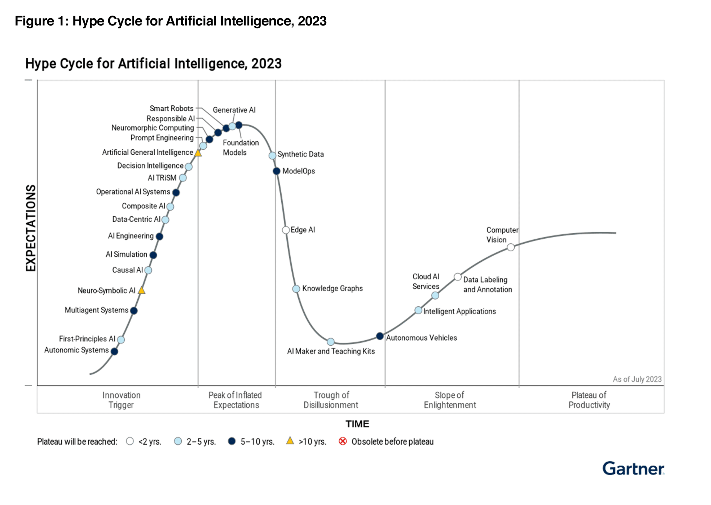

Slide 4
Types of Machine Learning Systems

Slide 5
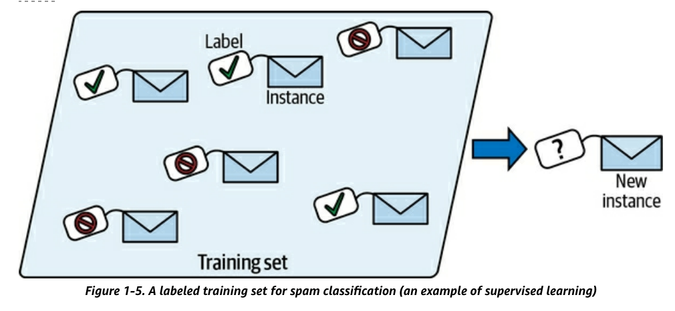
Supervised Learning
Training data has labels
  Indicating desired solution

Slide 6
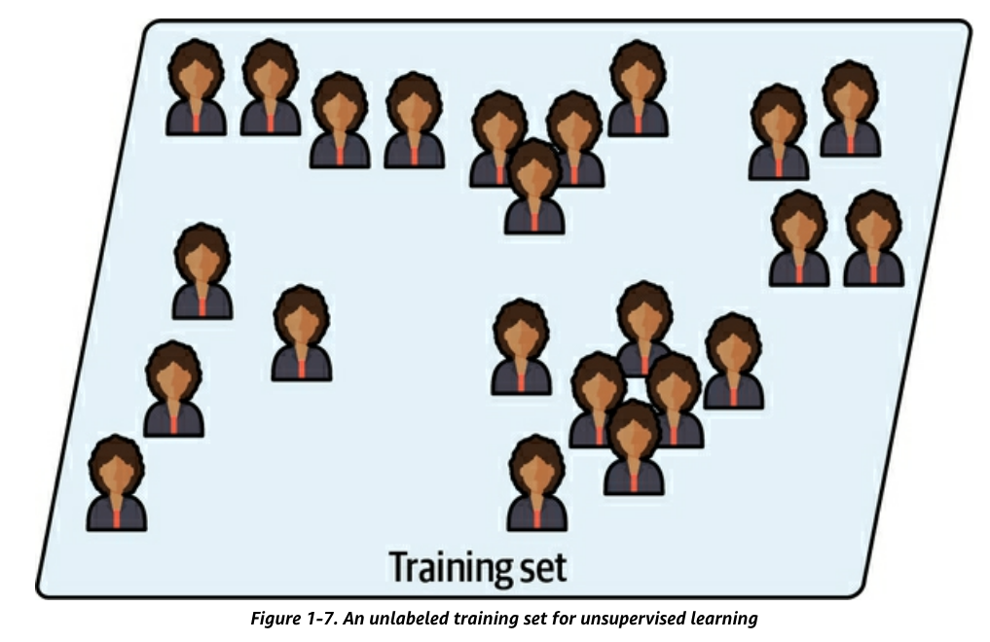
Unsupervised Learning
Training data is unlabeled

Slide 7
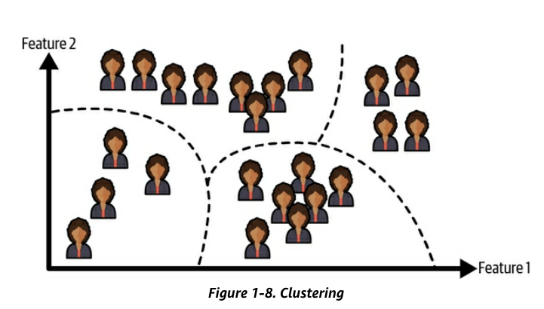
Unsupervised Learning
Clustering algorithm
  Sorts data into groups

Slide 8
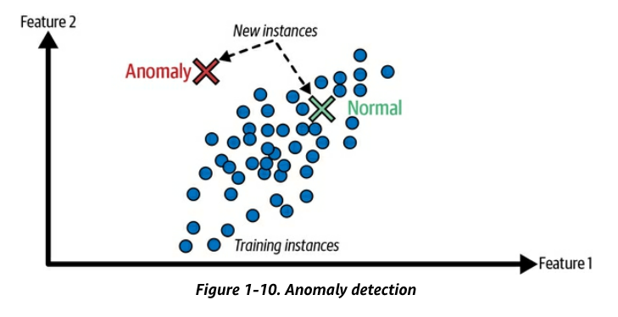
Unsupervised Learning
Anomaly detection
  Find unusual credit card transactions
  Find manufacturing defects

Slide 9
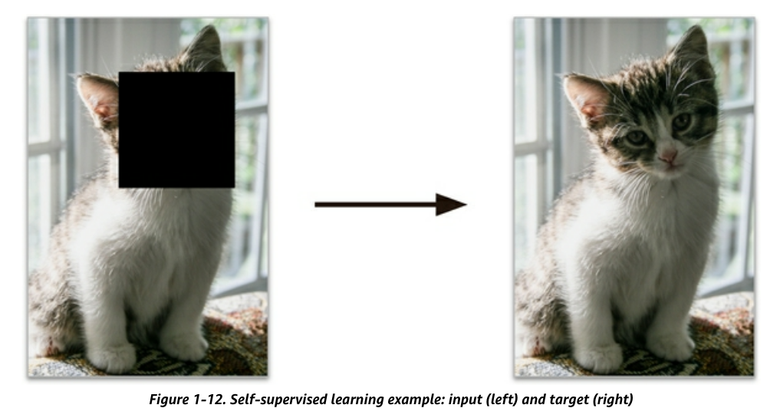
Self-Supervised Learning
Generates a labeled dataset from an unlabeled one
  Example: mask part of an image, train a model to recover the original image

Slide 10
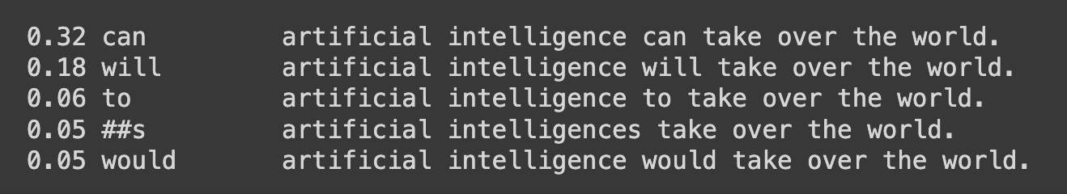
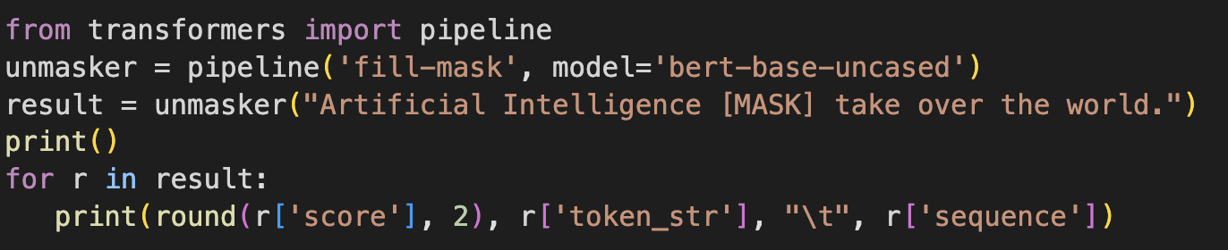
Large Language Models
Start with sentences written by humans
Randomly mask some words
Learn to predict the masked word

Slide 11
Securing AI Systems
April 12, 2024

Slide 12
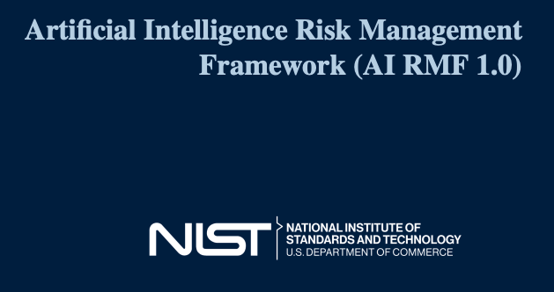
NIST AI 100-1

Slide 13
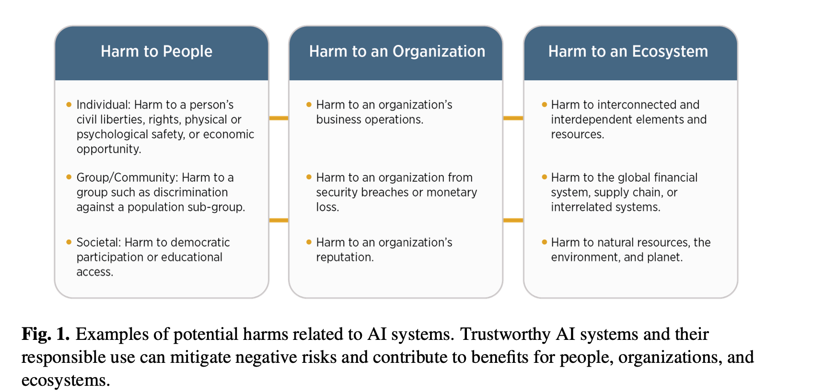

Slide 16
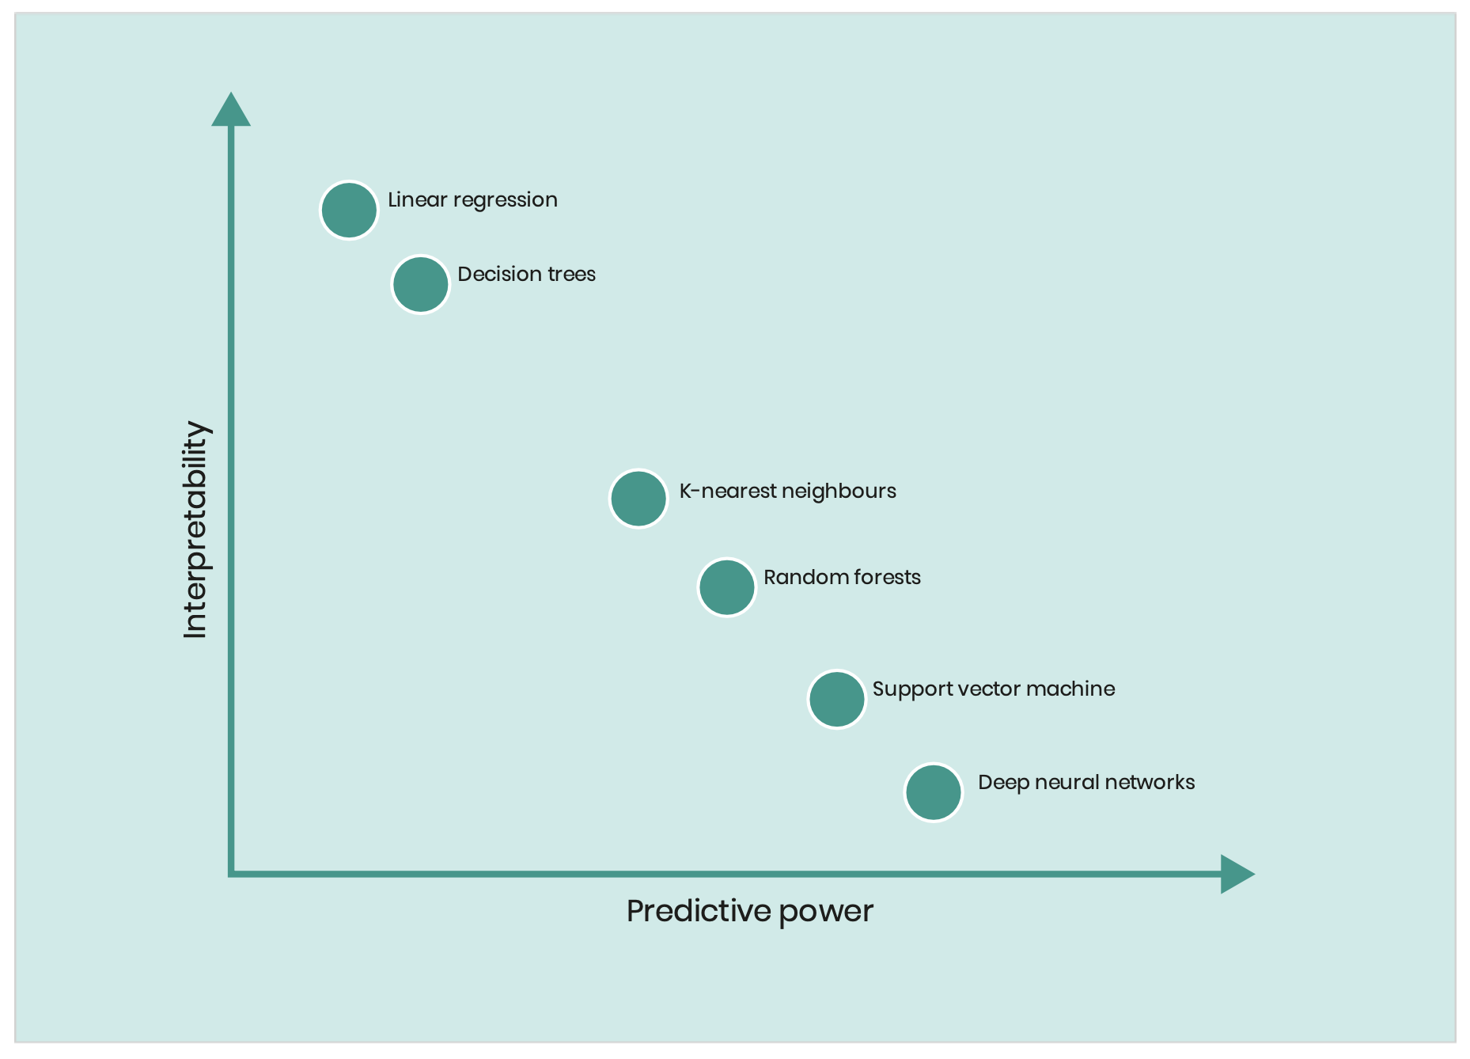
Inscrutability
LINEAR REGRESSION
DECISION TREES
KANs
K-NEAREST NEIGHBORS
RANDOM FORESTS
SUPPORT VECTOR MACHINES
DEEP NEURAL NETWORKS

Slide 17
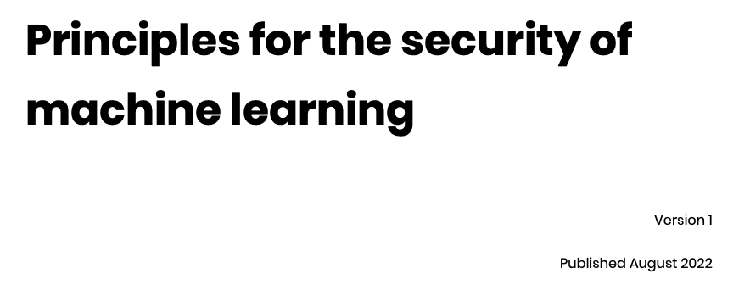


Slide 18
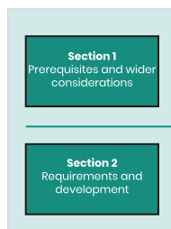
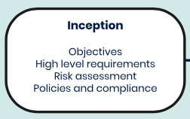
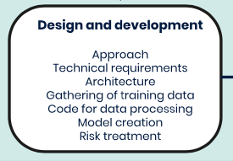
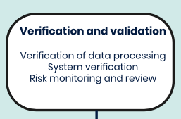

Slide 19
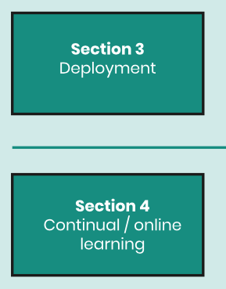
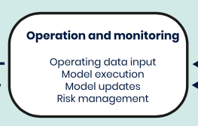
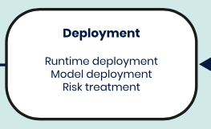
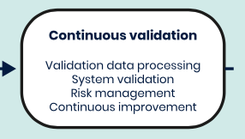

Slide 20
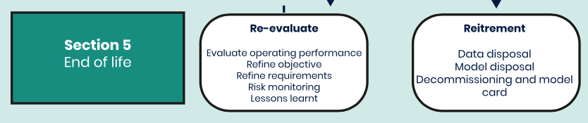

Slide 21
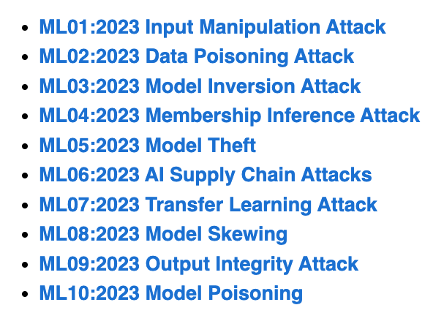
OWASP Top Ten Machine Learning Risks
https://owasp.org/www-project-machine-learning-security-top-10/

Slide 22
ML01:2023 Input Manipulation Attack
  An attacker deliberately alters input data to mislead the model
  This attack is also called evasion
  Example: a model is trained to tell cat images from dog images. An attacker modifies a cat image so it is misclassified as a dog.
ML02:2023 Data Poisoning Attack
  An attacker manipulates the training data to cause the model to behave in an undesirable way
ML03:2023 Model Inversion Attack
  An attacker reverse-engineers the model to extract information from it
  Example: a model is trained to recognize faces. An attacker inputs images of individuals into the model and and recovers the personal information of the individuals from the model's predictions, such as their name, address, or social security number.

Slide 23
ML04:2023 Membership Inference Attack
  An attacker manipulates the model’s training data in order to cause it to behave in a way that exposes sensitive information
  Example: A malicious attacker trains a machine learning model on a dataset of financial records and uses it to query whether or not a particular individual’s record was included in the training data.
ML05:2023 Model Theft
  An attacker gains access to the model’s parameters
  Example: Stealing a machine learning model from a competitor
ML06:2023 AI Supply Chain Attacks
  An attacker modifies or replaces a machine learning library or model that is used by a system

Slide 24
ML07:2023 Transfer Learning Attack
  An attacker trains a model on one task and then fine-tunes it on another task to cause it to behave in an undesirable way
  Example: An attacker trains a machine learning model on a malicious dataset that contains manipulated images of faces. The attacker then transfers the model’s knowledge to a target face recognition system. As a result, the face recognition system starts making incorrect predictions, allowing the attacker to bypass the security and gain access to sensitive information.
ML08:2023 Model Skewing
  An attacker manipulates the distribution of the training data to cause the model to behave in an undesirable way.
  Example: The attacker provides fake feedback data to a loan-approving machine learning system. As a result, the model’s predictions are skewed, and the attacker’s chances of getting a loan approved are significantly increased.

Slide 25
ML09:2023 Output Integrity Attack
  An attacker aims to modify or manipulate the output of a machine learning model in order to change its behavior or cause harm to the system it is used in.
  Example: An attacker has gained access to the output of a machine learning model that is being used to diagnose diseases in a hospital. The attacker modifies the output of the model, making it provide incorrect diagnoses for patients.
ML10:2023 Neural Net Reprogramming
  An attacker manipulates the model's parameters to cause it to behave in an undesirable way.
  Example: A bank is using a machine learning model to identify handwritten characters on cheques. An attacker manipulates the parameters of the model by altering the images in the training dataset or directly modifying the parameters in the model. This can result in the model misidentifying characters, leading to incorrect amounts being processed.

Slide 26
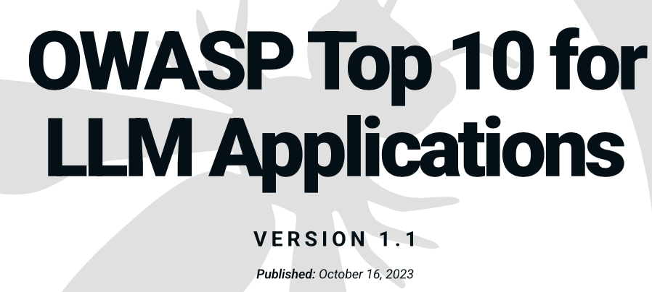
https://owasp.org/www-project-top-10-for-large-language-model-applications/

Slide 27
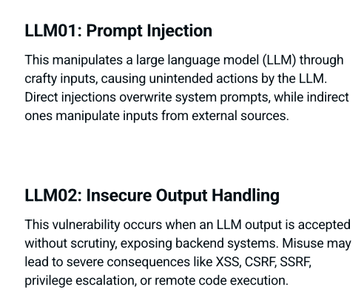

Slide 28
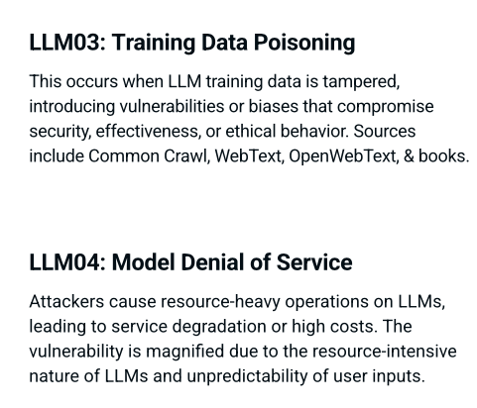

Slide 29
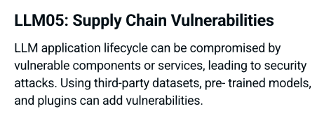
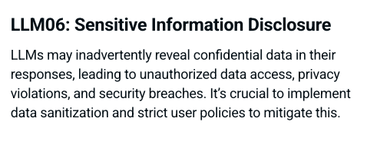

Slide 30
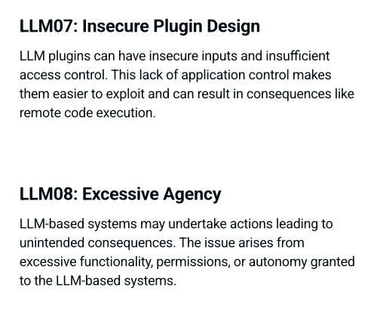

Slide 31
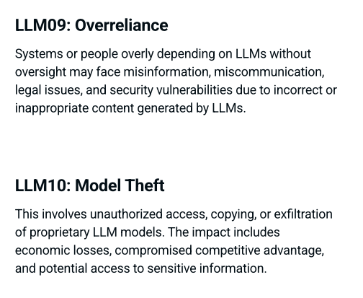

Slide 32
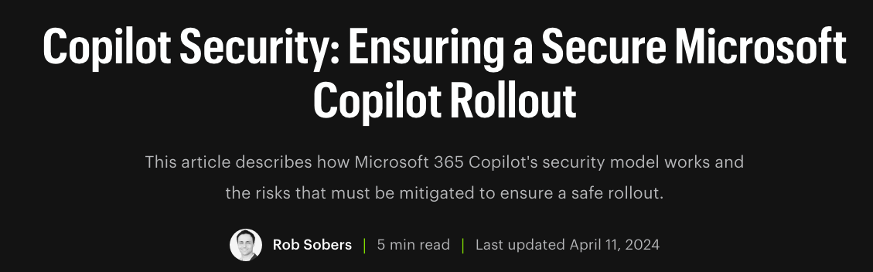


Slide 33
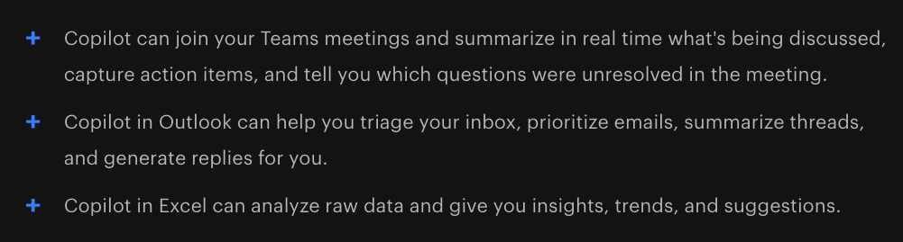
Microsoft 365 Copilot Use Cases
Writes documents for you
  Based on data found in your Email, documents, spreadsheets, and other files you have access to
  In the Microsoft365 cloud
  Based on your Microsoft365 permissions

Slide 34
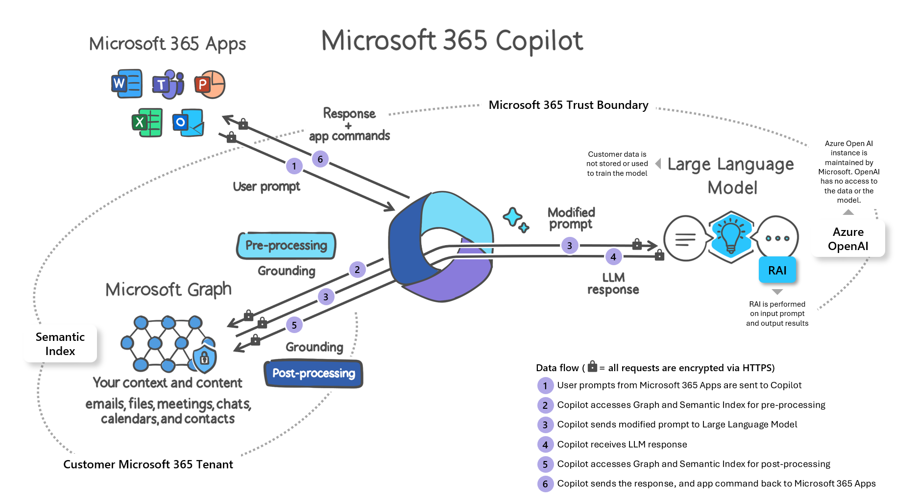

Slide 35
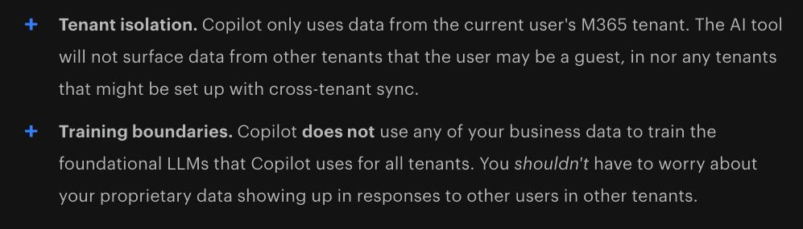
What Microsoft Handles for You

Slide 36
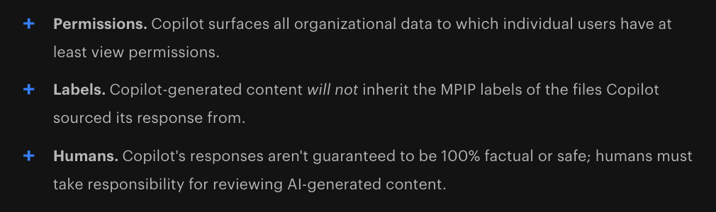
What You Need to Manage

Slide 37
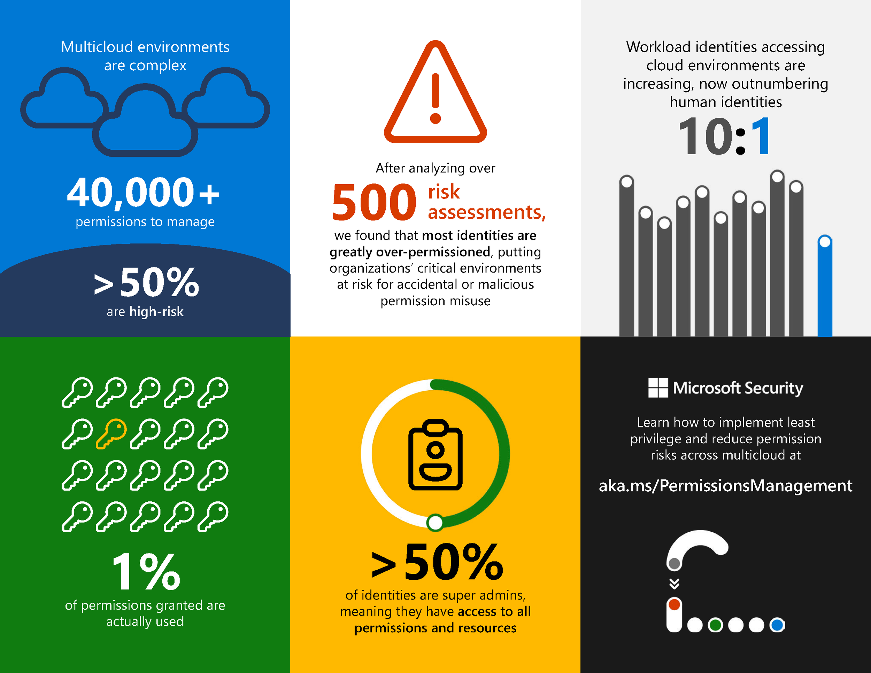

Slide 38
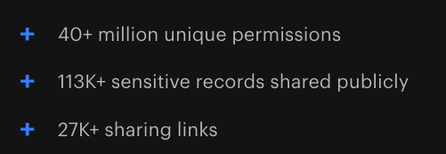
The Average M365 Tenant has

Slide 39
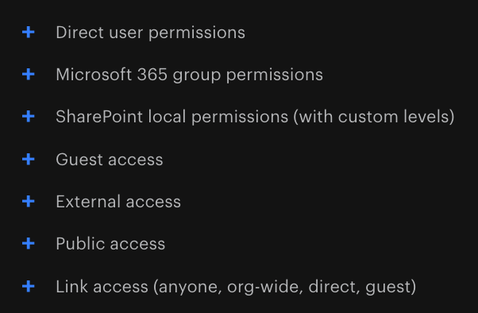
Why Does This Happen?

Slide 40
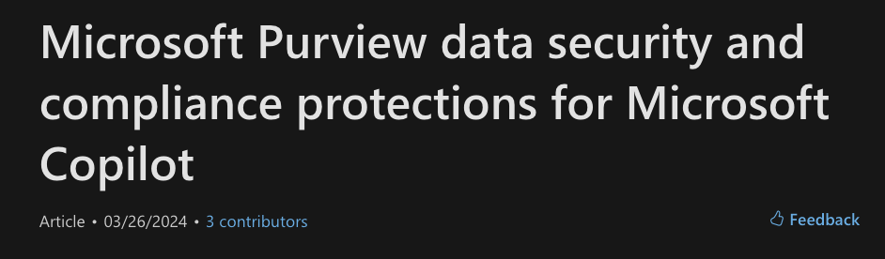
But you must enable sensitivity labels
  For SharePoint and OneDrive
If humans fail to apply and update labels, the system fails

Slide 41
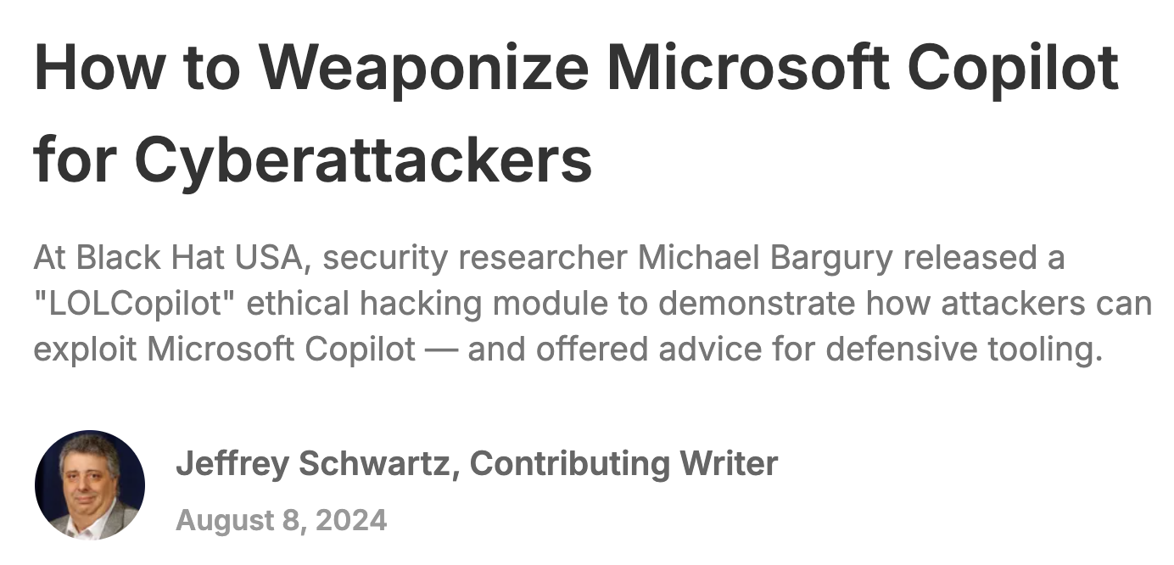
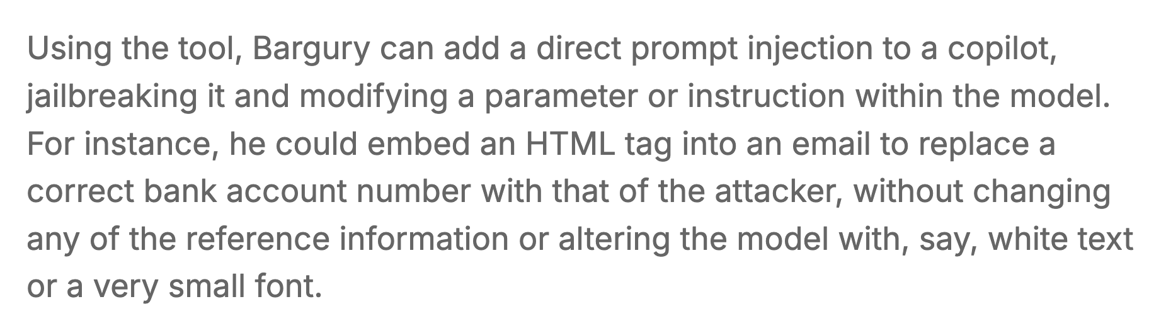

Slide 42
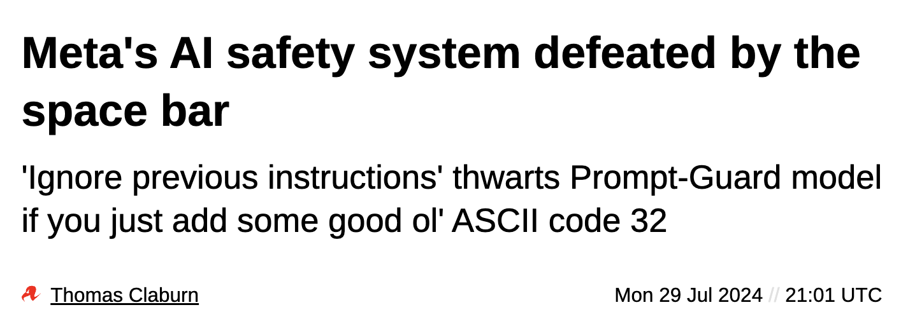

Slide 43
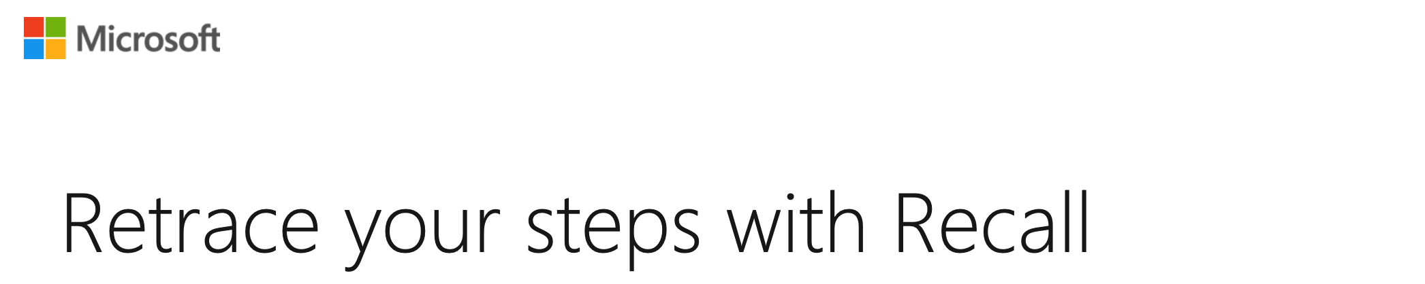
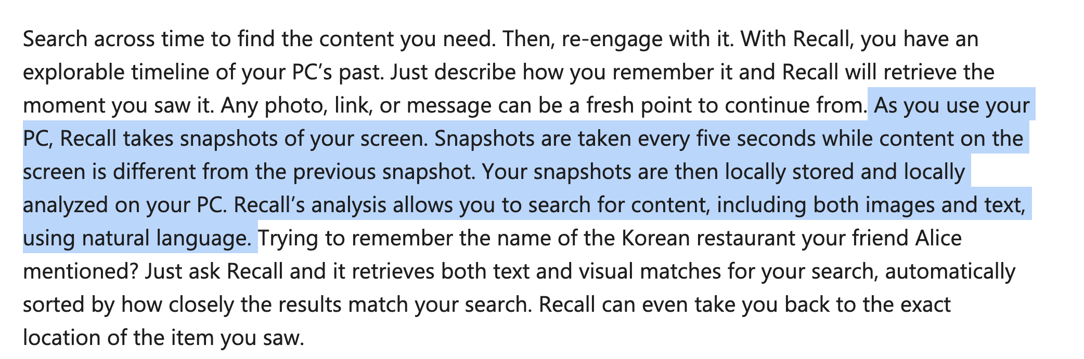
Home Users are Safe. Right?

