Slide 1

The Risk of Rushing into
AI Solutions
Sam Bowne
June 17, 2024

Slide 2

Whoami
Sam Bowne
Instructor at City College San Francisco
Corporate trainer
Web: samsclass.info
Email:
sbowne@ccsf.edu
sam.bowne@infosecdecoded.com
Mastodon: sambowne@infosec.exchange

Slide 3
The Threat

Slide 4
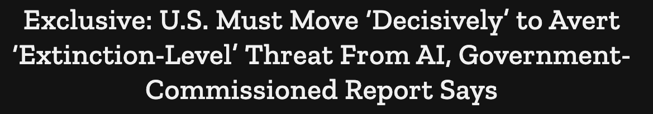



Slide 5
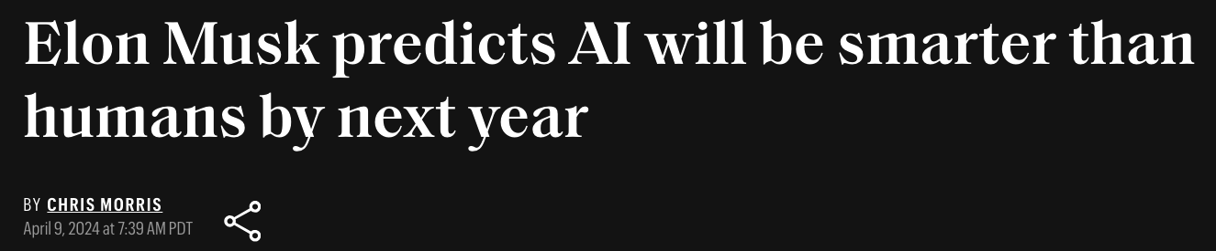


Slide 6
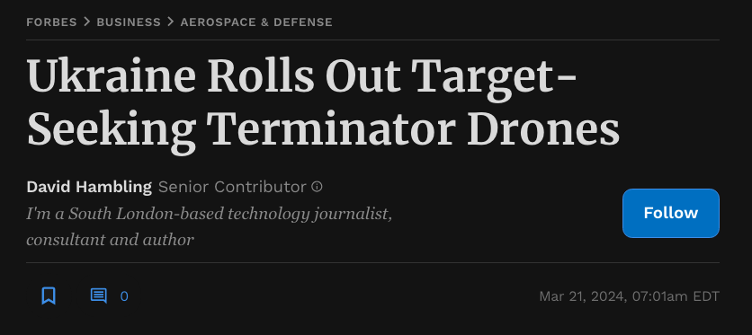

Slide 7
Religions of Silicon Valley

Slide 8
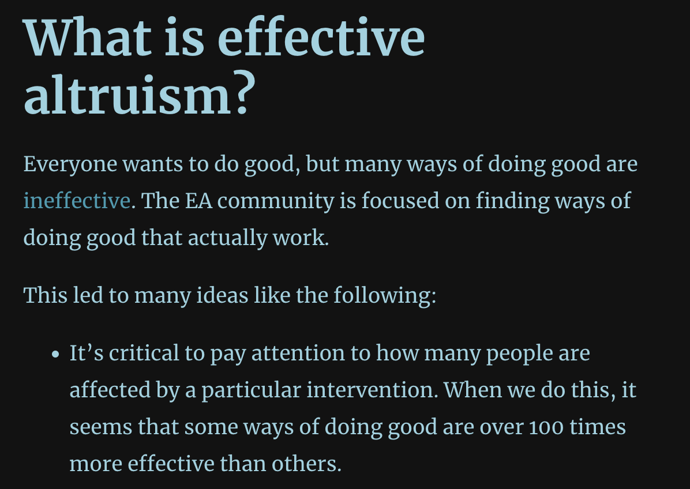
https://www.effectivealtruism.org/

Slide 9
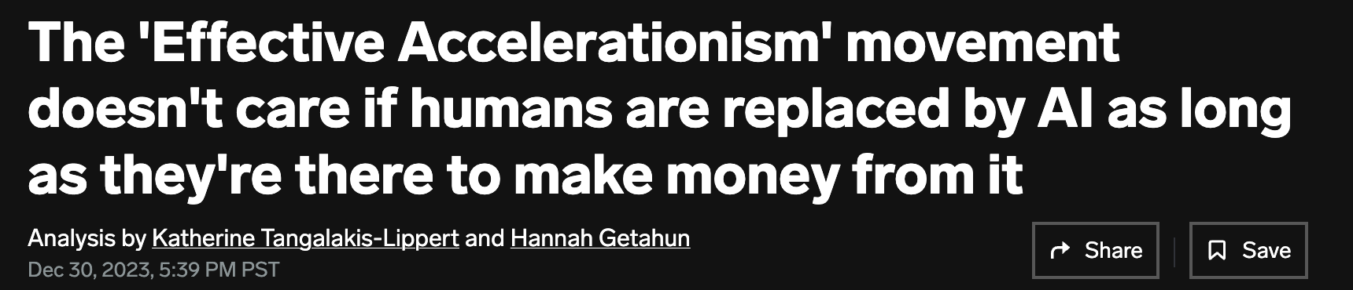

https://www.businessinsider.com/effective-accelerationism-humans-replaced-by-ai-2023-12
https://www.nytimes.com/2023/12/10/technology/ai-acceleration.html

Slide 10
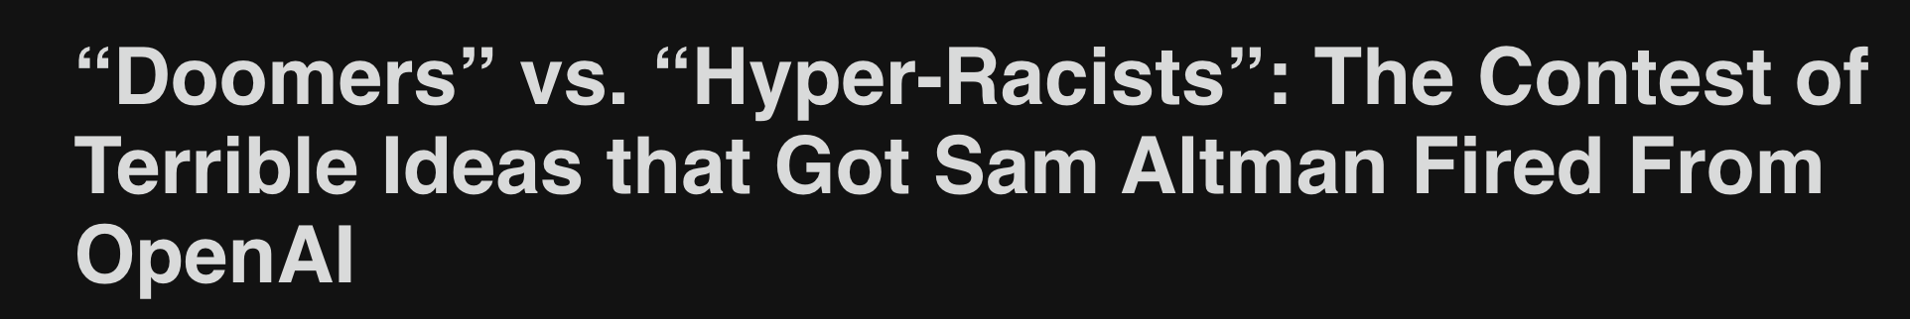
As I write this, the new, possibly interim CEO of OpenAI appears to be Emmett Shear, who has described AI development as “the creation of an alien god.”
https://davidzmorris.substack.com/p/doomers-vs-hyper-racists-the-contest

Slide 11
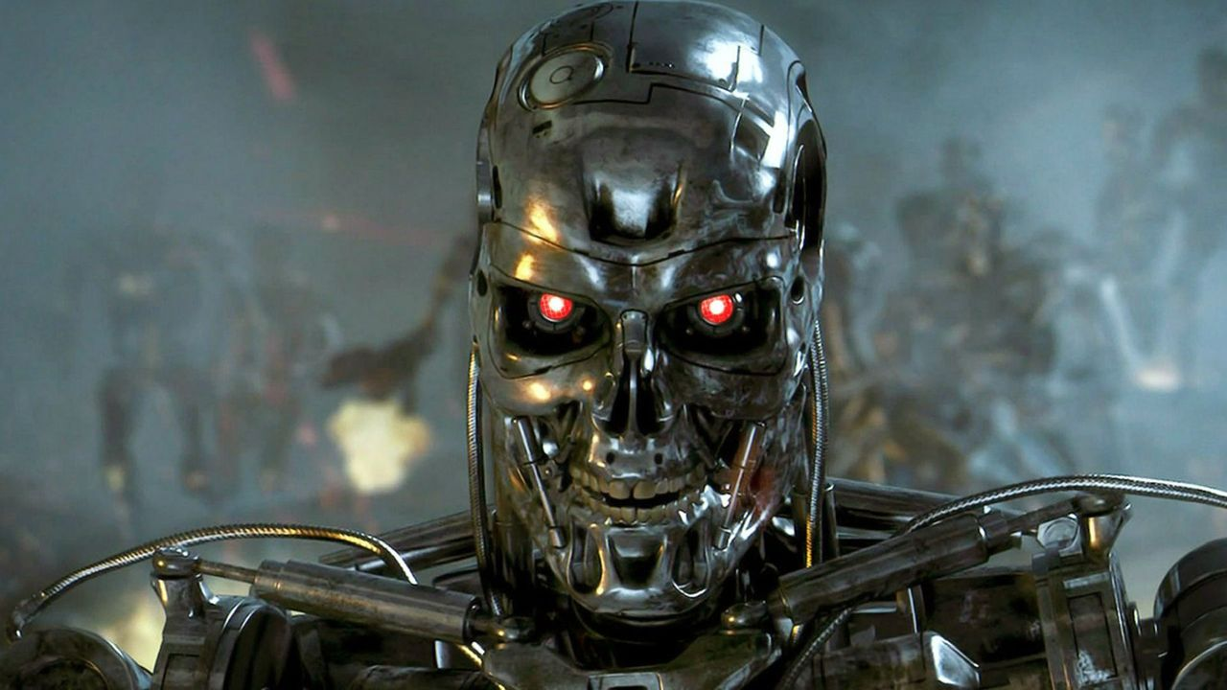

Slide 12



Slide 13
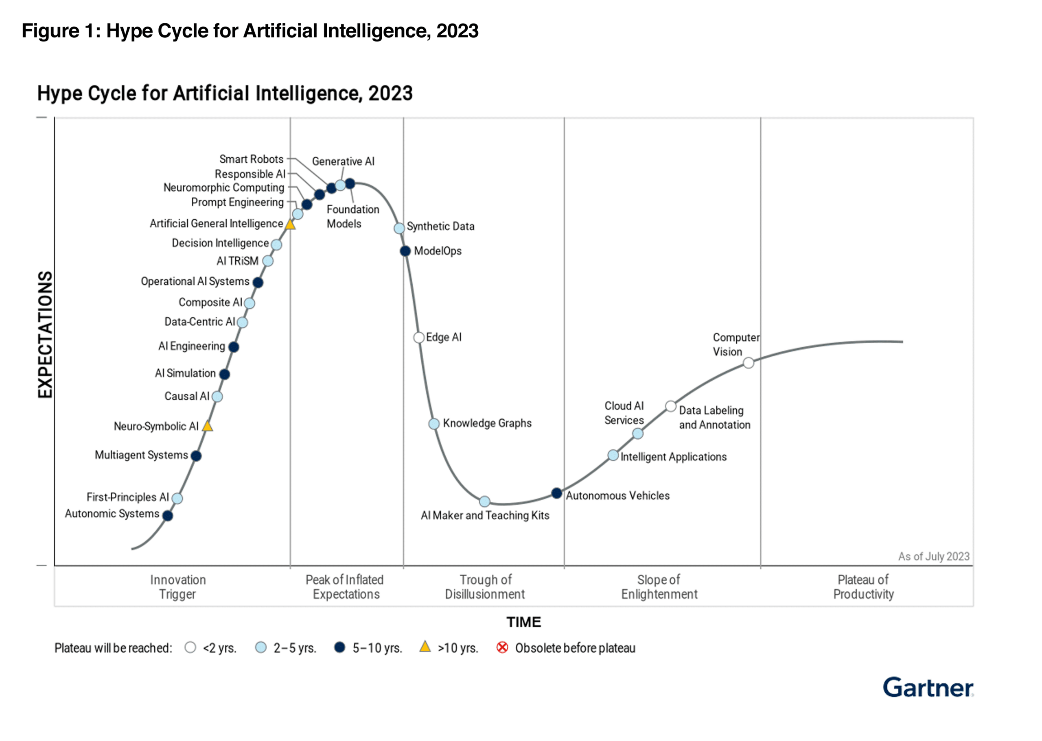

Slide 14
What Is Machine Learning?

Slide 15
What Is Machine Learning?
The science (and art) of programming computers so they learn from data
Example: spam filter
  Learns from examples of spam emails, flagged by users, and regular emails (the training set)
  The part of a ML system that learns and makes predictions is called a model.
  Neural networks and random forests are examples of models

Slide 16
Why Use Machine Learning?

Slide 17
Traditional Programming
To create a spam filter
  Examine spam examples and find words that appear often, like "4U", "credit card", "free", "amazing", or other paterns in sender's name or email body
  Write an algorithm to detect each pattern, flag email as spam if a number of these patterns are detected
  Test the program and repeat steps 1 and 2 until it's good enough to launch

Slide 18
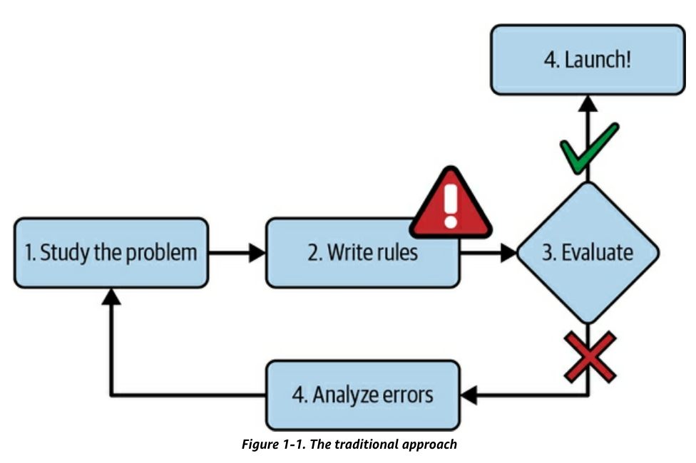
Traditional Programming
Program uses a long list of rules
Difficult to maintain

Slide 19
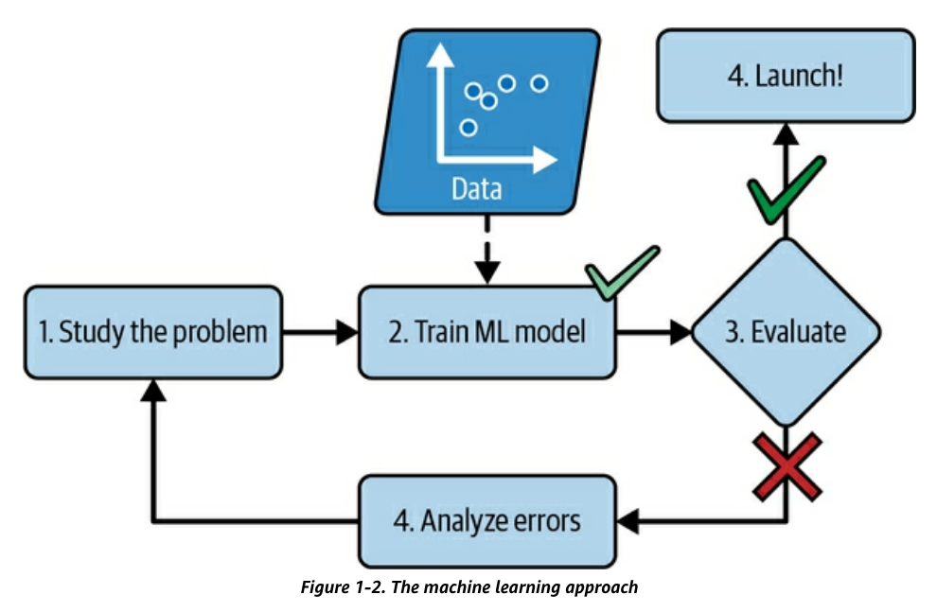
Machine Learning
Learns words and phrases that can predict spam
Program is shorter, easier to maintain, and more accurate

Slide 20
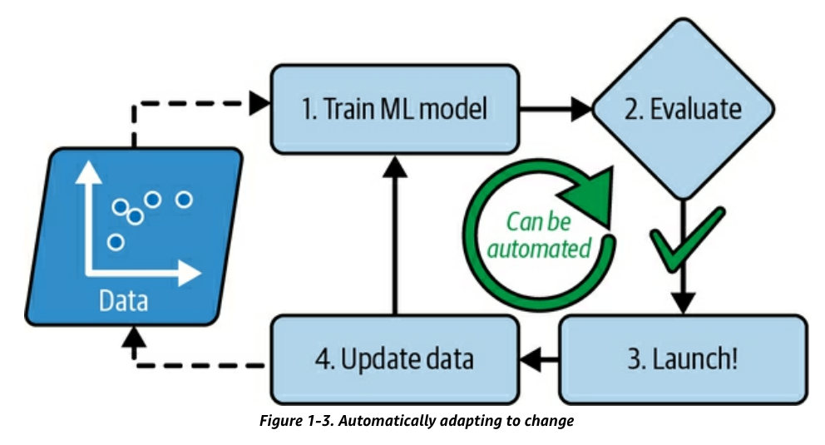
Machine Learning
Automatically adapts to changing tactics of spammers

Slide 21
Other Problems
Some problems are too complex for traditional approaches
  Or have no known algorithm
Speech recognition
  Trained on many example recordings

Slide 22
Examples of Applications

Slide 23
Examples of Applications
Analyzing images of products on a production line to automatically classify them
  Image classification typically uses Convolutional Neural Networks (CNNs) or Transformers
Detecting tumors in brain scans
Automatically classifying news articles
  This is Natural Language Processing (NLP), and more specifically text classification, which can be tackled using Recurrent Neural Networks (RNNs) and CNNs, but Transformers work even better

Slide 24
Examples of Applications
Creating a chatbot or a personal assistant
Forecasting your company’s revenue next year, based on many performance metrics
Making your app react to voice commands
Detecting credit card fraud
Segmenting clients based on their purchases so that you can design a different marketing strategy for each segment
Representing a complex, high-dimensional dataset in a clear and insightful diagram
Recommending a product that a client may be interested in, based on past purchases
Building an intelligent bot for a game

Slide 25
Types of Machine Learning Systems

Slide 26
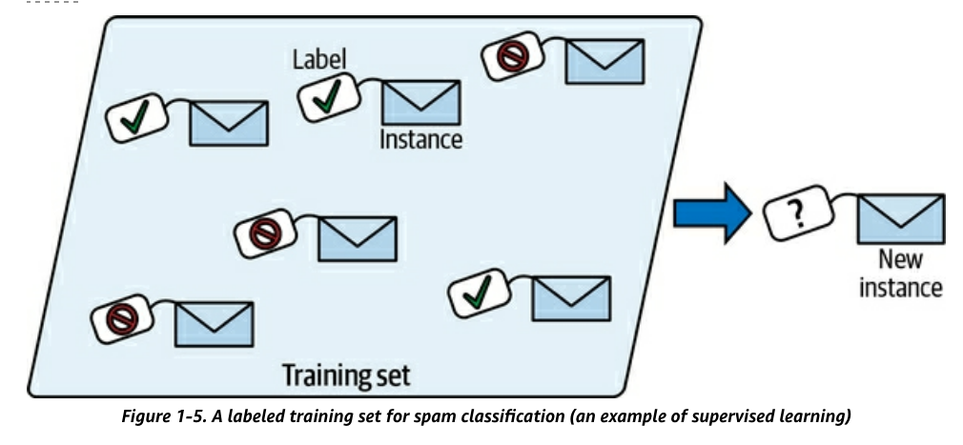
Supervised Learning
Training data has labels
  Indicating desired solution

Slide 27
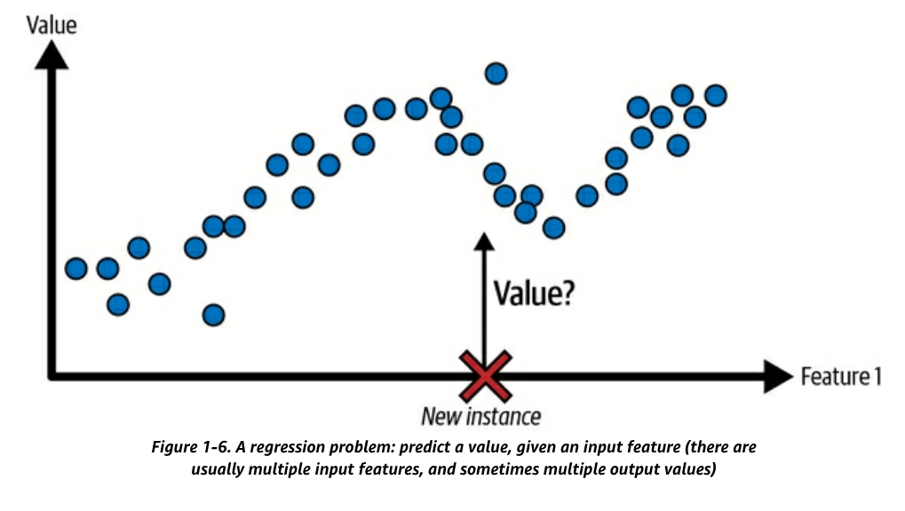
Supervised Learning Tasks
Classification
  Sort input samples into categories, like a spam filter
Regression
  Predict a target numerical value, like the price of a car, given a set of features, like mileage, age, brand, etc.

Slide 28
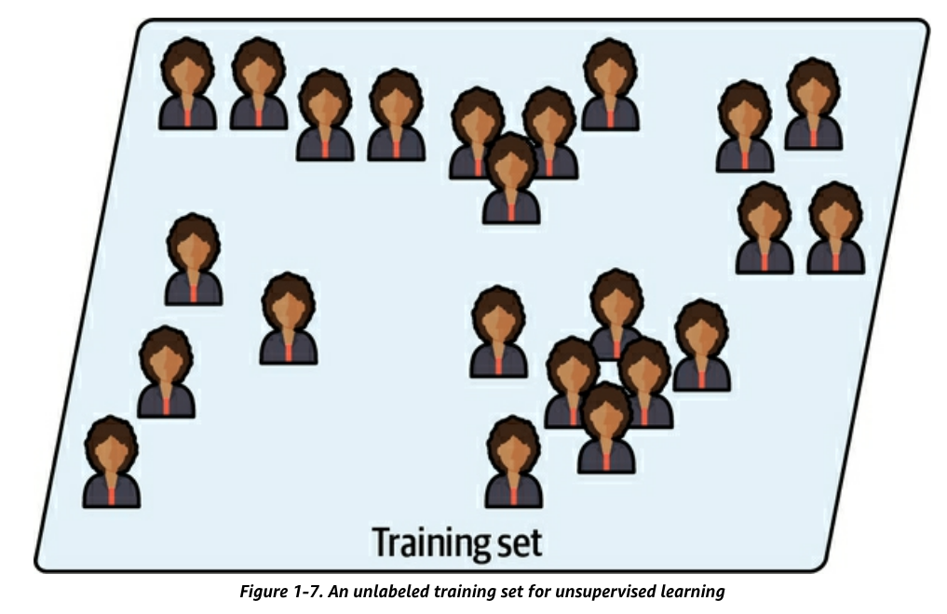
Unsupervised Learning
Training data is unlabeled

Slide 29
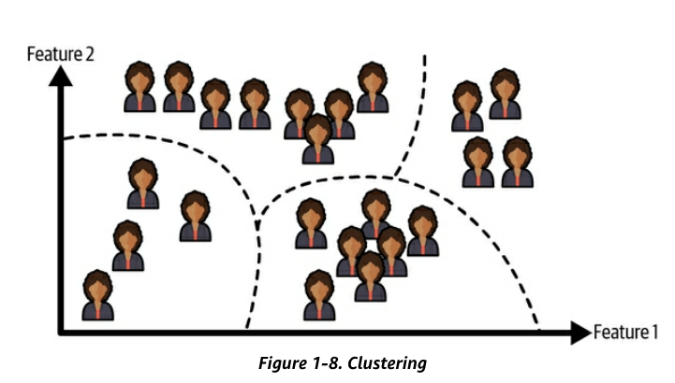
Unsupervised Learning
Clustering algorithm
  Sorts data into groups

Slide 30
Dimensionality Reduction
A way to simplify data
without losing too much information
Example: merge correlated features into one
  For a car, combine milage and age into wear-and-tear
  This is called feature extraction

Slide 31
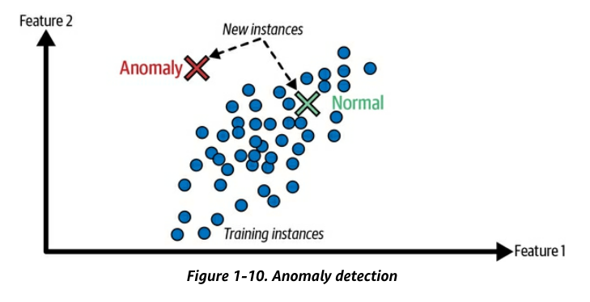
Unsupervised Learning
Anomaly detection
  Find unusual credit card transactions
  Find manufacturing defects

Slide 32
Unsupervised Learning
Association rule learning
  Discover interesting relations between attributes
  Find items customers purchase together

Slide 33
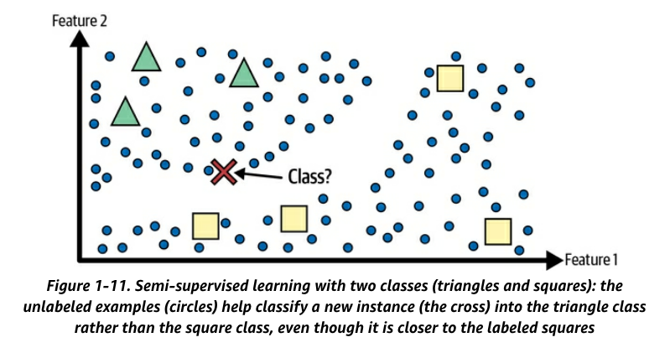
Semi-Supervised Learning
First unsupervised model groups similar images together
Then it asks the user to label a group at a time

Slide 34
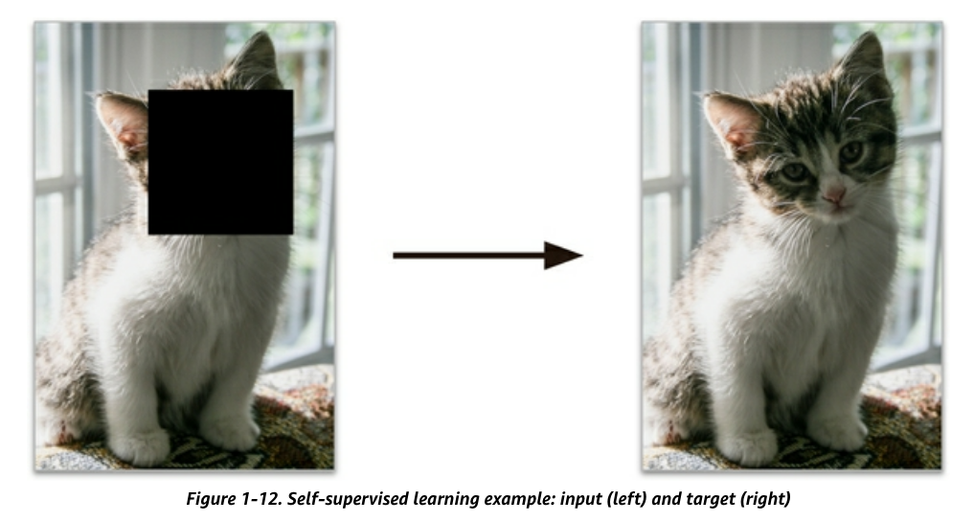
Self-Supervised Learning
Generates a labeled dataset from an unlabeled one
  Example: mask part of an image, train a model to recover the original image

Slide 35
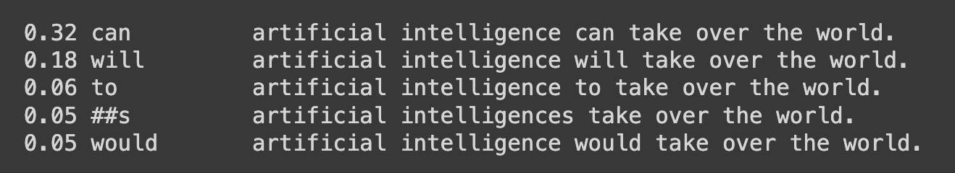
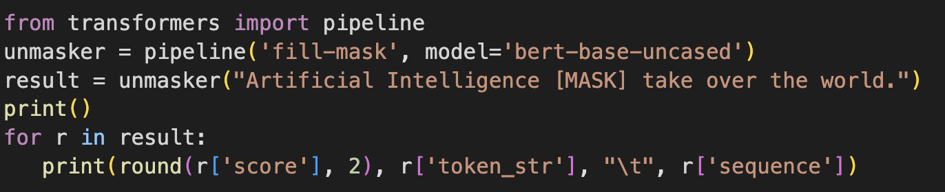
Large Language Models
Start with sentences written by humans
Randomly mask some words
Learn to predict the masked word

Slide 36
Reinforcement Learning
The learning system, called an agent
  Observes the environment
  Selects and performs actions
  Gets rewards or penalties
Like a robot learning to walk

Slide 37
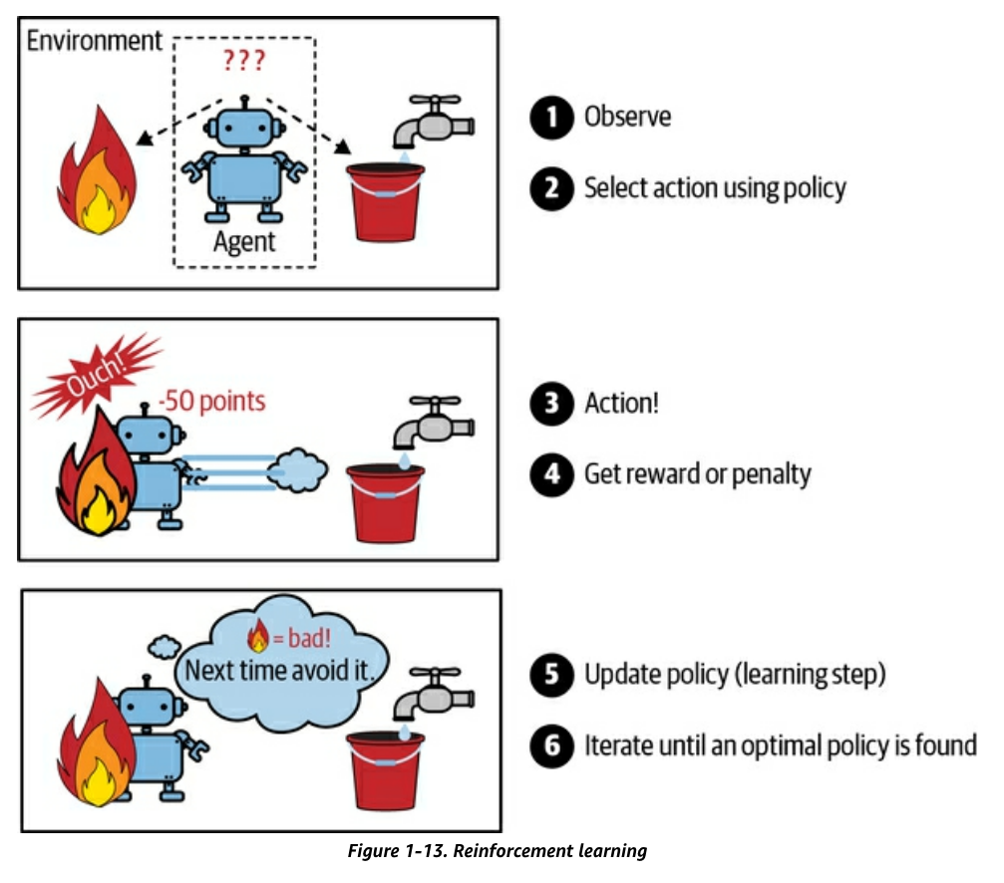
Reinforcement Learning

Slide 38
Securing AI Systems
April 12, 2024

Slide 39
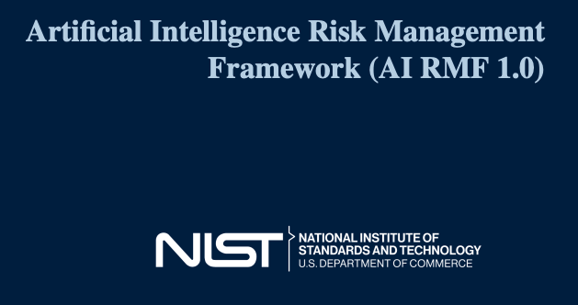
NIST AI 100-1

Slide 40
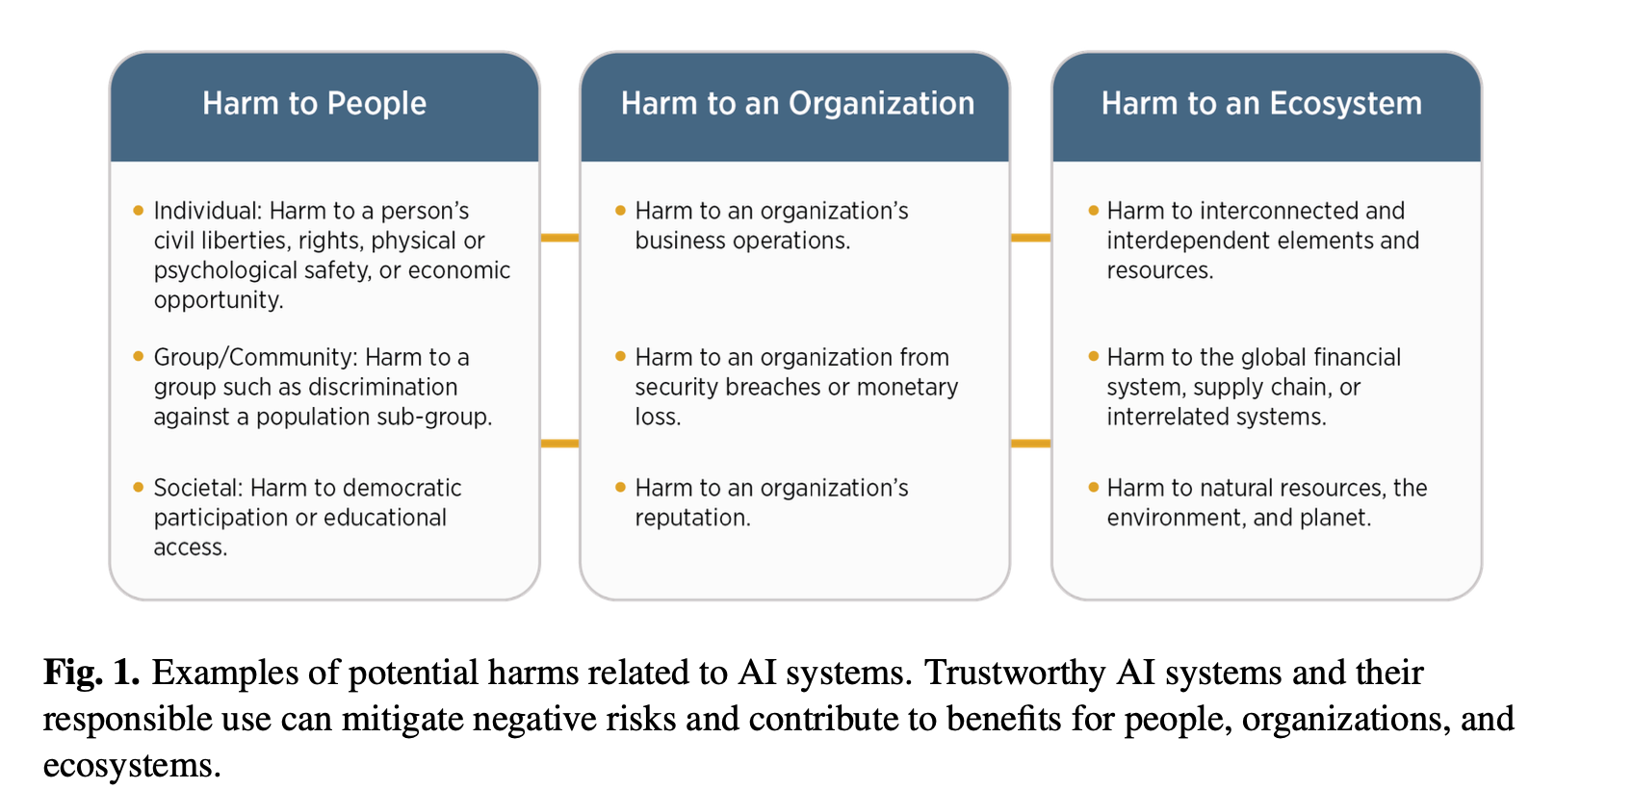

Slide 43
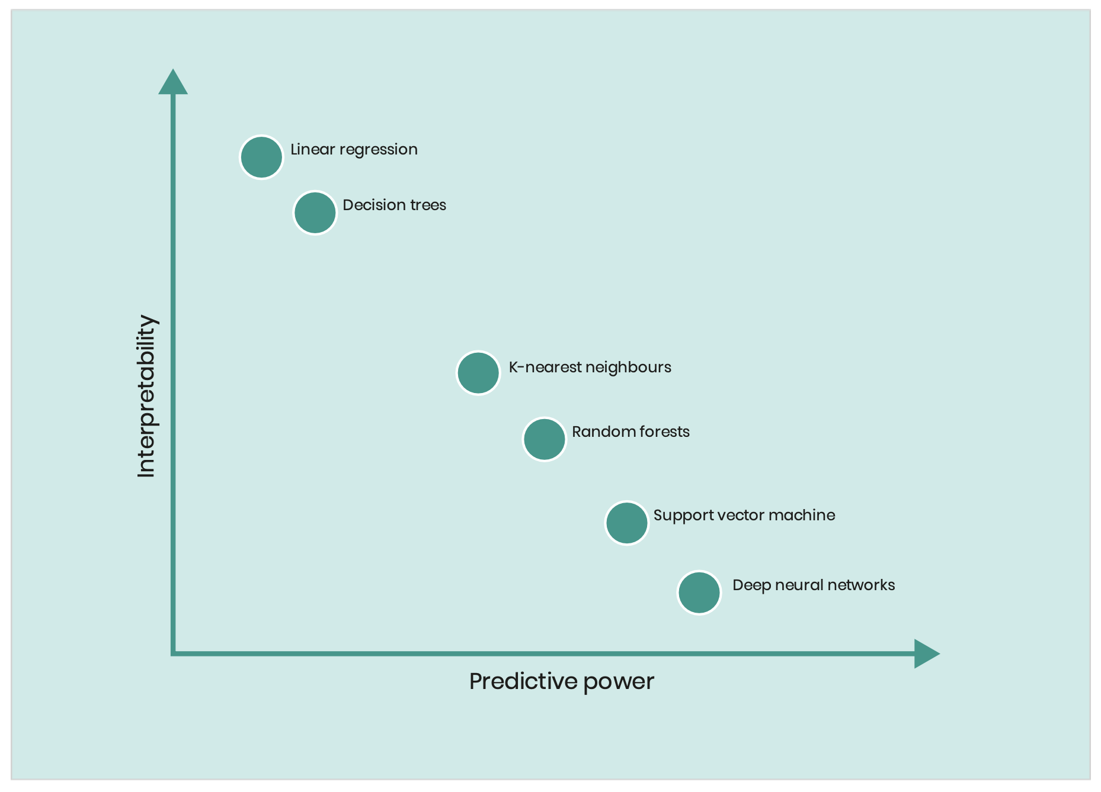
Inscrutability
LINEAR REGRESSION
DECISION TREES
K-NEAREST NEIGHBORS
RANDOM FORESTS
SUPPORT VECTOR MACHINES
DEEP NEURAL NETWORKS

Slide 44
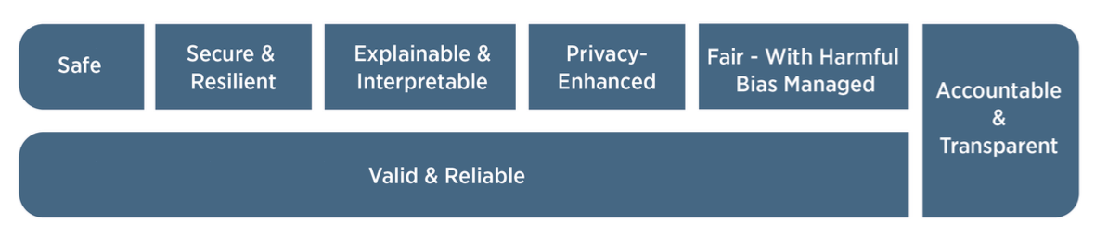
Characteristics of Trustworthy AI

Slide 45
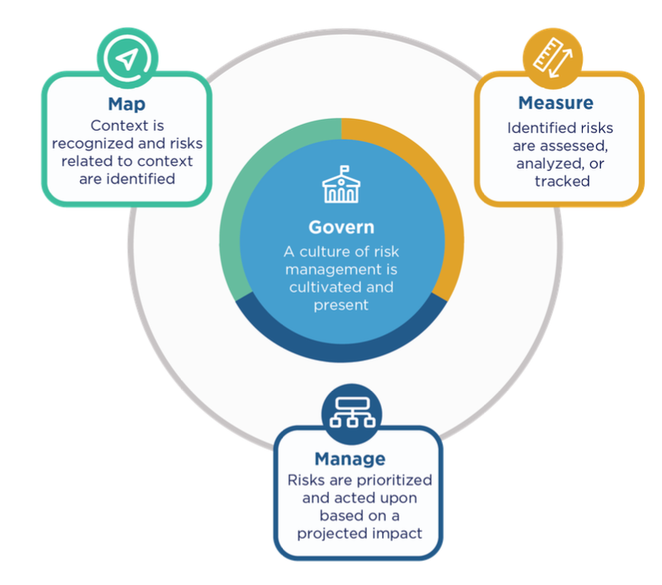
AI RMF Core

Slide 46
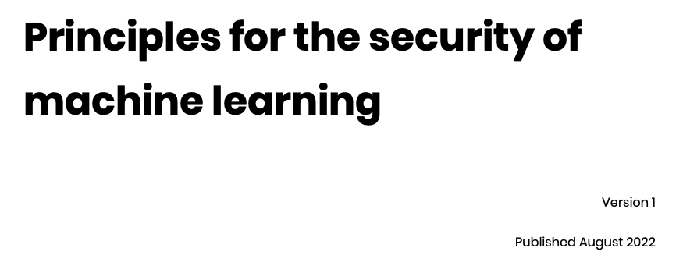


Slide 47
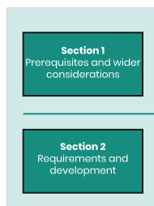
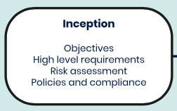
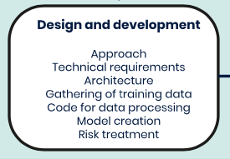
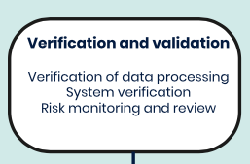

Slide 48
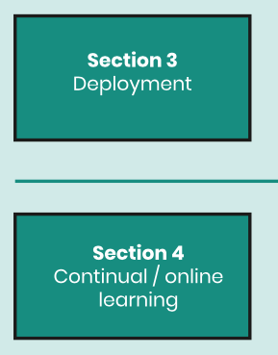
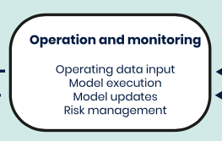
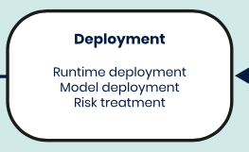
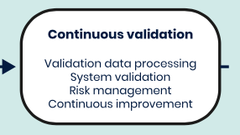

Slide 49
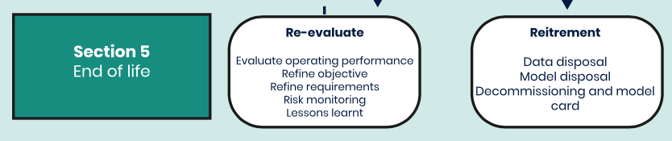

Slide 50
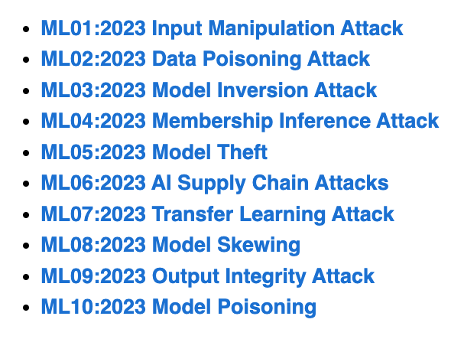
OWASP Top Ten Machine Learning Risks
https://owasp.org/www-project-machine-learning-security-top-10/

Slide 51
ML01:2023 Input Manipulation Attack
  An attacker deliberately alters input data to mislead the model
  This attack is also called evasion
  Example: a model is trained to tell cat images from dog images. An attacker modifies a cat image so it is misclassified as a dog.
ML02:2023 Data Poisoning Attack
  An attacker manipulates the training data to cause the model to behave in an undesirable way
ML03:2023 Model Inversion Attack
  An attacker reverse-engineers the model to extract information from it
  Example: a model is trained to recognize faces. An attacker inputs images of individuals into the model and and recovers the personal information of the individuals from the model's predictions, such as their name, address, or social security number.

Slide 52
ML04:2023 Membership Inference Attack
  An attacker manipulates the model’s training data in order to cause it to behave in a way that exposes sensitive information
  Example: A malicious attacker trains a machine learning model on a dataset of financial records and uses it to query whether or not a particular individual’s record was included in the training data.
ML05:2023 Model Theft
  An attacker gains access to the model’s parameters
  Example: Stealing a machine learning model from a competitor
ML06:2023 AI Supply Chain Attacks
  An attacker modifies or replaces a machine learning library or model that is used by a system

Slide 53
ML07:2023 Transfer Learning Attack
  An attacker trains a model on one task and then fine-tunes it on another task to cause it to behave in an undesirable way
  Example: An attacker trains a machine learning model on a malicious dataset that contains manipulated images of faces. The attacker then transfers the model’s knowledge to a target face recognition system. As a result, the face recognition system starts making incorrect predictions, allowing the attacker to bypass the security and gain access to sensitive information.
ML08:2023 Model Skewing
  An attacker manipulates the distribution of the training data to cause the model to behave in an undesirable way.
  Example: The attacker provides fake feedback data to a loan-approving machine learning system. As a result, the model’s predictions are skewed, and the attacker’s chances of getting a loan approved are significantly increased.

Slide 54
ML09:2023 Output Integrity Attack
  An attacker aims to modify or manipulate the output of a machine learning model in order to change its behavior or cause harm to the system it is used in.
  Example: An attacker has gained access to the output of a machine learning model that is being used to diagnose diseases in a hospital. The attacker modifies the output of the model, making it provide incorrect diagnoses for patients.
ML10:2023 Neural Net Reprogramming
  An attacker manipulates the model's parameters to cause it to behave in an undesirable way.
  Example: A bank is using a machine learning model to identify handwritten characters on cheques. An attacker manipulates the parameters of the model by altering the images in the training dataset or directly modifying the parameters in the model. This can result in the model misidentifying characters, leading to incorrect amounts being processed.

Slide 55
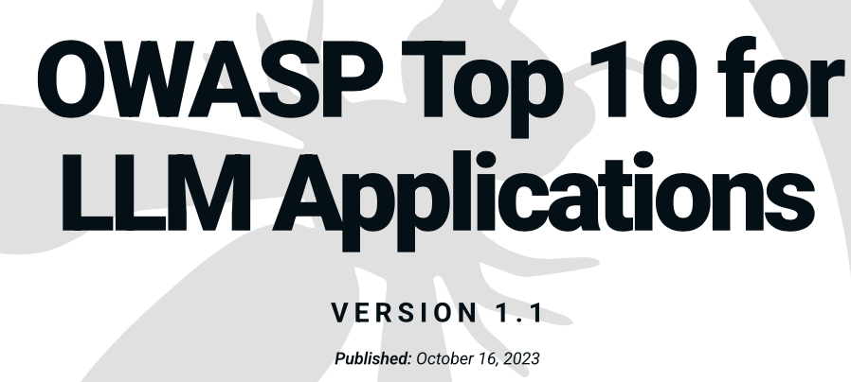
https://owasp.org/www-project-top-10-for-large-language-model-applications/

Slide 56
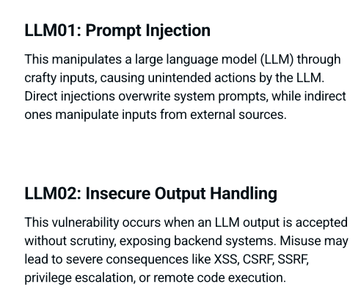

Slide 57
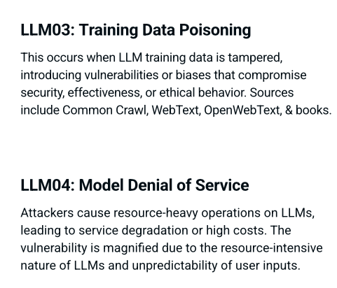

Slide 58
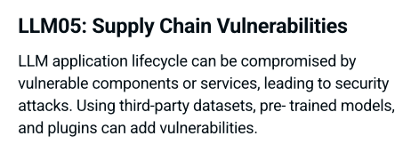
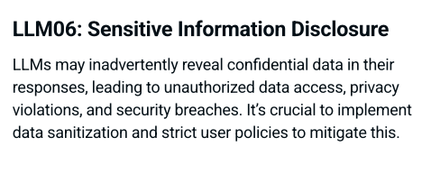

Slide 59
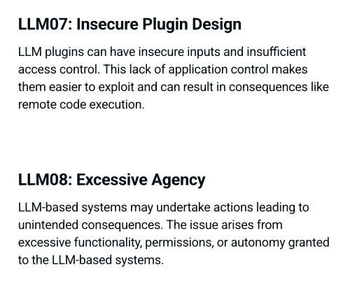

Slide 60
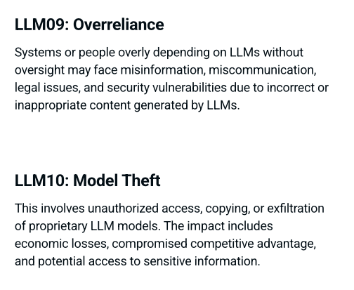

Slide 61
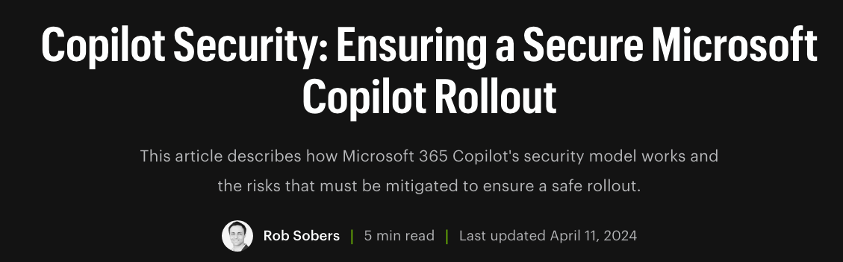


Slide 62
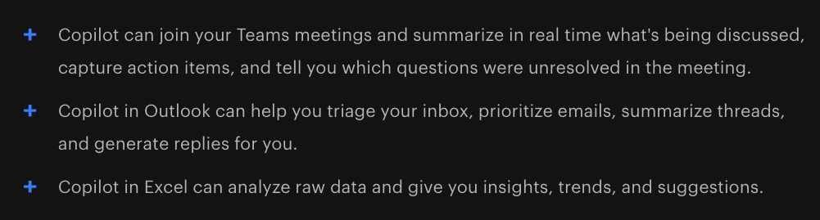
Microsoft 365 Copilot Use Cases
Writes documents for you
  Based on data found in your Email, documents, spreadsheets, and other files you have access to
  In the Microsoft365 cloud
  Based on your Microsoft365 permissions

Slide 63
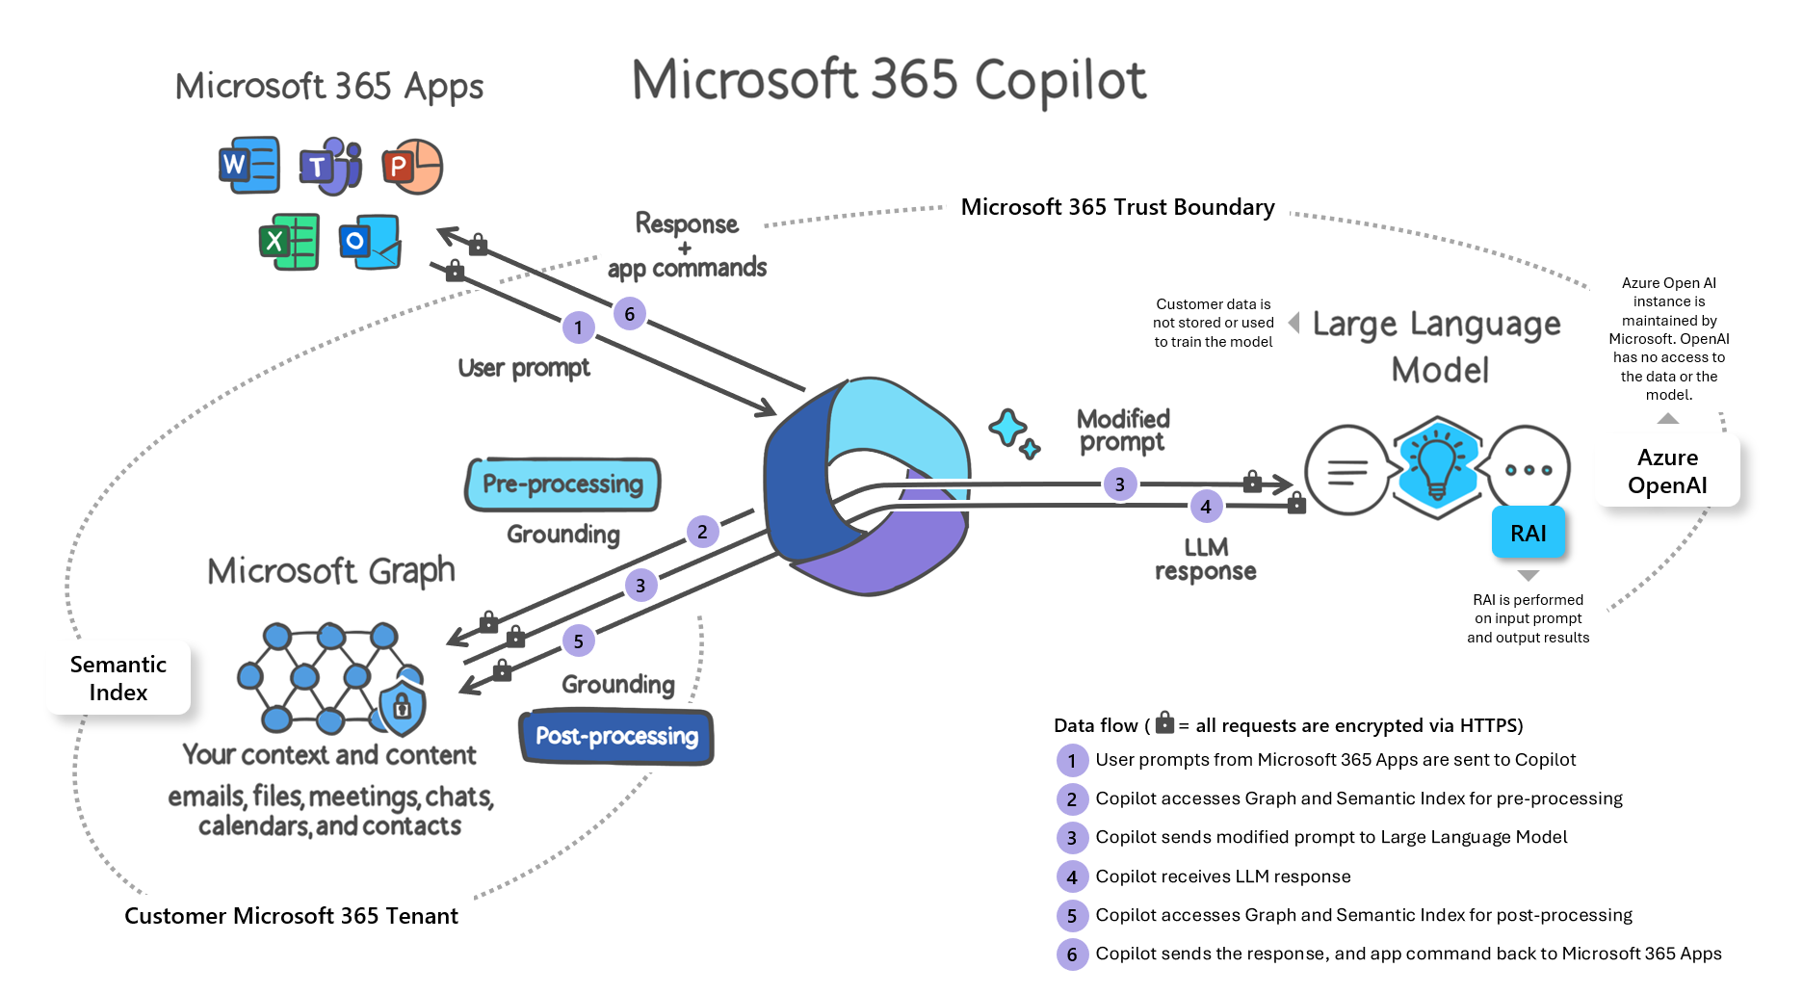

Slide 64
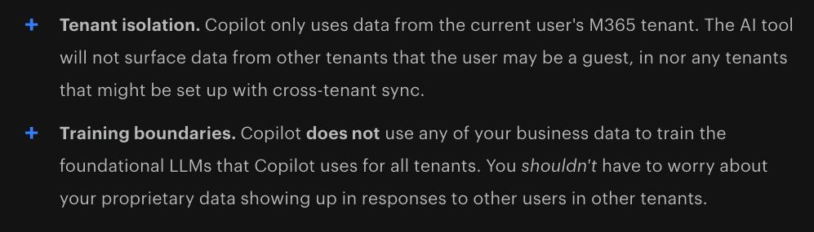
What Microsoft Handles for You

Slide 65
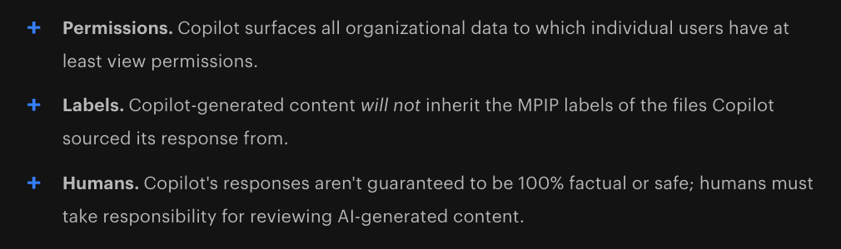
What You Need to Manage

Slide 66
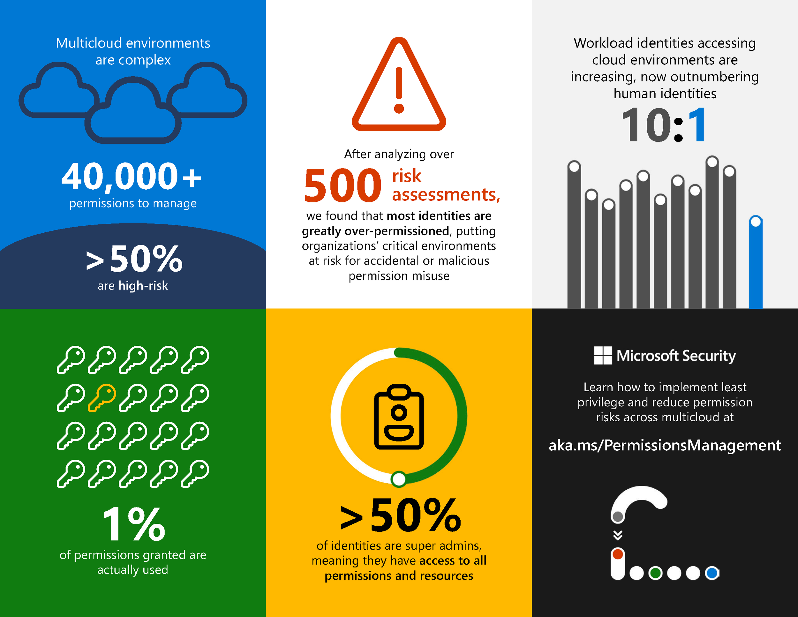

Slide 67

The Average M365 Tenant has

Slide 68

Why Does This Happen?

Slide 69

But you must enable sensitivity labels
  For SharePoint and OneDrive
If humans fail to apply and update labels, the system fails

Slide 70
Important ML Tools for Instructors

Slide 71

Perplexity.ai

Slide 72

Consensus.app

Slide 73

AnythingLLM
https://github.com/Mintplex-Labs/anything-llm

Slide 74

ollama.com
Run LLMs locally

Slide 75

Hands-On Projects
https://samsclass.info/ML/ML_CTF_S24.shtml

