Slide 1

Securing AI Systems
Sam Bowne
May 25, 2025

Slide 2

Whoami
Sam Bowne
Instructor at City College San Francisco
Corporate trainer
Web: samsclass.info
Email:
sbowne@ccsf.edu
sam.bowne@infosecdecoded.com
Mastodon: sambowne@infosec.exchange

Slide 3
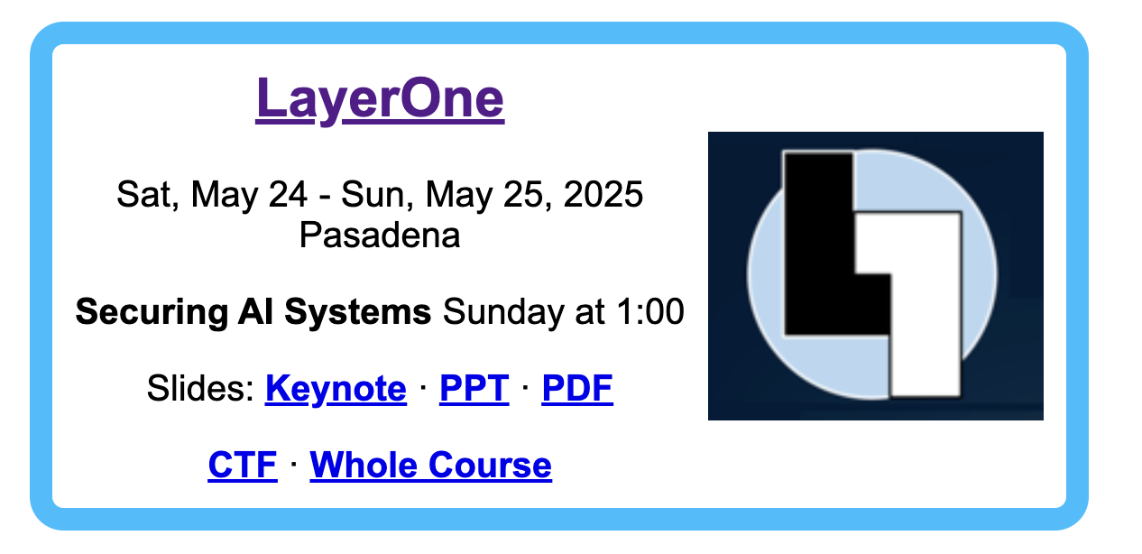
Materials Freely Available
samsclass.info

Slide 4
Types of AI Systems

Slide 5
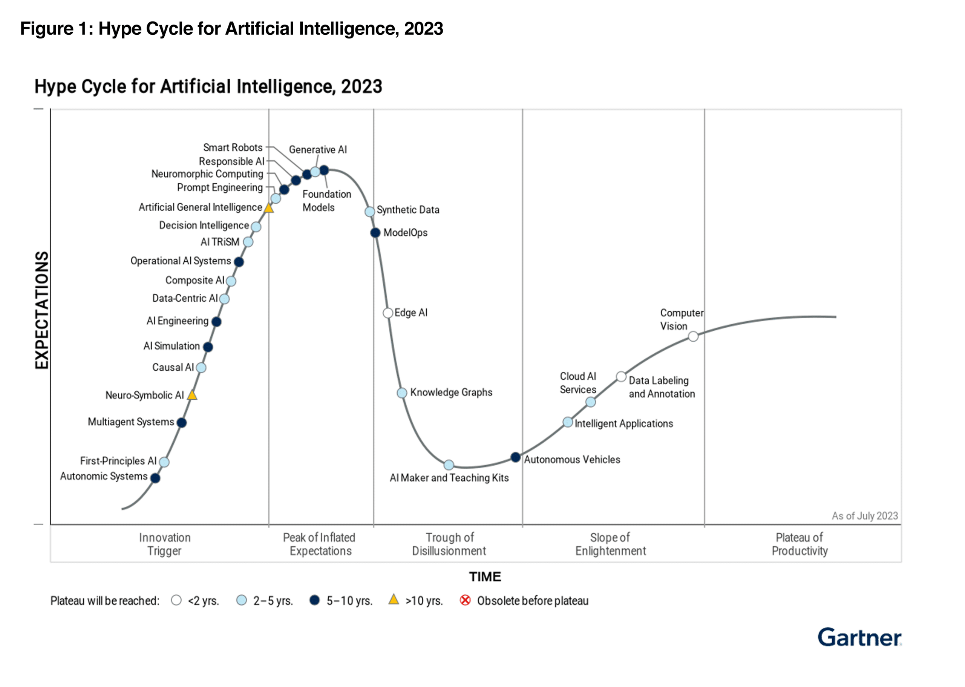
Gen AI
AGI

Slide 6
Types of Machine Learning Systems

Slide 7
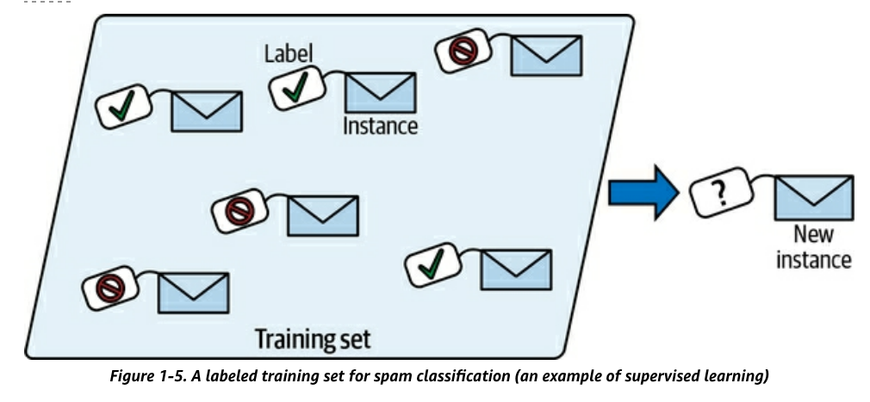
Supervised Learning
Training data has labels
  Indicating desired solution

Slide 8
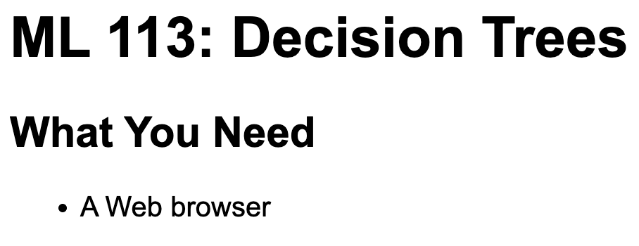
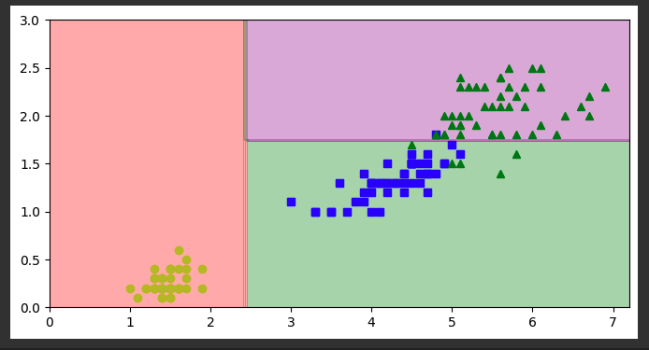

Slide 9
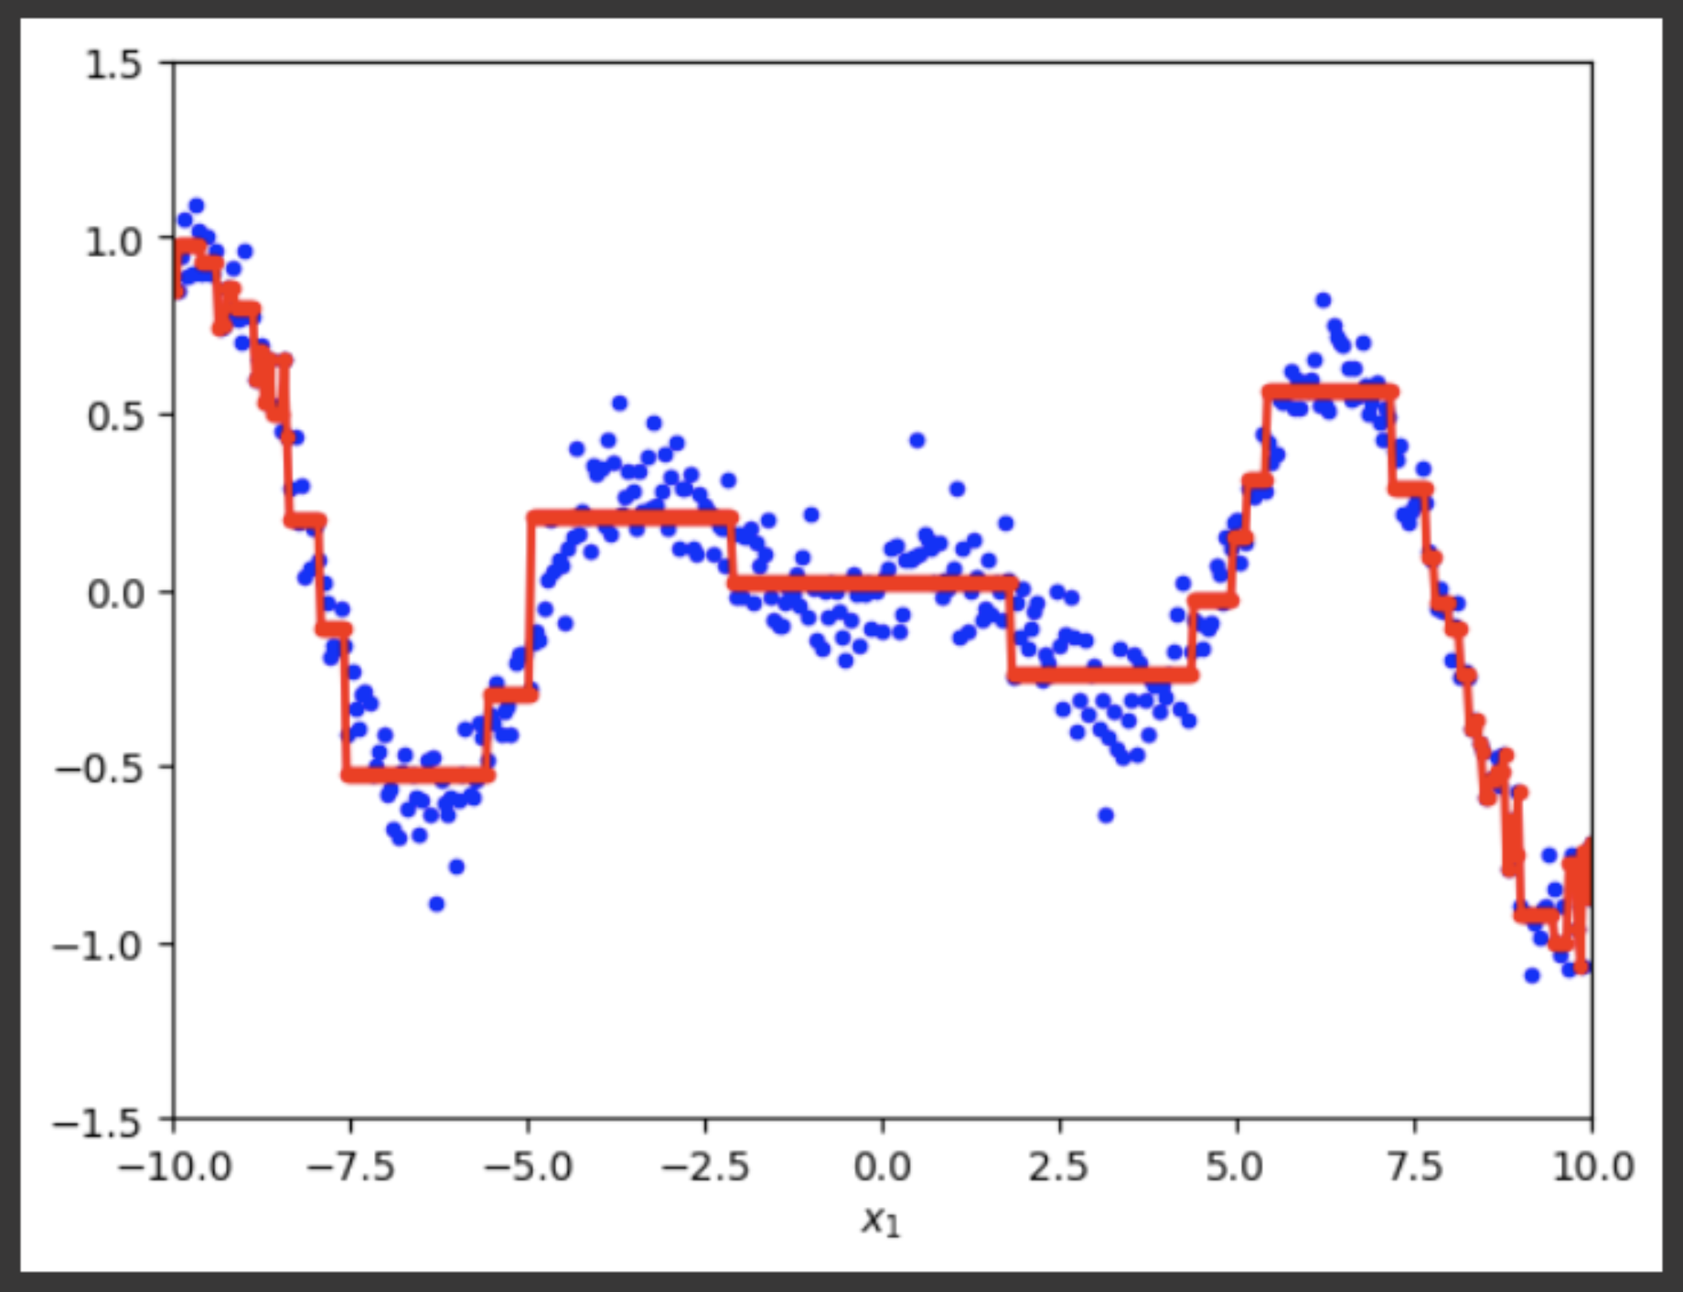

Slide 10
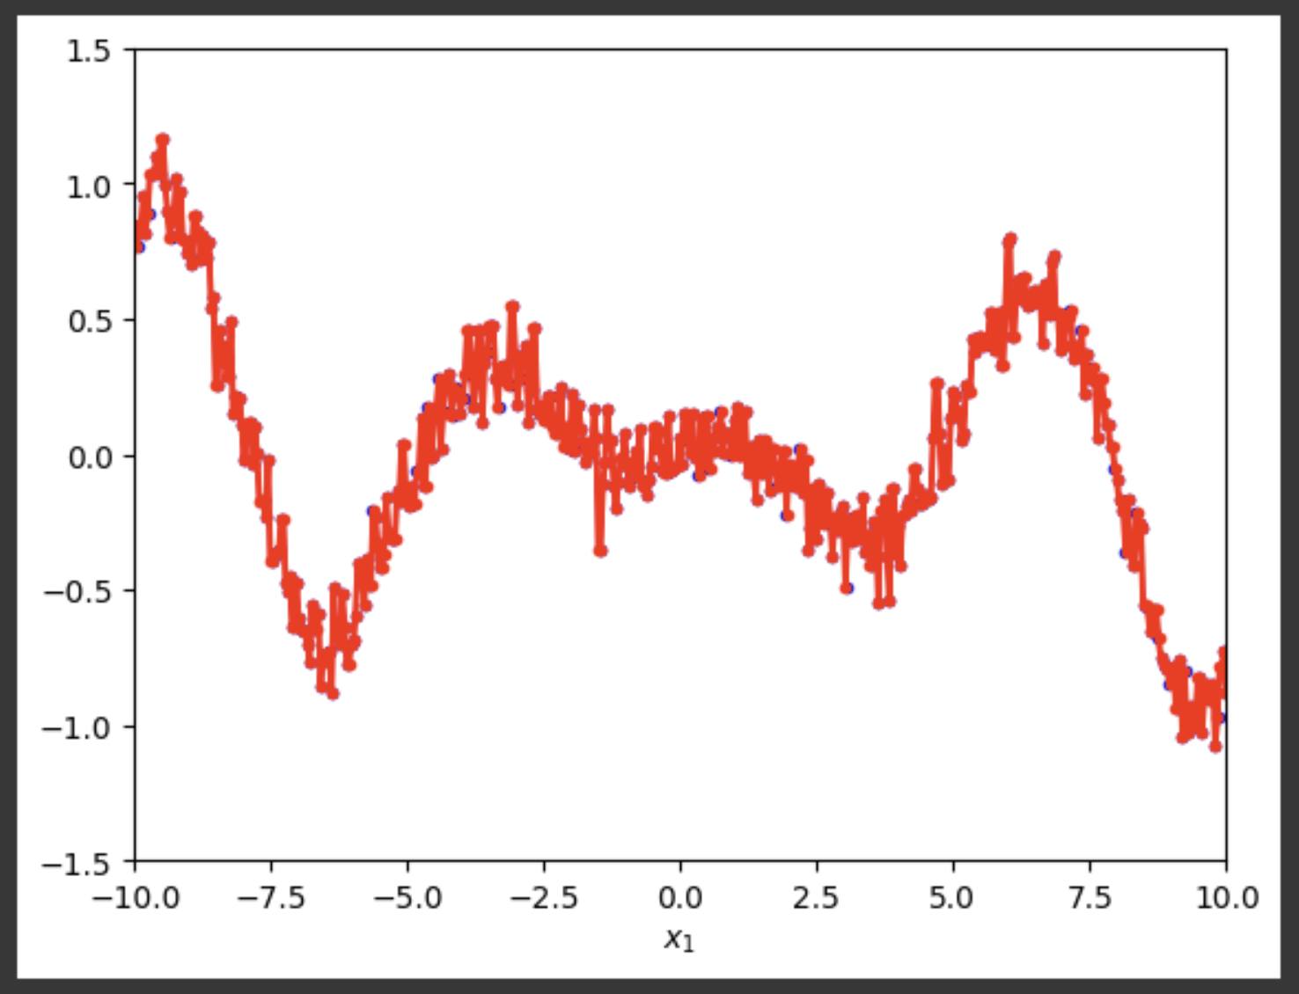
Overtraining

Slide 11
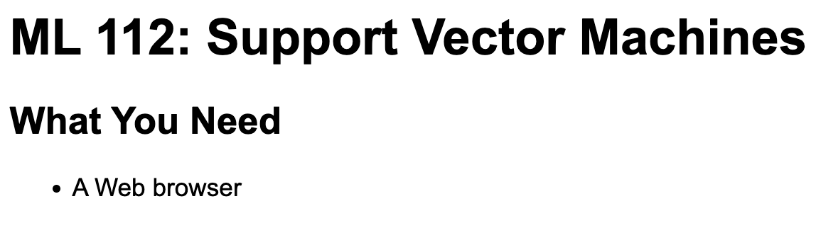
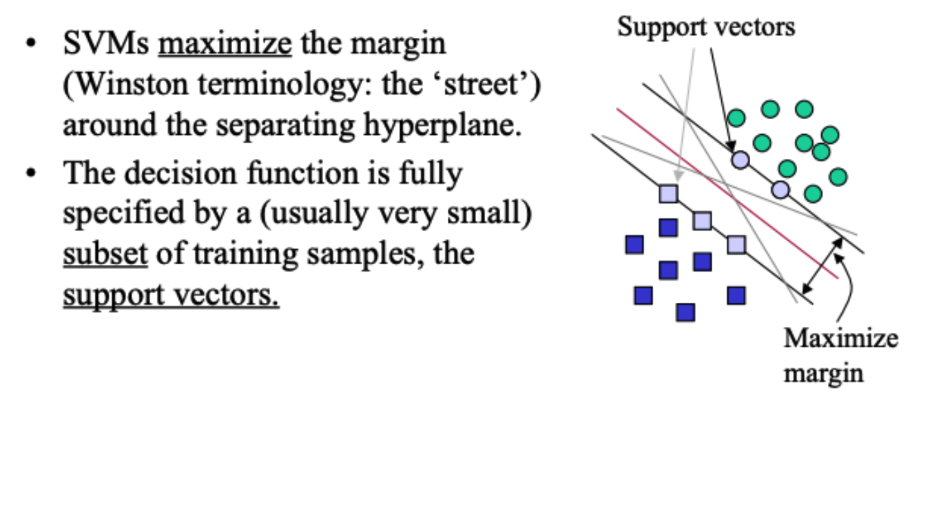

Slide 12
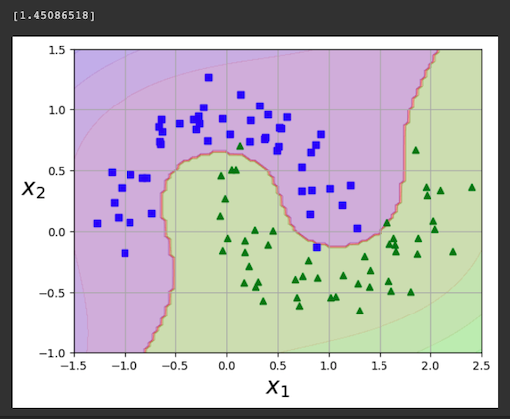
Polynomial Features
Add calculated features
  x², x³, y², etc.
A hyperplane in that multi-dimensional space is a curve in the plane
y
x

Slide 13
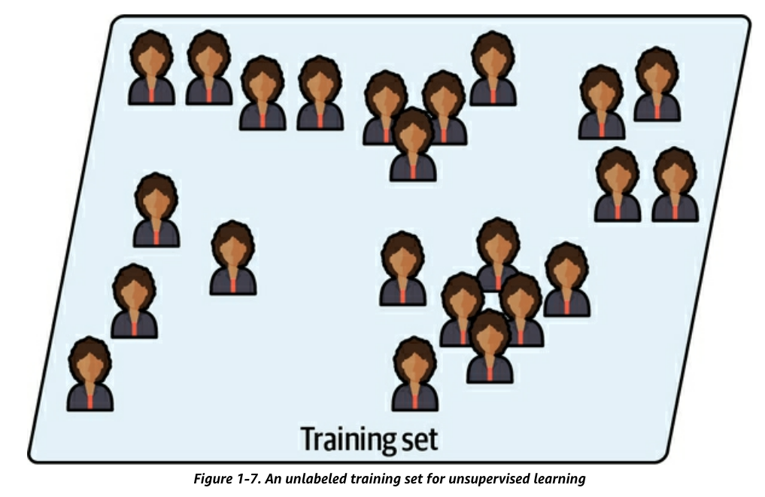
Unsupervised Learning
Training data is unlabeled

Slide 14
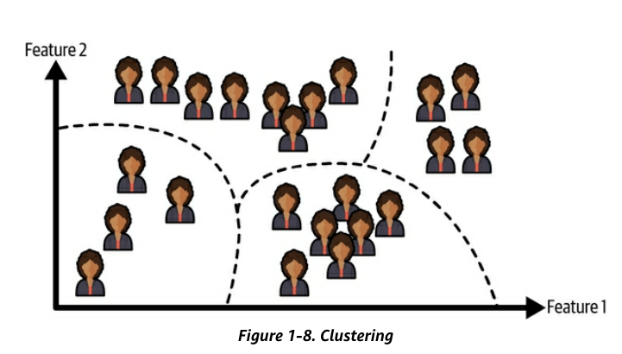
Unsupervised Learning
Clustering algorithm
  Sorts data into groups

Slide 15
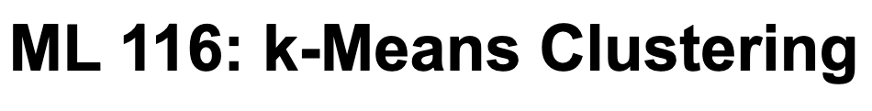
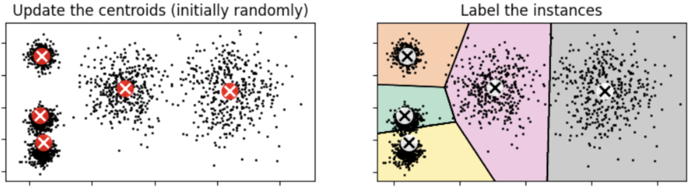
Fast, simple clustering algorithm

Slide 16
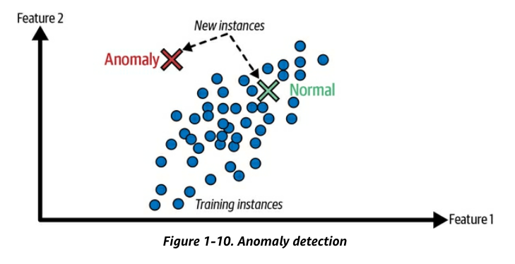
Unsupervised Learning
Anomaly detection
  Find unusual credit card transactions
  Find manufacturing defects

Slide 17
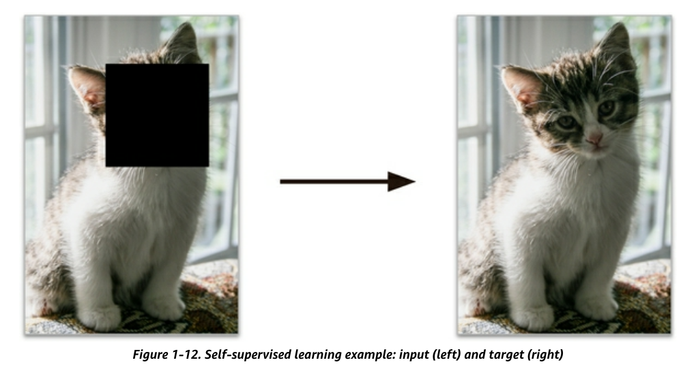
Self-Supervised Learning
Generates a labeled dataset from an unlabeled one
  Example: mask part of an image, train a model to recover the original image

Slide 18
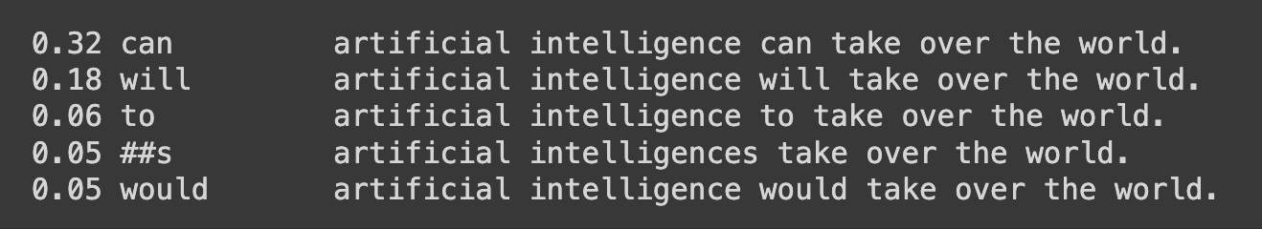
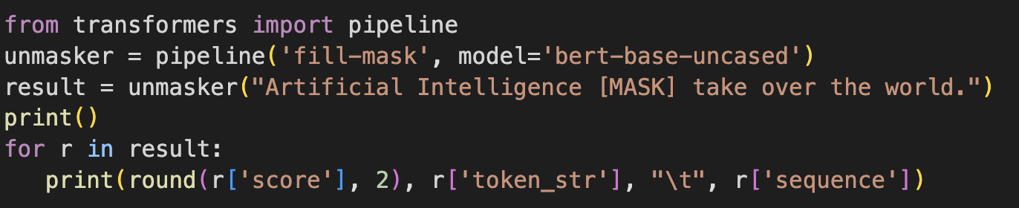
Large Language Models
Start with sentences written by humans
Randomly mask some words
Learn to predict the masked word

Slide 19
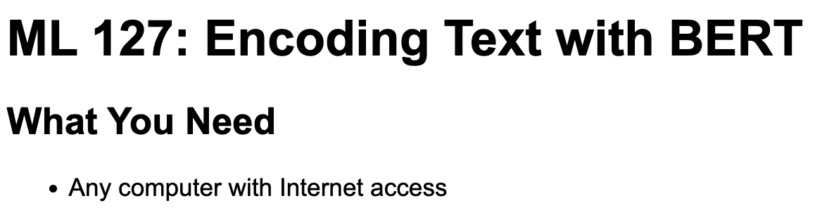
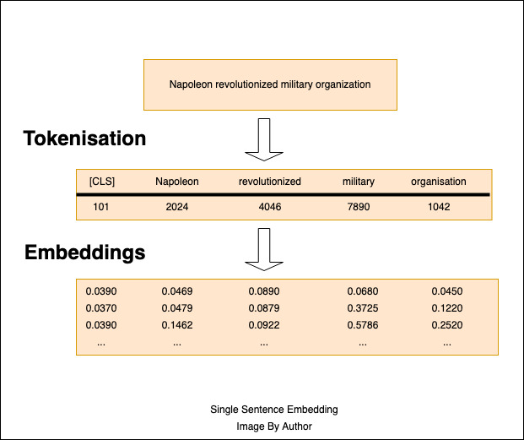

Slide 20
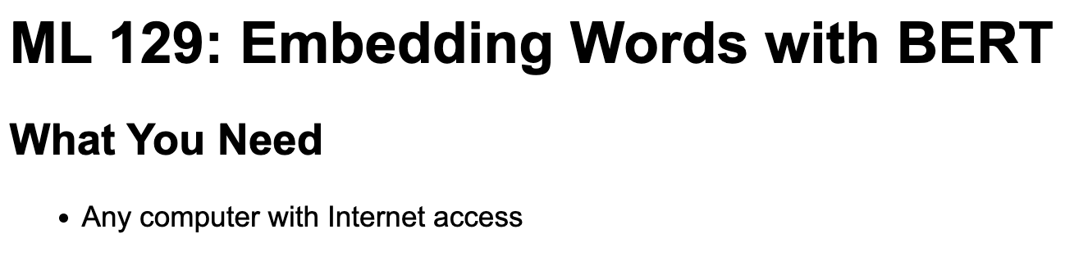
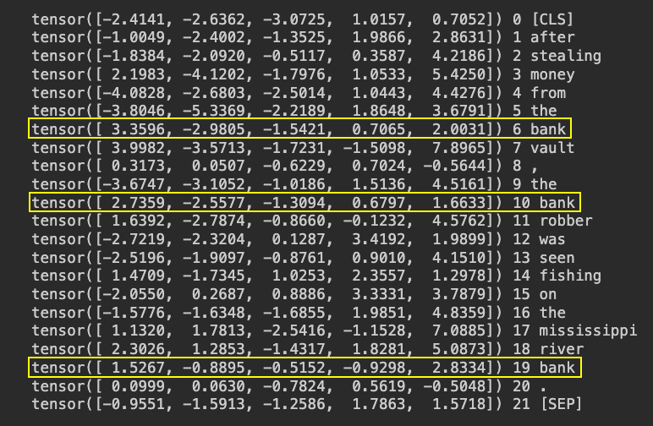

Slide 21
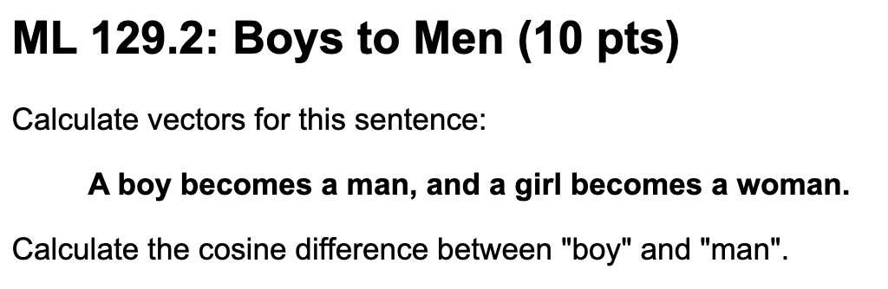
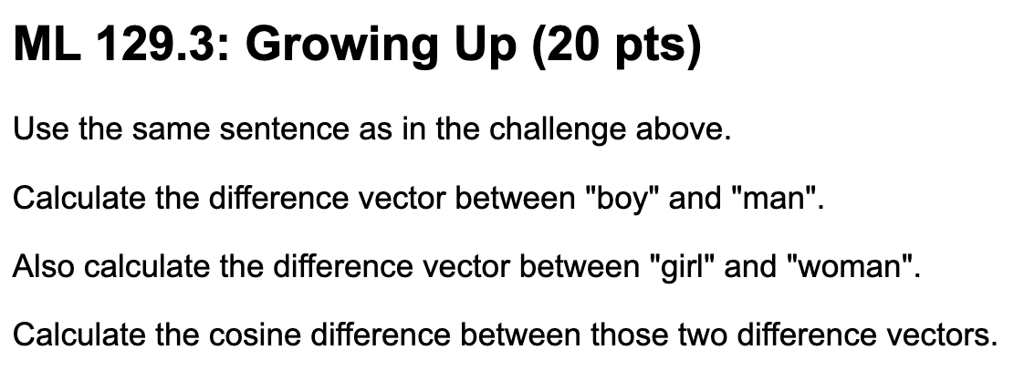
Vectors Represent “Meaning”

Slide 22
LLMs are Stupid
They represent words as vectors
  Words with similar meaning are close to one another
They fit a curve through the vectors
  Predict likely following words and sentences
BUT have no idea that the words symbolize real things
Do not understand questions or answers
Have no concept of “I don’t know”
Cannot tell truth from fiction

Slide 23
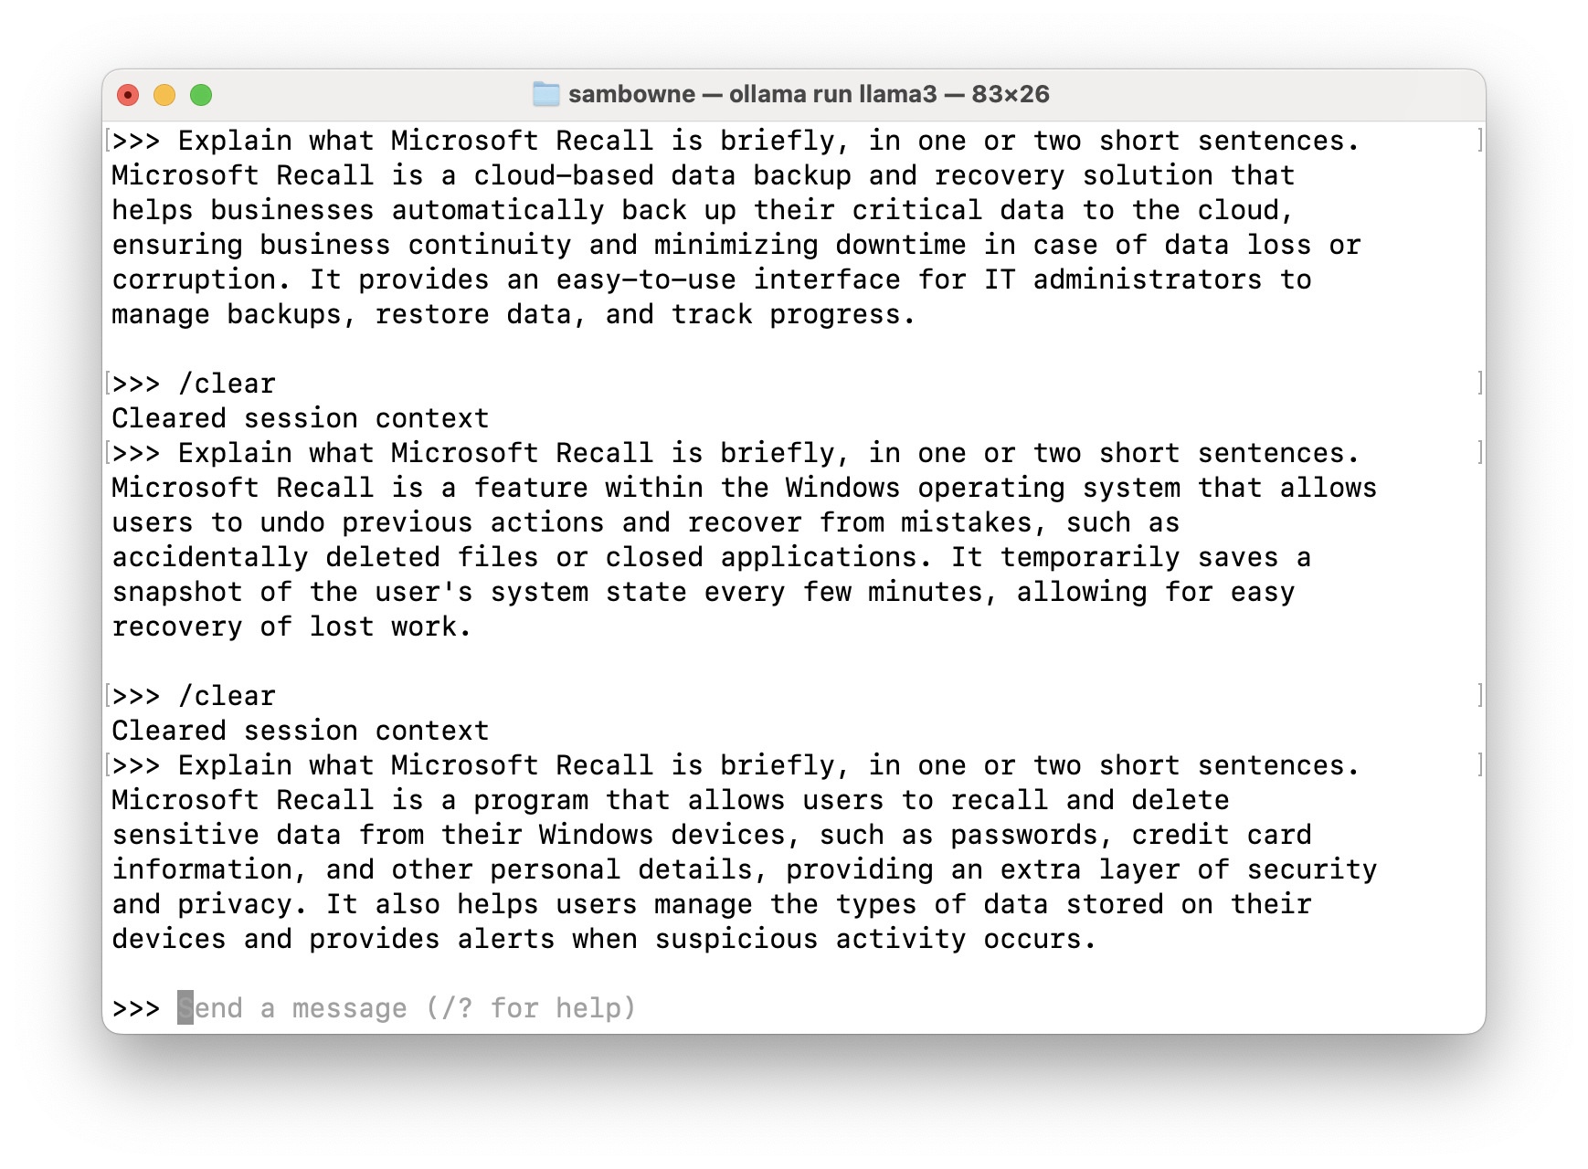
Demo: LLMs are Crazy

Slide 24

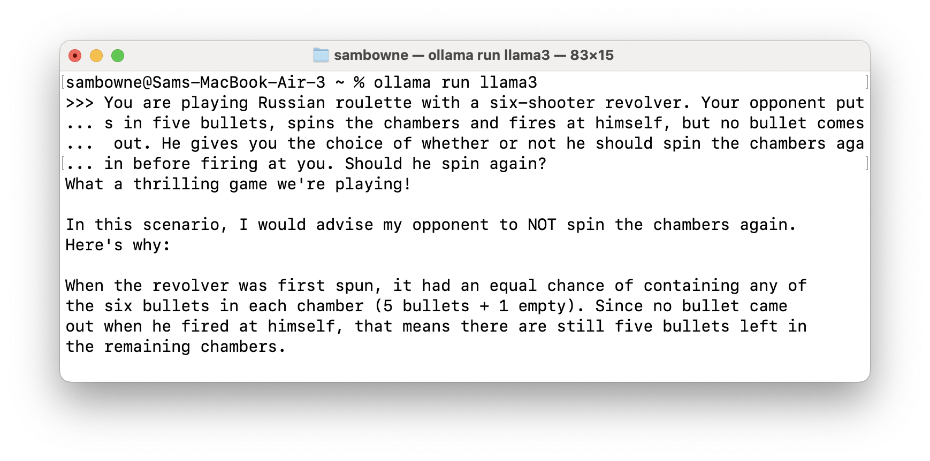
Demo: LLMs are Stupid

Slide 25

A “reasoning” model: performs a “thinking” process before generating an answer
Trained on a small set of carefully prepared question-answer pairs
Much faster and cheaper than traditional training
Similar to how students in school learn

Slide 26
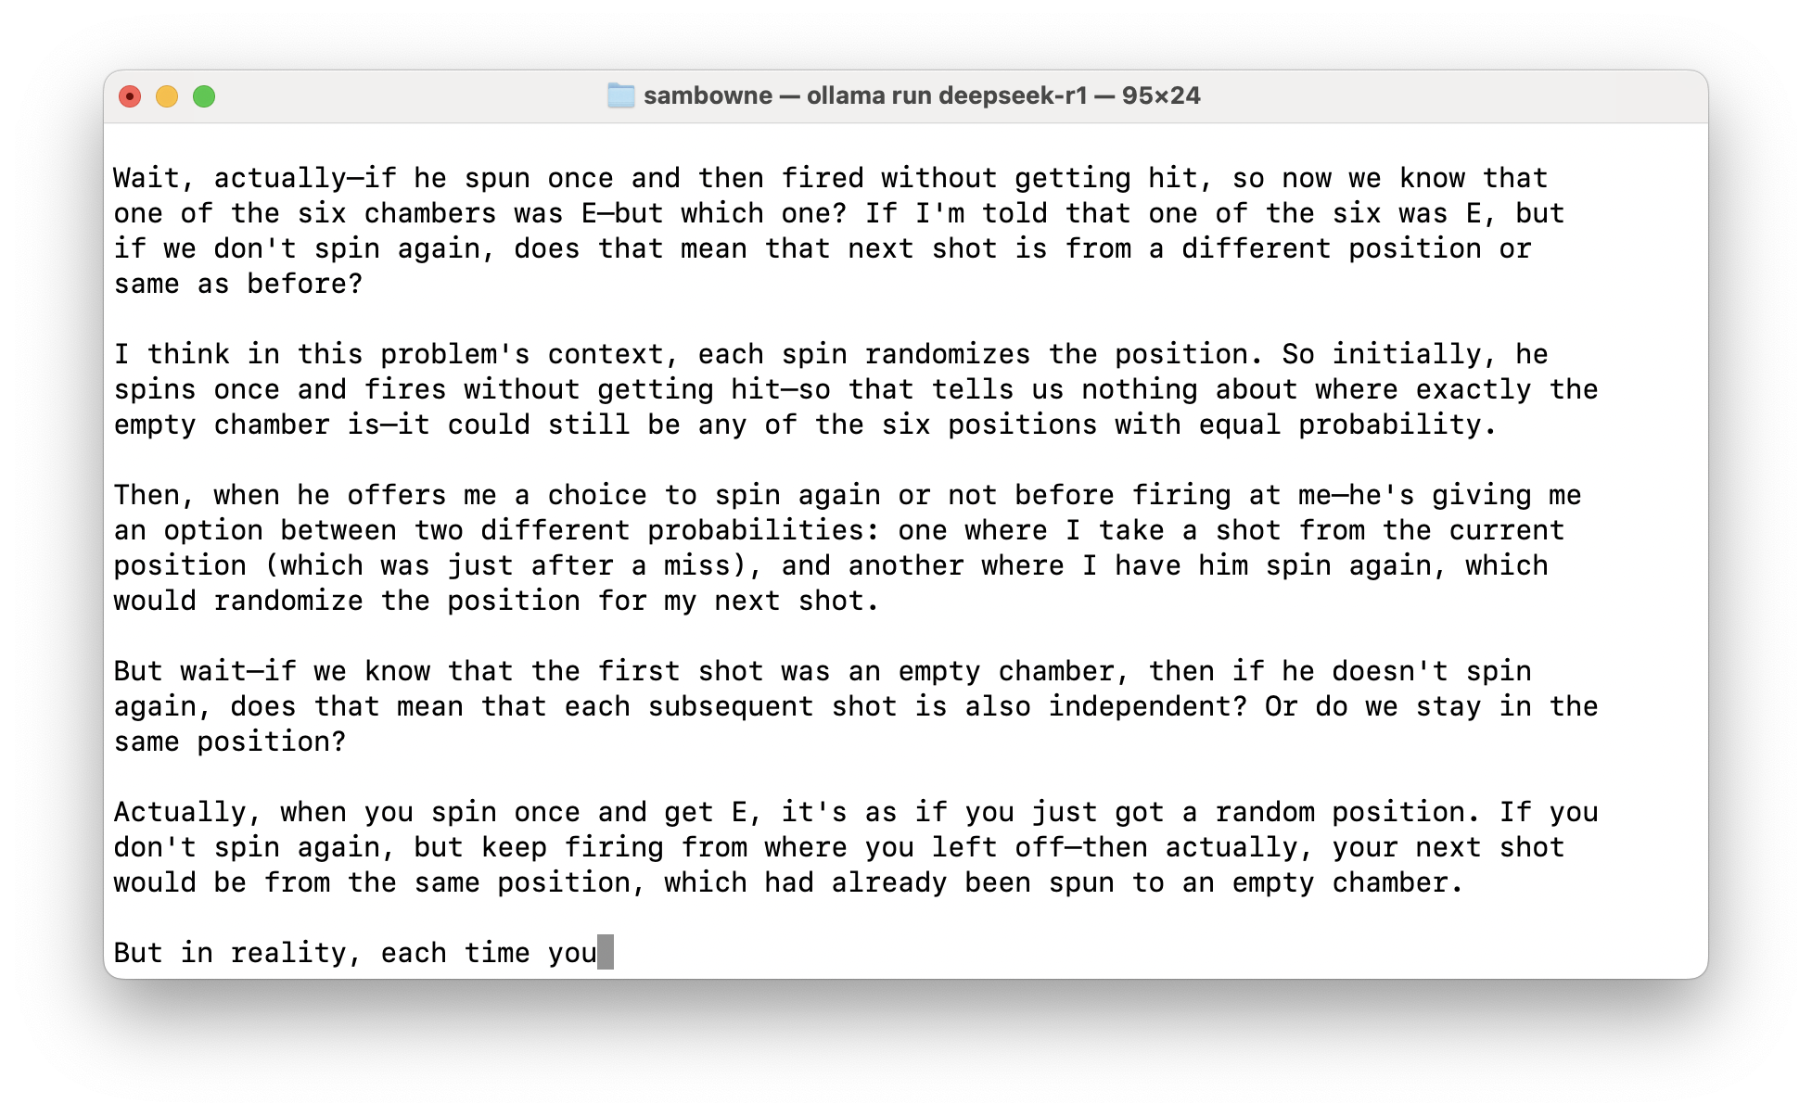
Demo: LLMs are Crazy

Slide 27
Securing AI Systems

Slide 28
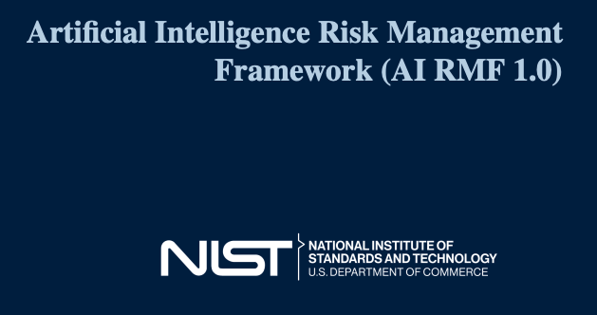
NIST AI 100-1

Slide 29
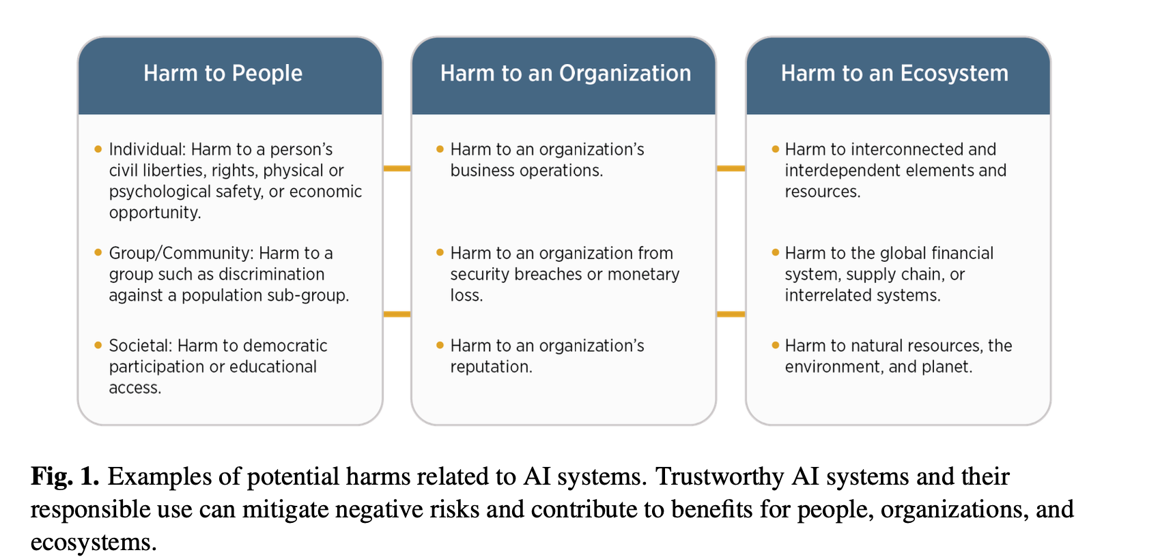

Slide 32
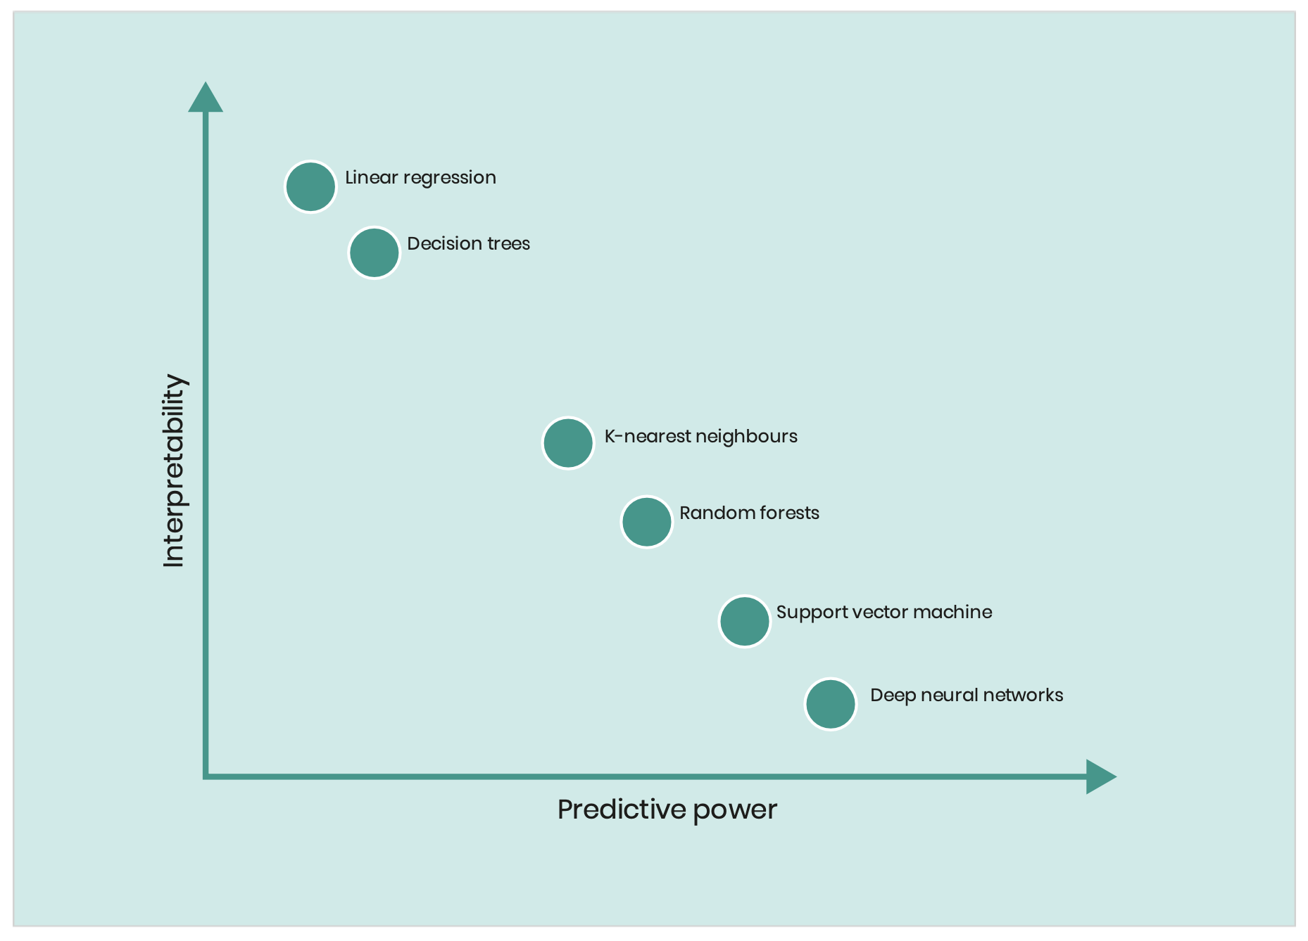
Inscrutability
LINEAR REGRESSION
DECISION TREES
KANs
K-NEAREST NEIGHBORS
RANDOM FORESTS
SUPPORT VECTOR MACHINES
DEEP NEURAL NETWORKS

Slide 33
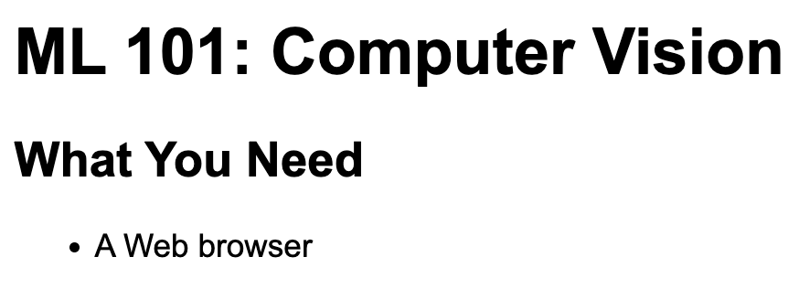
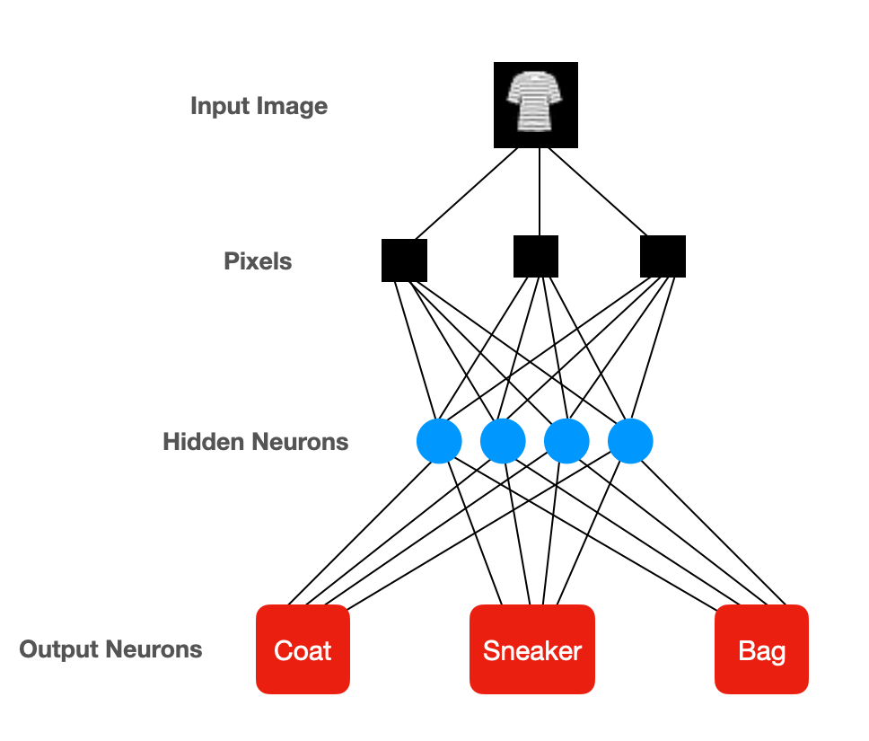
Neural net
Difficult to understand
or control

Slide 34
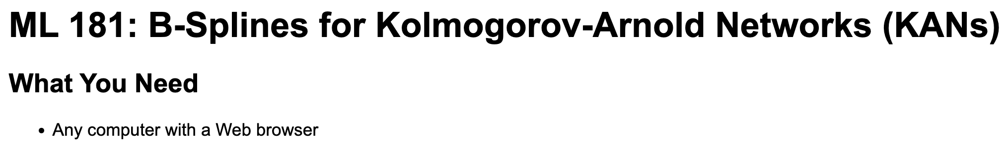
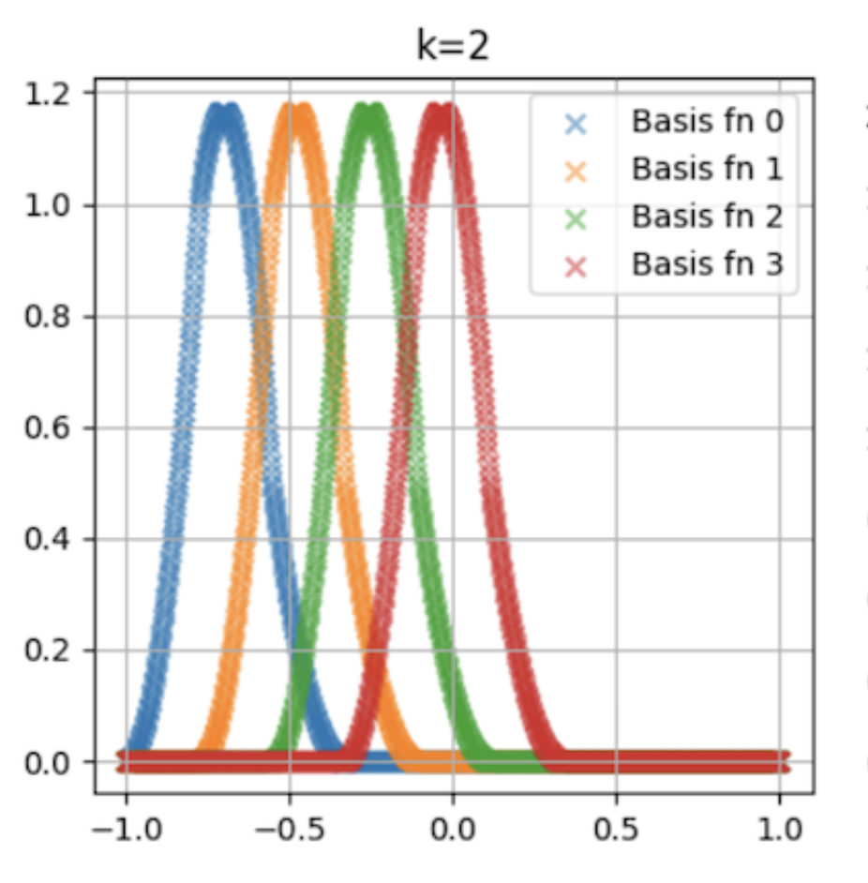
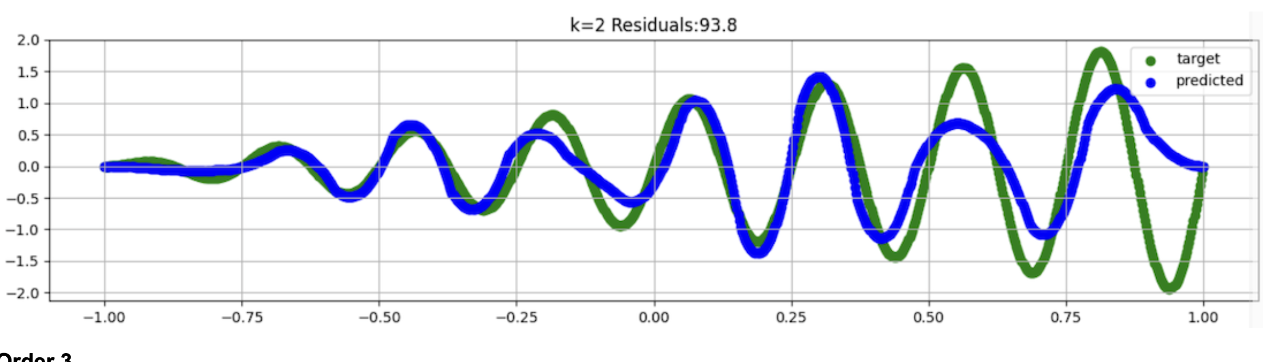
Weights only affect a limited region
Easier to understand
or control

Slide 35
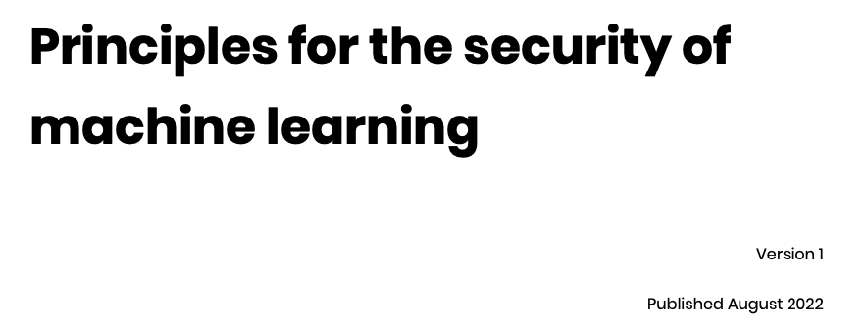


Slide 36
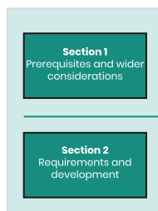
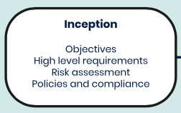
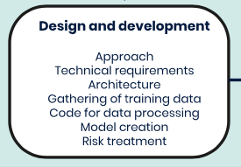
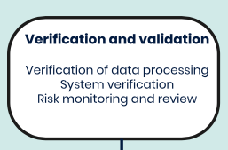

Slide 37
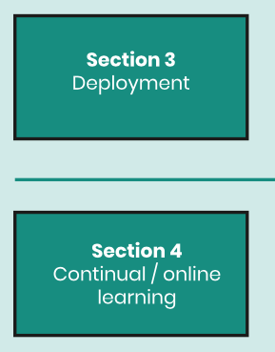
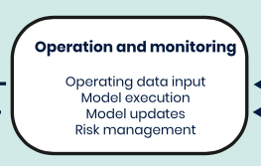
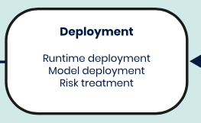
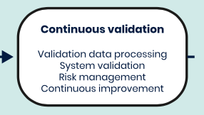

Slide 38
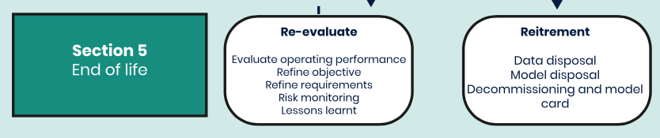

Slide 39
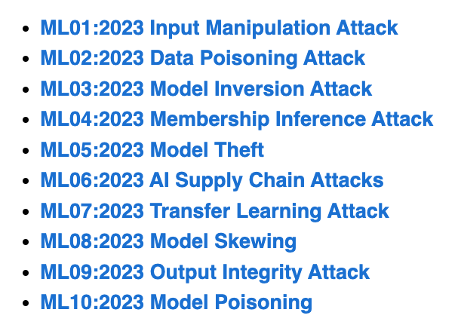
OWASP Top Ten Machine Learning Risks
https://owasp.org/www-project-machine-learning-security-top-10/

Slide 40
ML01:2023 Input Manipulation Attack
  An attacker deliberately alters input data to mislead the model
  This attack is also called evasion
  Example: a model is trained to tell cat images from dog images. An attacker modifies a cat image so it is misclassified as a dog.
ML02:2023 Data Poisoning Attack
  An attacker manipulates the training data to cause the model to behave in an undesirable way
ML03:2023 Model Inversion Attack
  An attacker reverse-engineers the model to extract information from it
  Example: a model is trained to recognize faces. An attacker inputs images of individuals into the model and and recovers the personal information of the individuals from the model's predictions, such as their name, address, or social security number.

Slide 41
ML04:2023 Membership Inference Attack
  An attacker manipulates the model’s training data in order to cause it to behave in a way that exposes sensitive information
  Example: A malicious attacker trains a machine learning model on a dataset of financial records and uses it to query whether or not a particular individual’s record was included in the training data.
ML05:2023 Model Theft
  An attacker gains access to the model’s parameters
  Example: Stealing a machine learning model from a competitor
ML06:2023 AI Supply Chain Attacks
  An attacker modifies or replaces a machine learning library or model that is used by a system

Slide 42
ML07:2023 Transfer Learning Attack
  An attacker trains a model on one task and then fine-tunes it on another task to cause it to behave in an undesirable way
  Example: An attacker trains a machine learning model on a malicious dataset that contains manipulated images of faces. The attacker then transfers the model’s knowledge to a target face recognition system. As a result, the face recognition system starts making incorrect predictions, allowing the attacker to bypass the security and gain access to sensitive information.
ML08:2023 Model Skewing
  An attacker manipulates the distribution of the training data to cause the model to behave in an undesirable way.
  Example: The attacker provides fake feedback data to a loan-approving machine learning system. As a result, the model’s predictions are skewed, and the attacker’s chances of getting a loan approved are significantly increased.

Slide 43
ML09:2023 Output Integrity Attack
  An attacker aims to modify or manipulate the output of a machine learning model in order to change its behavior or cause harm to the system it is used in.
  Example: An attacker has gained access to the output of a machine learning model that is being used to diagnose diseases in a hospital. The attacker modifies the output of the model, making it provide incorrect diagnoses for patients.
ML10:2023 Neural Net Reprogramming
  An attacker manipulates the model's parameters to cause it to behave in an undesirable way.
  Example: A bank is using a machine learning model to identify handwritten characters on cheques. An attacker manipulates the parameters of the model by altering the images in the training dataset or directly modifying the parameters in the model. This can result in the model misidentifying characters, leading to incorrect amounts being processed.

Slide 44

https://owasp.org/www-project-top-10-for-large-language-model-applications/

Slide 45
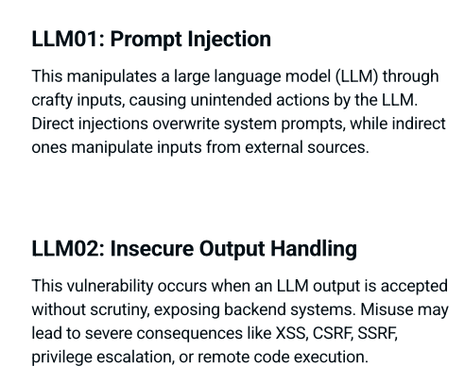

Slide 46
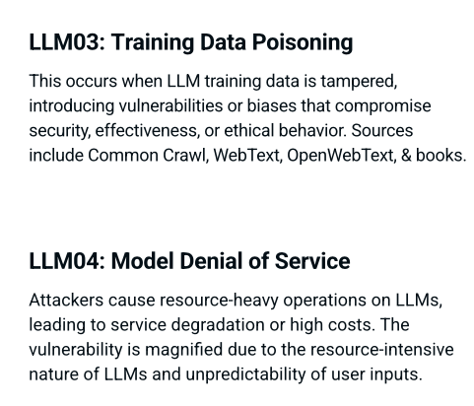

Slide 47
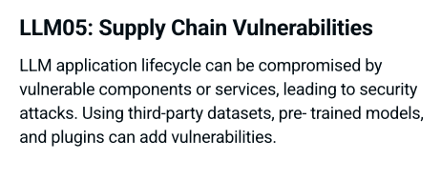
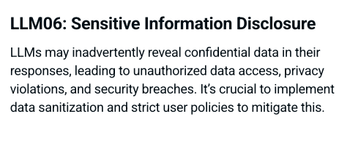

Slide 48


Slide 49


Slide 50



Slide 51

Microsoft 365 Copilot Use Cases
Writes documents for you
  Based on data found in your Email, documents, spreadsheets, and other files you have access to
  In the Microsoft365 cloud
  Based on your Microsoft365 permissions

Slide 52


Slide 53


Retrieval Augmented Generation (RAG)

Slide 54

What Microsoft Handles for You

Slide 55

What You Need to Manage

Slide 56


Slide 57

The Average M365 Tenant has

Slide 58

Why Does This Happen?

Slide 59

But you must enable sensitivity labels
  For SharePoint and OneDrive
If humans fail to apply and update labels, the system fails

Slide 60



Slide 61


Slide 62


Home Users are Safe. Right?

