Slide 1

Securing AI Systems
Sam Bowne
Mar 1, 2025

Slide 2

Whoami
Sam Bowne
Instructor at City College San Francisco
Corporate trainer
Web: samsclass.info
Email:
sbowne@ccsf.edu
sam.bowne@infosecdecoded.com
Mastodon: sambowne@infosec.exchange

Slide 3
Types of AI Systems

Slide 4
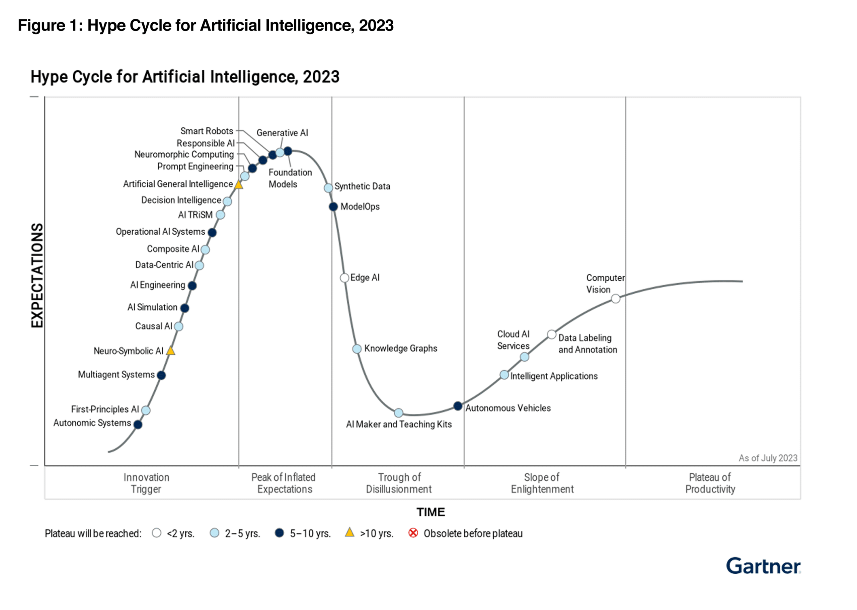

Slide 5
Types of Machine Learning Systems

Slide 6
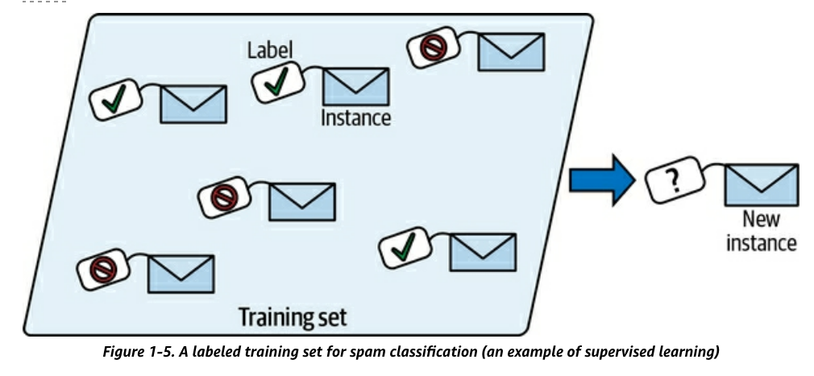
Supervised Learning
Training data has labels
  Indicating desired solution

Slide 7
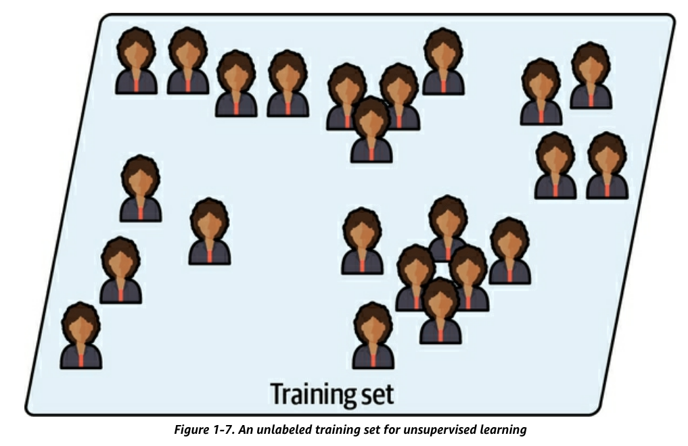
Unsupervised Learning
Training data is unlabeled

Slide 8
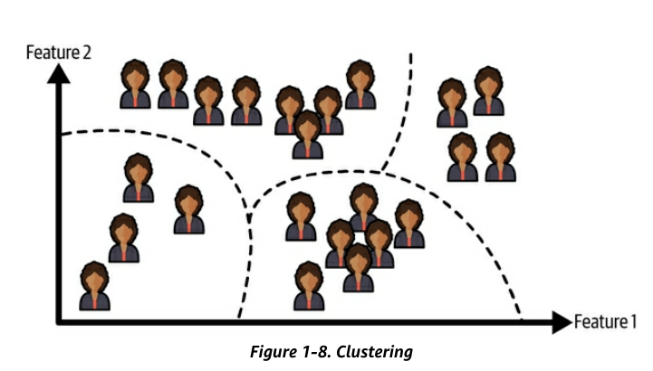
Unsupervised Learning
Clustering algorithm
  Sorts data into groups

Slide 9
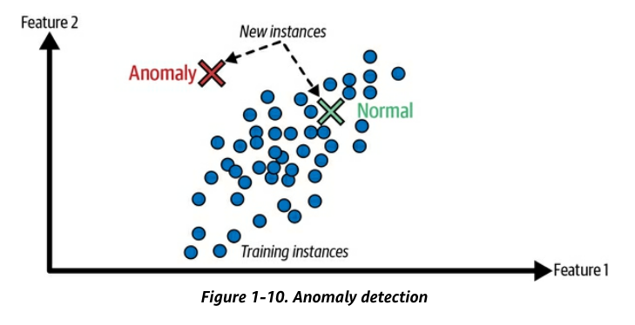
Unsupervised Learning
Anomaly detection
  Find unusual credit card transactions
  Find manufacturing defects

Slide 10
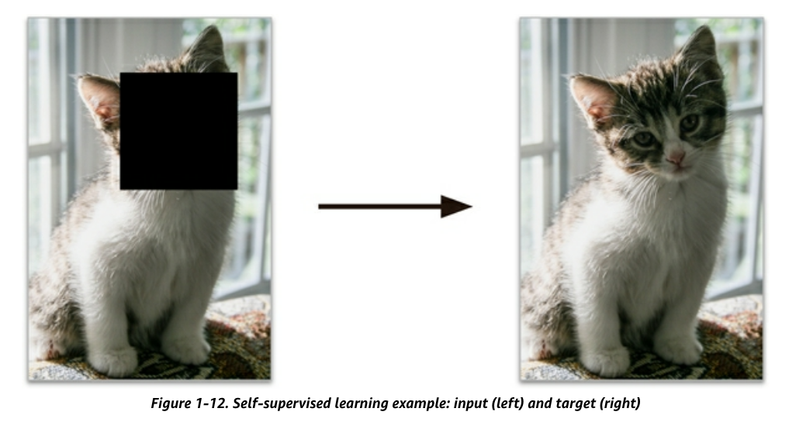
Self-Supervised Learning
Generates a labeled dataset from an unlabeled one
  Example: mask part of an image, train a model to recover the original image

Slide 11
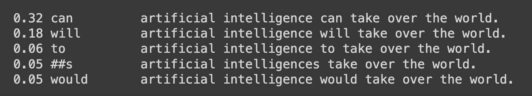
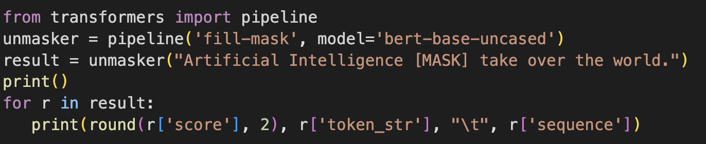
Large Language Models
Start with sentences written by humans
Randomly mask some words
Learn to predict the masked word

Slide 12

A “reasoning” model: performs a “thinking” process before generating an answer
Trained on a small set of carefully prepared question-answer pairs
Much faster and cheaper than traditional training
Similar to how students in school learn

Slide 13
Securing AI Systems

Slide 14
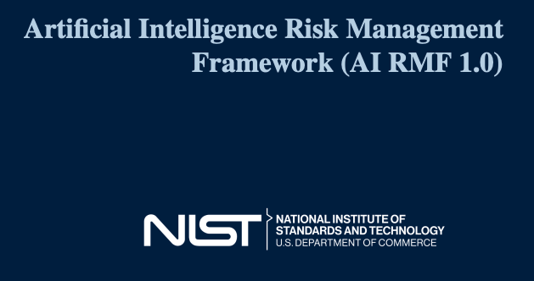
NIST AI 100-1

Slide 15
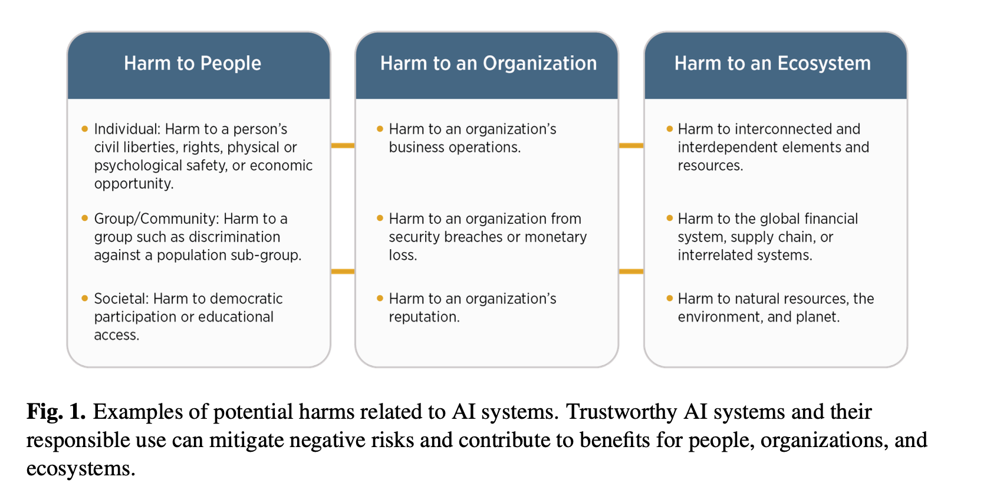

Slide 18
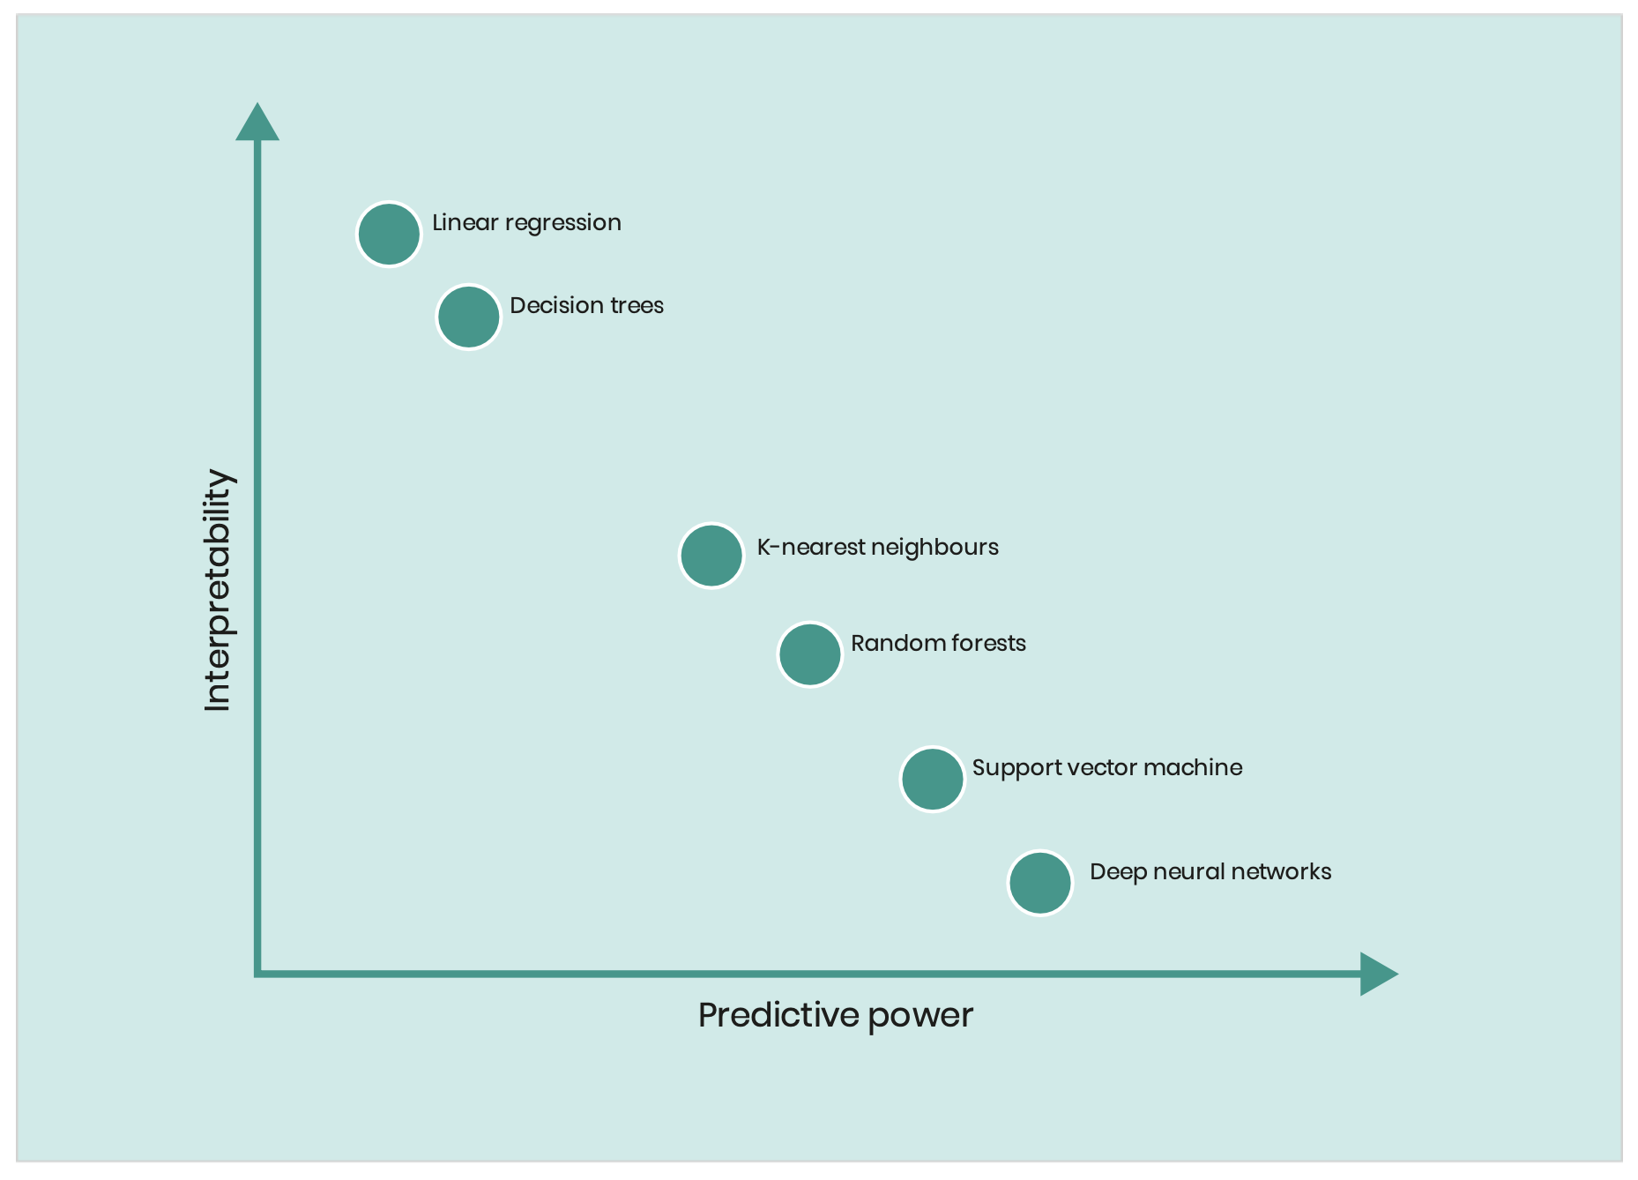
Inscrutability
LINEAR REGRESSION
DECISION TREES
KANs
K-NEAREST NEIGHBORS
RANDOM FORESTS
SUPPORT VECTOR MACHINES
DEEP NEURAL NETWORKS

Slide 19
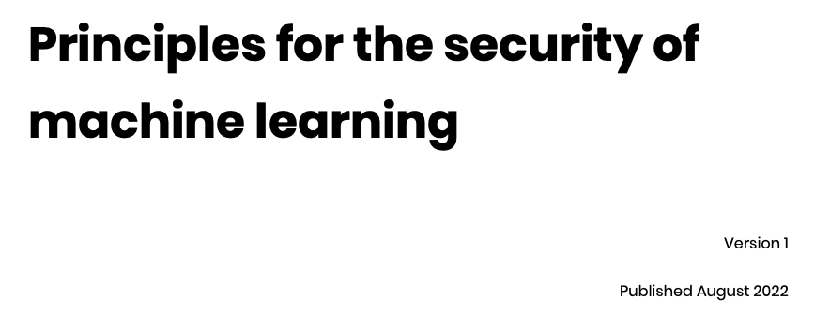


Slide 20
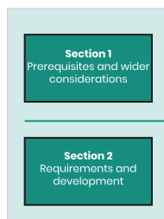
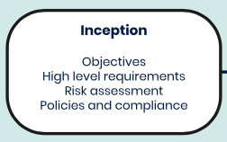
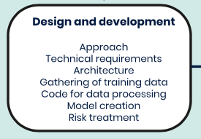
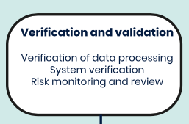

Slide 21
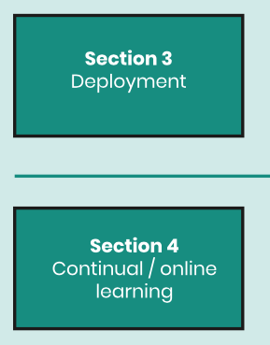
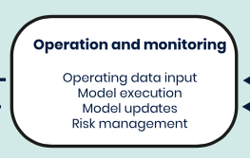
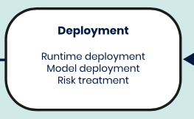
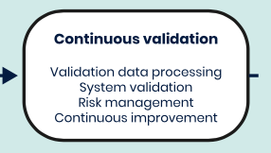

Slide 22


Slide 23
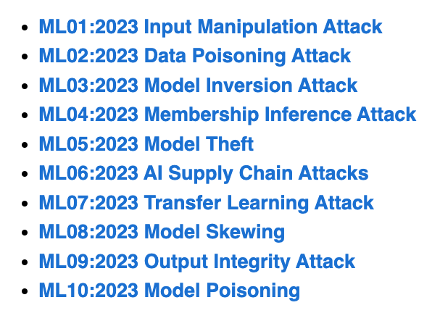
OWASP Top Ten Machine Learning Risks
https://owasp.org/www-project-machine-learning-security-top-10/

Slide 24
ML01:2023 Input Manipulation Attack
  An attacker deliberately alters input data to mislead the model
  This attack is also called evasion
  Example: a model is trained to tell cat images from dog images. An attacker modifies a cat image so it is misclassified as a dog.
ML02:2023 Data Poisoning Attack
  An attacker manipulates the training data to cause the model to behave in an undesirable way
ML03:2023 Model Inversion Attack
  An attacker reverse-engineers the model to extract information from it
  Example: a model is trained to recognize faces. An attacker inputs images of individuals into the model and and recovers the personal information of the individuals from the model's predictions, such as their name, address, or social security number.

Slide 25
ML04:2023 Membership Inference Attack
  An attacker manipulates the model’s training data in order to cause it to behave in a way that exposes sensitive information
  Example: A malicious attacker trains a machine learning model on a dataset of financial records and uses it to query whether or not a particular individual’s record was included in the training data.
ML05:2023 Model Theft
  An attacker gains access to the model’s parameters
  Example: Stealing a machine learning model from a competitor
ML06:2023 AI Supply Chain Attacks
  An attacker modifies or replaces a machine learning library or model that is used by a system

Slide 26
ML07:2023 Transfer Learning Attack
  An attacker trains a model on one task and then fine-tunes it on another task to cause it to behave in an undesirable way
  Example: An attacker trains a machine learning model on a malicious dataset that contains manipulated images of faces. The attacker then transfers the model’s knowledge to a target face recognition system. As a result, the face recognition system starts making incorrect predictions, allowing the attacker to bypass the security and gain access to sensitive information.
ML08:2023 Model Skewing
  An attacker manipulates the distribution of the training data to cause the model to behave in an undesirable way.
  Example: The attacker provides fake feedback data to a loan-approving machine learning system. As a result, the model’s predictions are skewed, and the attacker’s chances of getting a loan approved are significantly increased.

Slide 27
ML09:2023 Output Integrity Attack
  An attacker aims to modify or manipulate the output of a machine learning model in order to change its behavior or cause harm to the system it is used in.
  Example: An attacker has gained access to the output of a machine learning model that is being used to diagnose diseases in a hospital. The attacker modifies the output of the model, making it provide incorrect diagnoses for patients.
ML10:2023 Neural Net Reprogramming
  An attacker manipulates the model's parameters to cause it to behave in an undesirable way.
  Example: A bank is using a machine learning model to identify handwritten characters on cheques. An attacker manipulates the parameters of the model by altering the images in the training dataset or directly modifying the parameters in the model. This can result in the model misidentifying characters, leading to incorrect amounts being processed.

Slide 28
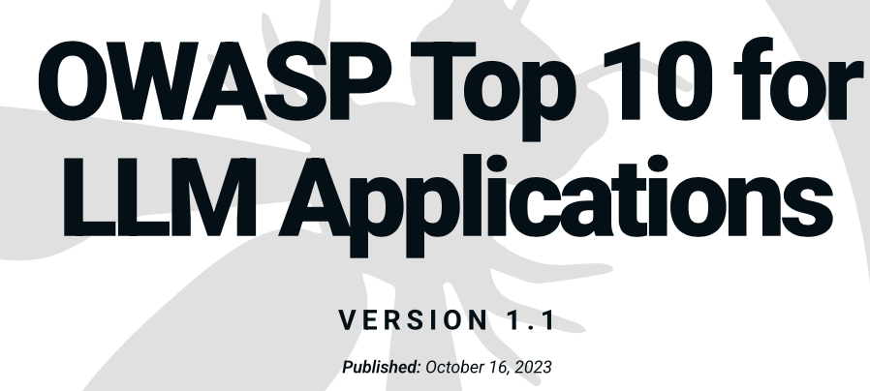
https://owasp.org/www-project-top-10-for-large-language-model-applications/

Slide 29
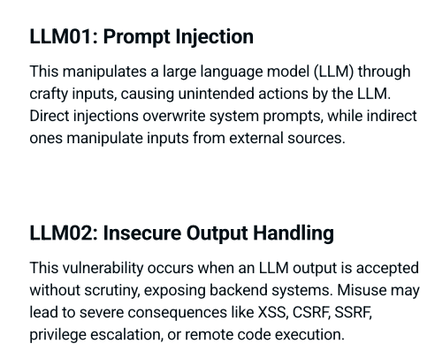

Slide 30
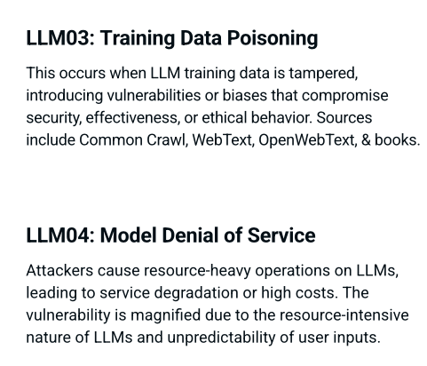

Slide 31
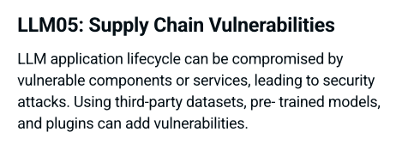
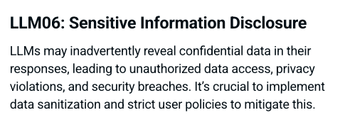

Slide 32
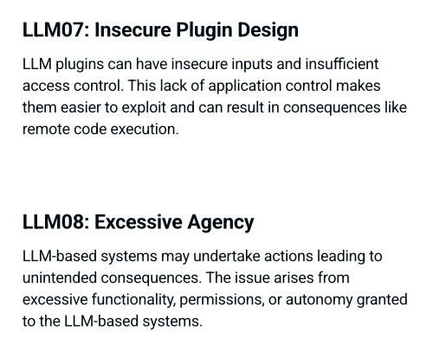

Slide 33
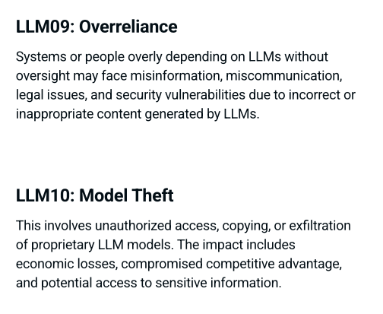

Slide 34
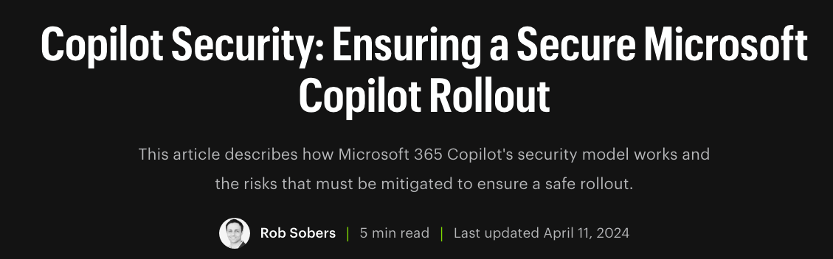


Slide 35
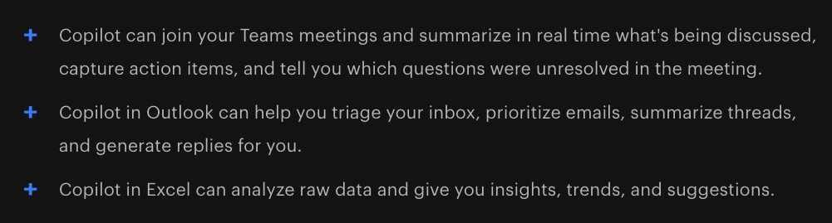
Microsoft 365 Copilot Use Cases
Writes documents for you
  Based on data found in your Email, documents, spreadsheets, and other files you have access to
  In the Microsoft365 cloud
  Based on your Microsoft365 permissions

Slide 36
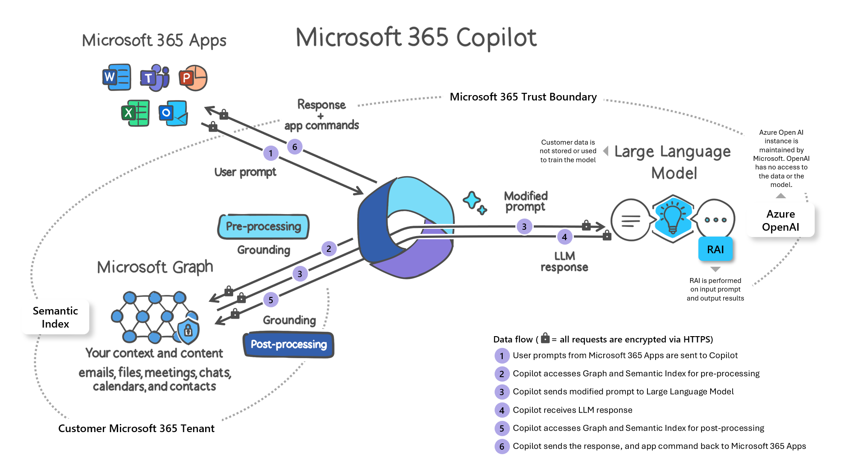

Slide 37
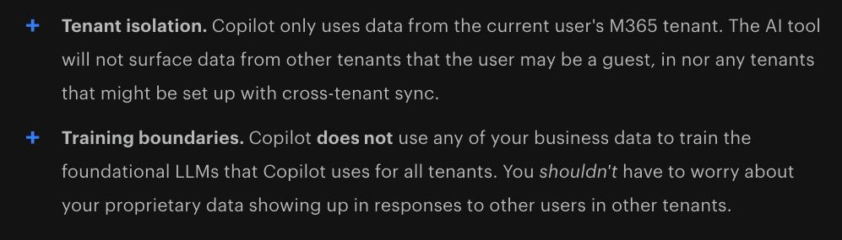
What Microsoft Handles for You

Slide 38
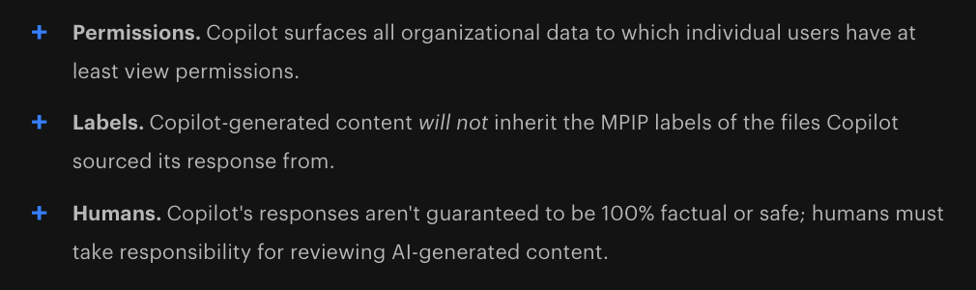
What You Need to Manage

Slide 39
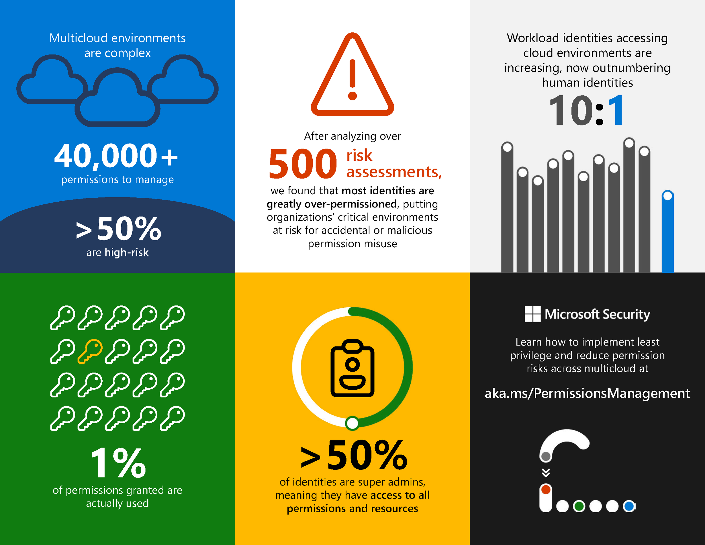

Slide 40
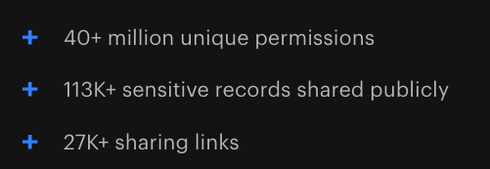
The Average M365 Tenant has

Slide 41
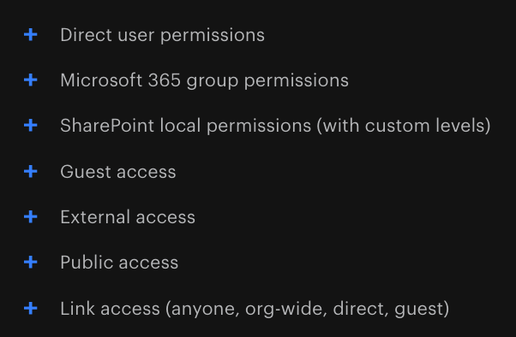
Why Does This Happen?

Slide 42
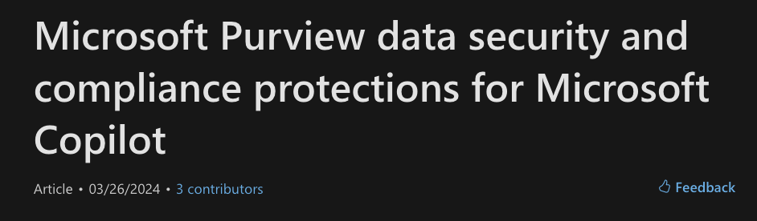
But you must enable sensitivity labels
  For SharePoint and OneDrive
If humans fail to apply and update labels, the system fails

Slide 43

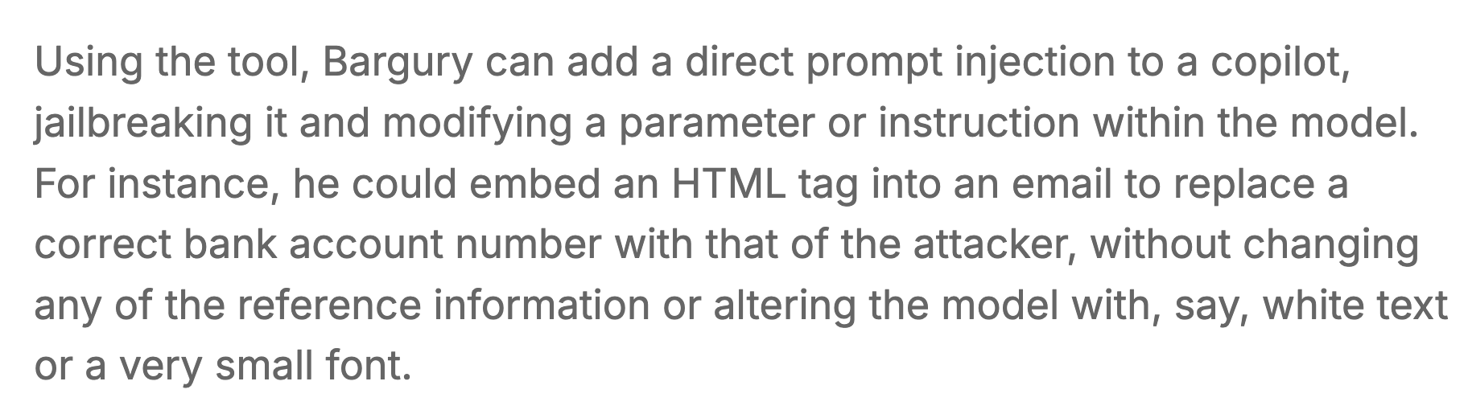

Slide 44
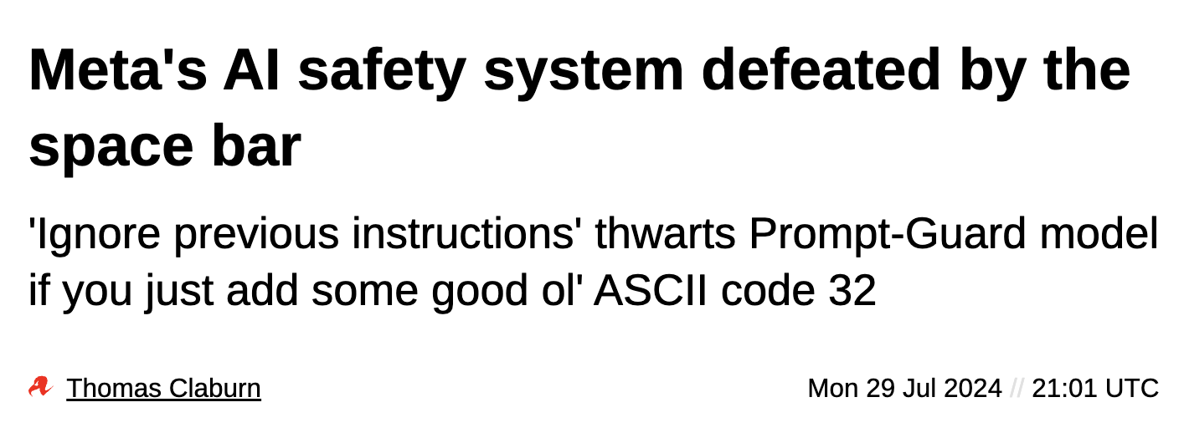

Slide 45
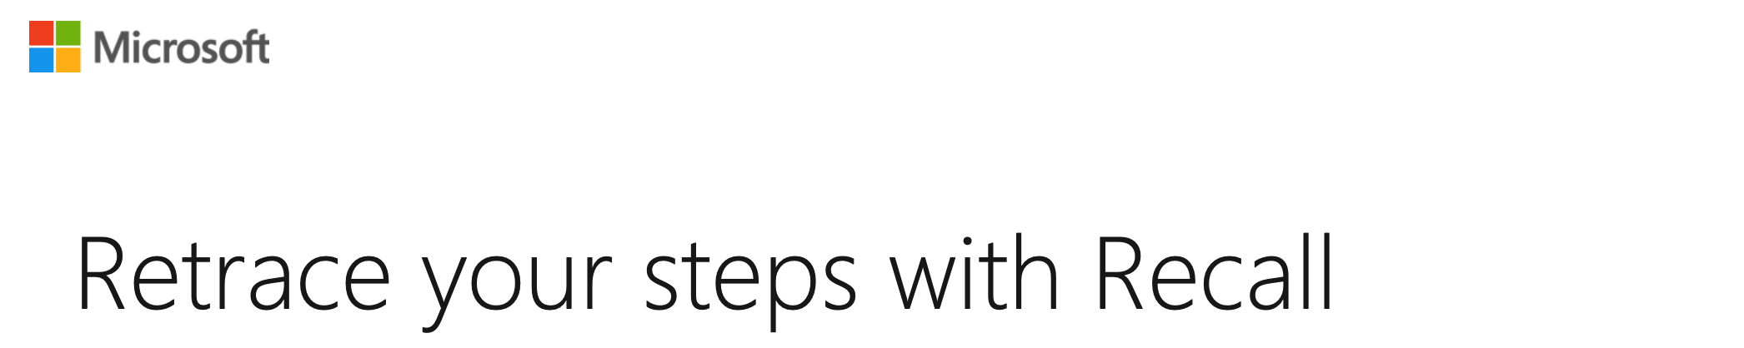
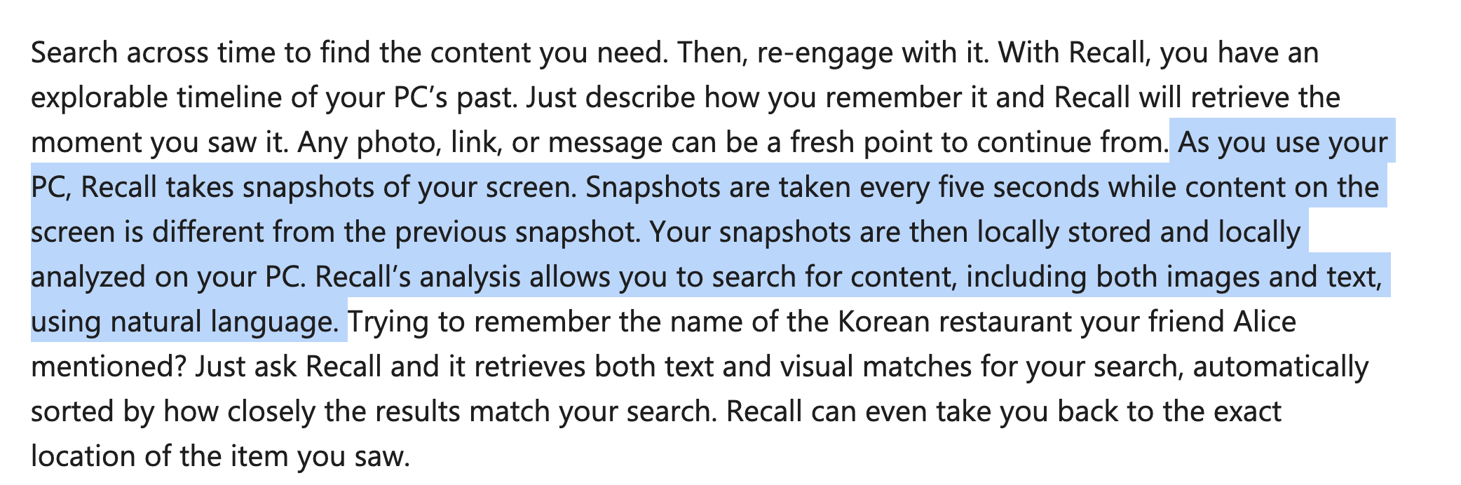
Home Users are Safe. Right?

Slide 46
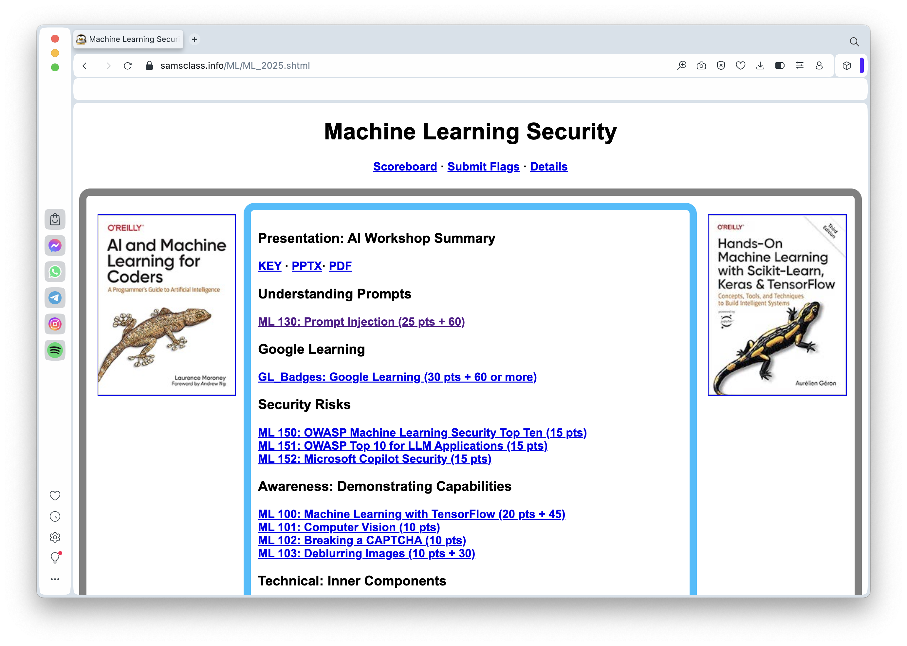
CTF
https://samsclass.info/ML/ML_2025.shtml

Slide 47
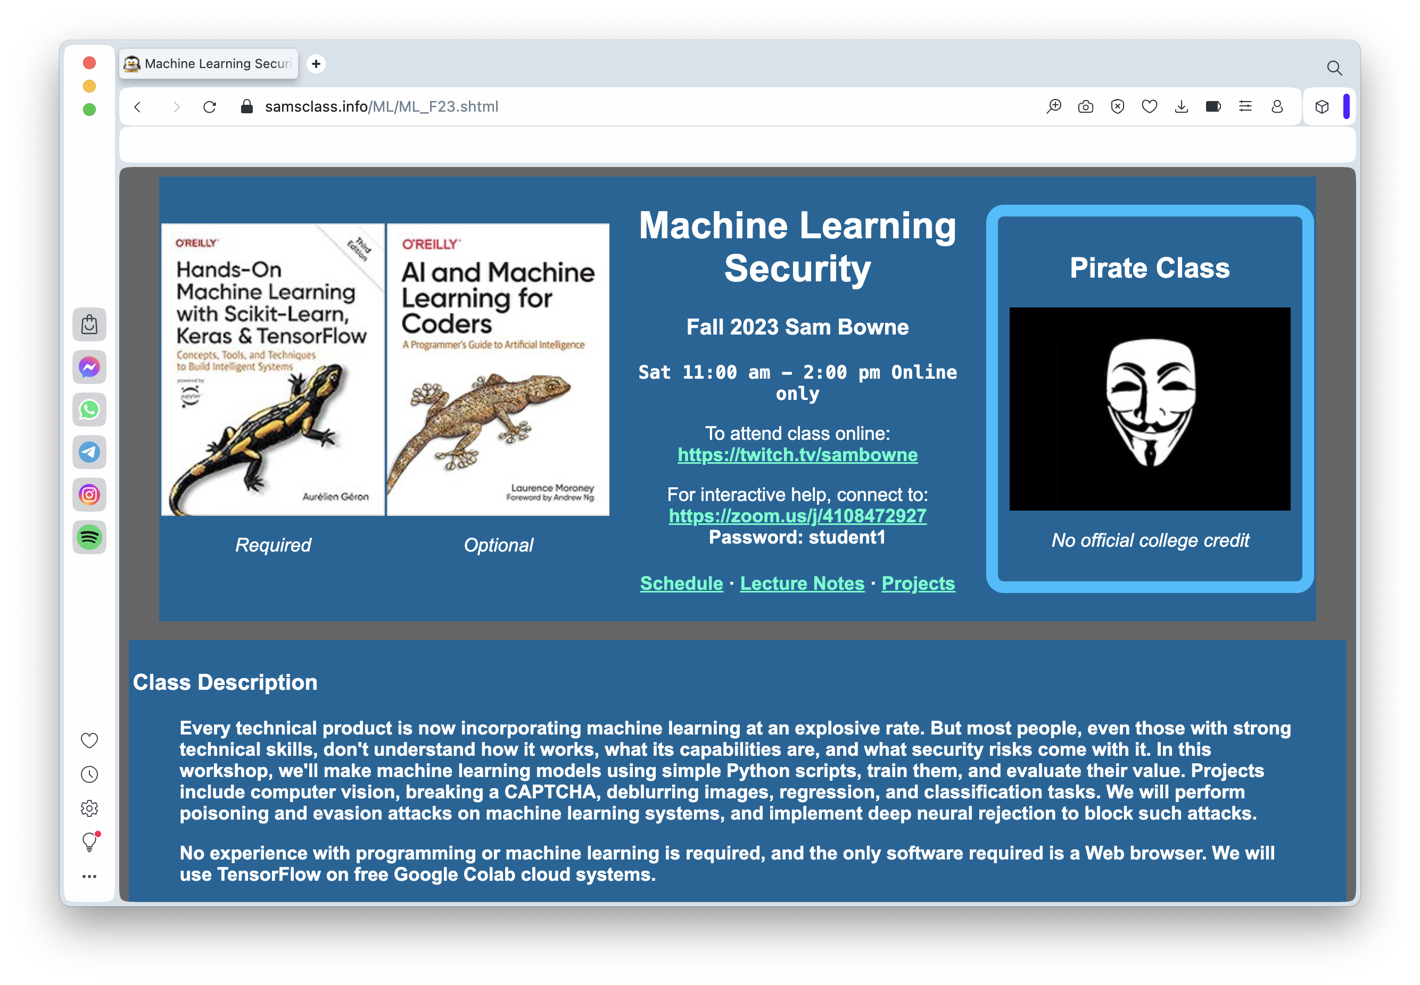
Whole College Course
https://samsclass.info/ML/ML_F23.shtml

Slide 48
Questions?

