Slide 1
Data Breaches & Password Hashes AND New IPv6 RA Flood Attack
BayThreat
Dec. 7, 2012

Slide 2
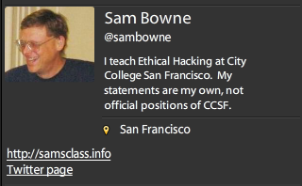
Bio

Slide 3
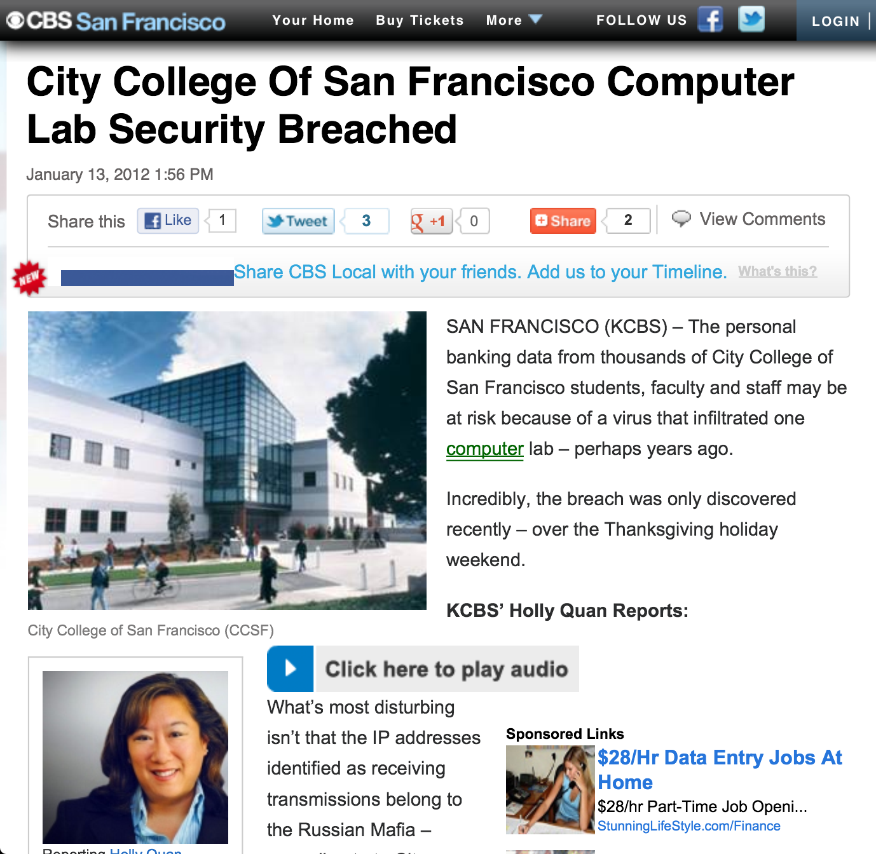

Slide 4
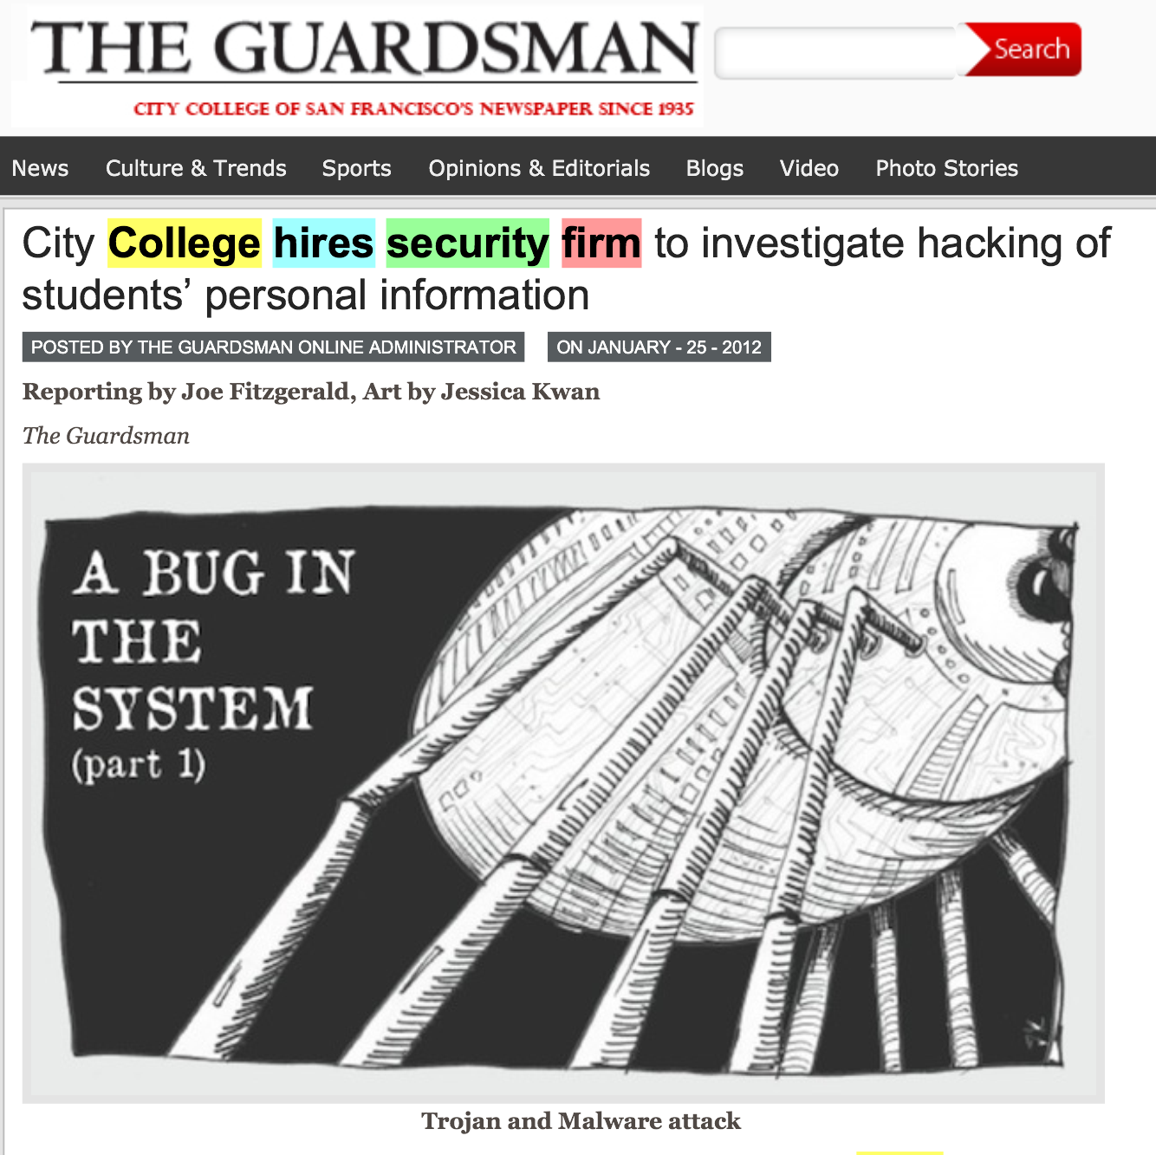

Slide 7
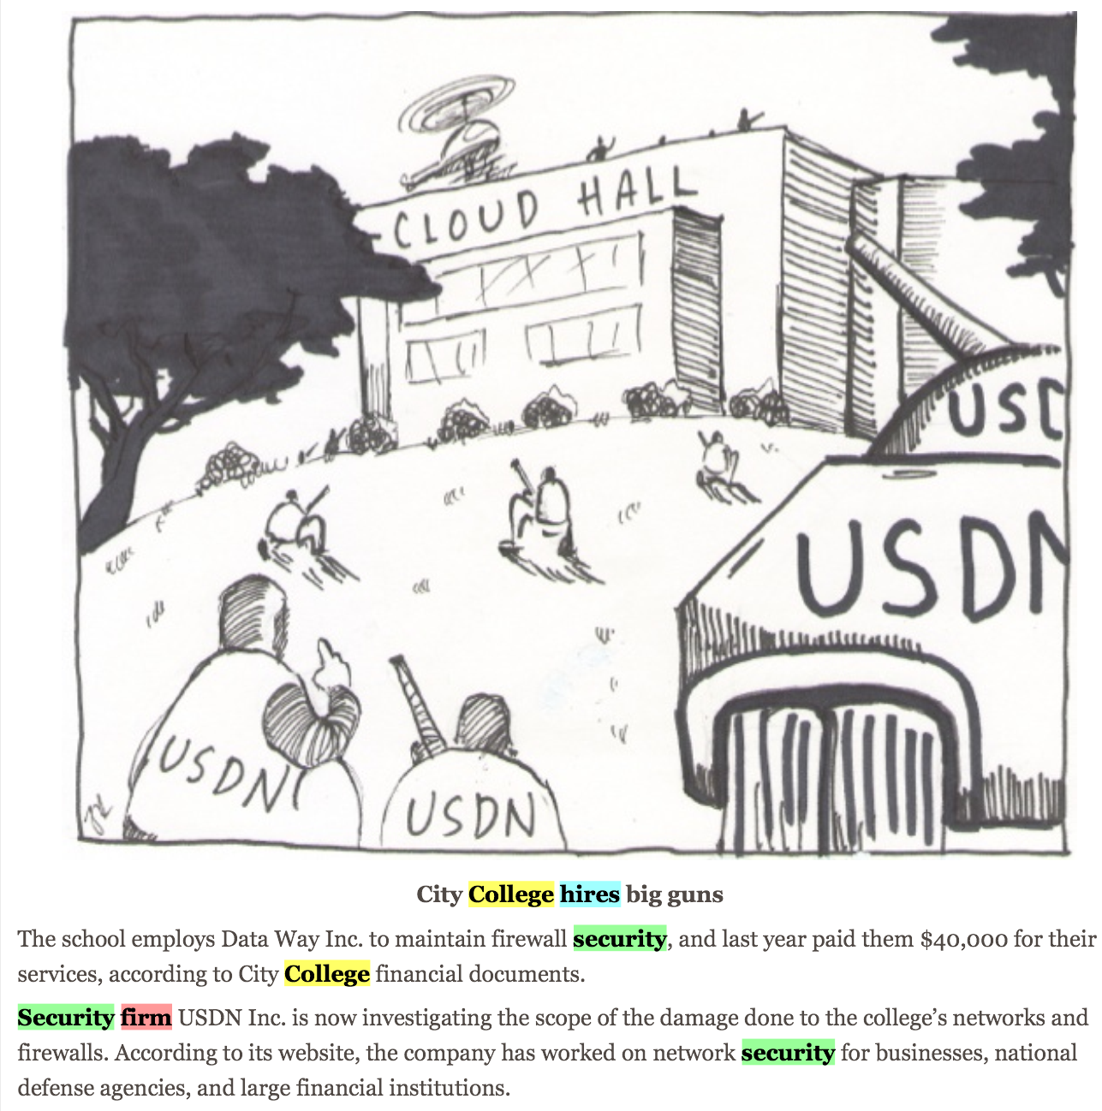

Slide 10
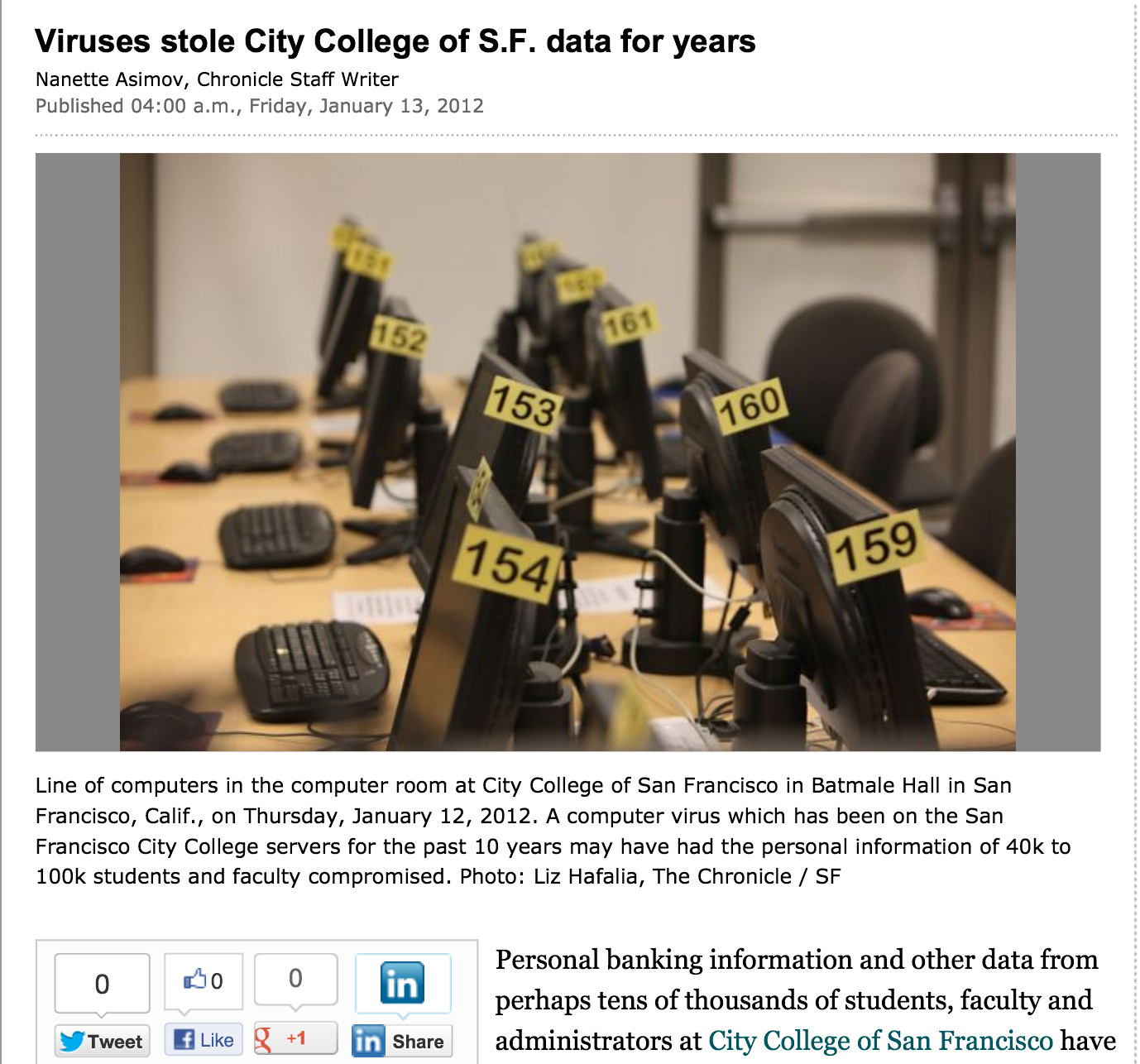

Slide 11
Outside attacks Insider threat Deluded Insider Threat

Slide 12
Security at CCSF
Two generations of complete hardware replacement in the last ten years
McAfee Enterprise antivirus
Deep Freeze
Palo Alto layer 7 firewall

Slide 13
Security Audits
There was a security audit and remediation process performed in 2007-2008 by a contractor
I did another security audit in 2010 with my CISSP students
No major problems found

Slide 14
Evidence for these "Viruses"
A report was supposedly prepared by USDN in Nov 2011, but we were never able to get a copy of it at all
The presentation from the CTO that went to the press was in Jan. 2011
We finally got a partial report on Jan. 31, lacking the appendices that were the evidence
"Proprietary and Confidential" but later published in the newspaper

Slide 15
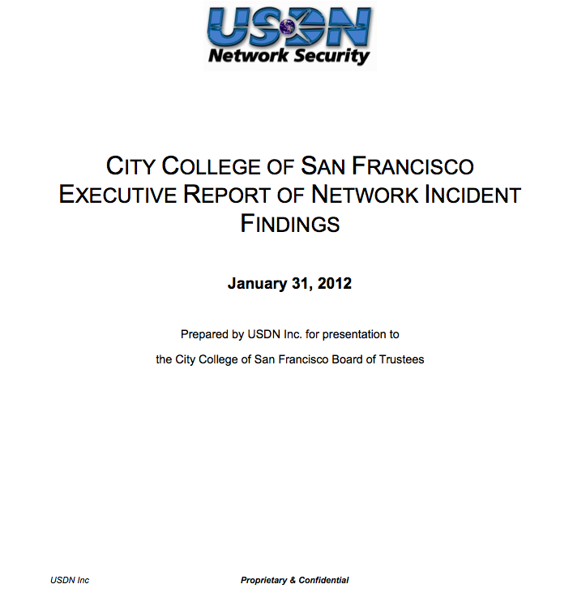

Slide 16
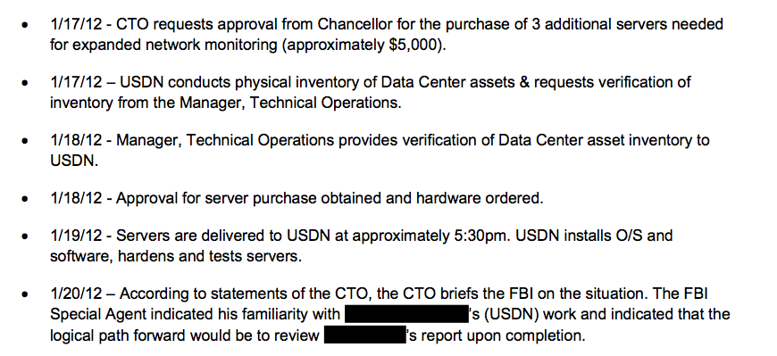
Wait, the FBI?

Slide 17
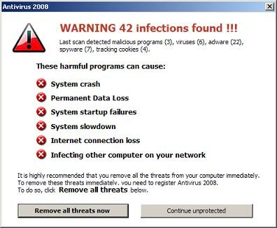
You are a manager, and a contractor says you have a scary virus infection. Who do you call immediately?
Upper management
Your IT Staff
Tell no one, keep it a secret
The FBI
The San Francisco Chronicle

Slide 18
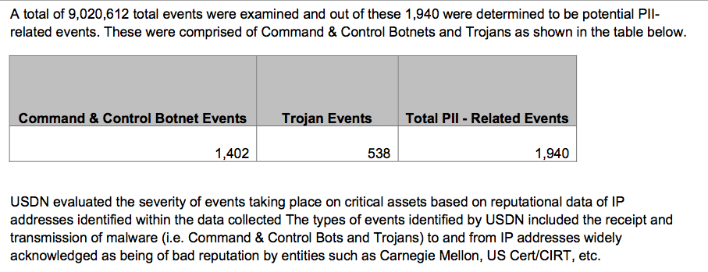

Slide 19
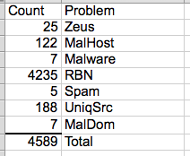
The List
On April 3, we finally got a list of the "infected machines"
Direct inspection of samples showed no real infections

Slide 20
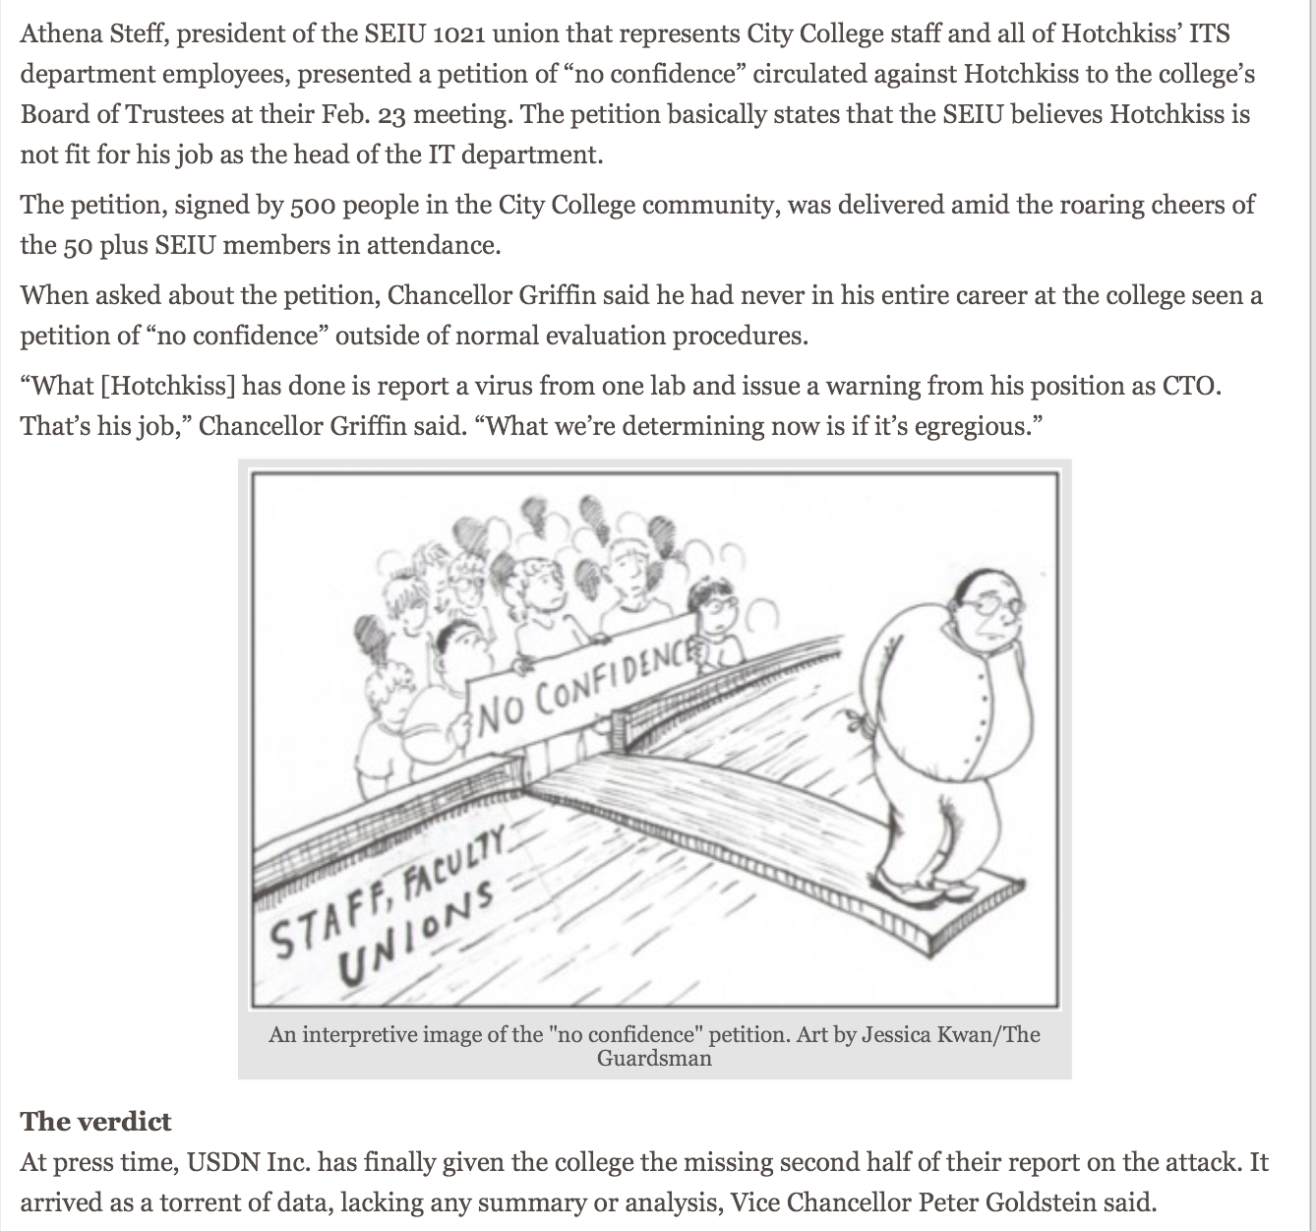

Slide 21
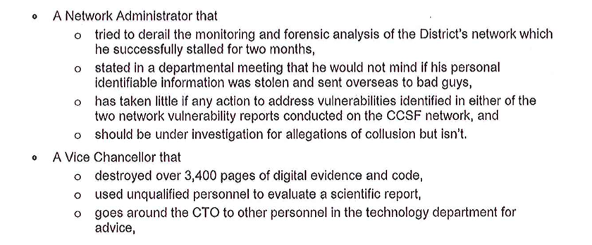
Letter to Trustees & Published in Newspaper

Slide 23
Falsified Breach in 2011

Slide 24
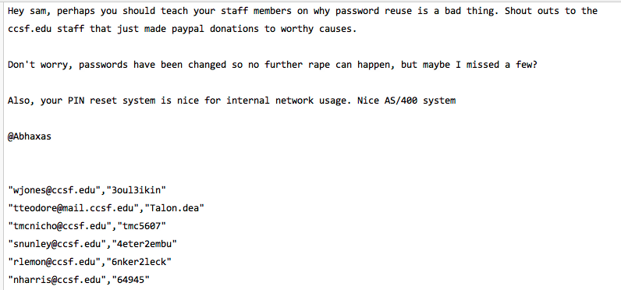
Proven False at the Time

Slide 25
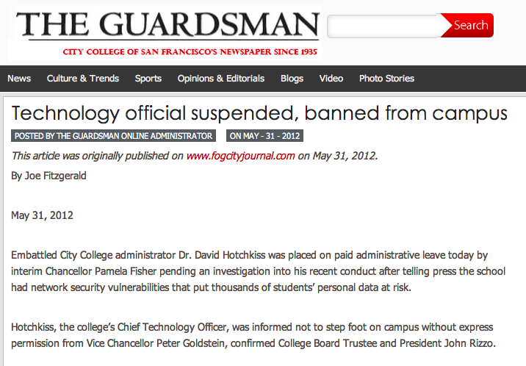

Slide 26
How Does a Real Breach Happen?

Slide 27
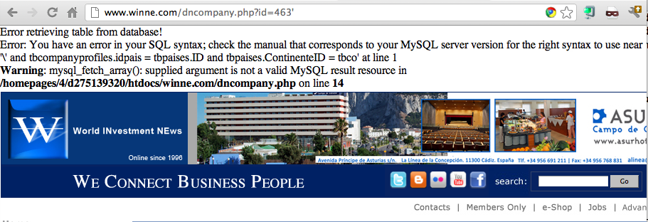
Example SQL Injection Vulnerability

Slide 29
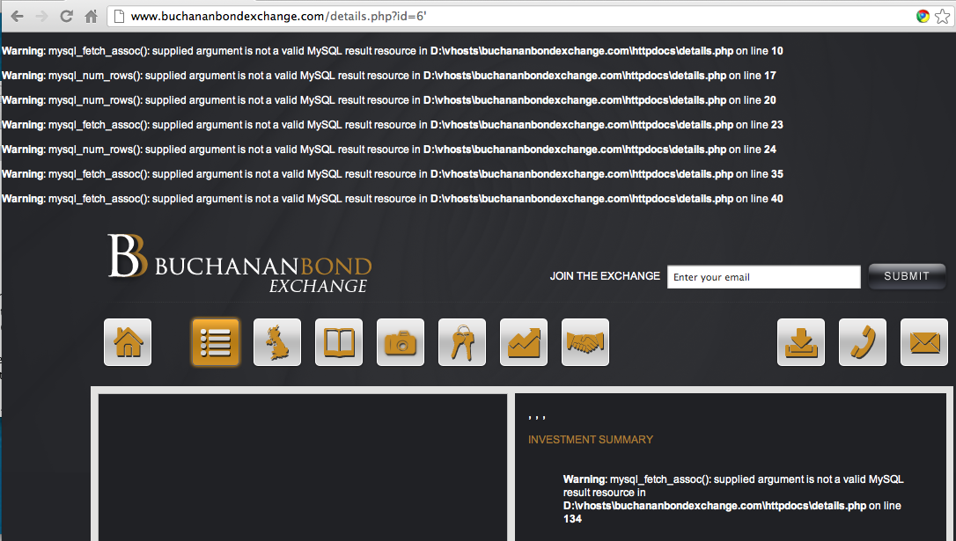

Slide 30
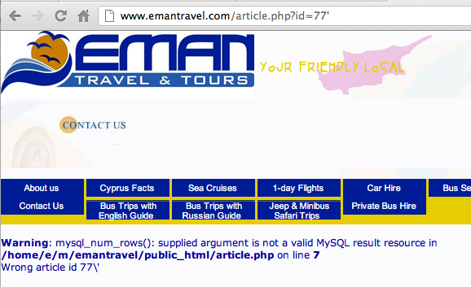

Slide 31
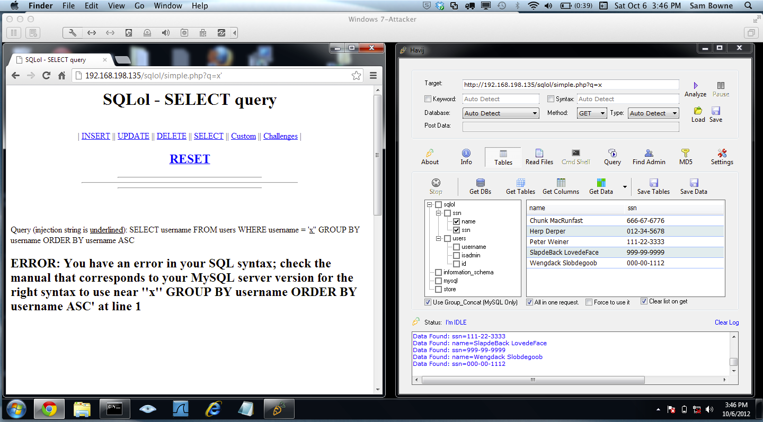
Demo

Slide 32
The Commands Used to Steal the Data

Slide 33
Analysis of Stolen Data Dumped by TEAMGHOSTSHELL on Aug 25, 2012

Slide 34
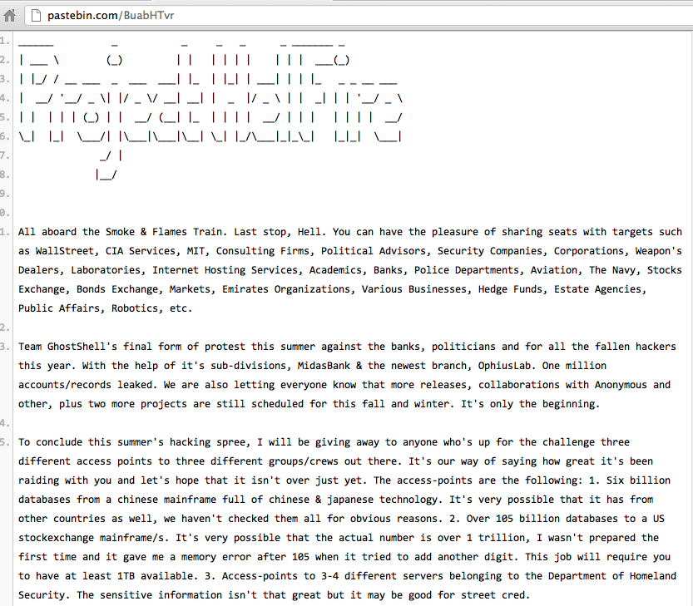

Slide 35
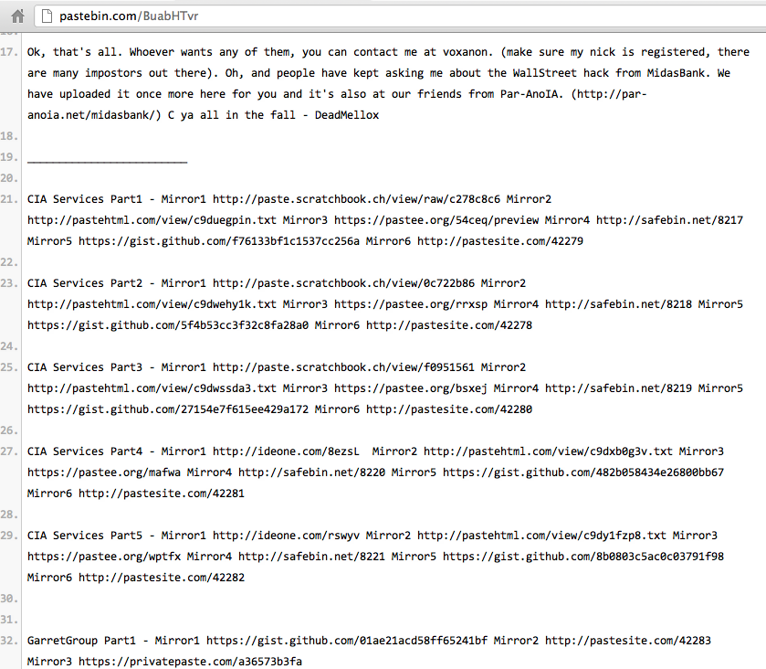

Slide 36
Password Storage: Awful Beyond Belief
Plaintext, obvious, all the same

Slide 37
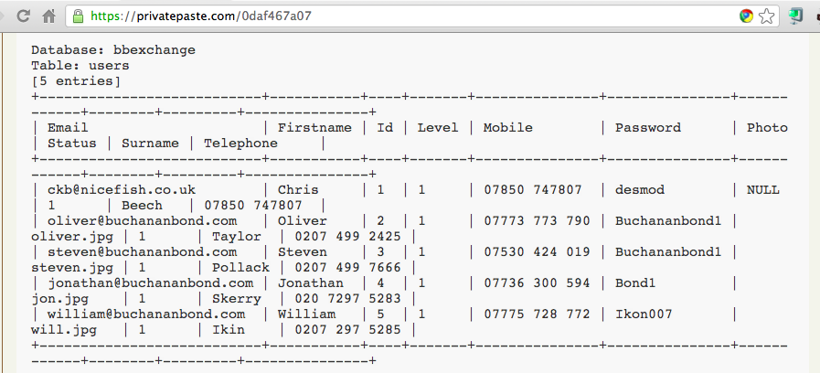
Plaintext Passwords, Easily Guessed

Slide 38
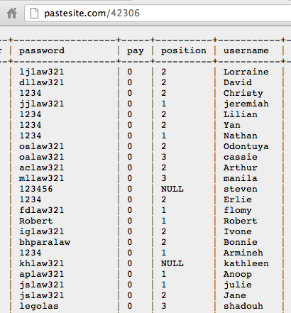

Slide 39
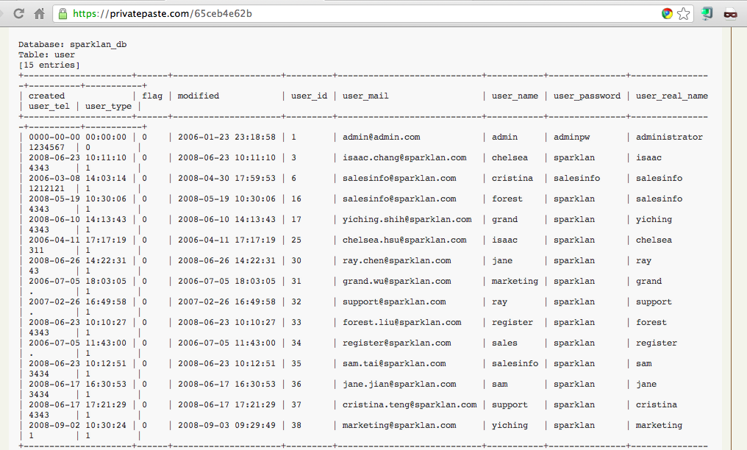
Sparklan Passwords

Slide 40
Beforward Transactions with PII

Slide 41
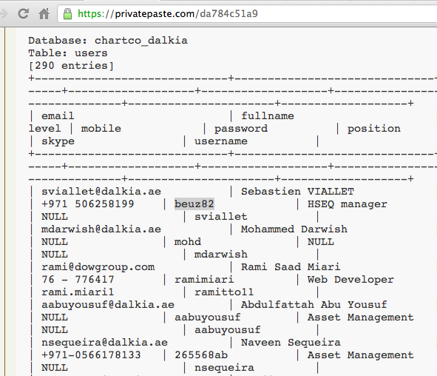
Plaintext Passwords

Slide 42
Password Storage: BASE64
Obfuscated, not hashed

Slide 43
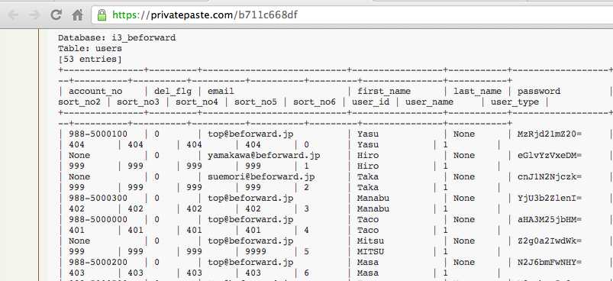
Beforward.jp

Slide 44
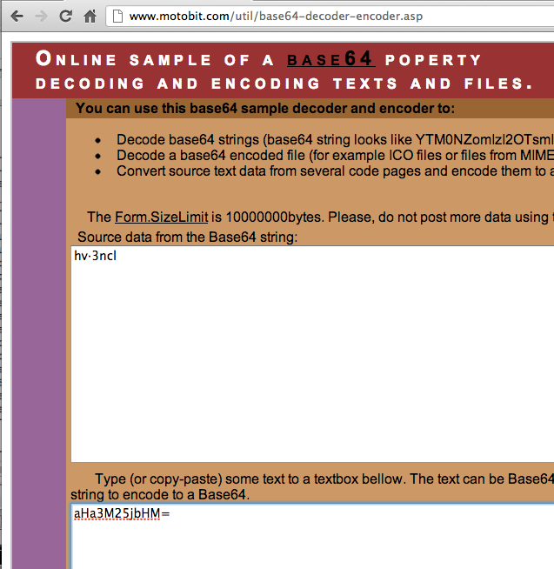
BASE64 Encoding

Slide 45
Password Storage: Unsalted MD5 or SHA-1
Real hashing, but very easy to crack

Slide 46
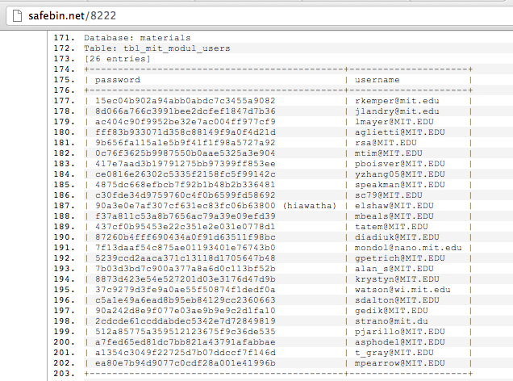
MIT – MD5 Password Hashes

Slide 47
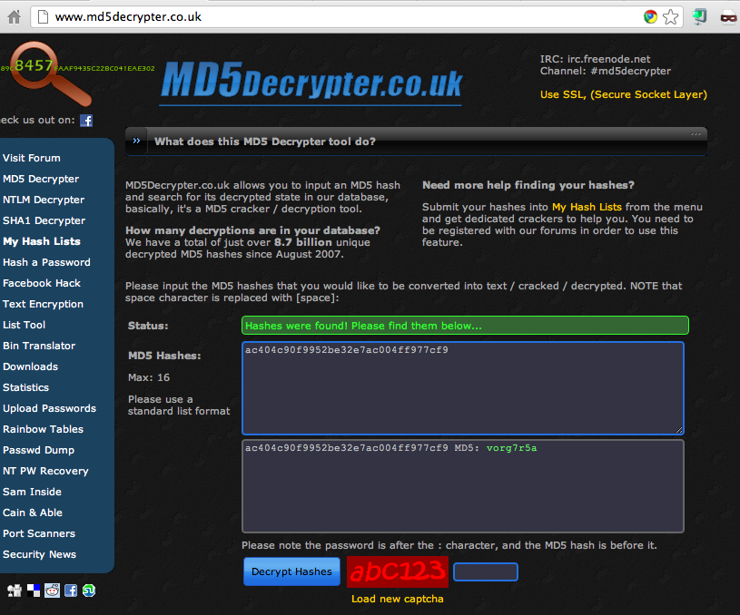

Slide 48
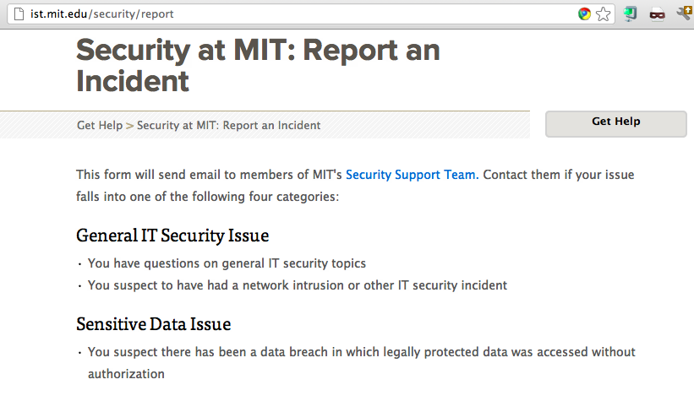

Slide 49
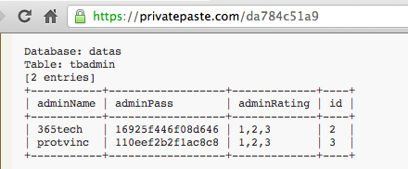
MySQL323 Password Hashes

Slide 50
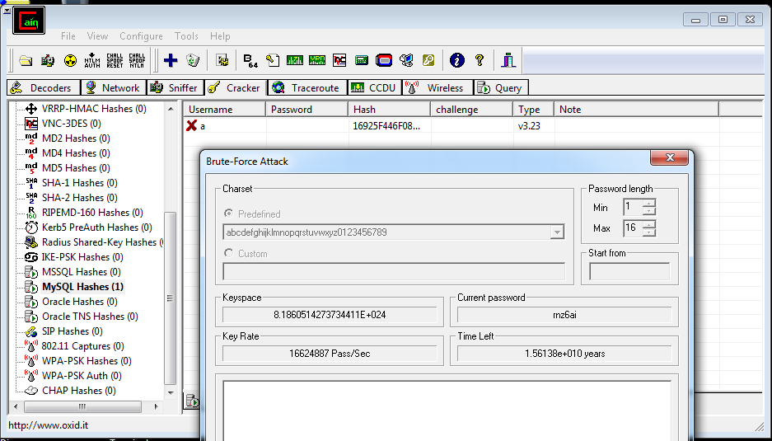
Cracking Hashes with Cain

Slide 51
SHA-1 Hash

Slide 52
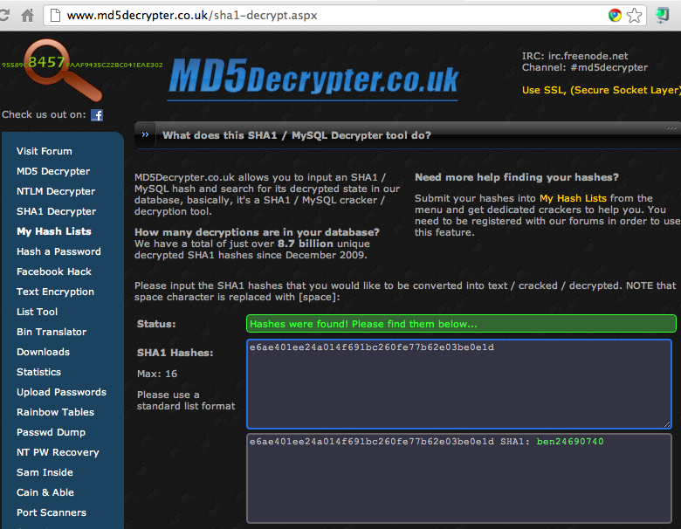
Cracked!

Slide 53
MySQL 5 Password Hashes

Slide 54
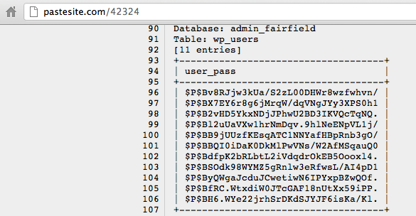
Wordpress Password Hashes

Slide 55
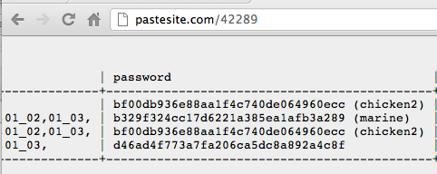
Relative Space

Slide 56
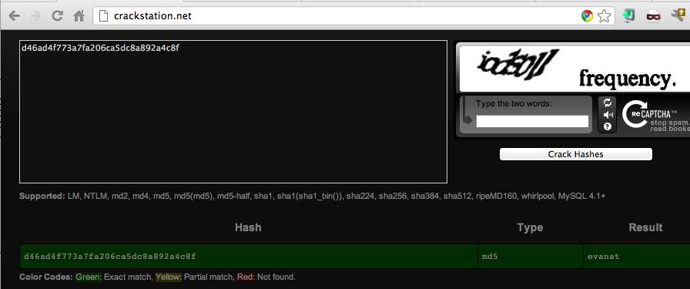
Cracked!

Slide 57
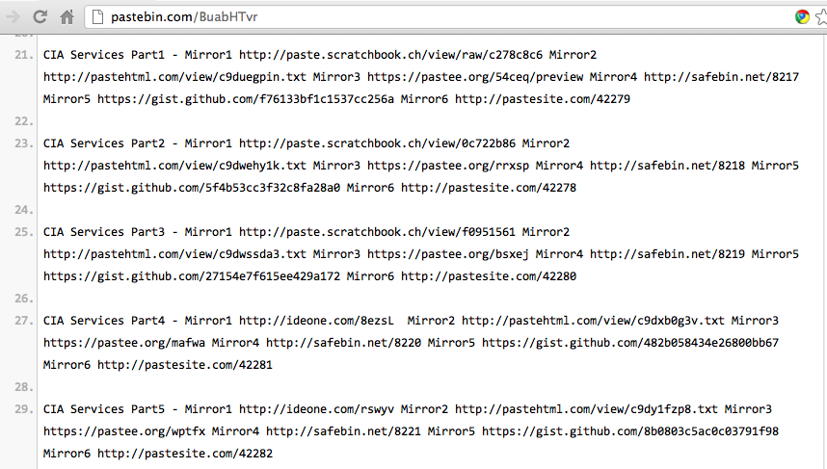

Slide 58
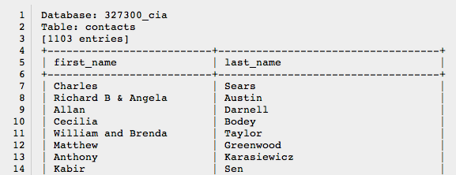
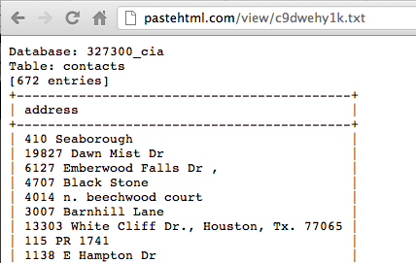
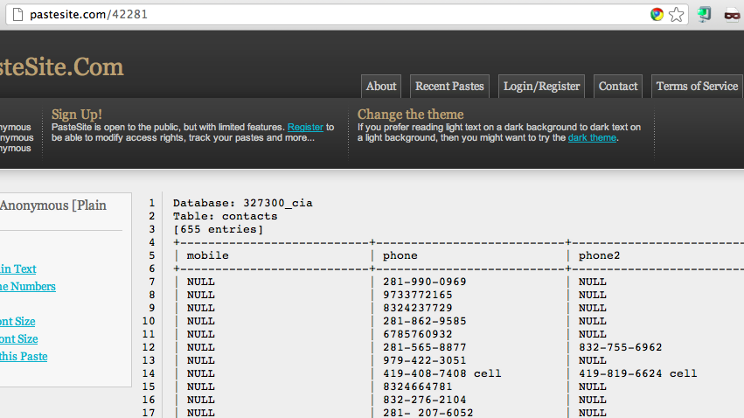

Slide 59
Password Hashing Algorithms

Slide 60
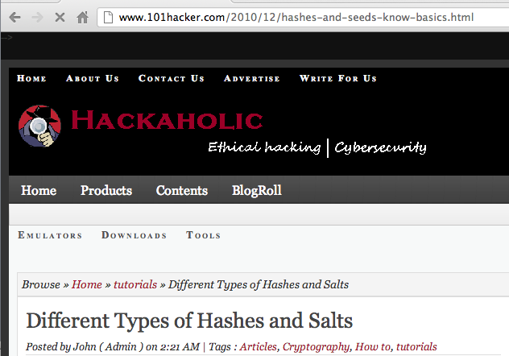

Slide 61
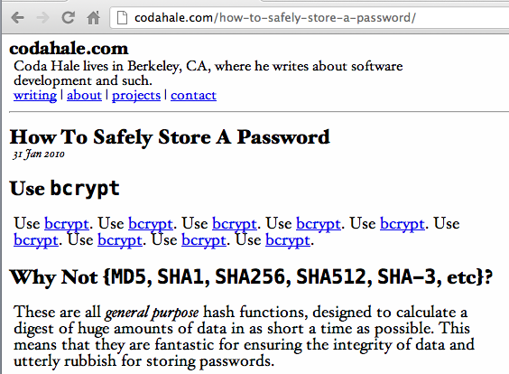
The Right Way

Slide 62
Link-Local DoS
IPv6 Router Advertisements

Slide 63
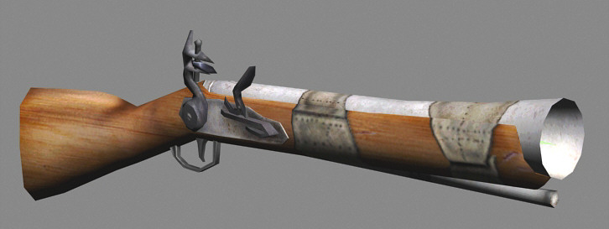
Old Attack (from 2011)
Image from forumlane.org

Slide 64
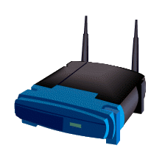
IPv4: DHCP
PULL process
Client requests an IP
Router provides one
I need an IP
Use this IP
Host
Router

Slide 65
IPv6: Router Advertisements
PUSH process
Router announces its presence
Every client on the LAN creates an address and joins the network
JOIN MY NETWORK
Yes, SIR
Host
Router

Slide 66
Router Advertisement Packet

Slide 67
RA Flood (from 2011) flood_router6

Slide 68
Effects of flood_router6
Drives Windows to 100% CPU
Also affects FreeBSD
No effect on Mac OS X or Ubuntu Linux

Slide 69
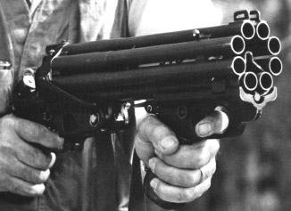
The New RA Flood
Image from guntech.com/

Slide 70
MORE IS BETTER
Each RA now contains
17 Route Information sections
18 Prefix Information sections

Slide 72
Effects of New RA Flood
Win 8 & Server 2012 die (BSOD)
Mac OS X dies
Win 7 & Server 2008 R2, with the "IPv6 Readiness Update" freeze during attack
iPad 3 slows and sometimes crashes
Ubuntu Linux suffers no harm

Slide 73
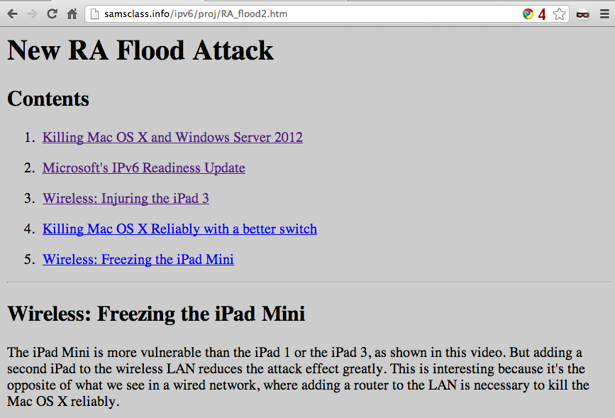
Videos and Details

Slide 74
Mitigation
Disable IPv6
Turn off Router Discovery with netsh
Use a firewall to block rogue Ras
Get a switch with RA Guard
Microsoft's "IPv6 Readiness Update" provides some protection
Released Nov. 13, 2012
KB 2750841

Slide 75
DEMO

