Slide 1
The Breach That Wasn't

Slide 2
Two Truths and a Lie
Please fill out the table below with two statements that are true and one lie about yourself. I will put the information into the polling system to go live before your presentation.
Statement | Truth or lie?
I have a PhD | Truth
I am a high school dropout | Truth
I am bilingual | Lie

Slide 3
Multiple choice question
Please list your question and multiple choice answers on this slide, marking the correct answer if applicable, and insert into your presentation where you’d like the question asked.
I will add the correct poll in place of the slide in your presentation.
There are two poll questions, and no answer is "correct"
Slide 12
You are a manager, and a contractor says you have a scary virus infection. Who do you call immediately?
Upper management
Your IT Staff
Tell no one, keep it a secret
The FBI
The San Francisco Chronicle
The last slide:
In your experience, how many serious security incidents were caused by insiders?
All of them
Most of them
Some of them
Few
None

Slide 4
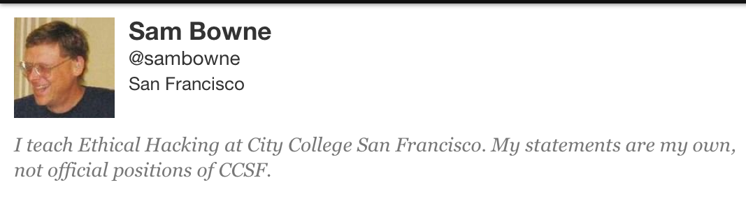
Bio

Slide 5
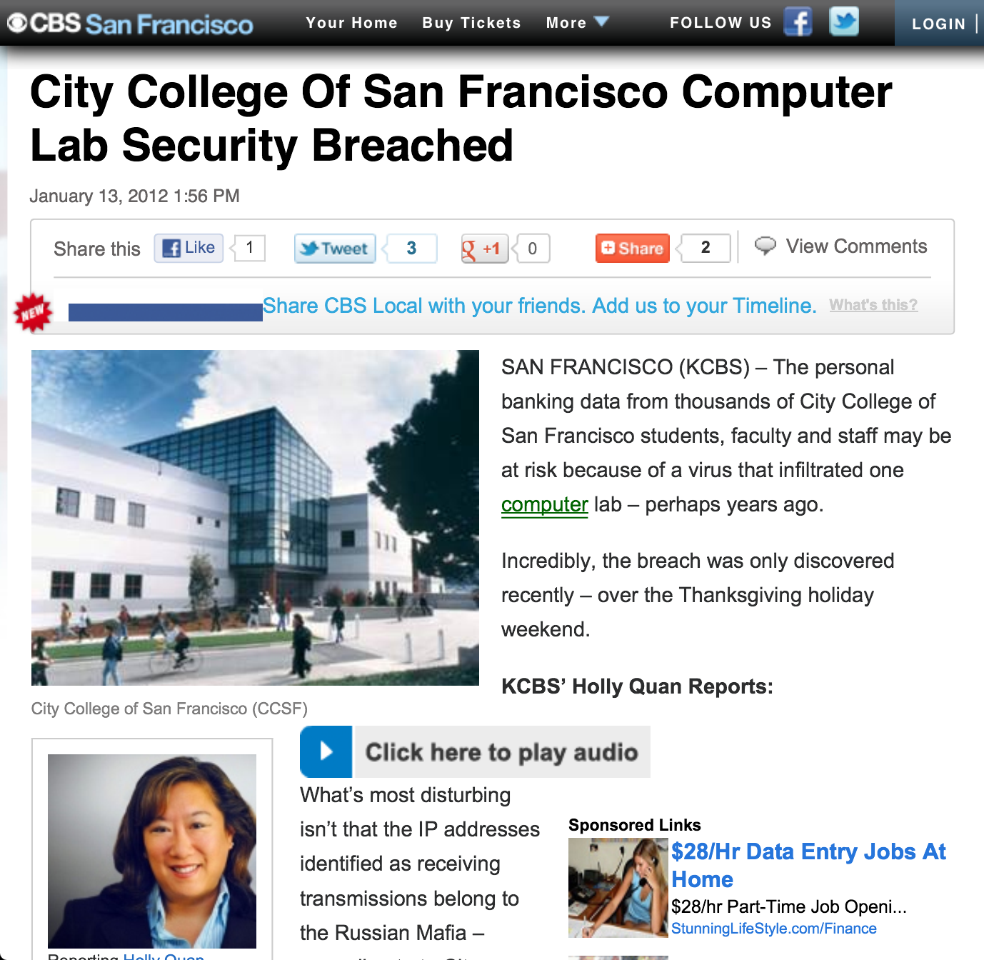
CBS

Slide 6
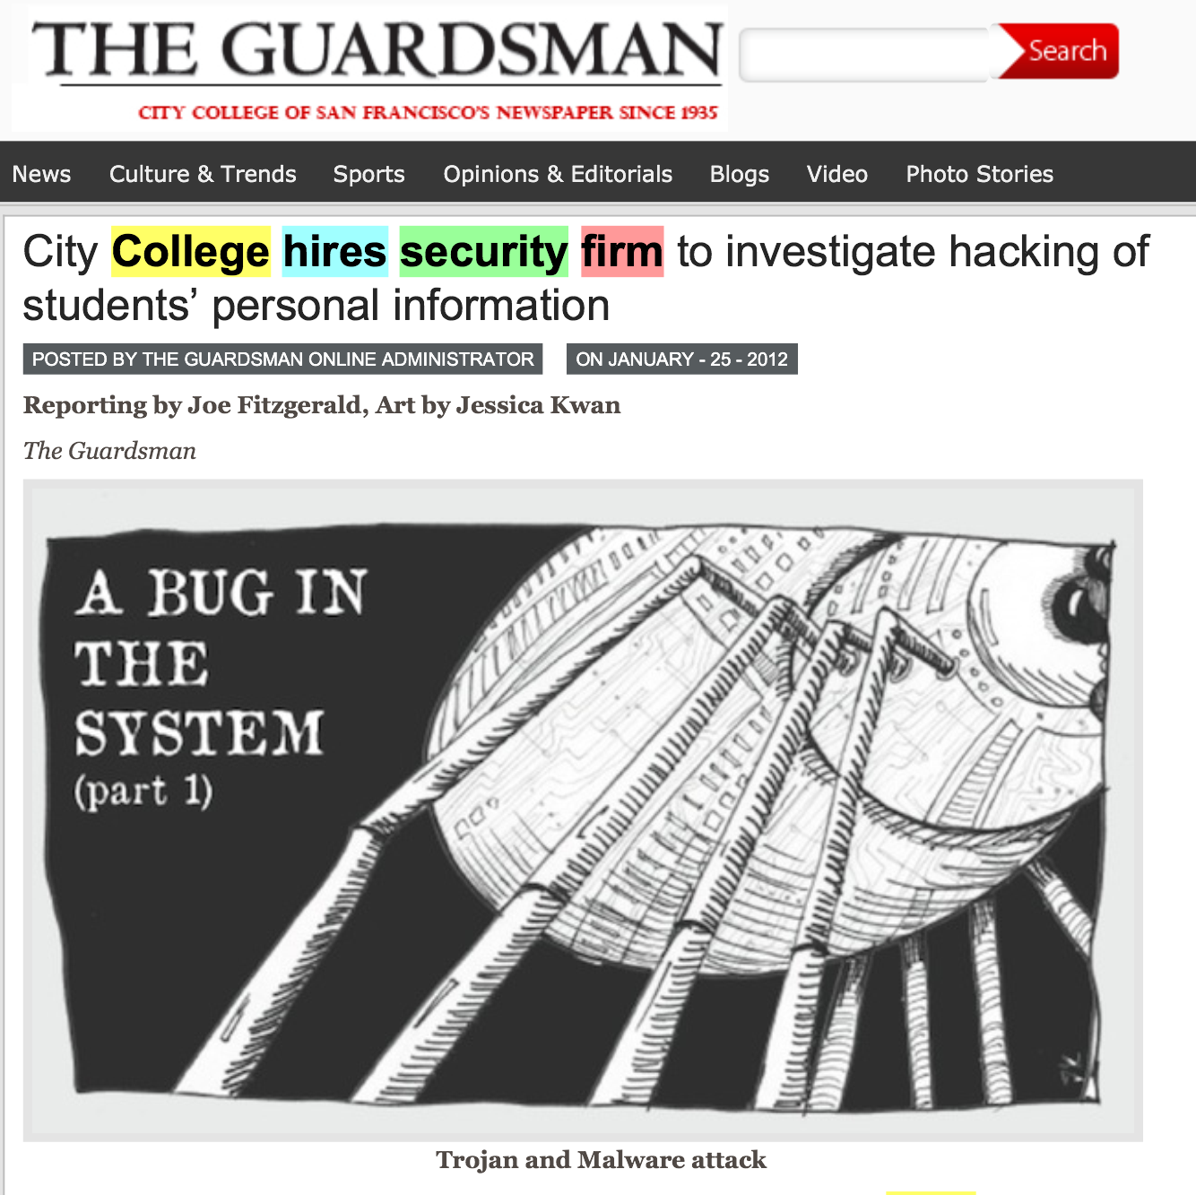
CCSF Guardsman

Slide 7
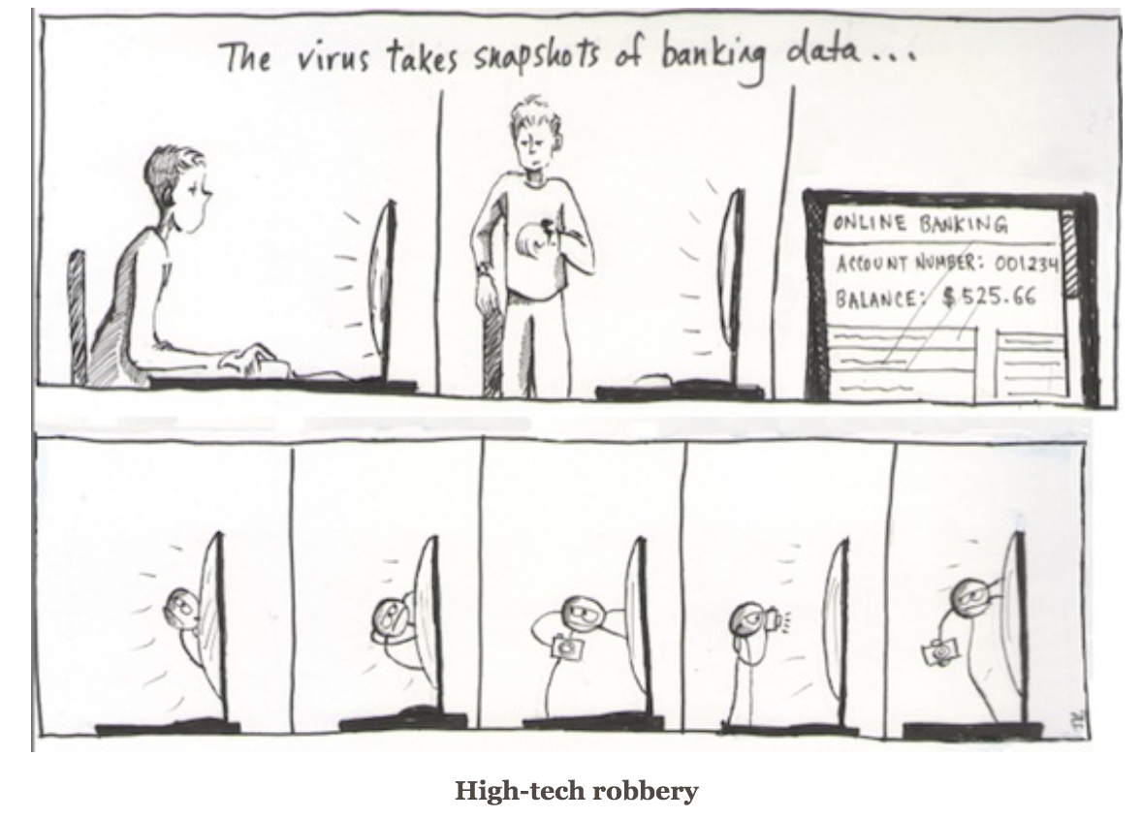
CCSF Guardsman

Slide 8
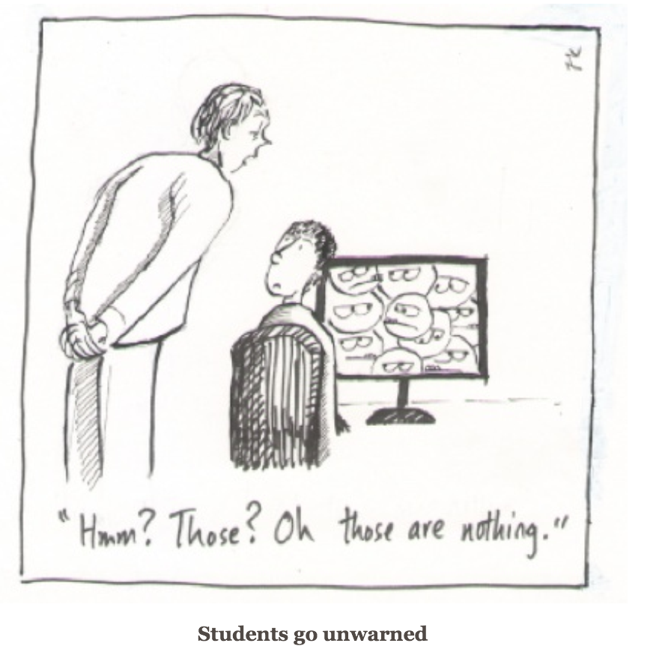
CCSF Guardsman

Slide 9
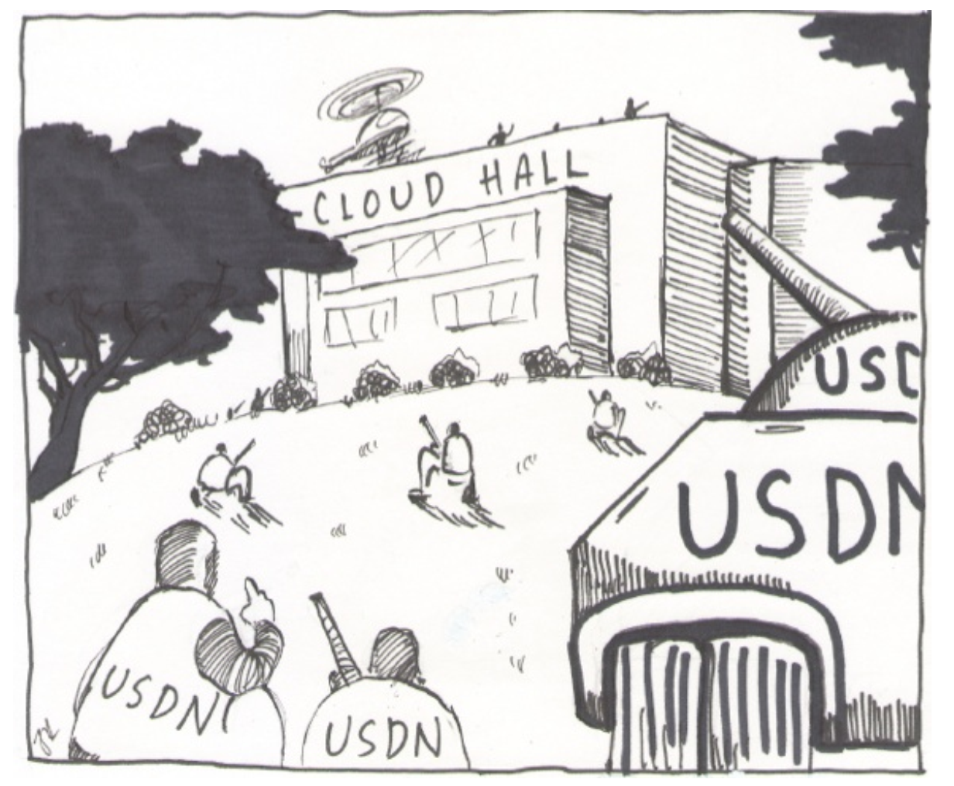
CCSF Guardsman

Slide 10
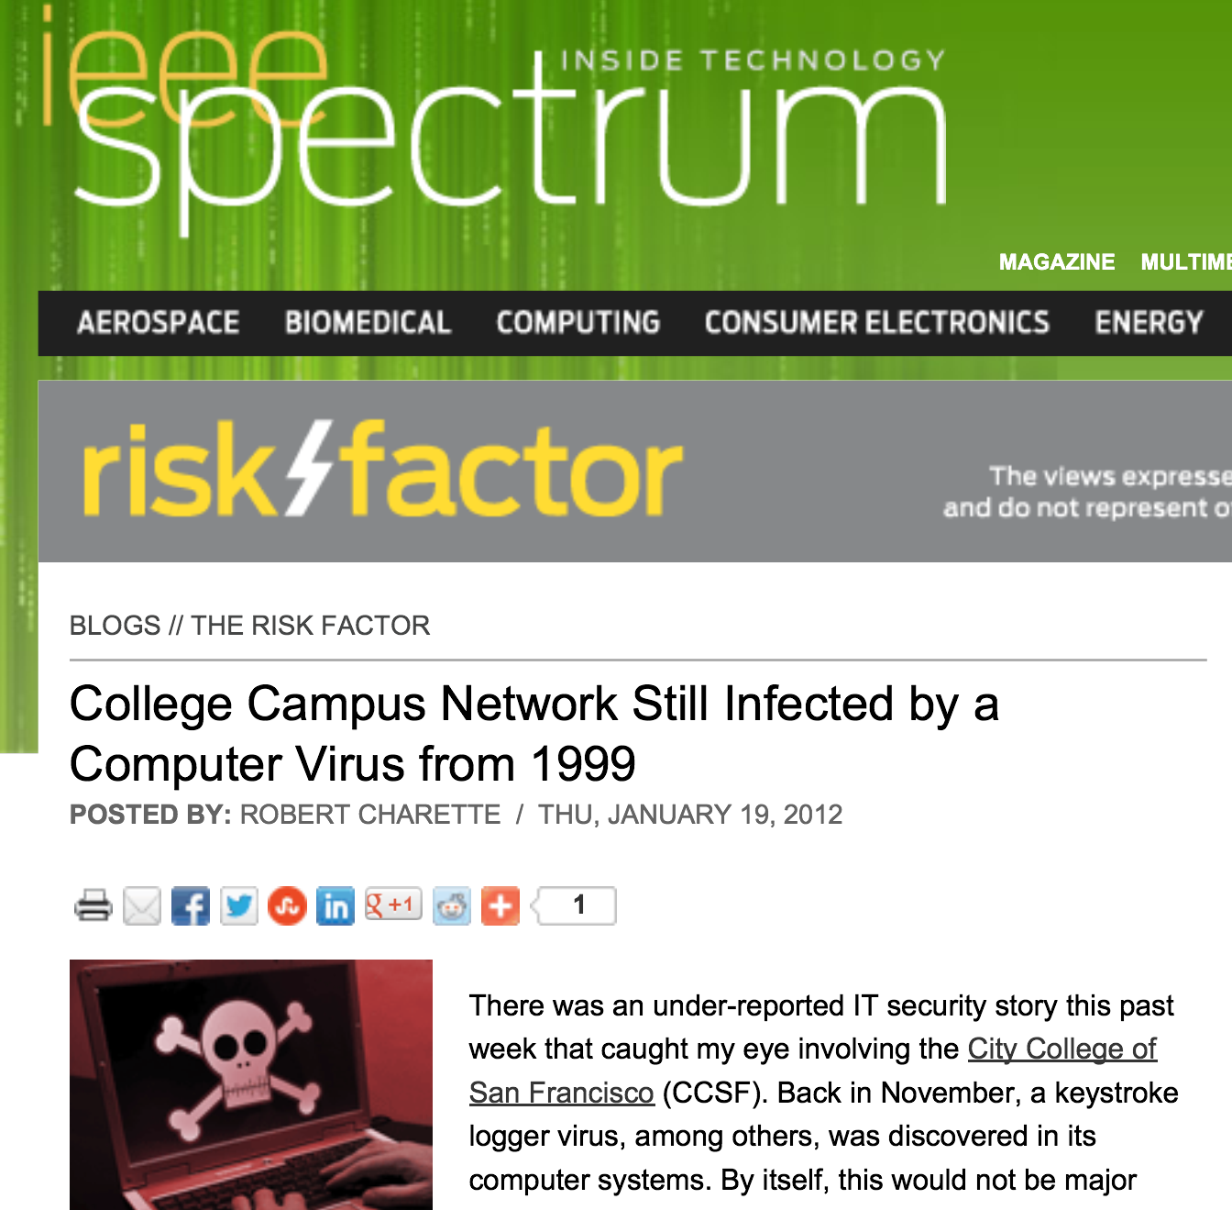
IEEE Spectrum

Slide 11
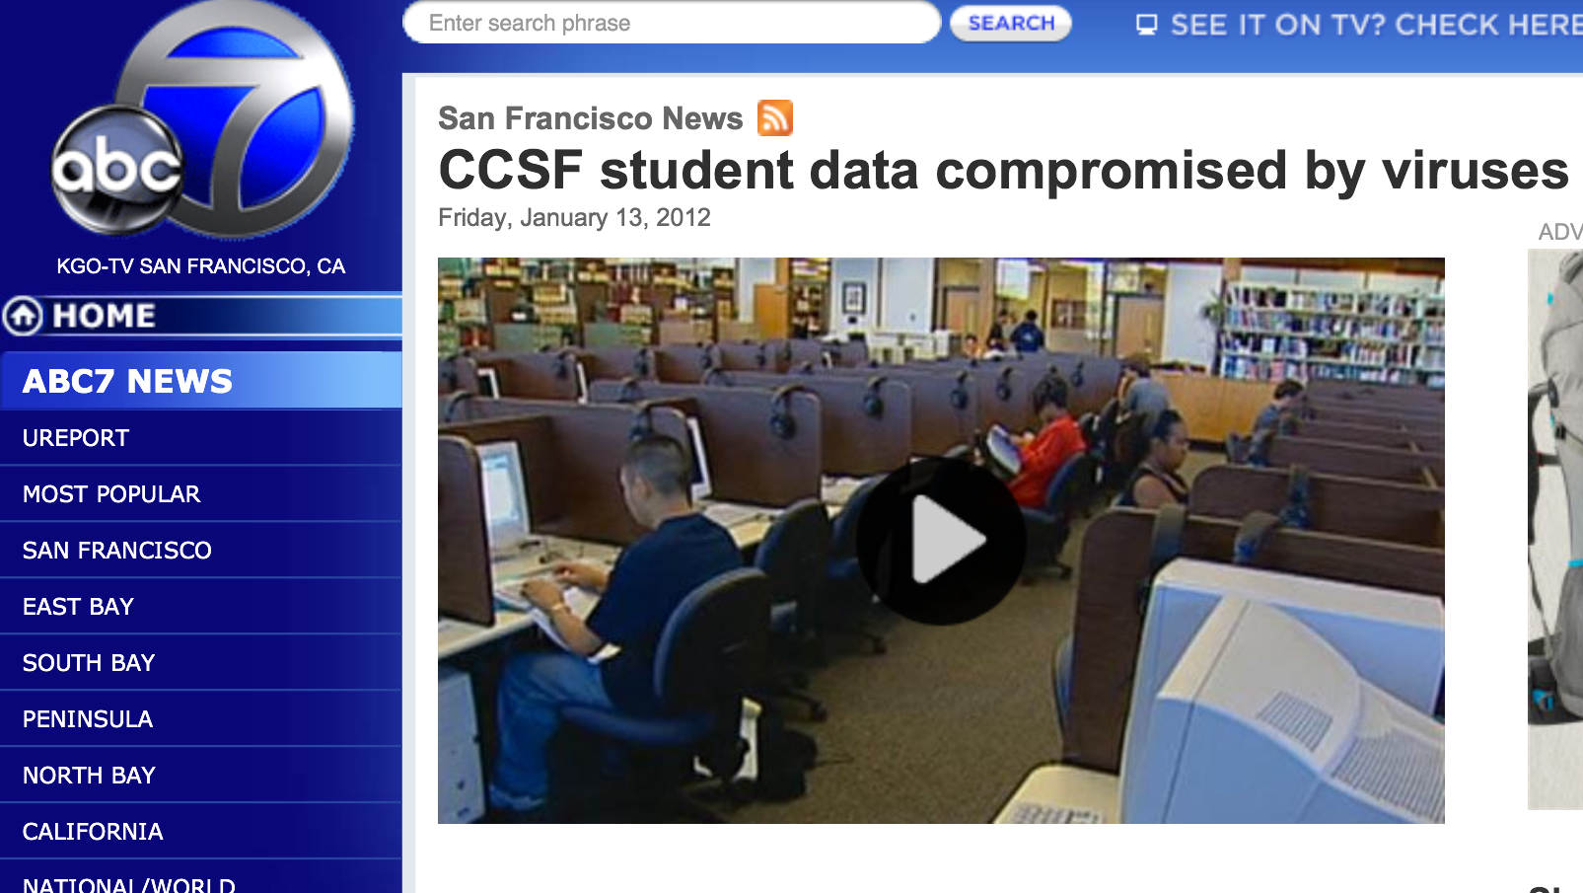
ABC TV

Slide 12
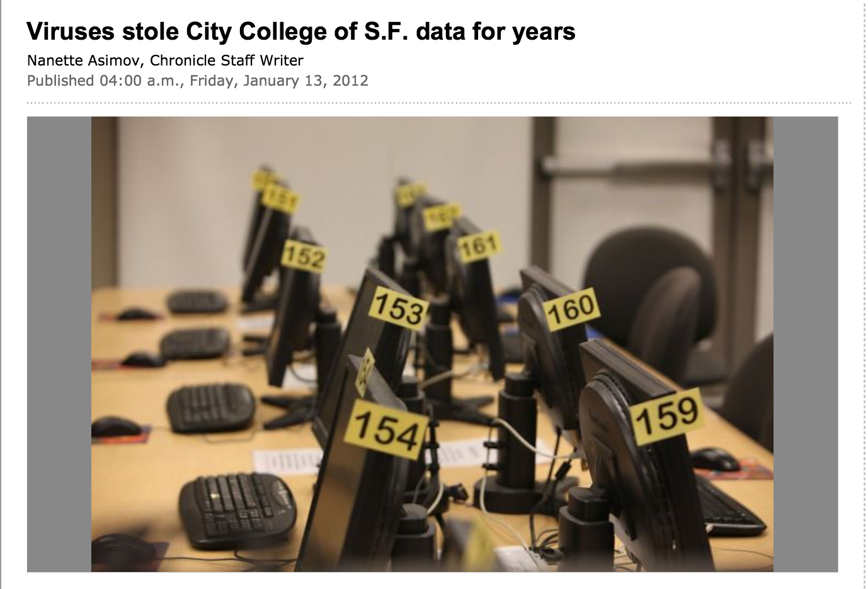
San Francisco Chronicle

Slide 13
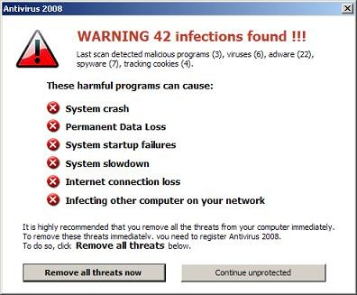
You are a manager, and a contractor says you have a scary virus infection. Who do you call immediately?
Upper management
Your IT Staff
Tell no one, keep it a secret
The FBI
The San Francisco Chronicle

Slide 14
Threats
Outside attacks
Insider threat
Deluded Insider threat

Slide 15
IT Management Flow Chart
Chancellor & Vice-Chancellor
Board of Trustees
CTO
IT Staff, Faculty, Students

Slide 16
IT Management Flow Chart
SF Chronicle
CTO & Outside Contractor
Chancellor & Vice-Chancellor
FBI
IT Staff, Faculty, Students

Slide 17
Security at CCSF
Two generations of complete hardware replacement in the last ten years
McAfee Enterprise antivirus
Deep Freeze
Palo Alto layer 7 firewall

Slide 18
Security Audits
There was a security audit and remediation process performed in 2007-2008 by a contractor
I did another security audit in 2010 with my CISSP students
  No major problems found

Slide 19
Evidence for these "Viruses"
A report was supposedly prepared by USDN in Nov 2011, but we were never able to get a copy of it at all
We finally got a partial report on Jan. 31, lacking the appendices that were the evidence
  "Proprietary and Confidential" but later published in the newspaper

Slide 20
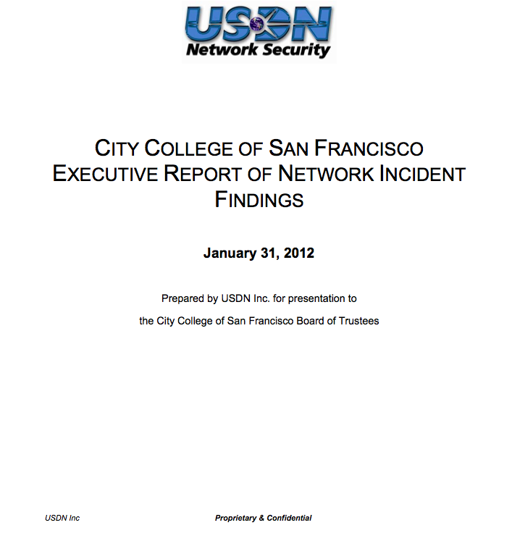
"Confidential" Report in Newspaper

Slide 21
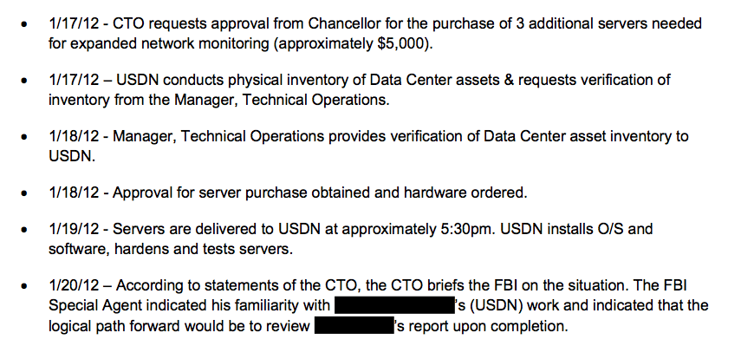
AlienVault Servers

Slide 22
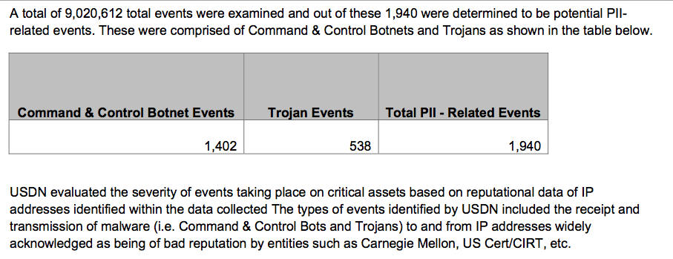
PII – Related Events

Slide 23
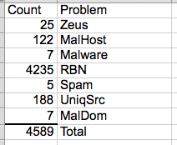
The List
On April 3, we finally got a list of the "infected machines"
Direct inspection of samples showed no real infections

Slide 24
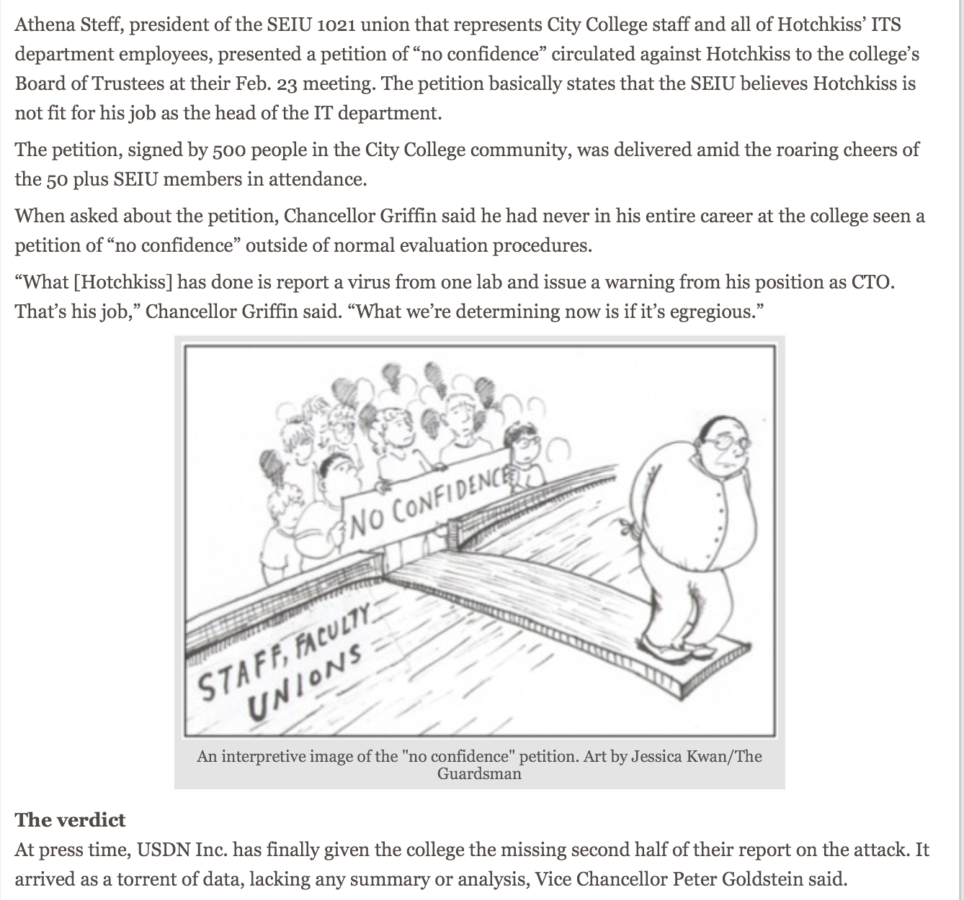
Petitions

Slide 25
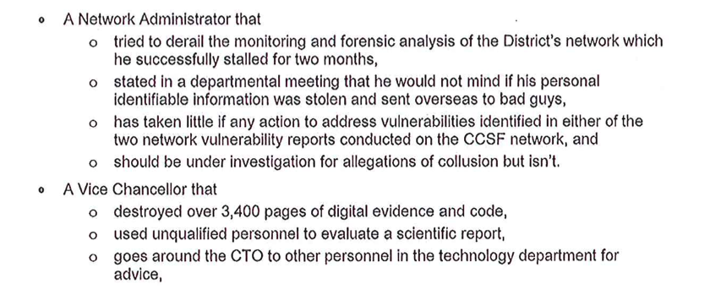
Letter to Trustees & Published in Newspaper

Slide 26
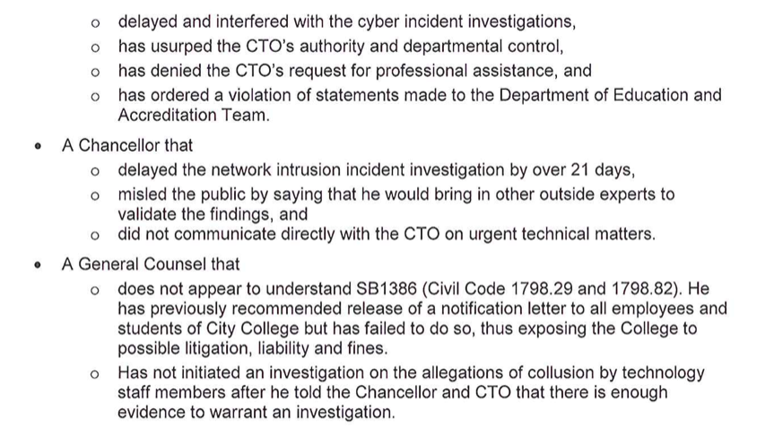
Letter to Trustees & Published in Newspaper

Slide 27
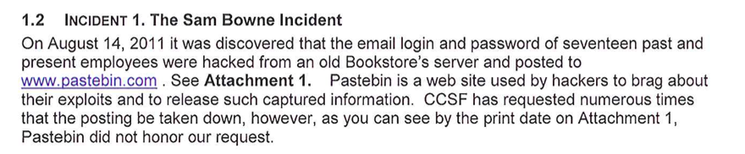

Letter to Trustees & Published in Newspaper

Slide 28
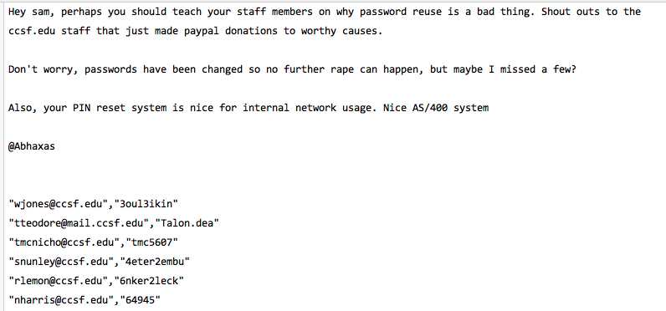
Proven False at the Time

Slide 29
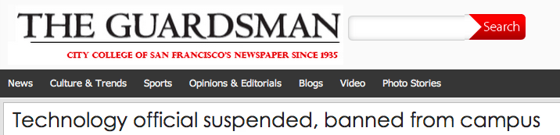
Removed by CCSF Police

Slide 30
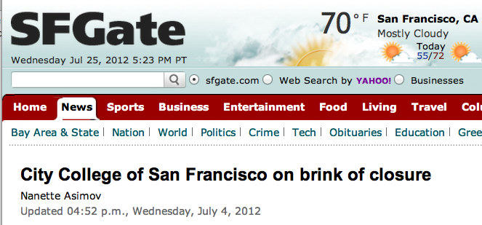
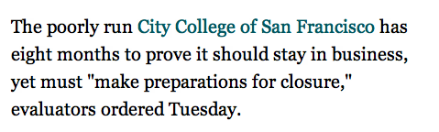
The Real Threat to CCSF

Slide 31
How Common are Insider Attacks?

Slide 32
My Case History
Four serious attacks so far to stop my teaching
  Gregory Evans – False accusations of racism and cyber-bullying
  Abhaxas – DoS attack and falsified password theft
  CTO of CCSF – False accusations of causing a breach and concealing viruses
  Jericho of Attrition.org – Baseless Ethics Complaint to (ISC)^2
3/4 are respected industry professionals – "Insiders"

Slide 33
In your experience, how many serious security incidents were caused by insiders?
All of them
Most of them
Some of them
Few
None

