Slide 1
I Own Your Web App
Oct 10, 2014

Slide 2
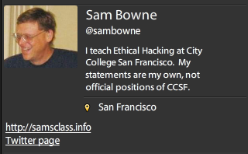

Slide 3
OWASP

Slide 4
OWASP.org
Security tips, tools, and coding guidance for Web applications

Slide 5
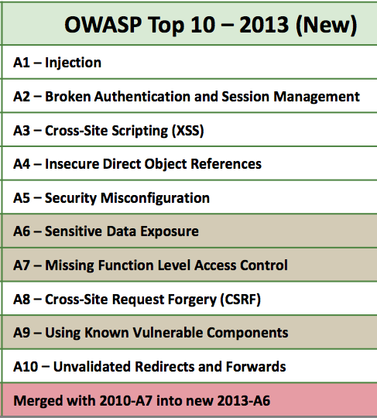
`

Slide 6
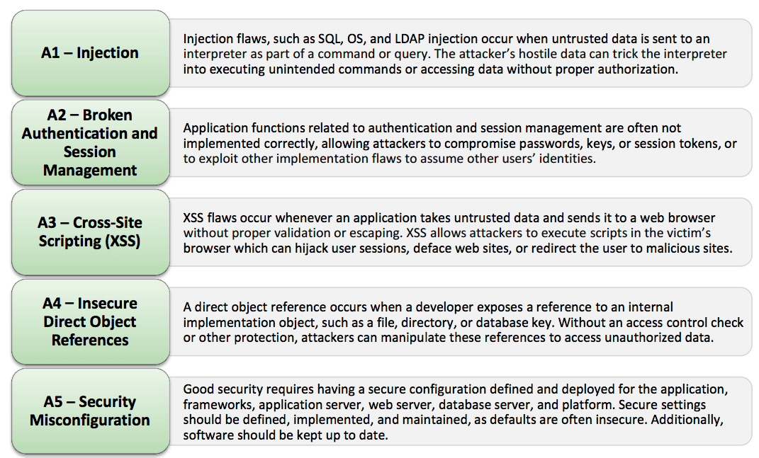

Slide 7
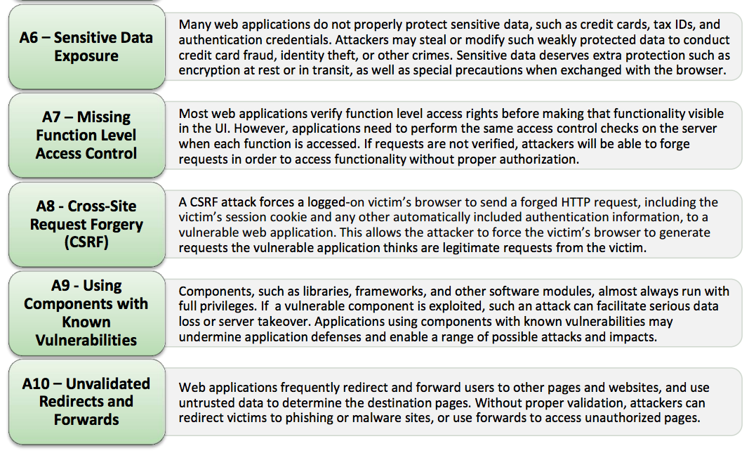

Slide 8
Cross-Site Request Forgery

Slide 9
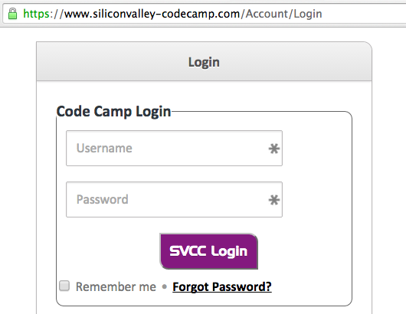
Login Secured with HTTPS

Slide 10
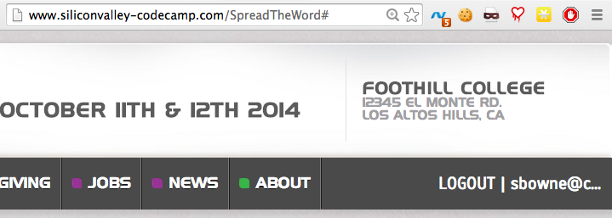
Authenticated Traffic Not Encrypted

Slide 11
Authentication Cookie

Slide 12
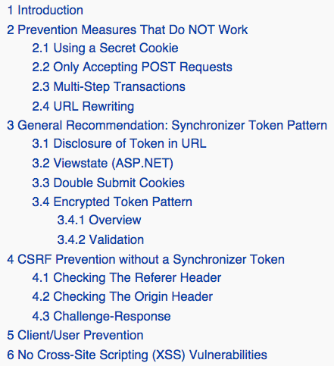

Slide 13
Blanket Solution: HTTPS
Use HTTPS for all transactions
But that might be
Expensive
Complicated
Slow

Slide 15
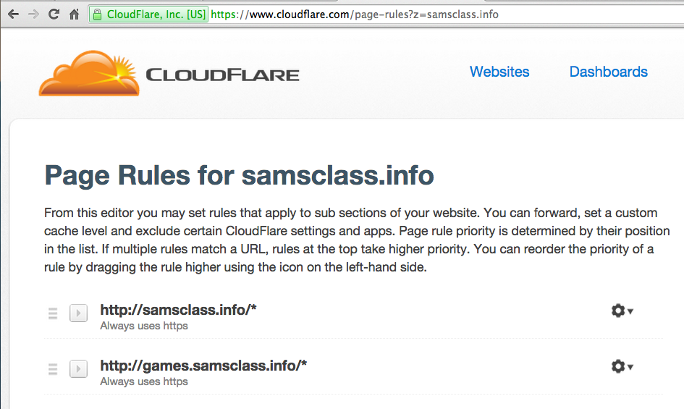

Slide 16
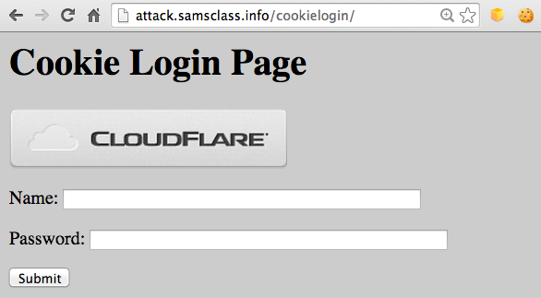
CSRF Demo

Slide 17
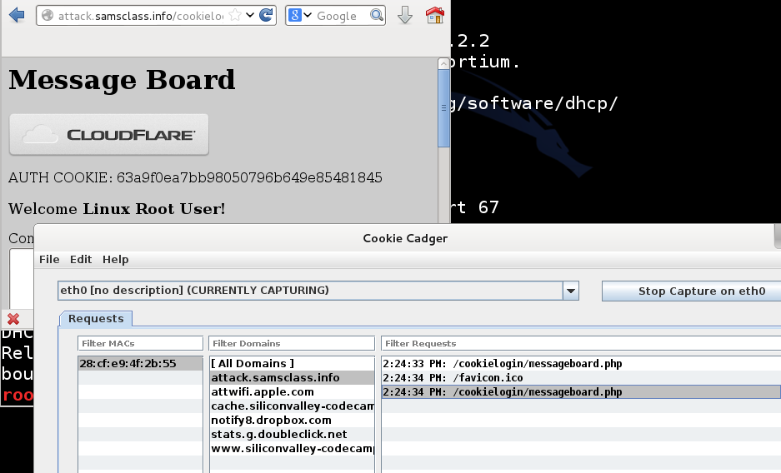
Cookie Cadger

Slide 18
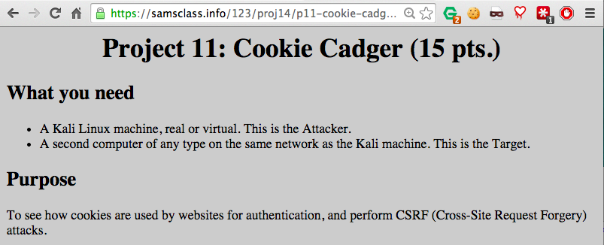
Homework Project

Slide 19
Vulnerable Sites
Amazon.com
AOL.com
siliconvalley-codecamp.com

Slide 20
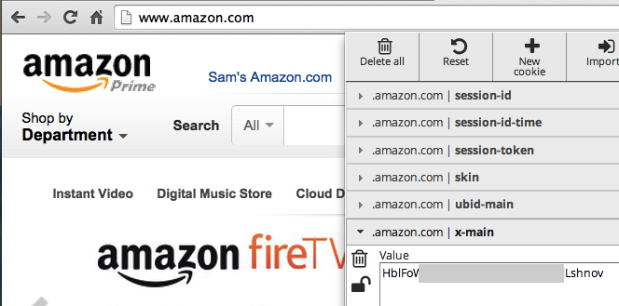
Amazon Sends Authentication Token Unencrypted

Slide 21
HTTPS-Only Sites
Google and Gmail
Live.com (Microsoft)
Yahoo.com
Paypal.com

Slide 22
Partially Vulnerable Sites
Tigerdirect.com
Wordpress.com

Slide 23
SQL Injection

Slide 24
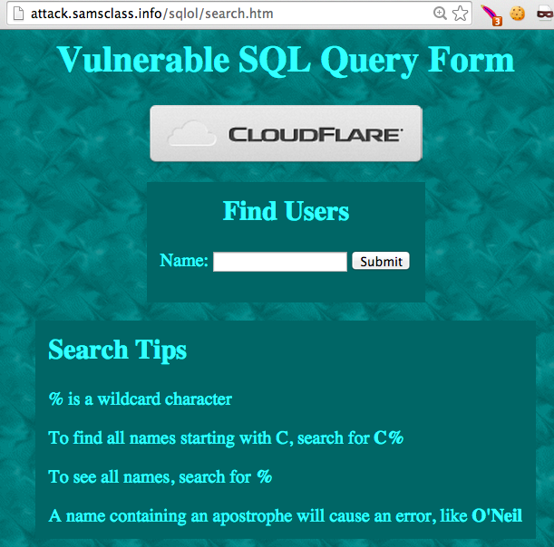

Slide 25
SQL Injection
Vulnerability caused by using input from the user which can be misinterpreted as active code
Weak defense: filter out special characters
Strong defense: parameterized queries

Slide 26
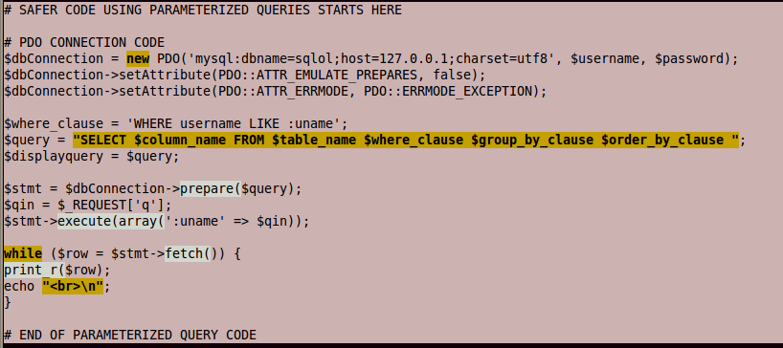

Slide 27
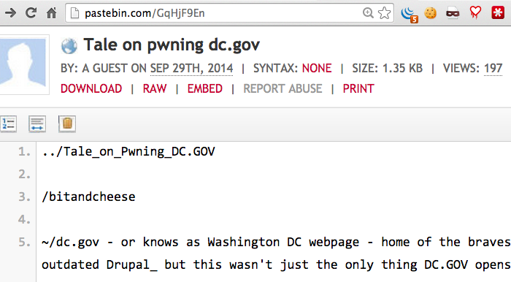
SQLi on Pastebin

Slide 28
URL for Live Demo
http://app.ocp.dc.gov/RUI/information/awards/detail.asp?award_id=4279%27%20AND%20999=991%20AND%20%27AEEs%27=%27AEEs

Slide 30
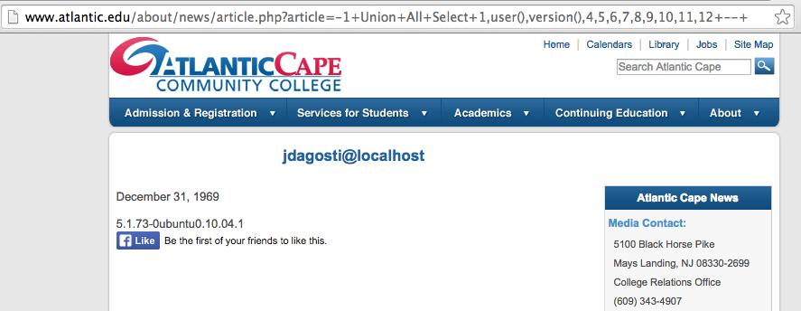
Extracting Data
No apostrophe required

Slide 31
Pharma Infections at Colleges

Slide 32
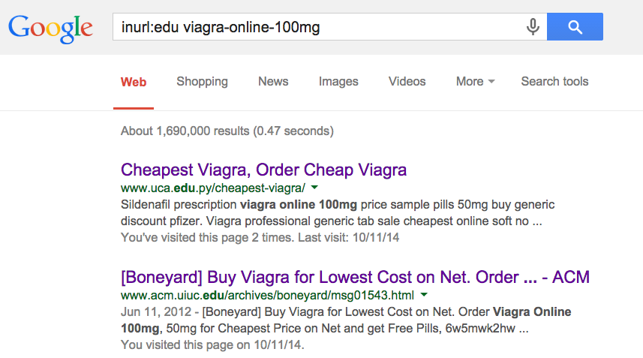

Slide 33
19 Colleges Infected with Pharma
5 Fixed within a few weeks
7 Fixed within 8 months
7 Still Infected on 7-19-14
http://samsclass.info/125/proj11/subtle-infect.htm#19more

Slide 34
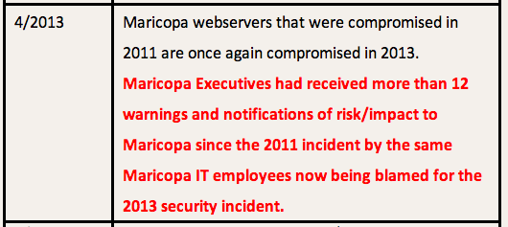

Slide 35
Infections at UC Santa Cruz

Slide 36
UCSC cleaned their server
Re-infected a week later
NEED ROOT CAUSE ANALYSIS

Slide 37
Many More Pharma Infections
Dozens of other schools, businesses, foreign sites, etc.
http://samsclass.info/125/proj11/subtle-infect.htm#19more

Slide 38
Exposed Data

Slide 39
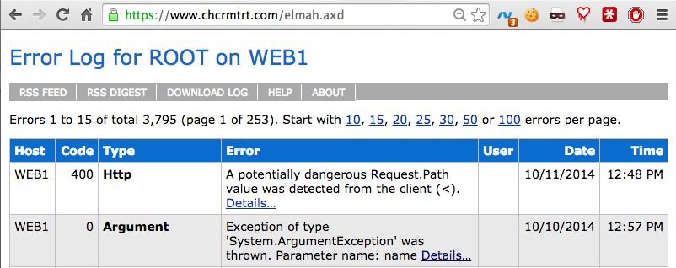
Exposed Error Logs
Can leak cookies
Even when secured by HTTPS

Slide 40
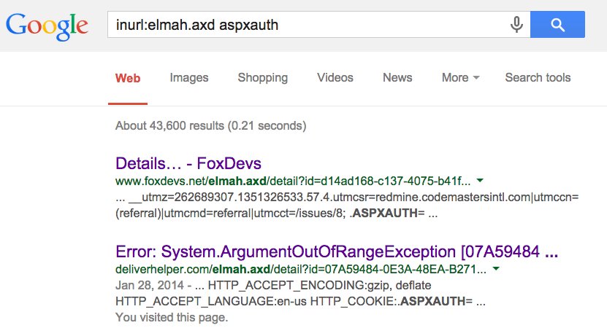
Google Dork for Exposed ELMAH Pages

Slide 41
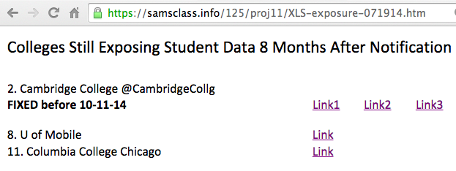
Exposed Student Data

Slide 42
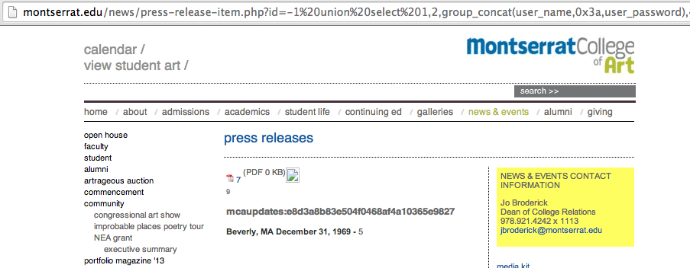
Exposed Password Hash

Slide 43
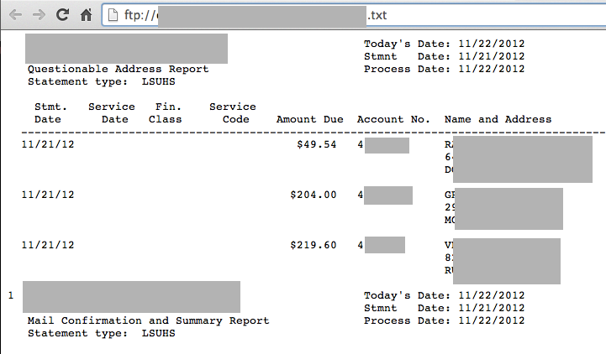
Open FTP Server with Medical Data

Slide 44
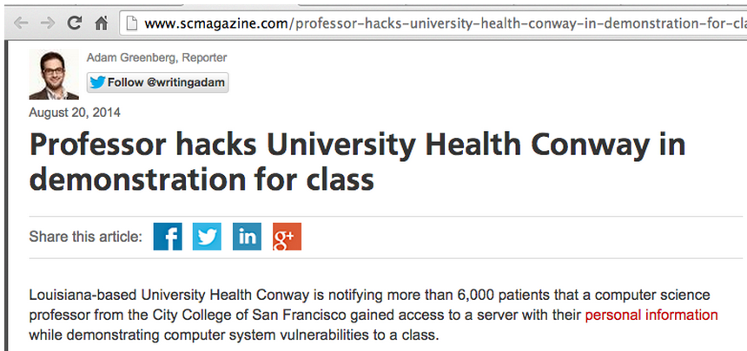
Libel by SC Magazine

Slide 45
Plaintext Login Pages at Colleges

Slide 46
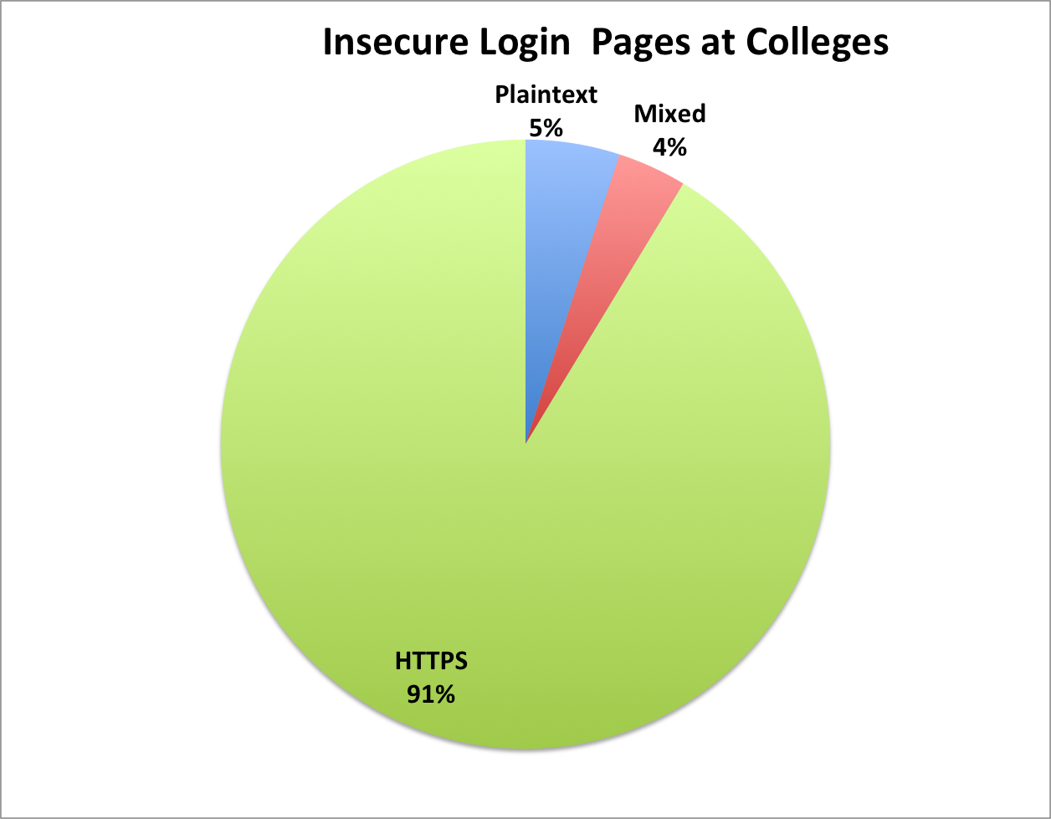
Insecure Login Pages at Colleges
90 colleges notified in Dec, 2013

Slide 47
Big Names
Cornell
Johns Hopkins
Stanford
UC Berkeley

Slide 48
Results
7 months after notification:
16/57 plaintext login pages fixed or improved (28%)
8/33 mixed login pages fixed or improved (24%)

Slide 49
Other Problems

Slide 50
ActiveMQ
Free open-source middleware from Apache
A Defcon talk said it was often insecure, so I looked on SHODAN to see

Slide 51
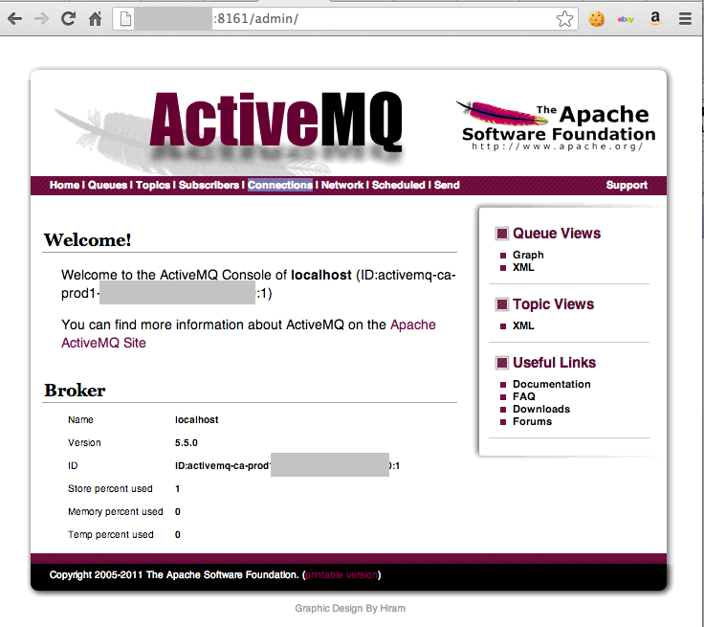

Slide 52
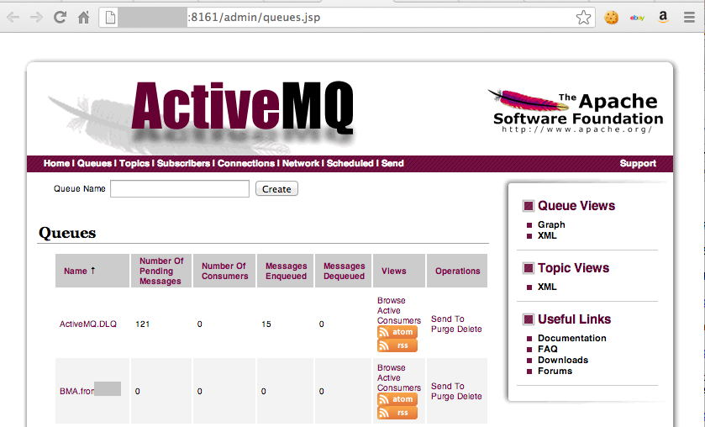

Slide 53
Real Check Data?

Slide 54
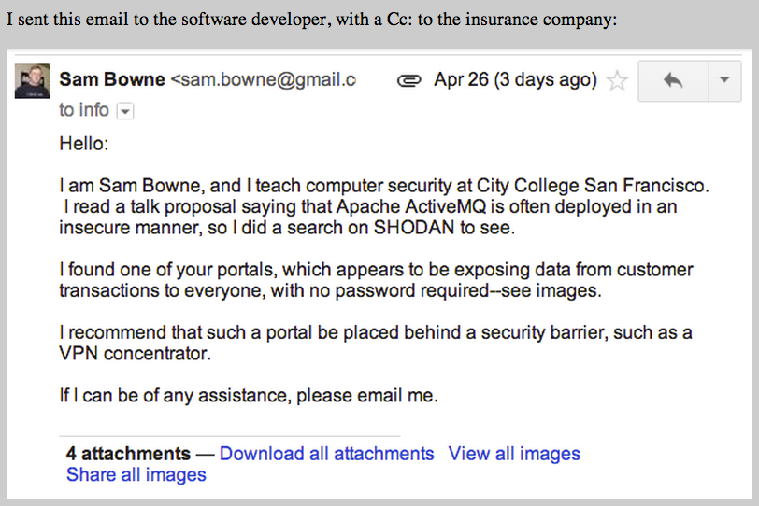

Slide 55
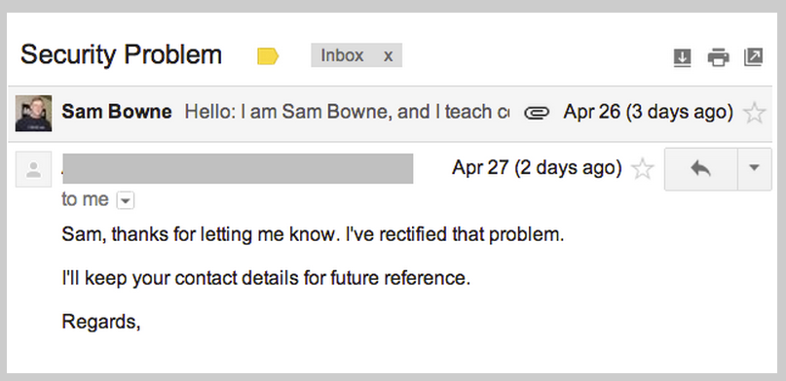

Slide 56
Wordpress Bots

Slide 57
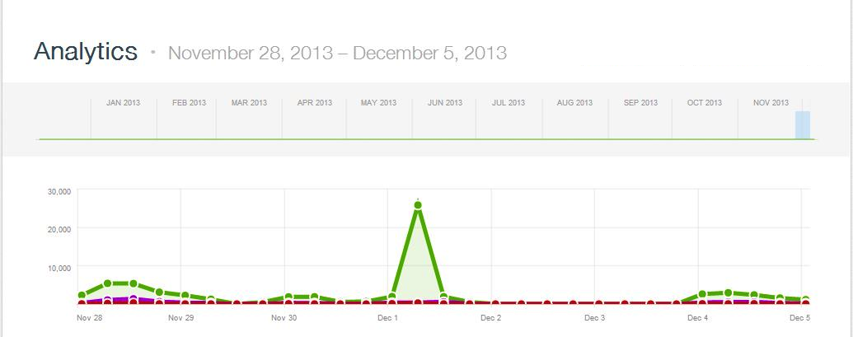
>2000 WordPress Bots
Thanks to Steven Veldkamp

Slide 58
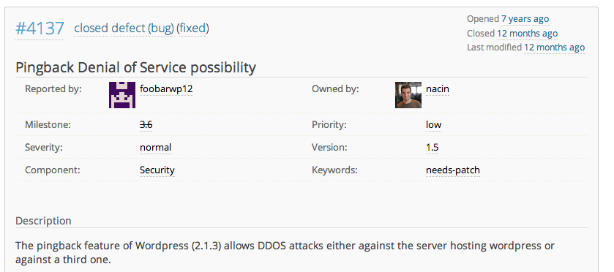
WordPress Has Known for 7 Years

Slide 59
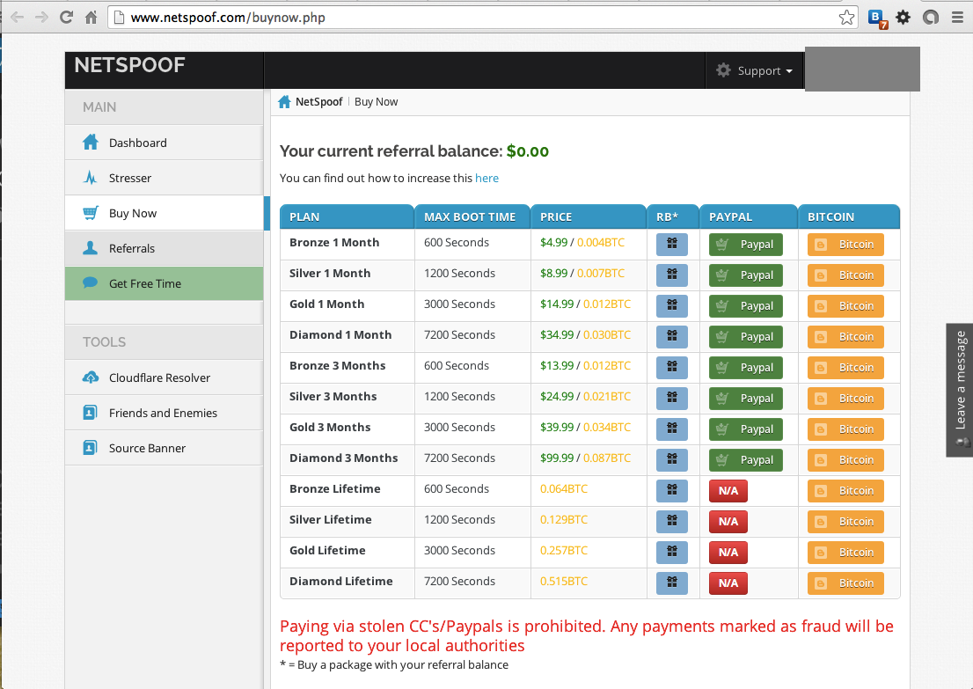

Slide 61
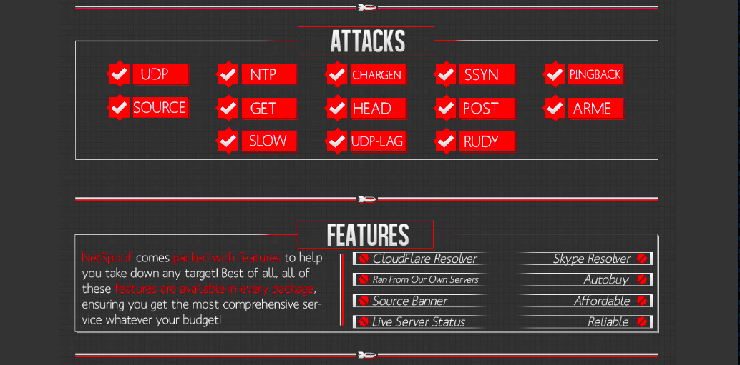

Slide 62
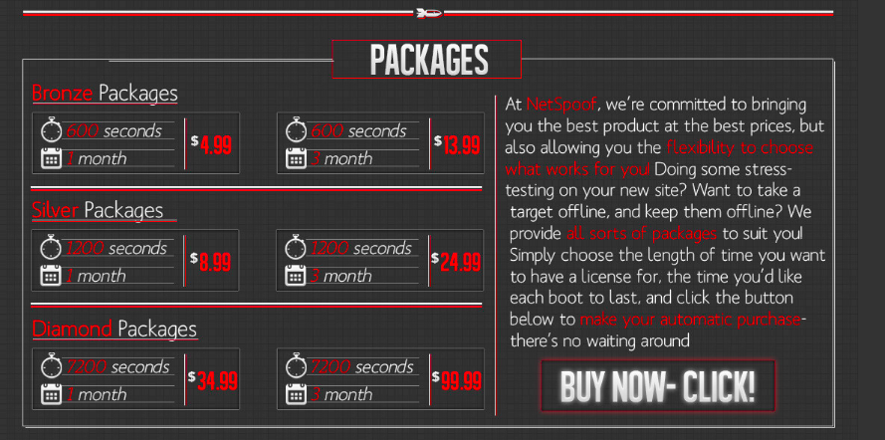

Slide 63
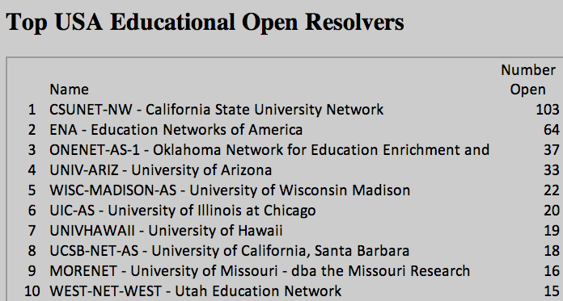
Open DNS Resolvers at Colleges

Slide 64
Results
Seven months after notification
38% decrease in open resolvers, from a total of 682 to 421

Slide 65
Old Wordpress Version
Wall Street Journal
Wordpress version from 2012
Ty Ryan Satterfield (@I_am_ryan_S)

