Slide 1
Evil DoS Attacks and Strong Defenses
Sam Bowne and Matthew Prince
AND
Cookie Re-Use
DEF CON 21
Aug 2, 2013

Slide 2



Slide 3
SockStress

Slide 4


TCP Handshake & Flow Control
SYN
SYN / ACK
ACK
Client
Data
Server
Data
ACK

Slide 5
SockStress Attack
SYN
SYN / ACK
ACK Window=0
Client
Server

Slide 6
From 2008
Still not patched
Attacks TCP by sending a small WINDOW size
Causes sessions to hang up, consuming RAM
Does not work well on BackTrack/Kali
Requires Slackware, works best on v. 10
Can render servers unbootable

Slide 7
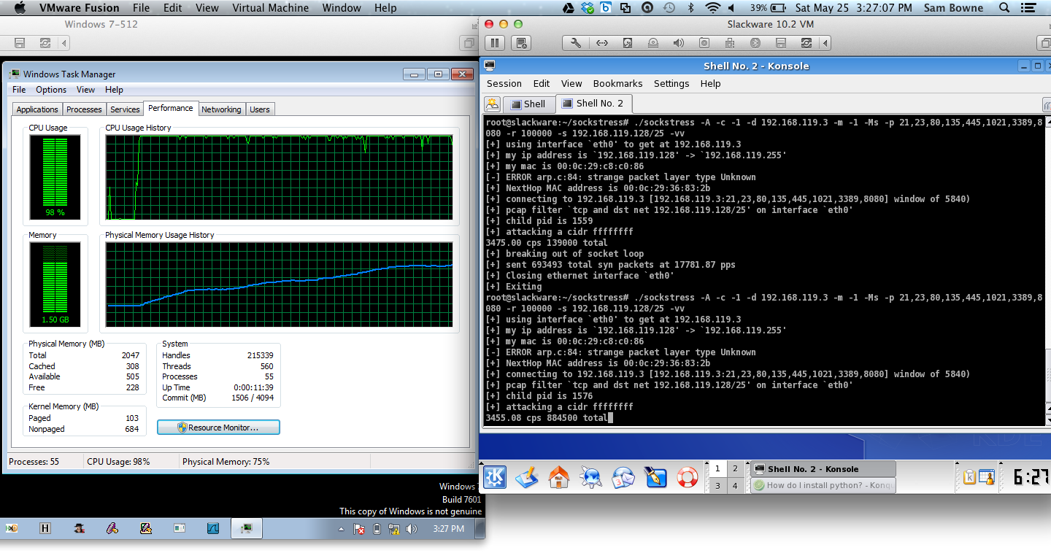
SockStress Demo

Slide 8
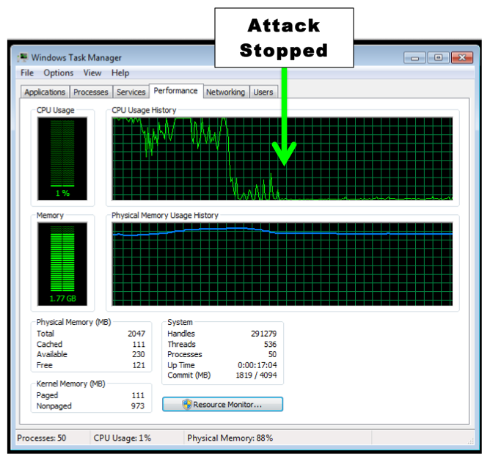

Slide 9
IPv4 Exhaustion

Slide 10
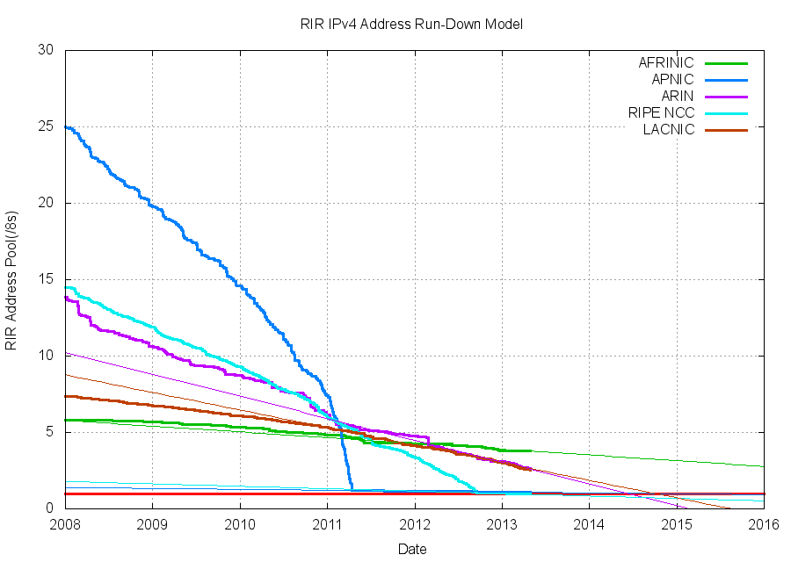
IPv4 Exhaustion

Slide 11
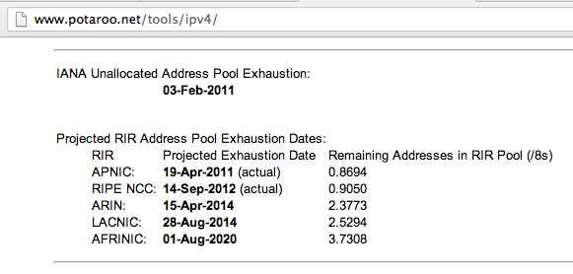
One Year Left

Slide 12
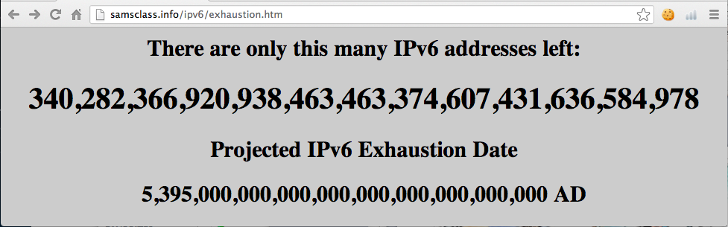
IPv6 Exhaustion

Slide 13
Link-Local DoS
IPv6 Router Advertisements

Slide 14

Old Attack (from 2011)

Slide 15
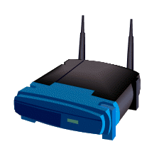
IPv4: DHCP
PULL process
Client requests an IP
Router provides one
I need an IP
Use this IP
Host
Router

Slide 16
IPv6: Router Advertisements
PUSH process
Router announces its presence
Every client on the LAN creates an address and joins the network
JOIN MY NETWORK
Yes, SIR
Host
Router

Slide 17
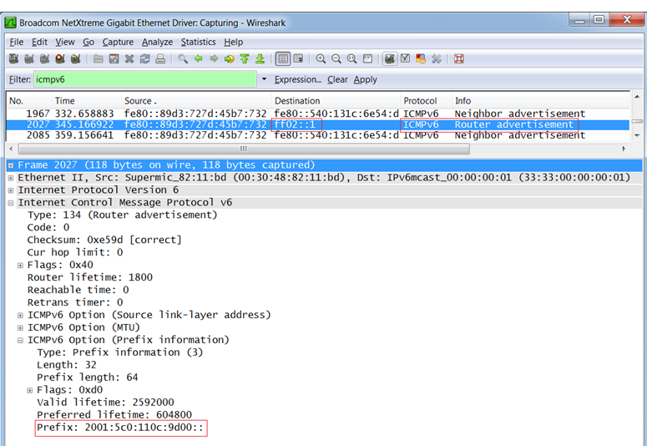
Router Advertisement Packet

Slide 18
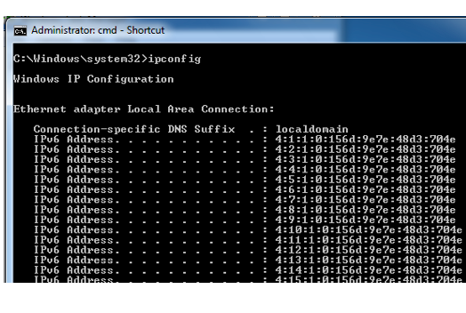
RA Flood (from 2011) flood_router6

Slide 19
Effects of flood_router6
Drives Windows to 100% CPU
Also affects FreeBSD
No effect on Mac OS X or Ubuntu Linux

Slide 20

The New RA Flood

Slide 21
MORE IS BETTER
Each RA now contains
  17 Route Information sections
  18 Prefix Information sections

Slide 22
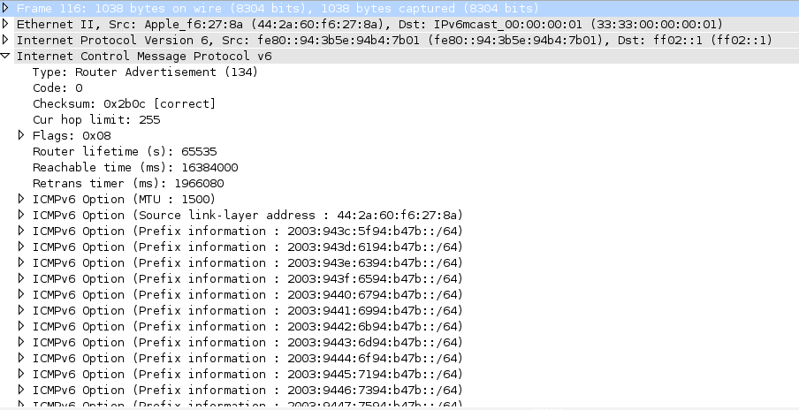

Slide 23
Flood Does Not Work Alone
Before the flood, you must send some normal RA packets
This puts Windows into a vulnerable state

Slide 24
How to Perform this Attack
For best results, use a gigabit Ethernet NIC on attacker and a gigabit switch
Use thc-ipv6 2.3 on Kali
Two Terminal windows:
  ./fake_router6 eth1 a::/64
  ./flood_router26 eth1
Windows dies within 30 seconds

Slide 25
Effects of New RA Flood
Win 8 & Server 2012 die (BSOD)
Microsoft Surface RT dies (BSOD)
Mac OS X dies
Win 7 & Server 2008 R2, with the "IPv6 Readiness Update" freeze during attack
iPad 3 slows and sometimes crashes
Android phone slows and sometimes crashes
Ubuntu Linux suffers no harm

Slide 26
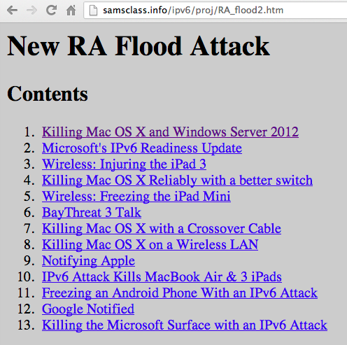
Videos and Details

Slide 27
Mitigation
Disable IPv6
Turn off Router Discovery with netsh
Use a firewall to block rogue RAs
Get a switch with RA Guard
Microsoft's "IPv6 Readiness Update" provides some protection for Win 7 & Server 2008 R2
  Released Nov. 13, 2012
  KB 2750841
  But NOT for Win 8 or Server 2012!!

Slide 28
DEMO

Slide 29
More Info
Slides, instructions for the attacks, and more at
Samsclass.info

Slide 30
Cookie Re-Use

Slide 31
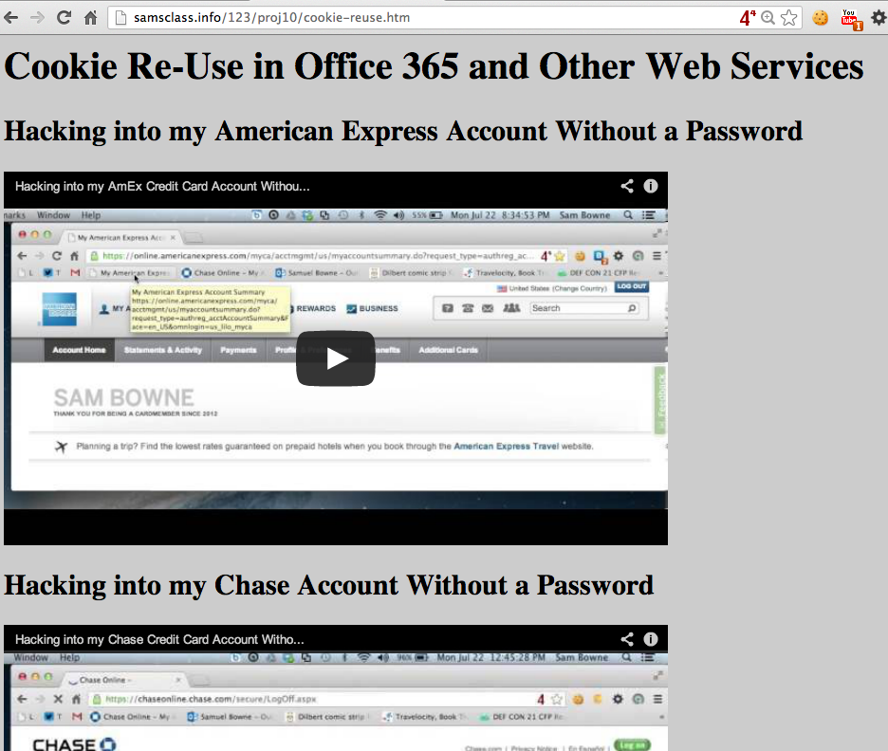

Slide 32
