Slide 1
SSD Data Evaporation
DEF CON 21
August 3, 2013

Slide 2
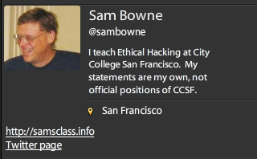
Bio

Slide 3
Data Remanence

Slide 4
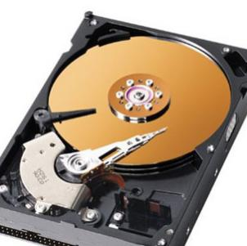
Deleted Data
On magnetic hard disks, data remains till it is overwritten
Image from www.howstuffworks.com

Slide 5
DEMO on Windows
Observing data on a magnetic hard disk after
  Moving to Recycle Bin
  Emptying Recycle Bin
  Formatting Drive (Quick)
  Formatting Drive (Slow)

Slide 6
Forensics & Data Recovery
We can recover deleted data
Find evidence of crimes
Even after a format
Very few criminals know enough to use encryption or forensic erasure

Slide 7
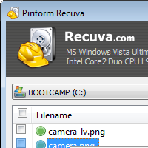

Useful Free Data Recovery Tools
Recuva for PC
Disk Drill for Mac

Slide 8

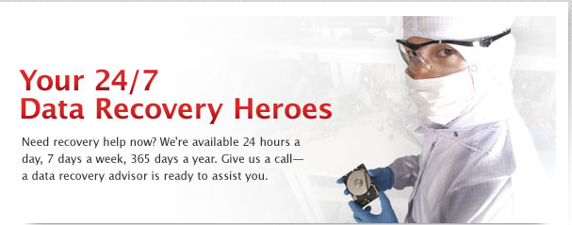

Slide 9
SSDs

Slide 10
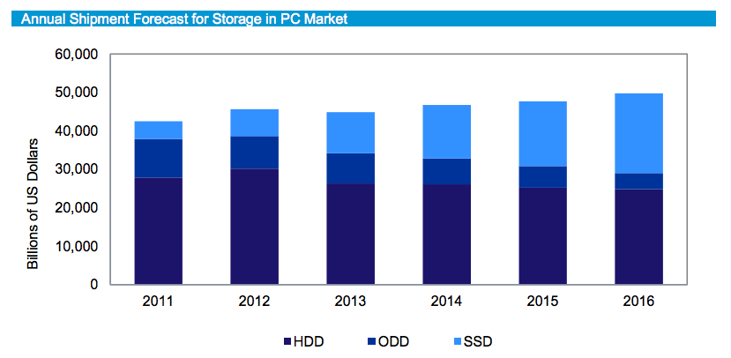
From http://www.isuppli.com/Abstract/P28276_20130322152341.pdf

Slide 11
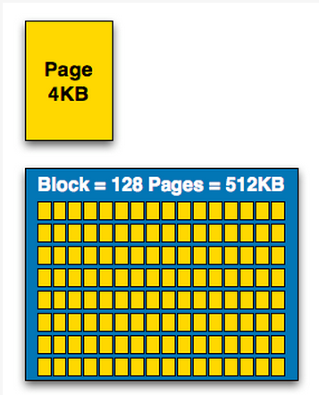
How SSDs Work
Data can be read and written one page at a time, but can only be erased a block at a time
Each erasure degrades the flash—it fails around 10,000 erasures
From http://www.anandtech.com/show/2738/5

Slide 12
Garbage Collection
SSD controller erases pages all by itself, when it knows they are empty
The TRIM command is sent to the SSD when a file is deleted
  But only if you use a the correct OS, Partition type, and BIOS settings
Yuri Gubanov calls this “Self-Corrosion” – I call it Data Evaporation

Slide 13
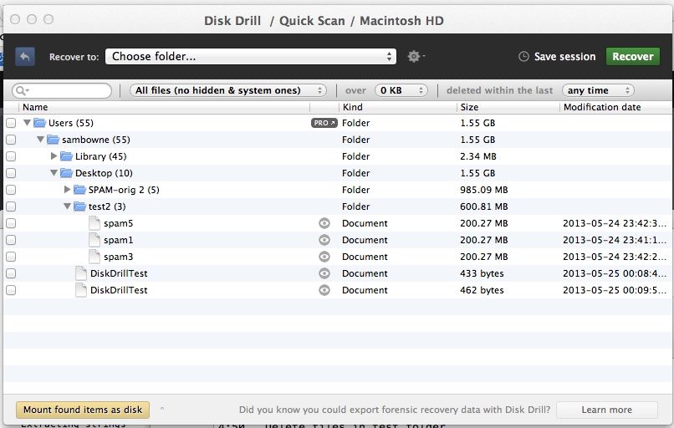
Demo on Mac: Disk Drill
Deleted files from desktop evaporate in 30-60 min

Slide 14
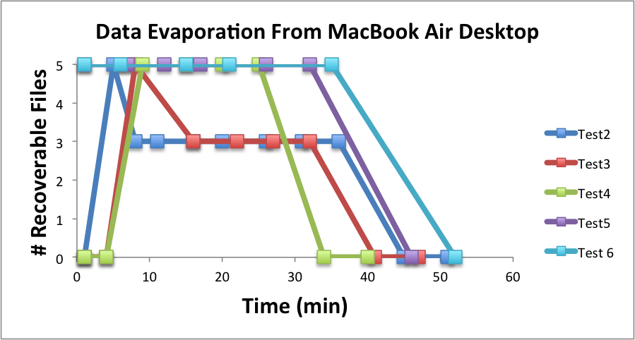

Slide 15
Demo on PC
Save data on an SSD
Watch it evaporate!
How to test TRIM
  fsutil behavior query DisableDeleteNotify
  Zero = TRIM enabled

Slide 16
When Does TRIM Work?
BIOS: Drive must be SATA in AHCI mode, not in IDE emulation mode
SSD must be new (Intel: 34 nm only)
Windows 7 or later
  NTFS volumes, not FAT
Mac OS X 10.6.8 or later
  Must be Apple-branded SSD

Slide 17
When Does TRIM Work?
External Drives must use SATA or SCSI, not USB
PCI-Express & RAID does not support TRIM
From http://forensic.belkasoft.com/en/why-ssd-destroy-court-evidence

Slide 18
Expert Witness Testimony

Slide 19
Experience
In court, an expert witness can state an opinion
Must be based on personal experience
  “I read it in a book” NO
  “A teacher said it in a class” NO
  “I know this because I tested it” YES
So forensic examiners do a lot of testing

Slide 20
Summary
SSDs retain deleted data sometimes
Other times they don’t
It depends on
  Manufacturer
  OS
  BIOS
  Interface
  Who knows what else

Slide 21
The evap Tool
For Mac OS X Only

Slide 22
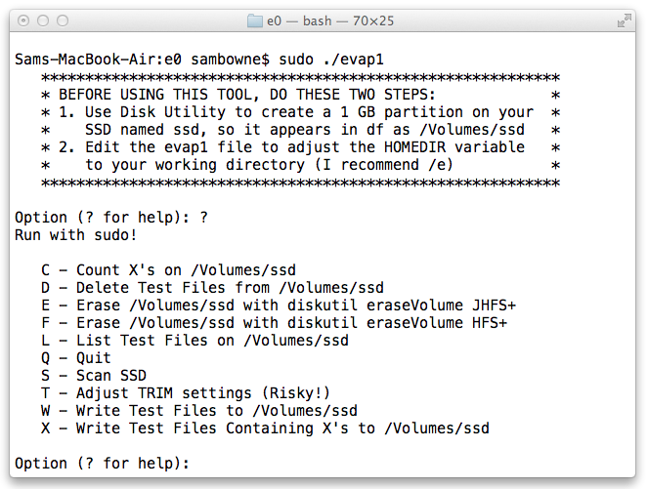
Intro

Slide 23
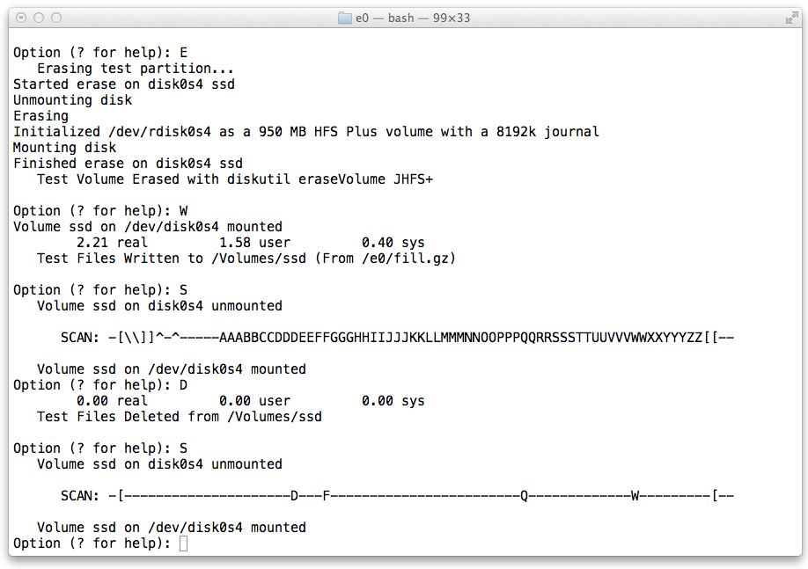
Evaporation on JHFS+

Slide 24
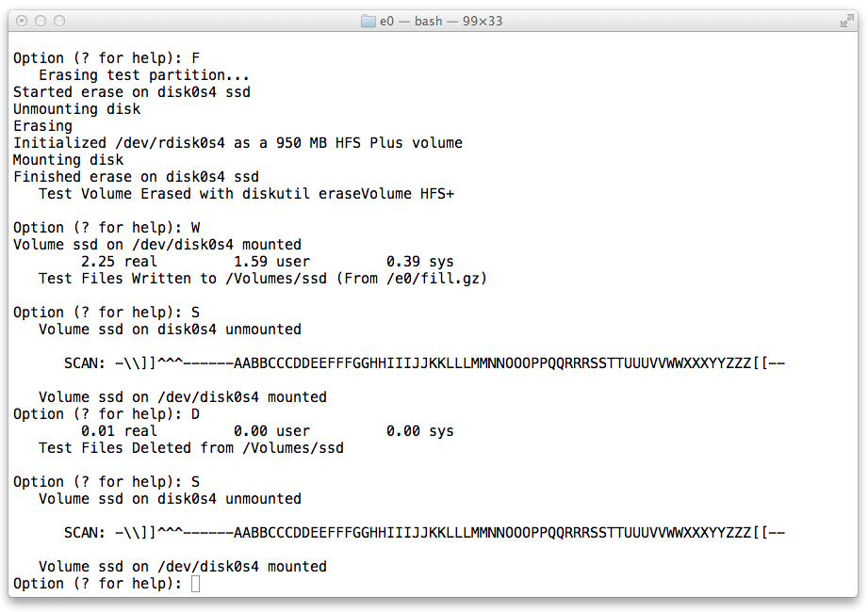
No Evaporation on HFS+

Slide 25
More Info
Slides, instructions for the attacks, & more at
Samsclass.info

