Slide 1
Two Scary DoS Attacks AND Hacking American Express and Chase Manhattan Accounts
HI-TEC
July 24, 2013

Slide 2
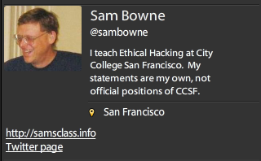
Bio

Slide 3
Cookie Re-Use

Slide 4
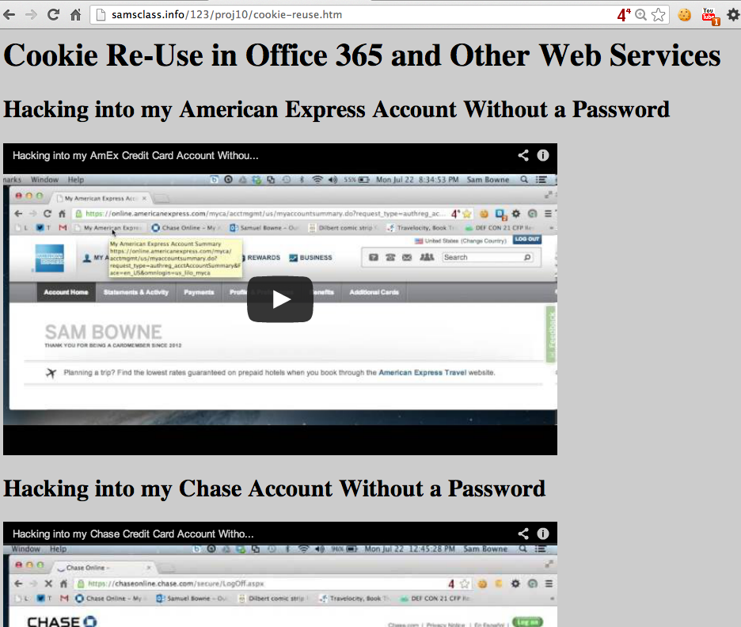

Slide 5
SockStress

Slide 6
From 2008
Still not patched
Attacks TCP by sending a small WINDOW size
Causes sessions to hang up, consuming RAM
Does not work on BackTrack/Kali
Requires Slackware, works best on v. 10
Can render servers unbootable

Slide 7
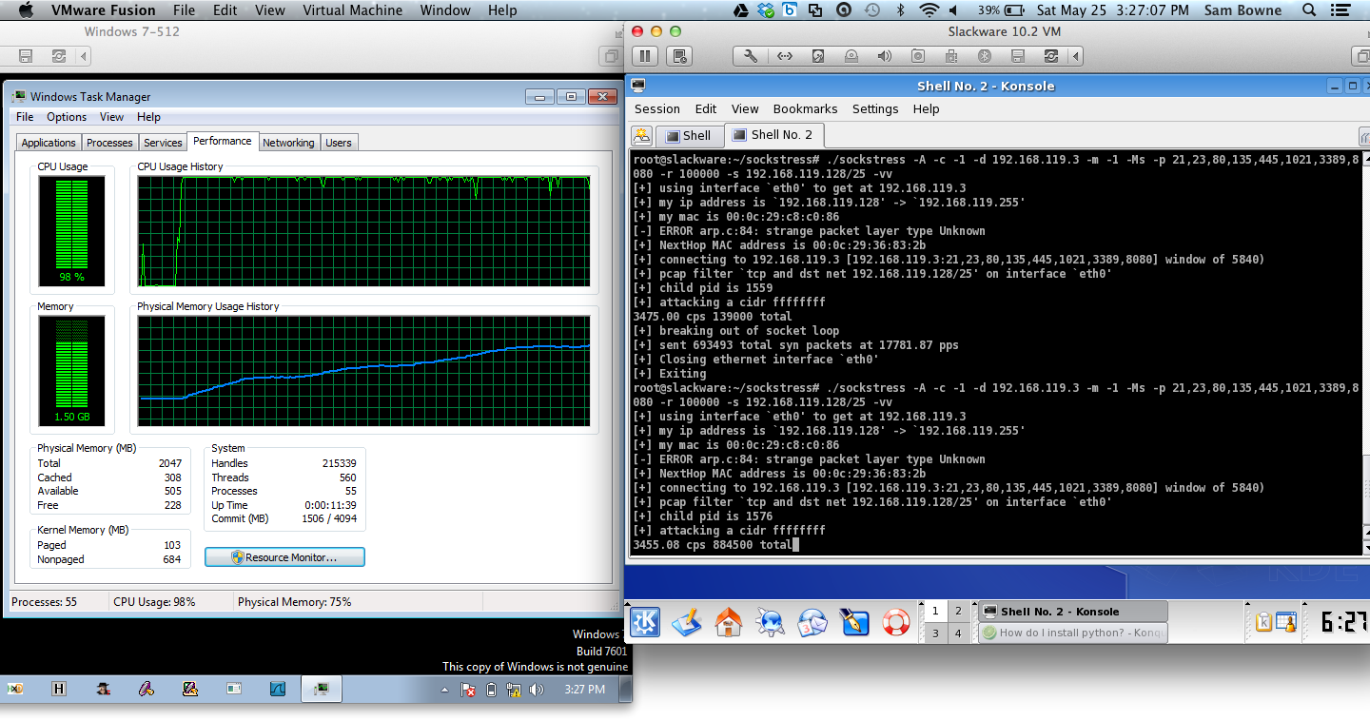
SockStress Demo

Slide 8
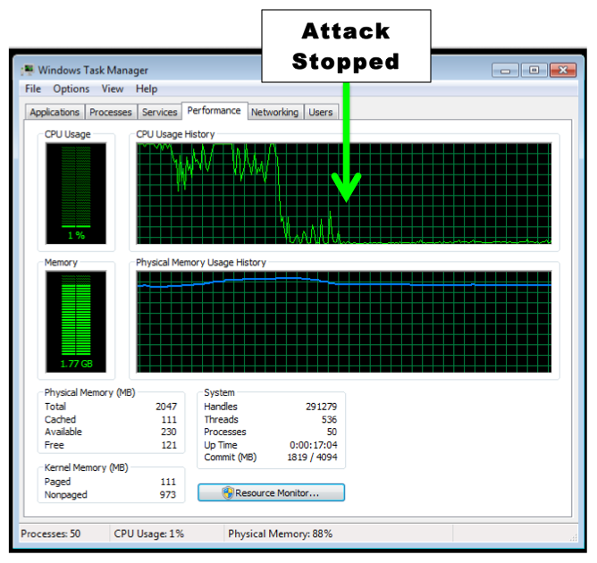

Slide 9
IPv4 Exhaustion

Slide 10
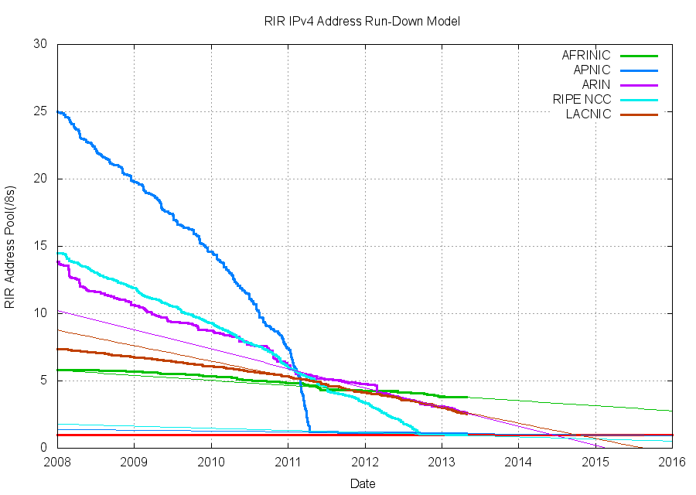
IPv4 Exhaustion

Slide 11
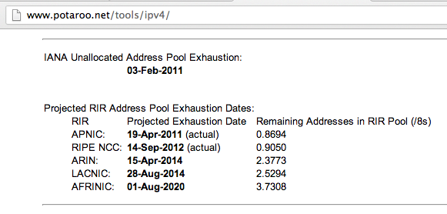
One Year Left

Slide 12
IPv6 Exhaustion

Slide 13
Link-Local DoS
IPv6 Router Advertisements

Slide 14
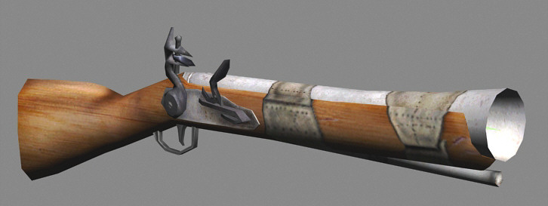
Old Attack (from 2011)
Image from forumlane.org

Slide 15
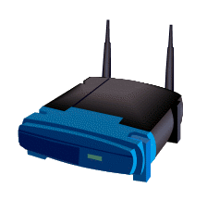
IPv4: DHCP
PULL process
Client requests an IP
Router provides one
I need an IP
Use this IP
Host
Router

Slide 16
IPv6: Router Advertisements
PUSH process
Router announces its presence
Every client on the LAN creates an address and joins the network
JOIN MY NETWORK
Yes, SIR
Host
Router

Slide 17
Router Advertisement Packet

Slide 18
RA Flood (from 2011) flood_router6

Slide 19
Effects of flood_router6
Drives Windows to 100% CPU
Also affects FreeBSD
No effect on Mac OS X or Ubuntu Linux

Slide 20
The New RA Flood
Image from guntech.com/

Slide 21
MORE IS BETTER
Each RA now contains
17 Route Information sections
18 Prefix Information sections

Slide 23
Flood Does Not Work Alone
Before the flood, you must send some normal RA packets
This puts Windows into a vulnerable state

Slide 24
How to Perform this Attack
For best results, use a gigabit Ethernet NIC on attacker and a gigabit switch
Use thc-ipv6 2.1 on Linux
Three Terminal windows:
./fake_router6 eth1 a::/64
./fake_router6 eth1 b::/64
./flood_router26 eth1
Windows dies within 30 seconds

Slide 25
Effects of New RA Flood
Win 8 & Server 2012 die (BSOD)
Microsoft Surface RT dies (BSOD)
Mac OS X dies
Win 7 & Server 2008 R2, with the "IPv6 Readiness Update" freeze during attack
iPad 3 slows and sometimes crashes
Android phone slows and sometimes crashes
Ubuntu Linux suffers no harm

Slide 26
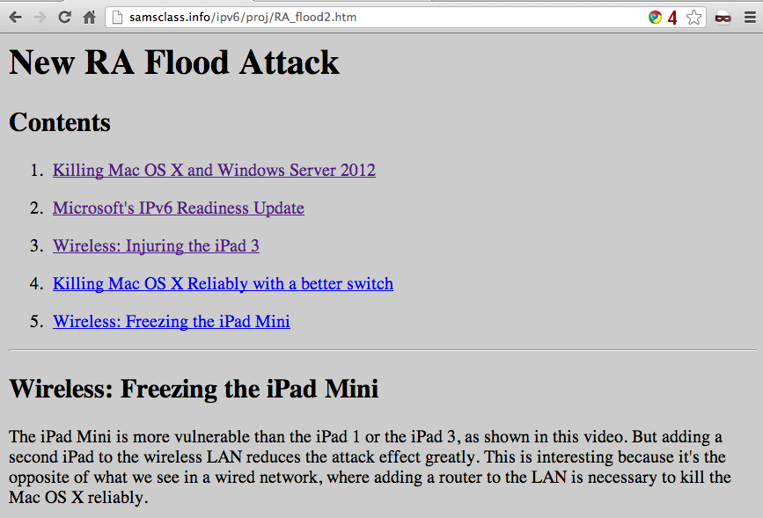
Videos and Details

Slide 27
Mitigation
Disable IPv6
Turn off Router Discovery with netsh
Use a firewall to block rogue RAs
Get a switch with RA Guard
Microsoft's "IPv6 Readiness Update" provides some protection for Win 7 & Server 2008 R2
Released Nov. 13, 2012
KB 2750841
But NOT for Win 8 or Server 2012!!

Slide 28
DEMO

Slide 29
More Info
Slides, instructions for the attacks, and more at
Samsclass.info

