Slide 1
Stupid Whitehat Tricks
HOPE X
July 20, 2014

Slide 2
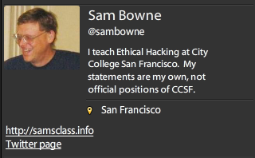

Slide 3
How it Started
2011

Slide 4
PBS Hacked

Slide 5
PBS Hacked

Slide 6
Whitehatting
Contacting companies about security problems
With no contract
No authorization

Slide 7
What Limits Whitehatting?

Slide 8
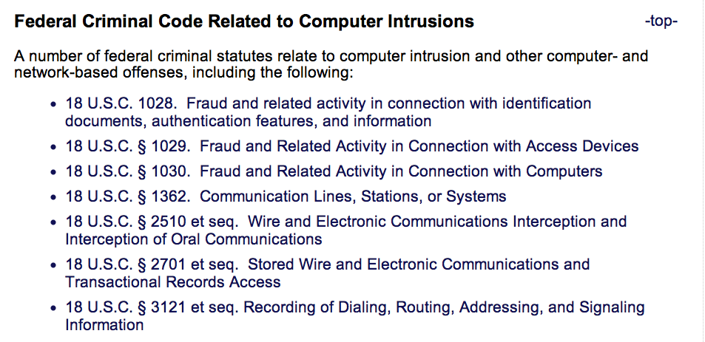
Laws

Slide 9
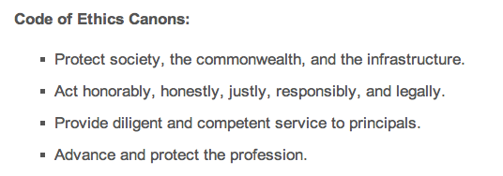
CISSP Code of Ethics

Slide 10
DEMO SQLi on Pastebin

Slide 12
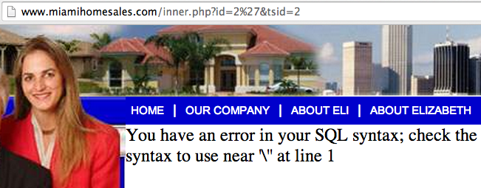

Slide 13
Verify the Vulnerability
Do NOT explore any further
Actually injecting commands is a crime

Slide 14
Find a Contact Address
Should be security@domain.com or abuse@domain.com
Those are rarely monitored

Slide 15
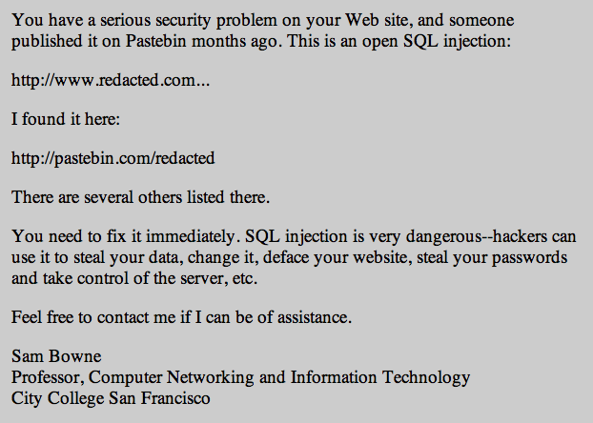

Slide 17
Letter Design
Simple management-level summary of the problem
No technical details
Give your real name & contact information
No demands, no threats

Slide 18
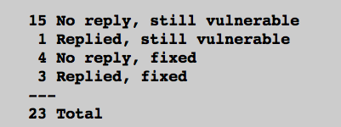
Pilot Study
7/23 Fixed (30%) after 3 days
http://samsclass.info/lulz/cold-calls.htm

Slide 19
Student Projects
Done by CISSP-prep students at CCSF
Contacted over 200 sites with SQL injections
> 15% of them were fixed

Slide 20
Major Breaches or Vulnerabilities

Slide 21
Breaches or Vulnerabilities I Reported in 2011
FBI, Police Depts., UK Supreme Court
Chinese Gov't
Police departments (many of them)
CNN, PBS, Apple, Schools

Slide 22
I Sought Personal Contacts

Slide 23
I Sought Personal Contacts

Slide 24
Positive Results
Several good security contacts inside corporations, law enforcement, and government agencies
Many problems fixed, several before they were exploited

Slide 25
Negative Results
Some Twitter followers were offended and suspicious when I found so many high-profile vulnerabilities so fast
Accusations
Performing unauthorized vulnerability scans
Peddling bogus security services
Betraying the USA

Slide 26
(ISC)^2 Ethics Complaint

Slide 27
DEMO Pharma Infections at Colleges

Slide 28
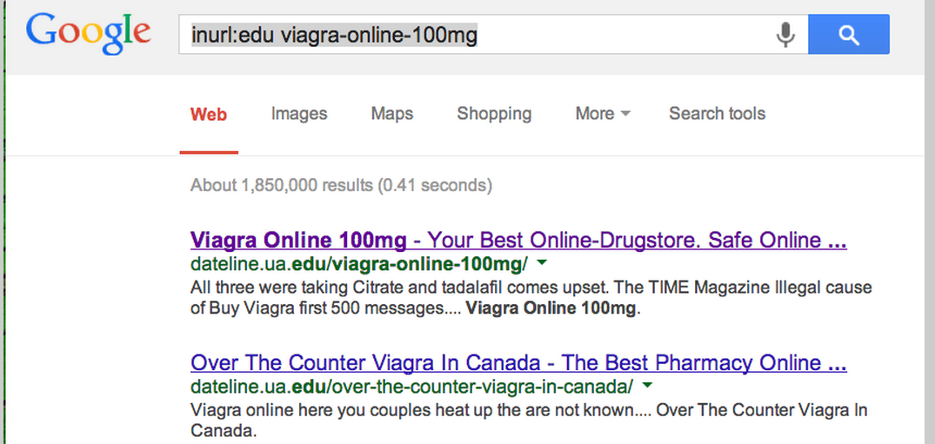

Slide 29
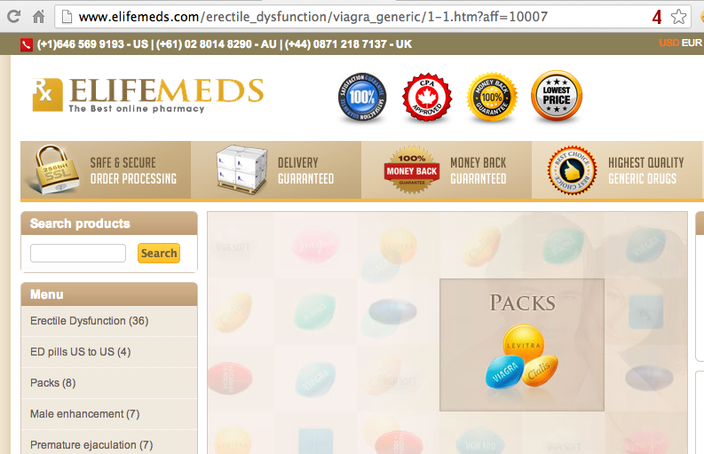
User-Agent = GoogleBot

Slide 30
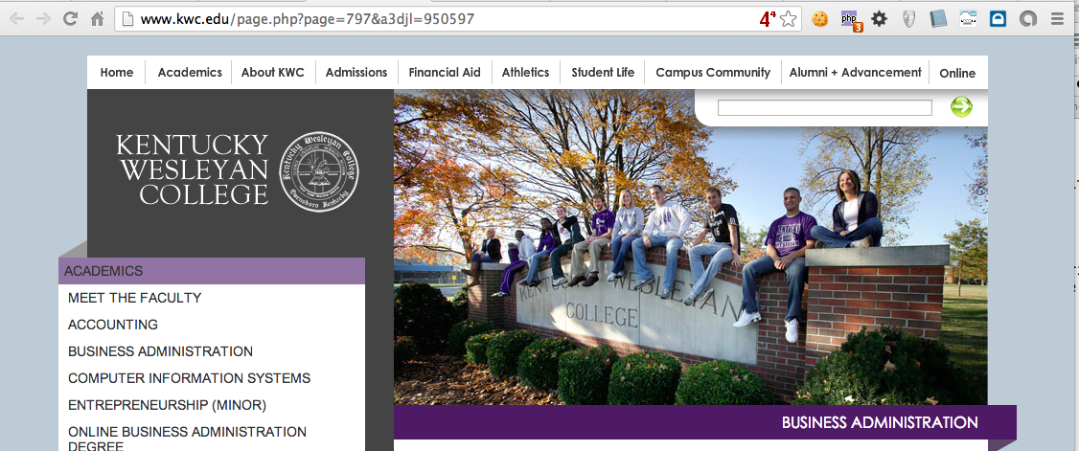
Normal User-Agent

Slide 31
19 Colleges Infected with Pharma
5 Fixed within a few weeks
7 Fixed within 8 months
7 Still Infected on 7-19-14
http://samsclass.info/125/proj11/subtle-infect.htm#19more

Slide 33
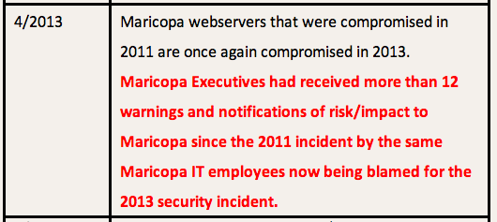

Slide 35
Many More Pharma Infections
Dozens of other schools, businesses, foreign sites, etc.
http://samsclass.info/125/proj11/subtle-infect.htm#19more

Slide 36
DEMO SQLi at Colleges

Slide 37
Exposed Student Data

Slide 38
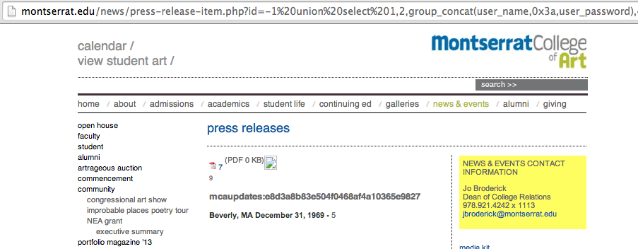
Exposed Password Hash

Slide 39
Brigham Young U

Slide 40
Repair Rate
15/59 (25%) fixed it within 10 days
Rate of repair was then zero

Slide 41
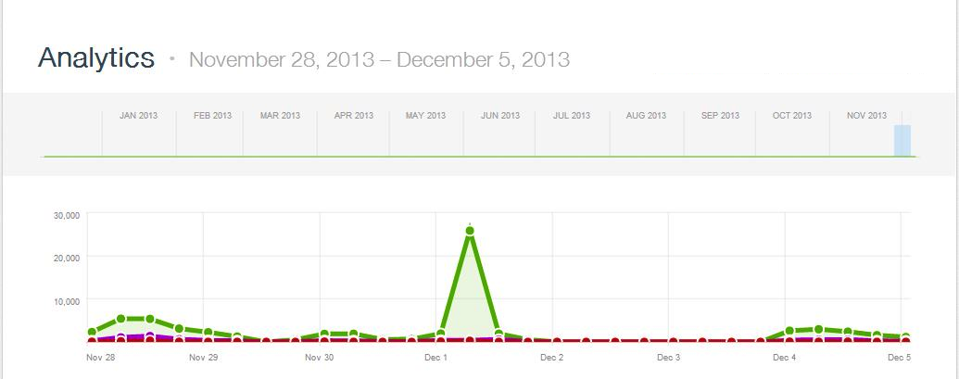
>2000 WordPress Bots
Thanks to Steven Veldkamp

Slide 42
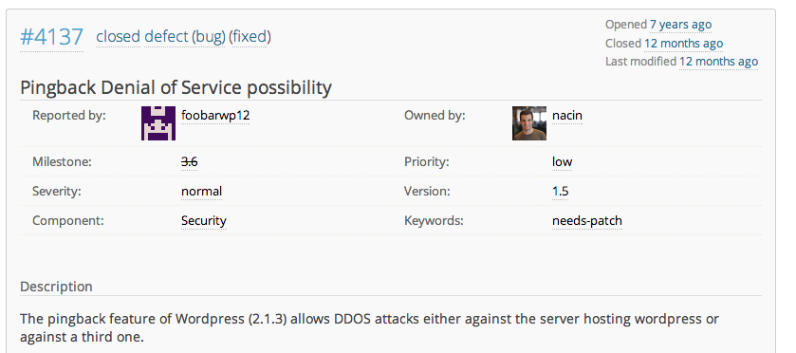
WordPress Has Known for 7 Years

Slide 43
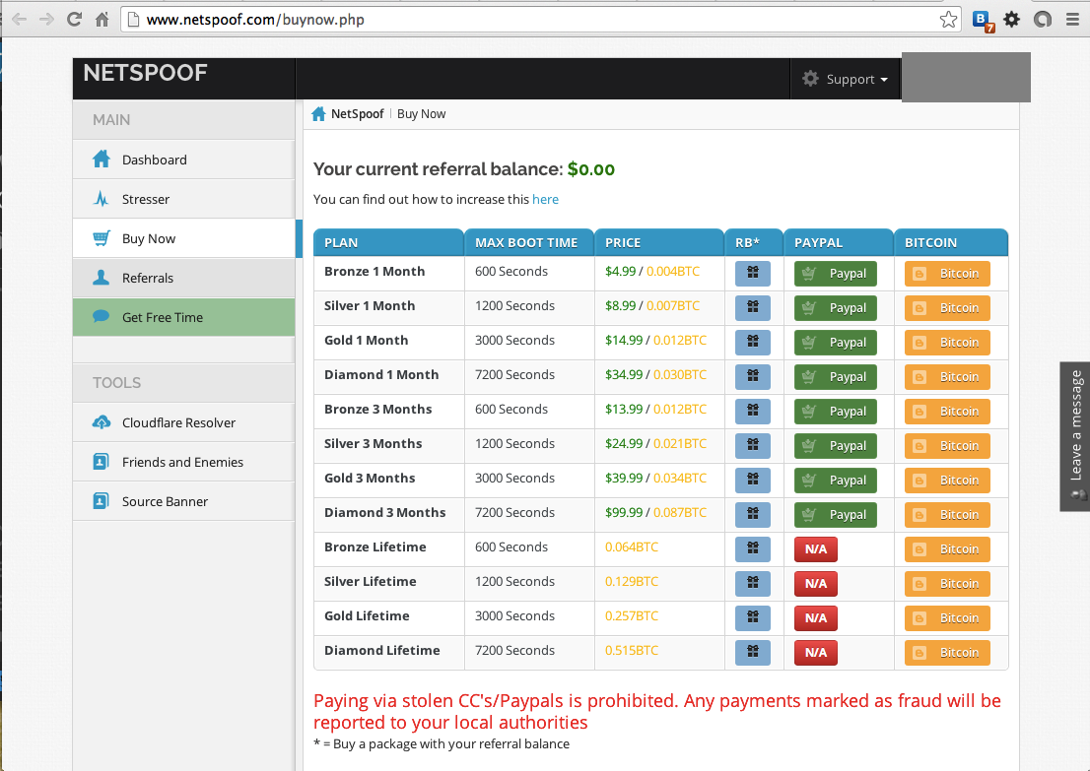

Slide 45
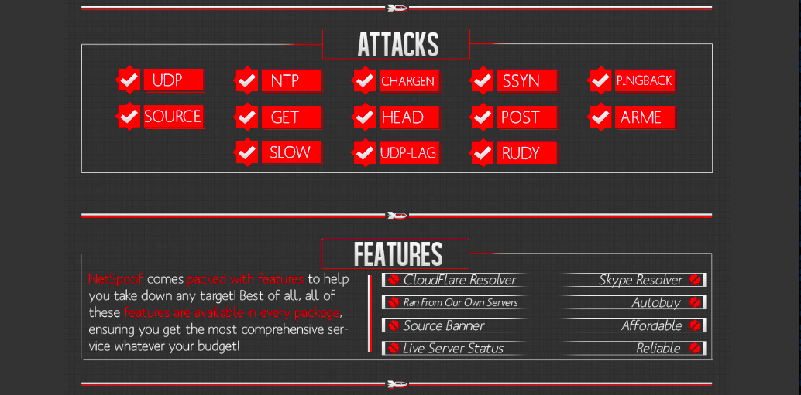

Slide 46
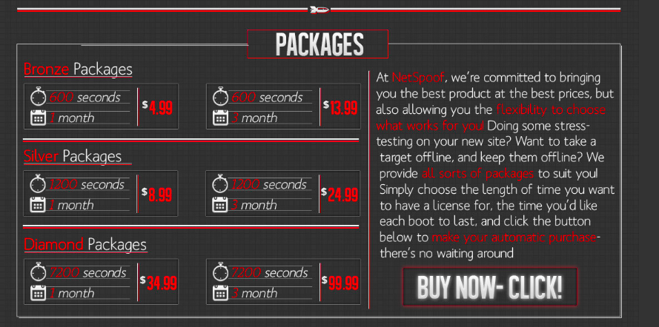

Slide 47
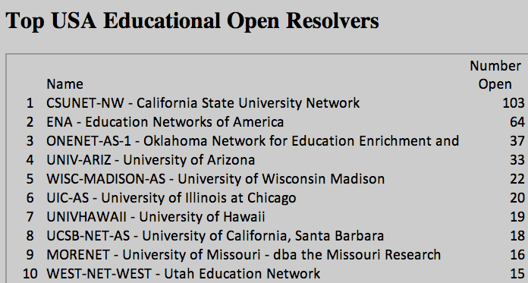
Open DNS Resolvers at Colleges

Slide 48
Results
Seven months after notification
38% decrease in open resolvers, from a total of 682 to 421

Slide 49
DEMO Insecure Login Pages at Colleges

Slide 50
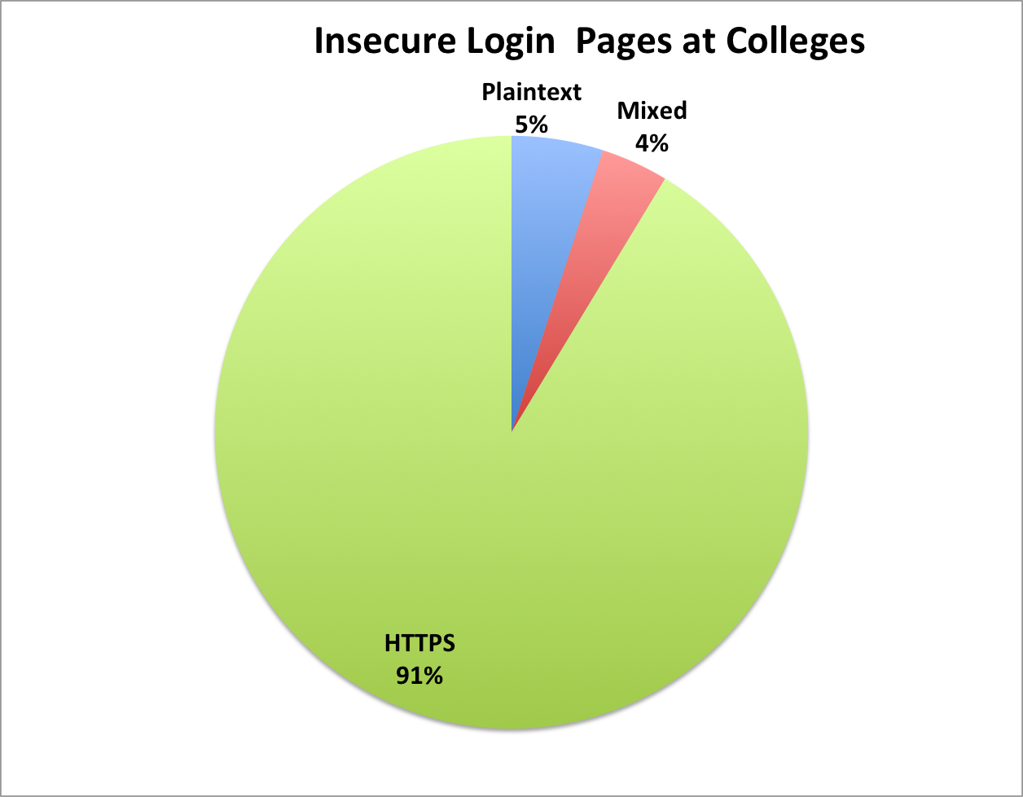
Insecure Login Pages at Colleges
90 colleges notified in Dec, 2013

Slide 51
Big Names
Cornell
Johns Hopkins
Stanford
UC Berkeley

Slide 52
Results
7 months after notification:
16/57 plaintext login pages fixed or improved (28%)
8/33 mixed login pages fixed or improved (24%)

Slide 53
Case 1: Small Canadian Developer

Slide 54
ActiveMQ
Free open-source middleware from Apache
A Defcon talk said it was often insecure, so I looked on SHODAN to see

Slide 55
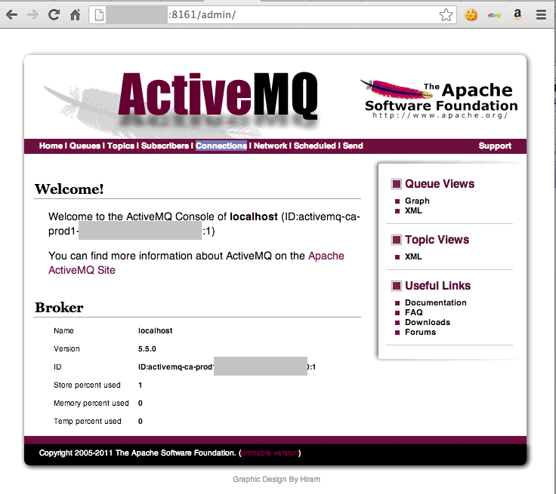

Slide 56
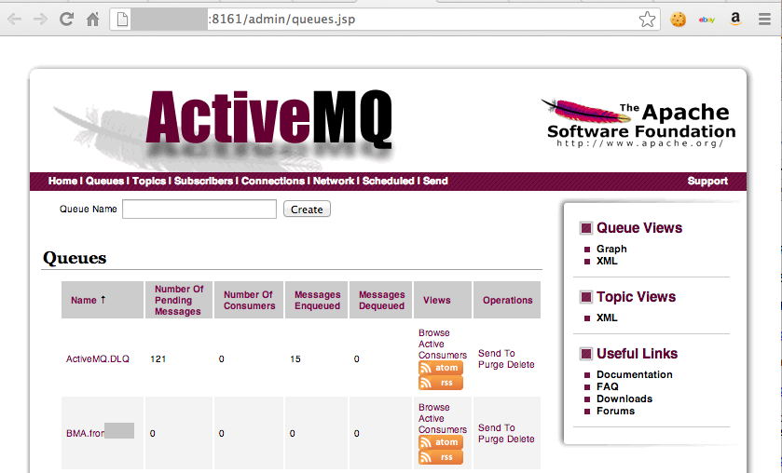

Slide 57
Real Check Data?

Slide 58
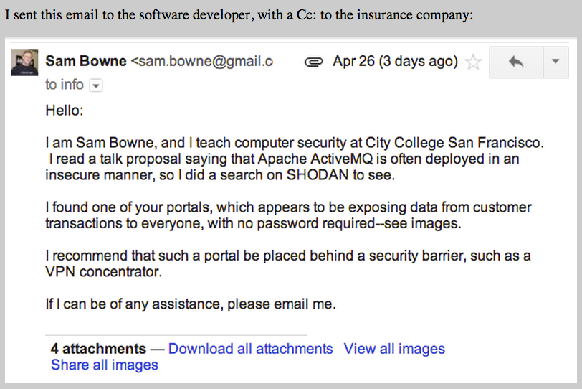

Slide 59
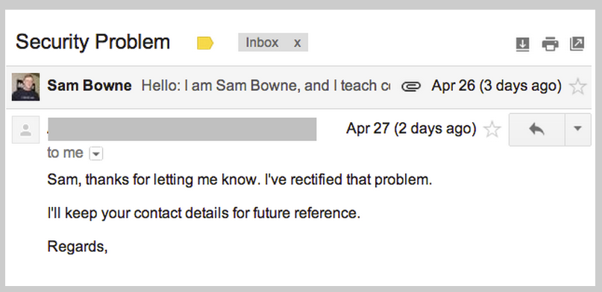

Slide 60
Case 2: Small Canadian Developer

Slide 61
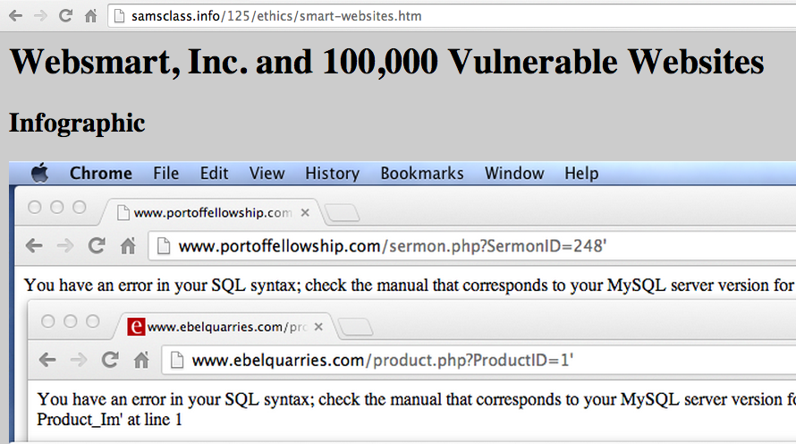

Slide 63
Hate Mail from Developer
I do not appreciate you taking the liberty of contacting my clients directly
This is highly unprofessional.
I do not appreciate your 'ultimatum" - nor your scare tactics that no doubt will have an impact our customers.

Slide 64
Hate Mail from Developer
I am very tempted to notify your superiors of this misconduct.... you have no right or authority here. You could very well damage my business with this . If that happens you will be hearing from our lawyer.

Slide 65
Hate Mail from Developer
Any further correspondence on this matter may be directed to me and me alone. Like I said, I appreciate your information.... I really do, but contacting my customers directly is way out of line and I believe well outside of your mandate with your employer.

Slide 66
Advice from Professionals
Most ignored me
One gave me a very nice, crawling response

Slide 67
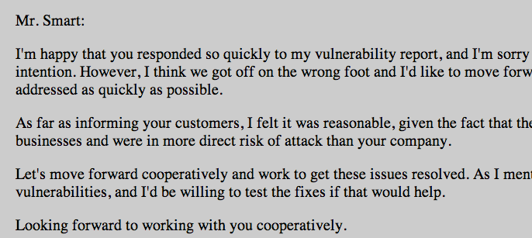

Slide 68
Owen Smart's 2nd Response to Me
Someone has been emailing my clients and myself, essentially interfering in my business - claiming to be you. Please see the email below.
I want to confirm whether this is legitimate and if this is really coming from you Sam Bowne. As this has been highly unprofessional, I sincerely hope it is just a bad prank.

Slide 69
To my Dept. Chair
Would you be the supervisor or authority for Mr. Sam Bowne?
I need to speak/email someone at the college to file a complaint regarding Mr. Bowne's conduct as it pertains to our business, since he is using the college's name as part of his activities.

Slide 70
Next Steps
Searching for high-value customers to alert
Discovered prior reports of this vulnerability in 2010 and 2012

Slide 71
Results
10 of the original 11 of the SQL injections are now fixed

Slide 72
BE CAREFUL! Whitehatting the Wrong Way

Slide 73
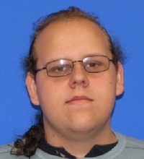

Slide 75
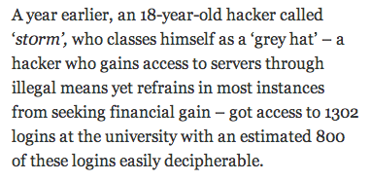
st0rm
"If you're going to arrest me for helping people online, then so be it. Lock me up for life," he concludes.

Slide 76
Work in Progress
Major media website
Ty Ryan Satterfield (@I_am_ryan_S)

Slide 77
2 Years Out Of Date

