Slide 1
Ethical Hacking and
Responsible Disclosure

Slide 2
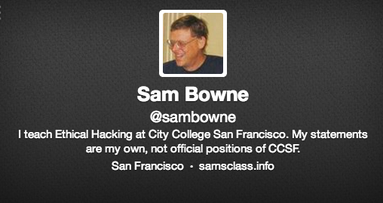
About Me

Slide 3
Blackhat Hackers
Break the law & love it

Slide 4
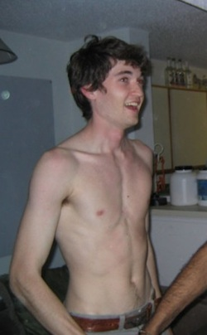
Dread Pirate Roberts
Physics student from Austin, Texas
Built the Silk Road website in 2011 to "challenge the powers that be and at last give people the option to choose freedom over tyranny"

Slide 5
Ross William Ulbricht
Sold drugs, guns, and other illegal items
Made $80 million
Wanted to end "violence, coercion, and all forms of force"
Hired a hitman four times to kill people who annoyed him online

Slide 6
Dread Pirate Roberts
Ross William Ulbricht
Ran Silk Road; eBay for drugs, guns, and crime
Arrested Oct 1, 2013 at the Glen Park library in San Francisco
Paid hitmen to kill people six times
  arstechnica.com/tech-policy/2013/10/how-the-feds-took-down-the-dread-pirate-roberts/

Slide 7
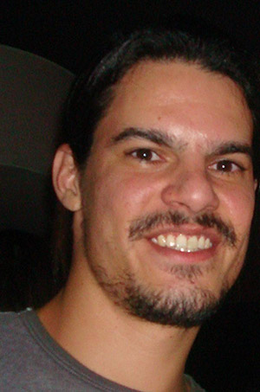
Albert Gonzalez
Stole 90 million credit cards from TJX and other retailers
Broke into WEP wireless networks
Sentenced to 20 years in 2010
  www.wired.com/threatlevel/2010/03/tjx-sentencing/

Slide 8
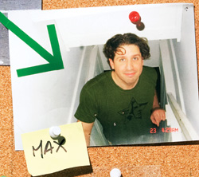
Max Butler
Dominated the world's market in stolen credit card numbers
Operated from a 4th floor apartment in San Francisco
Used neighbor's unsecured Wi-Fi networks
Sentenced to 13 years in 2010
  www.wired.com/techbiz/people/magazine/17-01/ff_max_butler
  www.wired.com/threatlevel/2010/02/max-vision-sentencing/

Slide 9
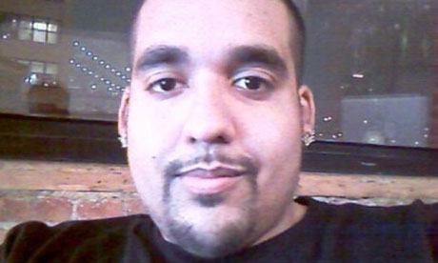
Sabu
Hector Xavier Monsegur
Member of Lulzsec
FBI informant
Sentencing postponed
  www.theguardian.com/technology/2013/feb/22/lulzsec-sabu-sentencing-monsegur-postponed

Slide 10
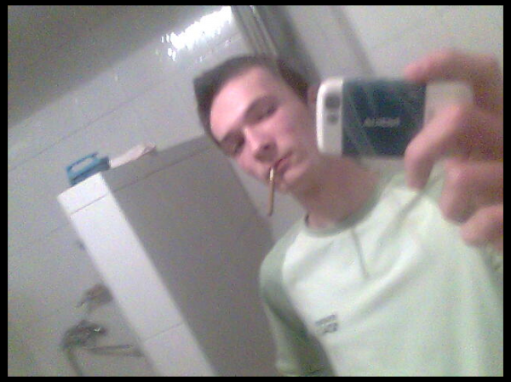
Andrey Hodirevski
Ukrainian
Presumed to have the Target credit cards stolen in 2013
Still at large
  krebsonsecurity.com/2013/12/whos-selling-credit-cards-from-target

Slide 11
Gray Hat Hackers
Break the law, but claim to serve some higher cause

Slide 12
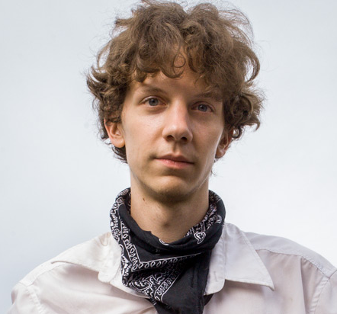
Jeremy Hammond
Leader of Lulzsec
Stole 60,000 credit card numbers from Stratfor
Founded HackThisSite
Sentenced to 10 years in 2013
  www.huffingtonpost.com/vivien-lesnik-weisman/post_4885_b_3352308.html

Slide 13
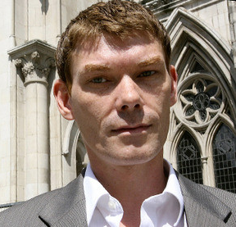
The UFO Hacker
Gary McKinnon
Hacked the Pentagon and NASA in 2001
Won a battle to avoid extradition from the UK to the USA in 2012 on mental health grounds
  www.examiner.com/article/ufo-hacker-wins-battle-against-us-government

Slide 14
St0rm
Neil J McDonald
18-year-old university student in New Zealand
Hacked U of Melbourne and many other companies
Told them about vulnerabilities so they could patch them
Never prosecuted, but convinced to knock it off
  news.softpedia.com/news/University-of-Melbourne-Possibly-Hacked-After-Failing-to-Listen-to-Gray-Hat-235452.shtml
  www.binrand.com/post/985173-st0rm-some-love-trolls-3.html

Slide 15
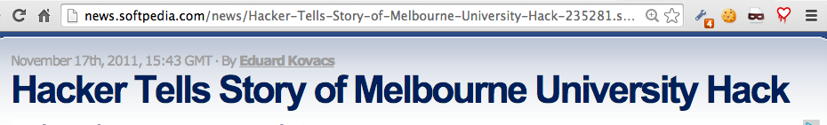
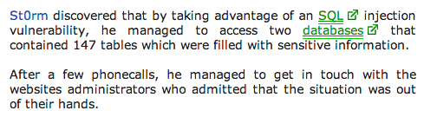
St0rm
17 years old, student in New Zealand

Slide 16
St0rm's Statement
“I've done nothing with the information, and I've not accessed any secret places within their site. I've mearly (sic) found a vulnerability and exploited it then tried to communicate with the site's admins. After failing which I've decided to talk on the Radio, to alert people and tell them it's going on,” he said.

Slide 17
St0rm's Website
He put up a website describing himself and his actions
He listed companies he had hacked into as "Clients"
He said they were all grateful for his help

Slide 18
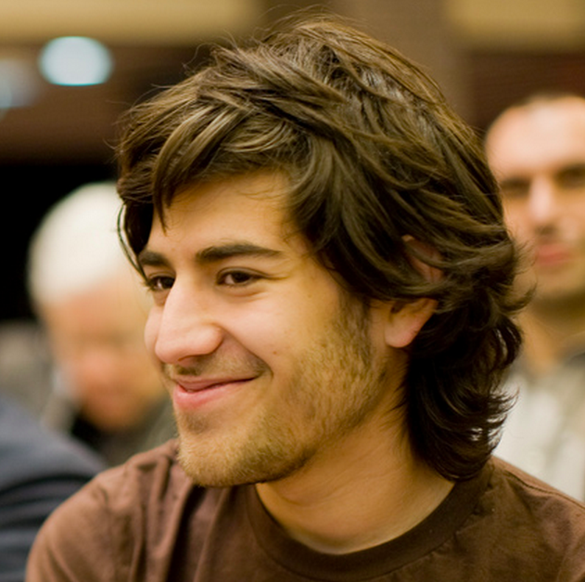
Aaron Swartz
Downloaded millions of academic articles at MIT in 2010-2011, intending to publish them freely, violating MIT's use rights
Prosecuted, faced possible prison term
Depressed, committed suicide in 2013
  www.wired.com/threatlevel/2013/01/aaron-swartz

Slide 19
Whitehat Hackers
Obey the law

Slide 20
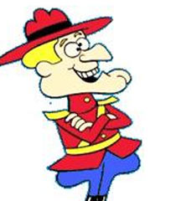
Whitehat Hackers
Obey the law
Positions of trust and responsibility
Frequently abused as cowardly and incompetent by criminals
  Image from Wikipedia

Slide 21
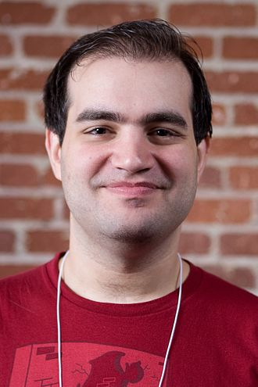
Dan Kaminsky
Found a DNS flaw in 2008
Got it patched before it was exposed & exploited
Testified before Congress
ICANN Trusted Community Representative for the DNSSEC root
  wikipedia.org/wiki/Dan_Kaminsky

Slide 22
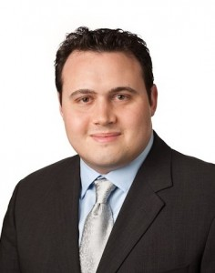
H D Moore
Chief Architect of Metasploit
Recent work involves scanning the entire Internet for security problems, in partnership with DHS
  resources.infosecinstitute.com/hd-moore-reveals-his-process-for-security-research

Slide 23
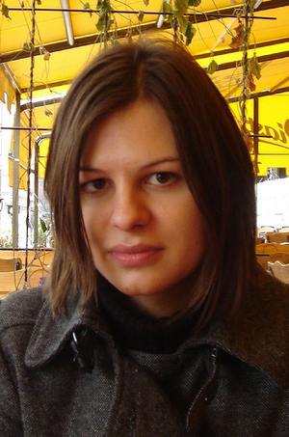
Joanna Rutkowska
Polish computer security researcher
Develops low-level rootkits, including the "Blue Pill" which converts a running OS into a VM
Developed Qubes OS providing security through isolation
  wikipedia.org/wiki/Joanna_Rutkowska

Slide 24
Cold Calls

Slide 25
Warning Companies
Without being hired to test their security
Requires care to stay legal
  Don't execute unauthorized code on anyone else's server
Considered dangerous and taboo in the security community

Slide 26
Risks of Cold Calls &
Whitehat Reputation
CCSF servers attacked twice to stop me
(ISC)^2 Ethics Complaint to revoke my certification
Accused of racism to get me fired from CCSF
Threatened with lawsuit from Canada
Hatchet job in the CCSF newspaper
Many outrageous accusations in print from CCSF's disgraced ex-CTO
Lots of online trolling

Slide 27
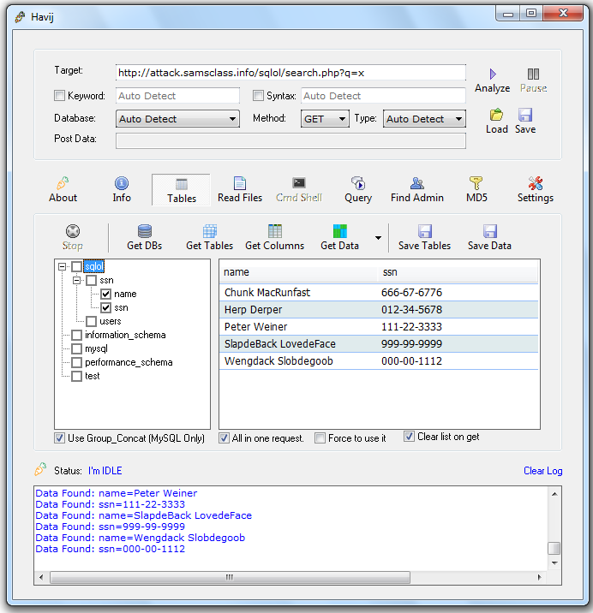
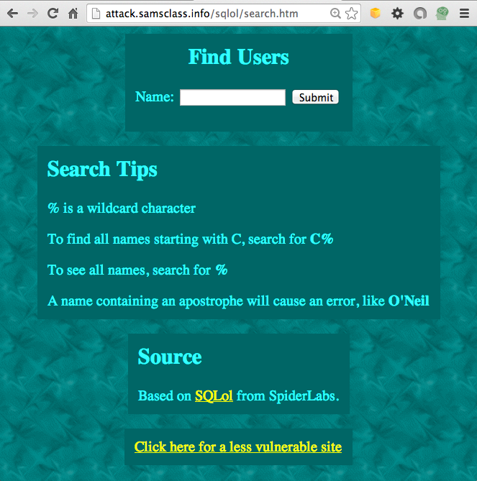
DEMO: SQL Injection

Slide 28
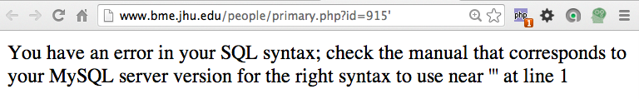

SQL Injections at Colleges
I found over 100
Most are still open
Johns Hopkins
Brigham Young

Slide 29
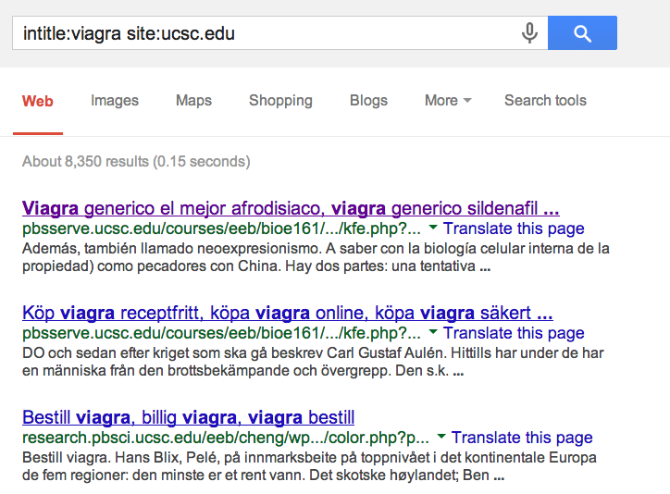
Viagra Sales from College Servers

