Slide 1
SSD Data Evaporation and DoS
LayerOne
May 26, 2013

Slide 2
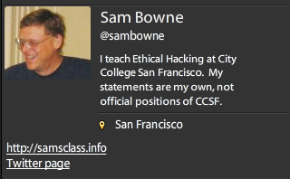
Bio

Slide 3
Data Remanence

Slide 4
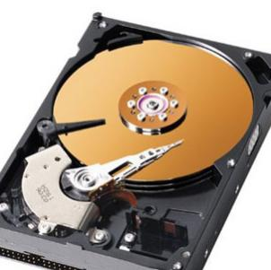
Deleted Data
On magnetic hard disks, data remains till it is overwritten
Image from www.howstuffworks.com

Slide 5
DEMO on Windows
Observing data on a magnetic hard disk after
  Moving to Recycle Bin
  Emptying Recycle Bin
  Formatting Drive (Quick)
  Formatting Drive (Slow)

Slide 6
Forensics & Data Recovery
We can recover deleted data
Find evidence of crimes
Even after a format
Very few criminals know enough to use encryption or forensic erasure

Slide 7
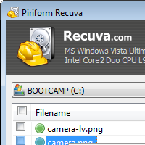

Useful Free Data Recovery Tools
Recuva for PC
Disk Drill for Mac

Slide 8

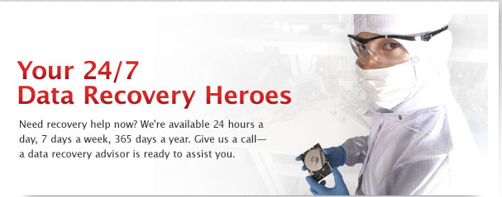

Slide 9
SSDs

Slide 10
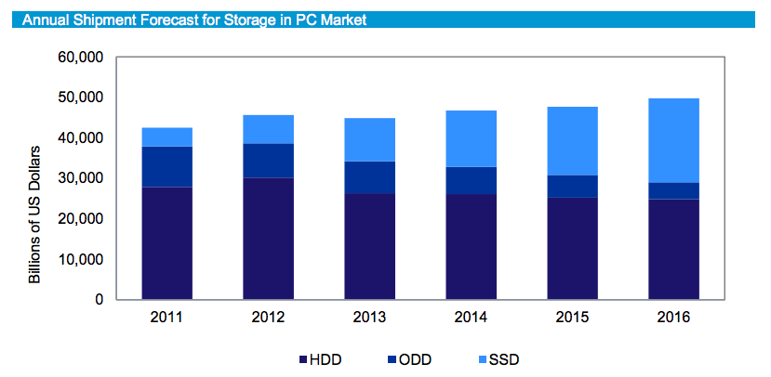
From http://www.isuppli.com/Abstract/P28276_20130322152341.pdf

Slide 11
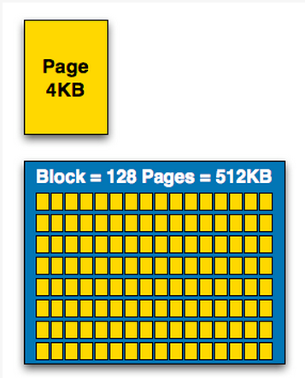
How SSDs Work
Data can be read and written one page at a time, but can only be erased a block at a time
Each erasure degrades the flash—it fails around 10,000 erasures
From http://www.anandtech.com/show/2738/5

Slide 12
Garbage Collection
SSD controller erases pages all by itself, when it knows they are empty
The TRIM command is sent to the SSD when a file is deleted
  But only if you use a the correct OS, Partition type, and BIOS settings
Yuri Gubanov calls this “Self-Corrosion” – I call it Data Evaporation

Slide 13
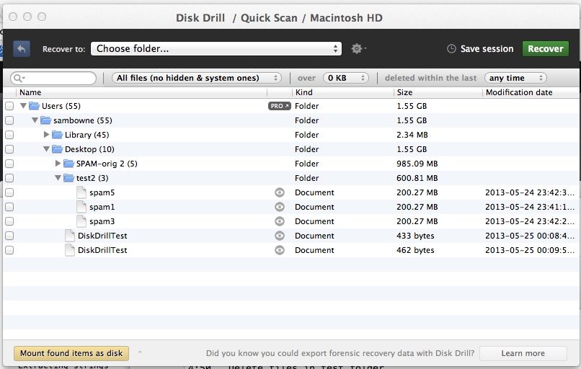
Demo on Mac: Disk Drill
Deleted files from desktop evaporate in 30-60 min

Slide 14
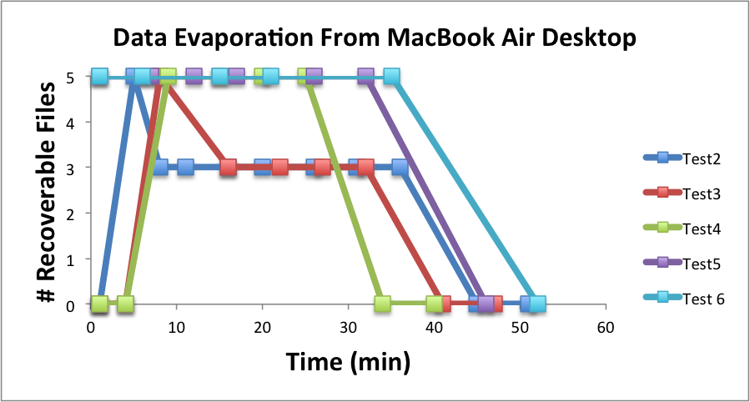

Slide 15
Demo on PC
Save data on an SSD
Watch it evaporate!
How to test TRIM
  fsutil behavior query DisableDeleteNotify
  Zero = TRIM enabled

Slide 16
When Does TRIM Work?
BIOS: Drive must be SATA in AHCI mode, not in IDE emulation mode
SSD must be new (Intel: 34 nm only)
Windows 7 or later
  NTFS volumes, not FAT
Mac OS X 10.6.8 or later
  Must be Apple-branded SSD

Slide 17
When Does TRIM Work?
External Drives must use SATA or SCSI, not USB
PCI-Express & RAID does not support TRIM
From http://forensic.belkasoft.com/en/why-ssd-destroy-court-evidence

Slide 18
Expert Witness Testimony

Slide 19
Experience
In court, an expert witness can state an opinion
Must be based on personal experience
  “I read it in a book” NO
  “A teacher said it in a class” NO
  “I know this because I tested it” YES
So forensic examiners do a lot of testing

Slide 20
Summary
SSDs retain deleted data sometimes
Other times they don’t
It depends on
  Manufacturer
  OS
  BIOS
  Interface
  Who knows what else

Slide 21
The evap Tool
For Mac OS X Only

Slide 22
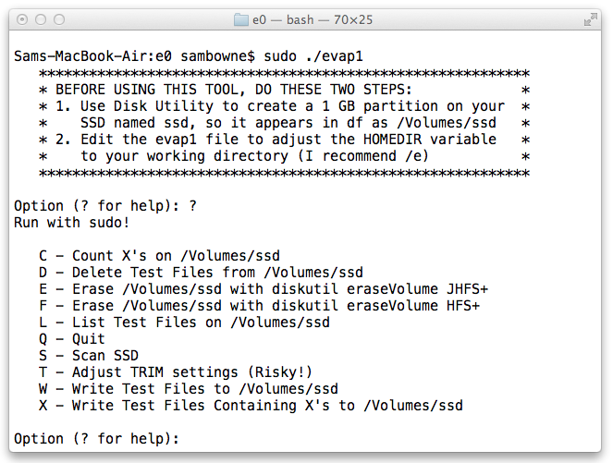
Intro

Slide 23
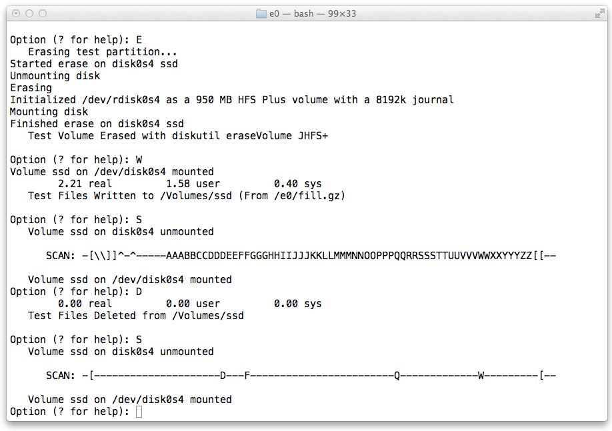
Evaporation on JHFS+

Slide 24
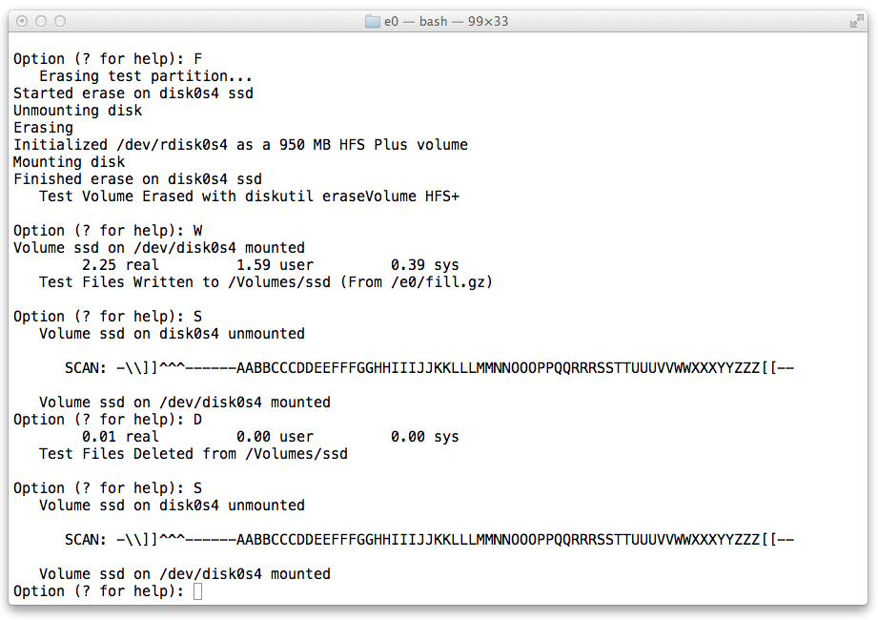
No Evaporation on HFS+

Slide 25
SockStress

Slide 26
From 2008
Still not patched
Attacks TCP by sending a small WINDOW size
Causes sessions to hang up, consuming RAM
Does not work on BackTrack/Kali
Requires Slackware, works best on v. 10
Can render servers unbootable

Slide 27
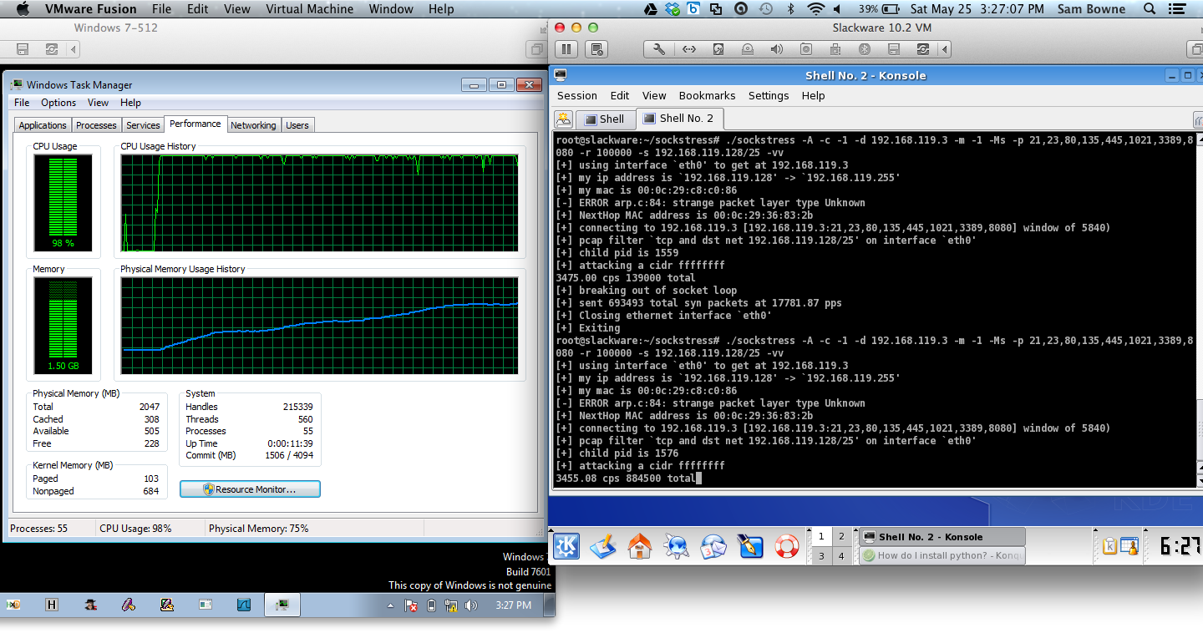
SockStress Demo

Slide 28
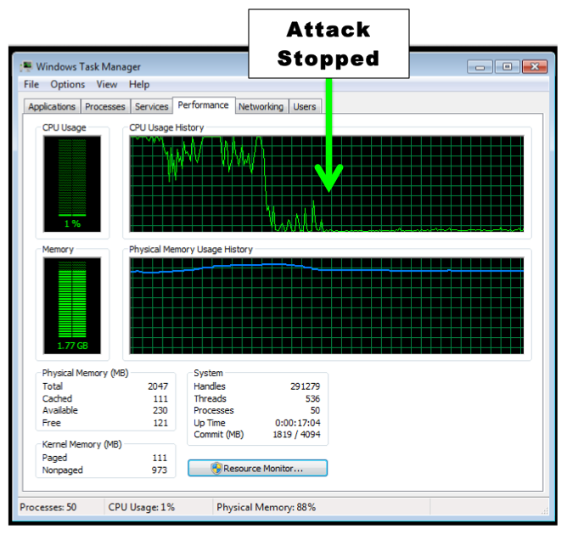

Slide 29
IPv4 Exhaustion

Slide 30
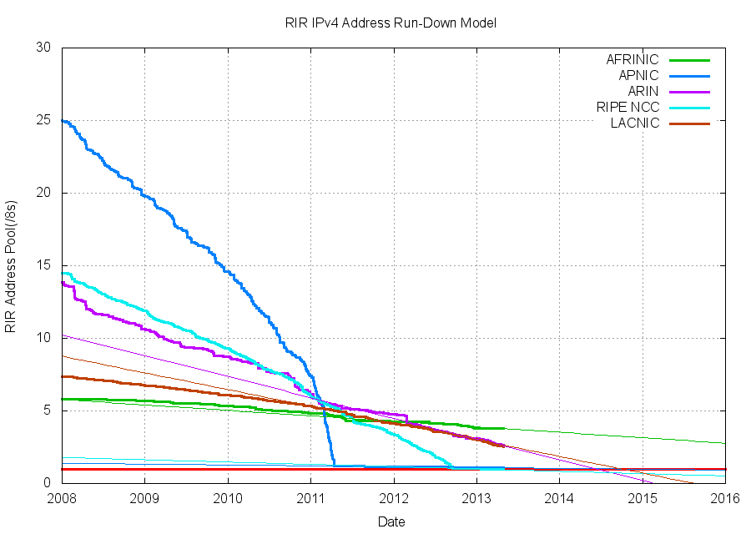
IPv4 Exhaustion

Slide 31
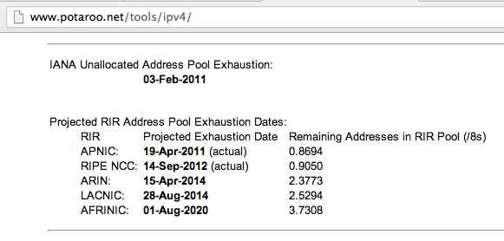
One Year Left

Slide 32
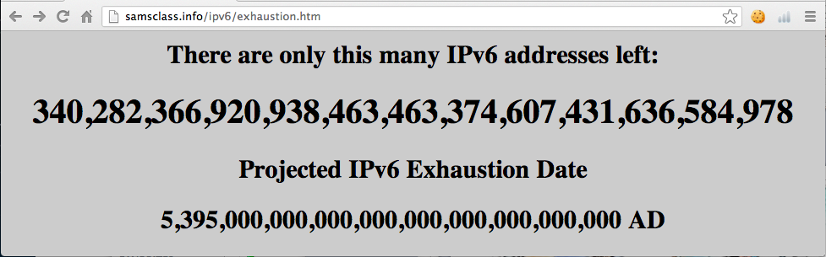
IPv6 Exhaustion

Slide 33
Link-Local DoS
IPv6 Router Advertisements

Slide 34
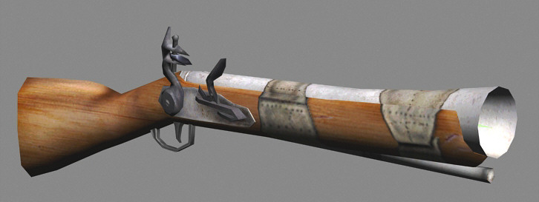
Old Attack (from 2011)
Image from forumlane.org

Slide 35
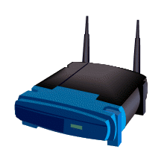

IPv4: DHCP
PULL process
Client requests an IP
Router provides one
I need an IP
Use this IP
Host
Router

Slide 36
IPv6: Router Advertisements
PUSH process
Router announces its presence
Every client on the LAN creates an address and joins the network
JOIN MY NETWORK
Yes, SIR
Host
Router

Slide 37
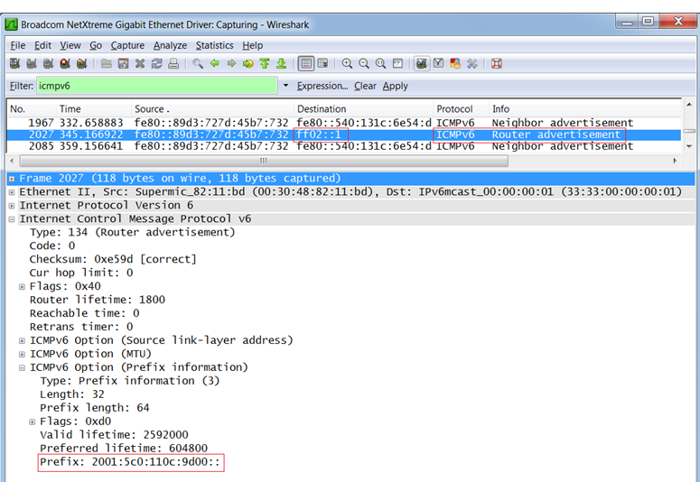
Router Advertisement Packet

Slide 38
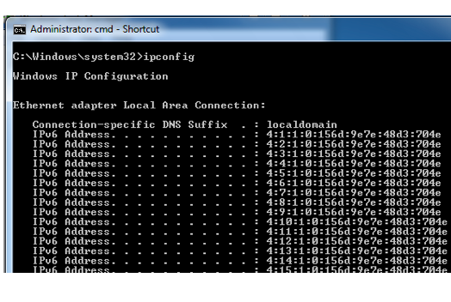
RA Flood (from 2011) flood_router6

Slide 39
Effects of flood_router6
Drives Windows to 100% CPU
Also affects FreeBSD
No effect on Mac OS X or Ubuntu Linux

Slide 40
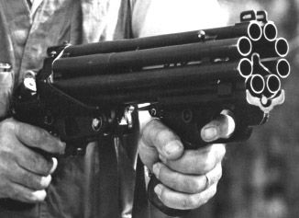
The New RA Flood
Image from guntech.com/

Slide 41
MORE IS BETTER
Each RA now contains
  17 Route Information sections
  18 Prefix Information sections

Slide 42
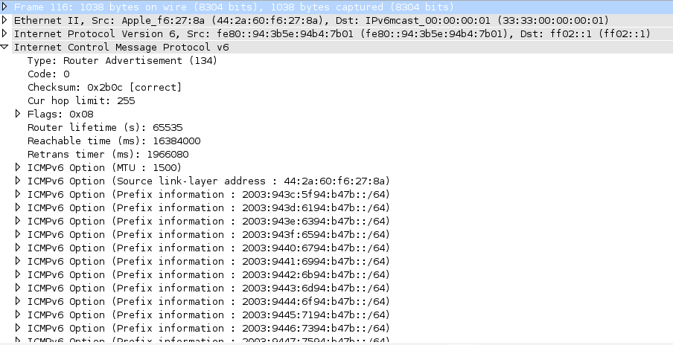

Slide 43
Flood Does Not Work Alone
Before the flood, you must send some normal RA packets
This puts Windows into a vulnerable state

Slide 44
How to Perform this Attack
For best results, use a gigabit Ethernet NIC on attacker and a gigabit switch
Use thc-ipv6 2.1 on Linux
Three Terminal windows:
  ./fake_router6 eth1 a::/64
  ./fake_router6 eth1 b::/64
  ./flood_router26 eth1
Windows dies within 30 seconds

Slide 45
Effects of New RA Flood
Win 8 & Server 2012 die (BSOD)
Microsoft Surface RT dies (BSOD)
Mac OS X dies
Win 7 & Server 2008 R2, with the "IPv6 Readiness Update" freeze during attack
iPad 3 slows and sometimes crashes
Android phone slows and sometimes crashes
Ubuntu Linux suffers no harm

Slide 46
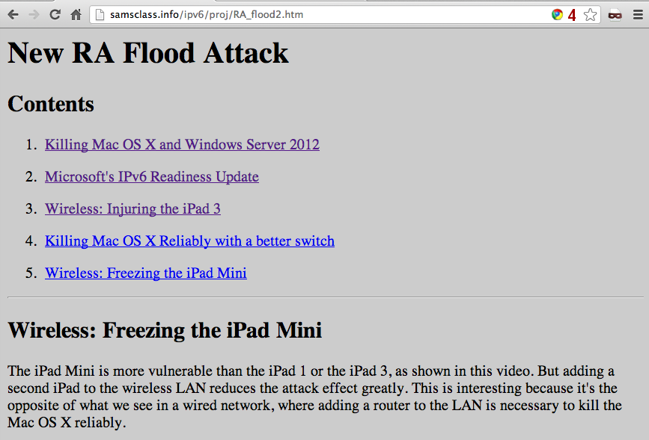
Videos and Details

Slide 47
Mitigation
Disable IPv6
Turn off Router Discovery with netsh
Use a firewall to block rogue RAs
Get a switch with RA Guard
Microsoft's "IPv6 Readiness Update" provides some protection for Win 7 & Server 2008 R2
  Released Nov. 13, 2012
  KB 2750841
  But NOT for Win 8 or Server 2012!!

Slide 48
DEMO

Slide 49
More Info
Slides, instructions for the attacks, and more at
Samsclass.info

