Slide 1
Breach: Real and Imaginary
NASA Ames
Oct 10, 2012

Slide 2
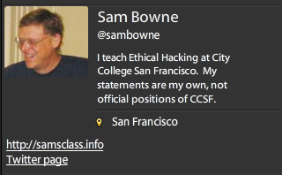
Bio

Slide 3
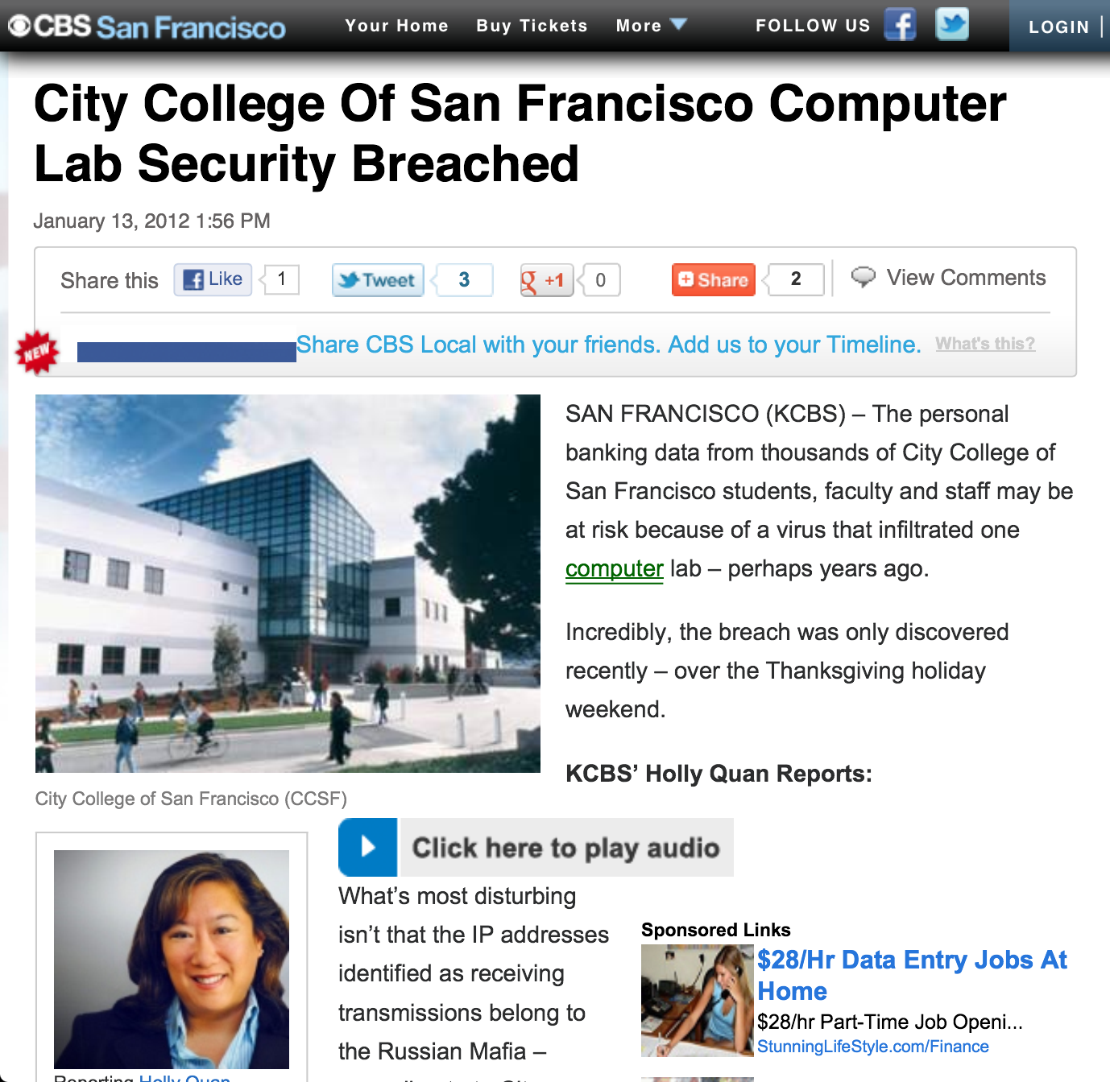

Slide 4
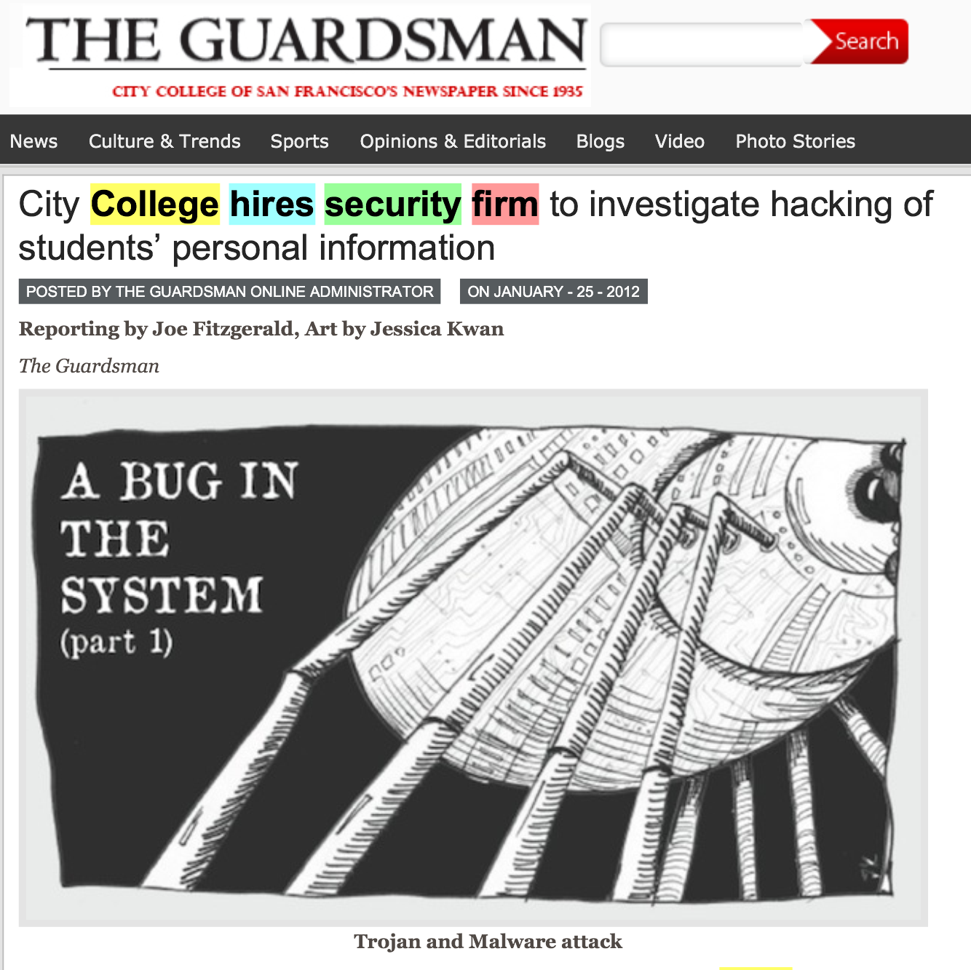

Slide 5
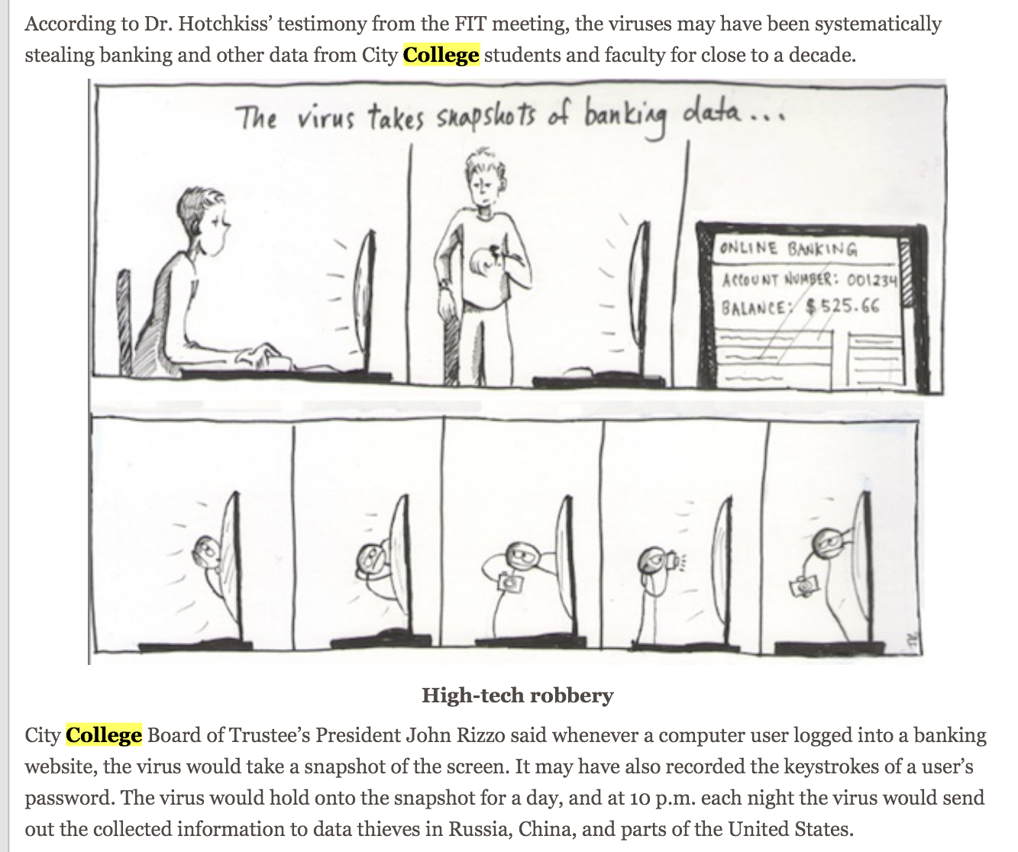

Slide 6
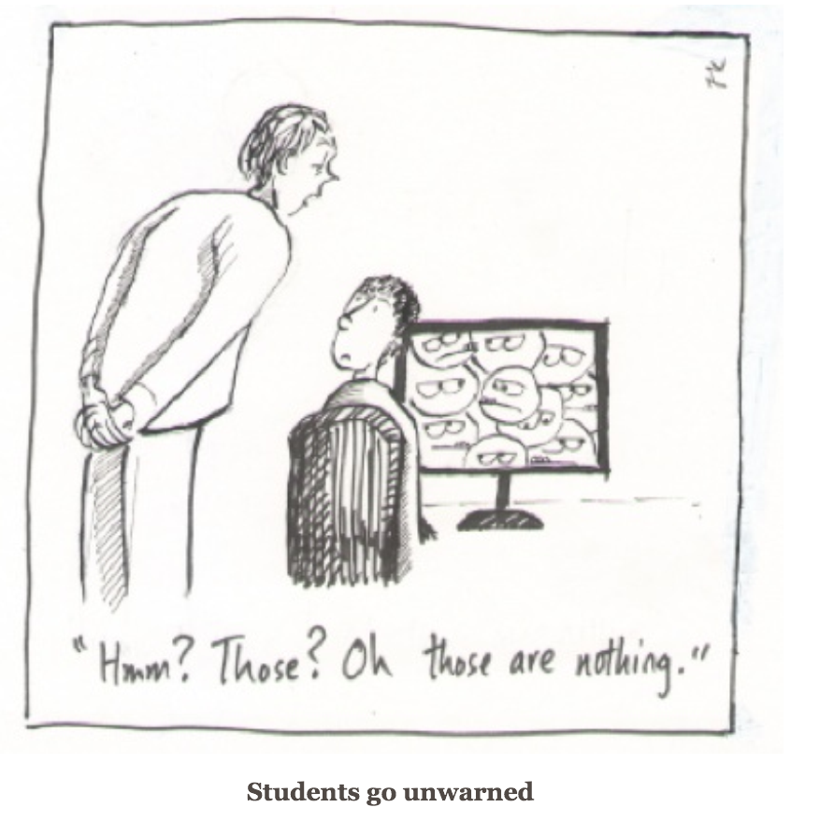

Slide 7
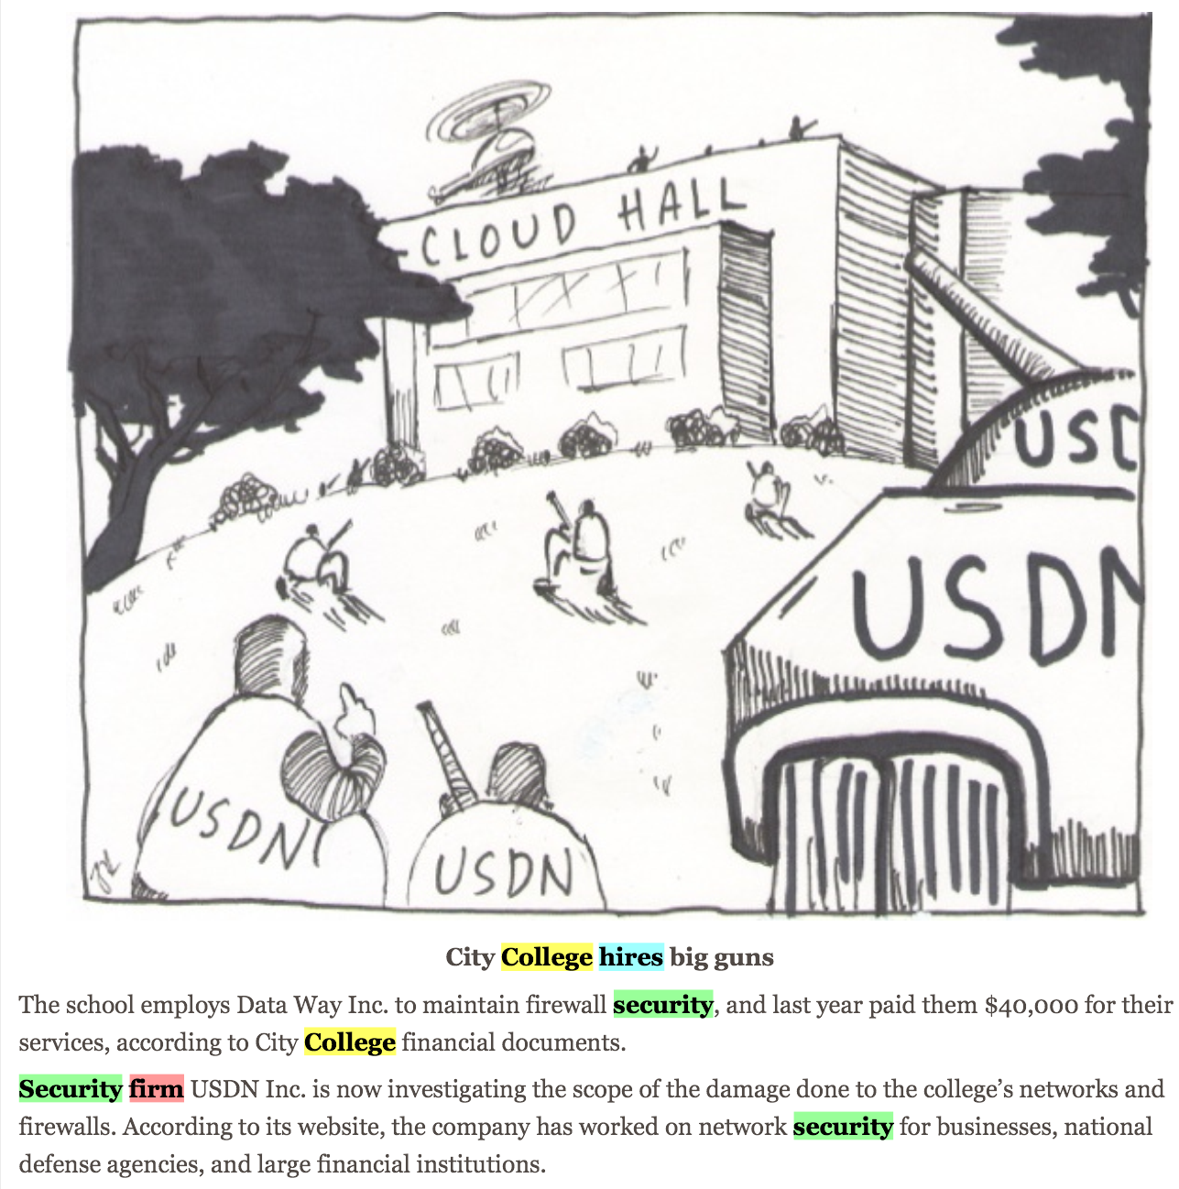

Slide 8
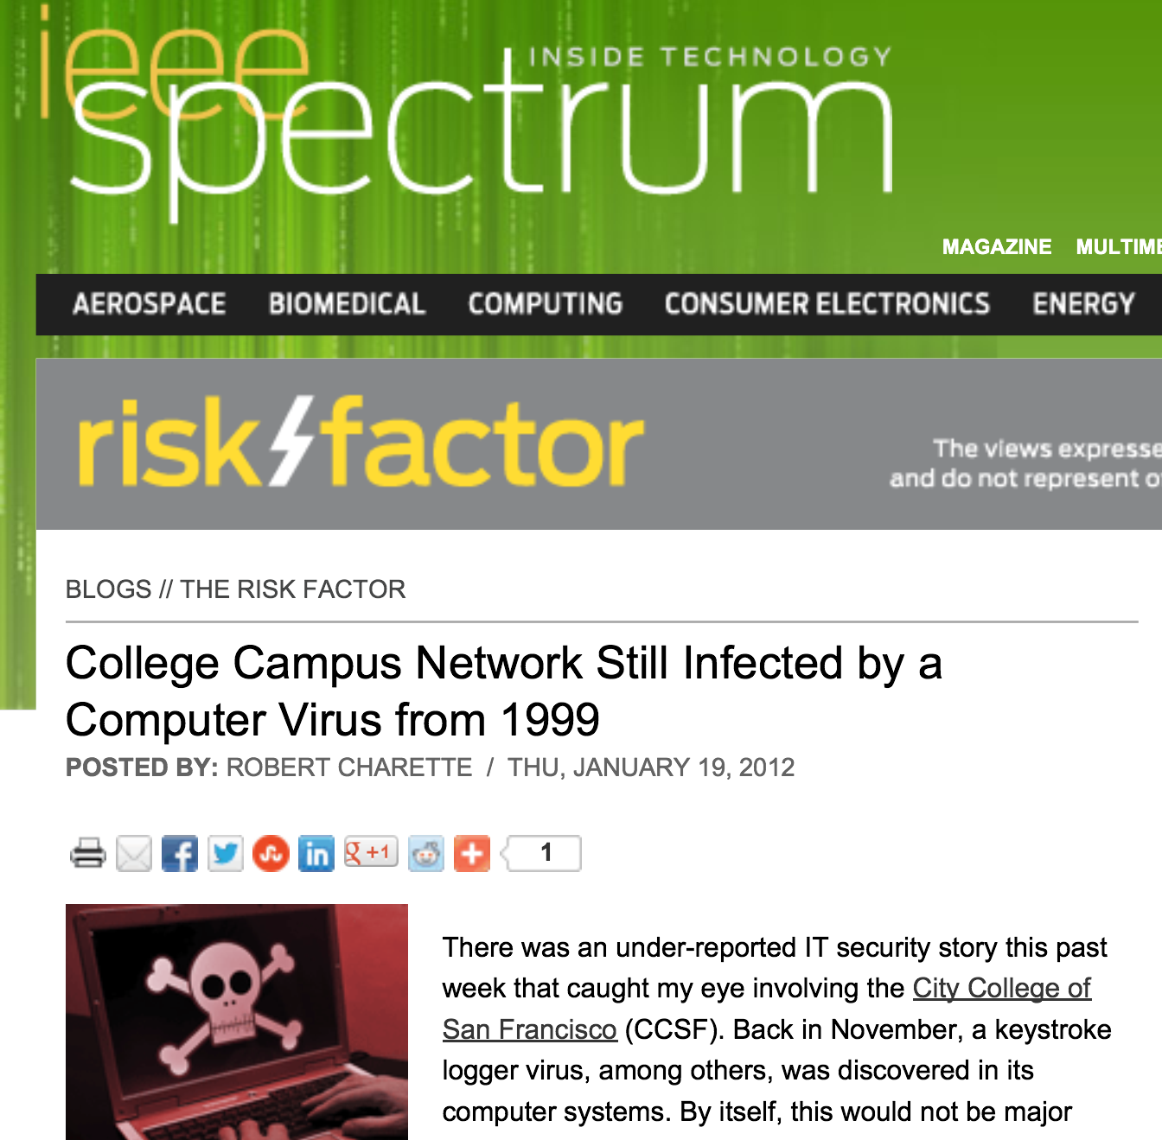

Slide 9
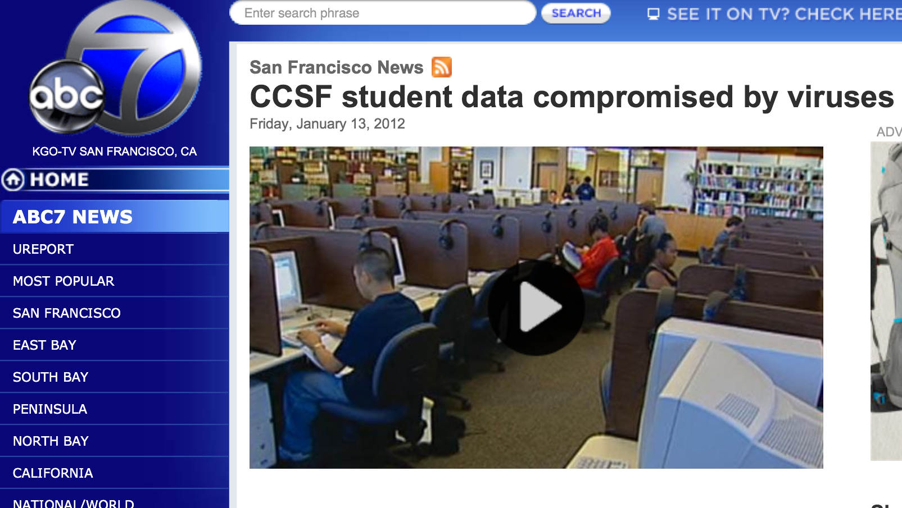

Slide 10
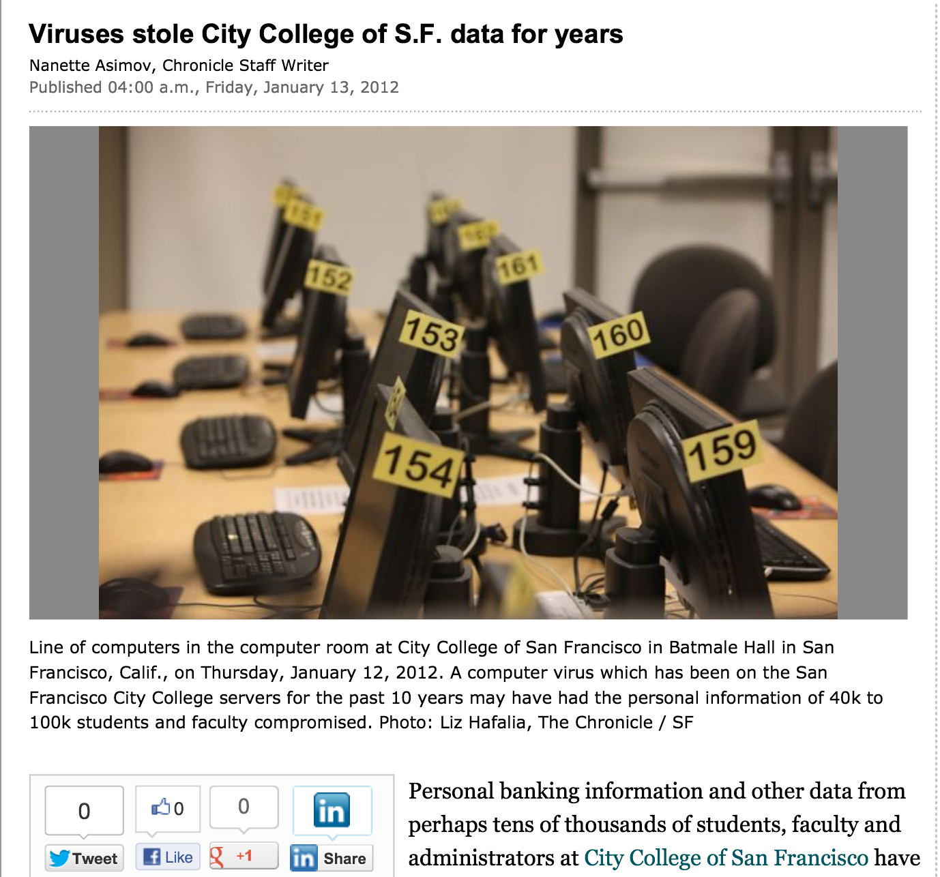

Slide 11
Outside attacks
Insider threat
Deluded Insider Threat

Slide 12
Security at CCSF
Two generations of complete hardware replacement in the last ten years
McAfee Enterprise antivirus
Deep Freeze
Palo Alto layer 7 firewall

Slide 13
Security Audits
There was a security audit and remediation process performed in 2007-2008 by a contractor
I did another security audit in 2010 with my CISSP students
  No major problems found

Slide 14
Evidence for these "Viruses"
A report was supposedly prepared by USDN in Nov 2011, but we were never able to get a copy of it at all
The presentation from the CTO that went to the press was in Jan. 2011
We finally got a partial report on Jan. 31, lacking the appendices that were the evidence
  "Proprietary and Confidential" but later published in the newspaper

Slide 15
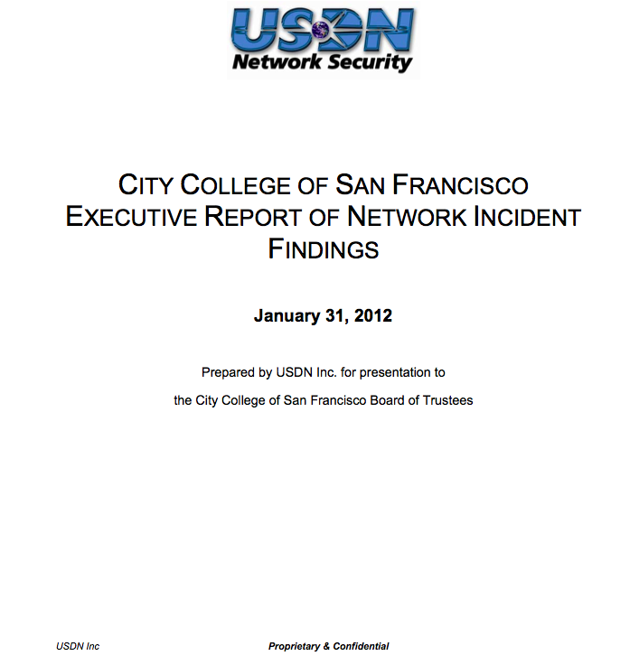

Slide 16
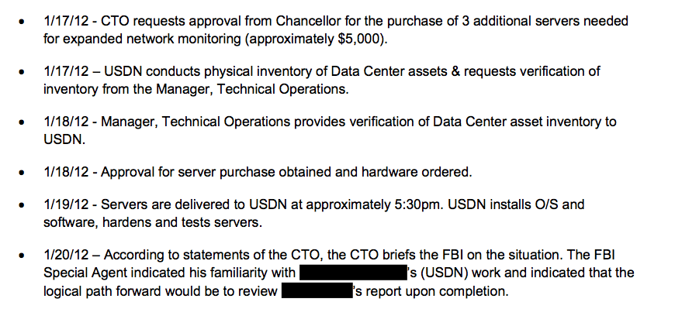

Slide 17
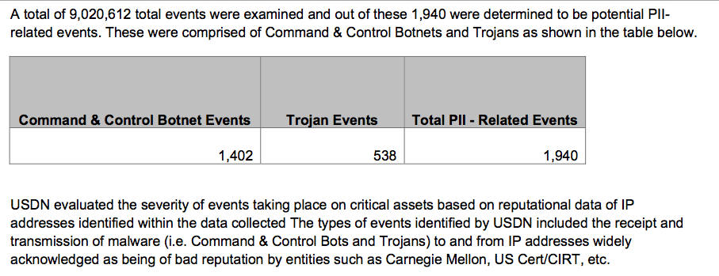

Slide 18
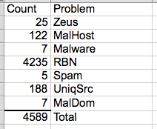
The List
On April 3, we finally got a list of the "infected machines"
Direct inspection of samples showed no real infections

Slide 19
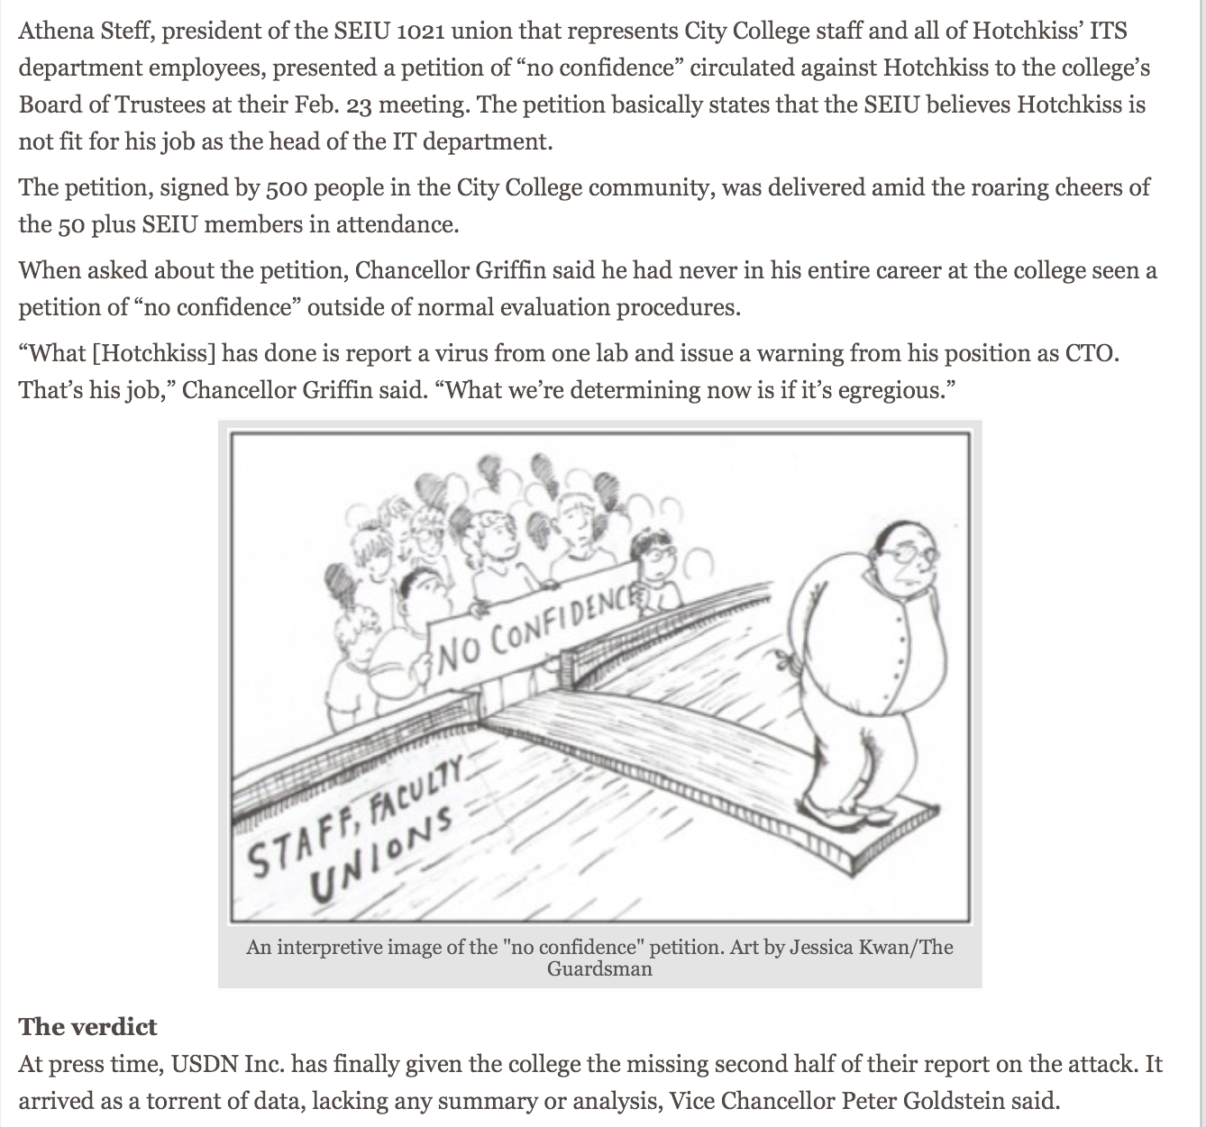

Slide 20
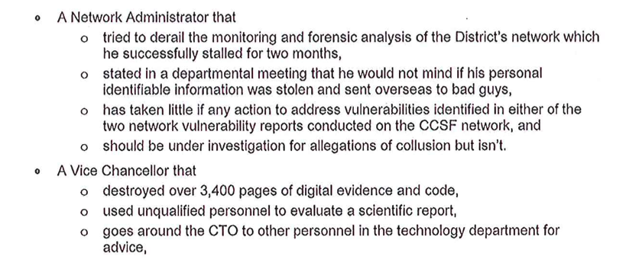
Letter to Trustees & Published in Newspaper

Slide 21
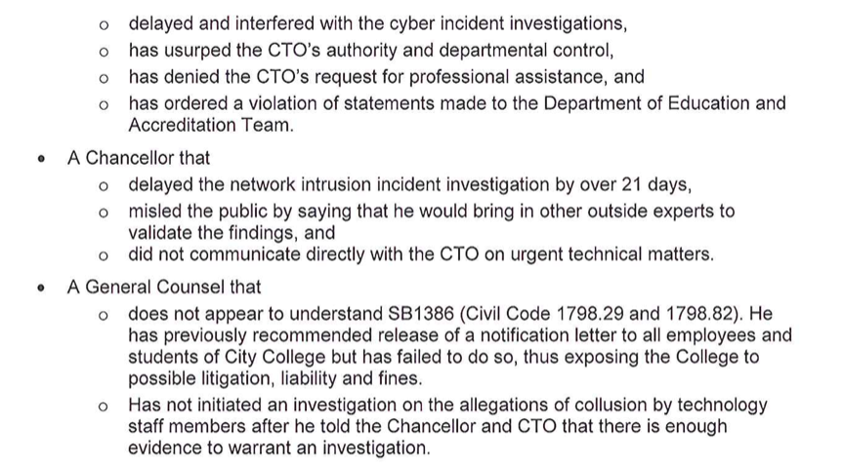

Slide 22
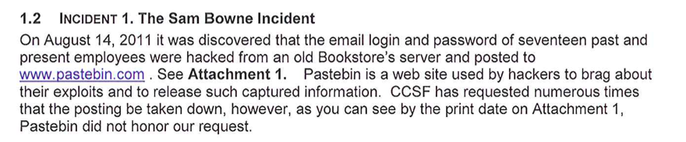

Falsified Breach in 2011

Slide 23
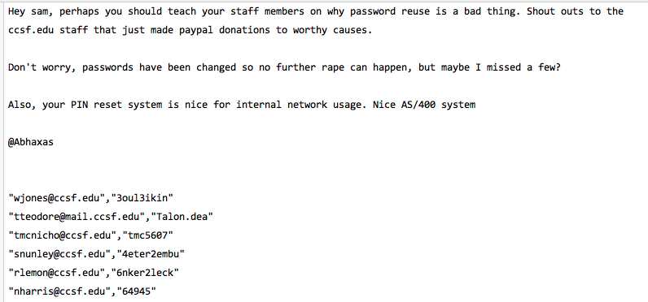
Proven False at the Time

Slide 24
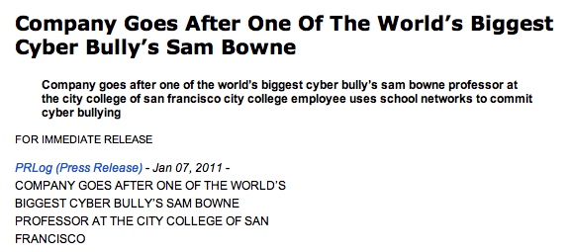
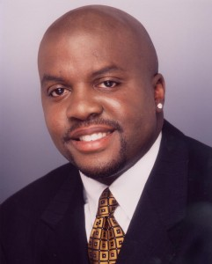
Cyber-Bullying

Slide 25
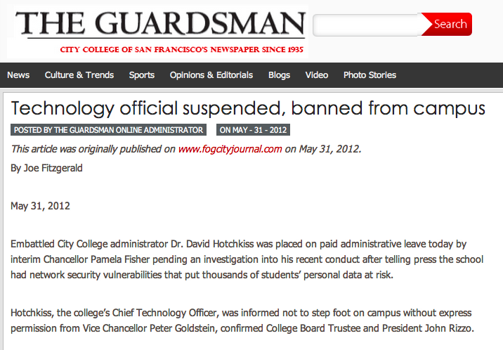

Slide 26
How Does a Real Breach Happen?

Slide 27
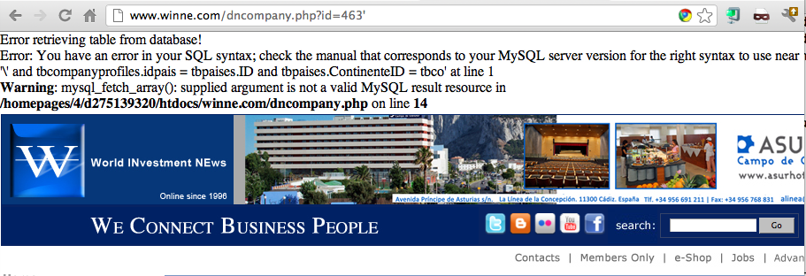
Example SQL Injection Vulnerability

Slide 28
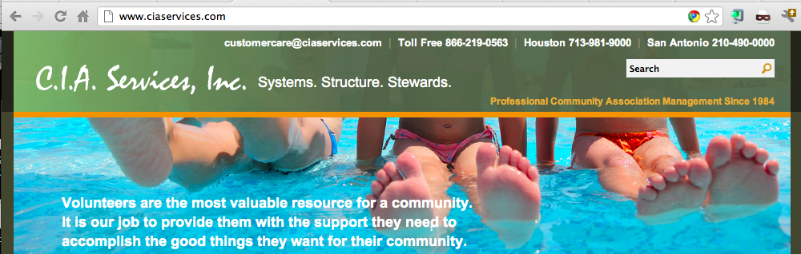
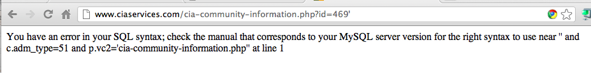

Slide 29
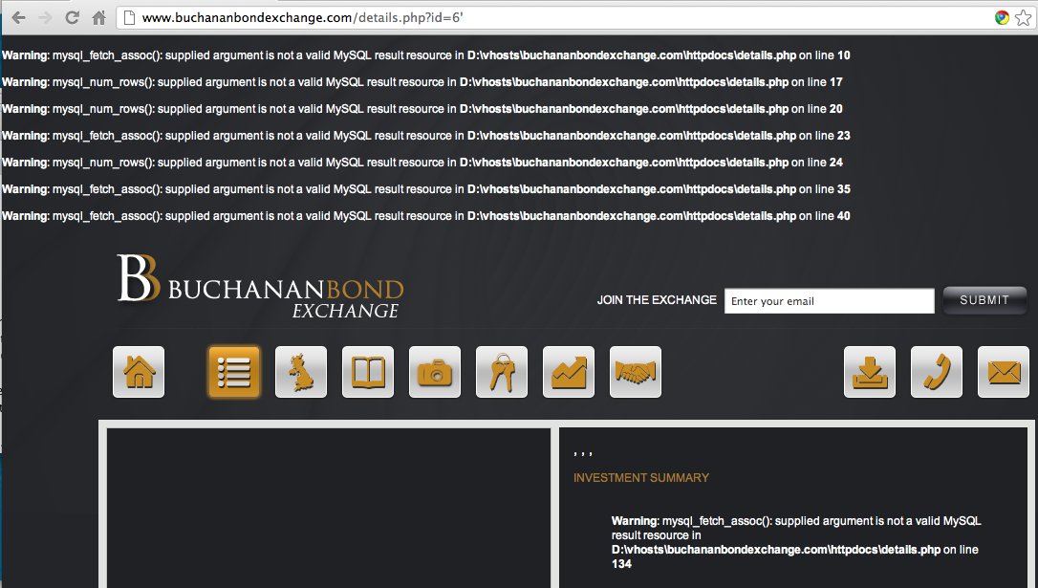

Slide 30
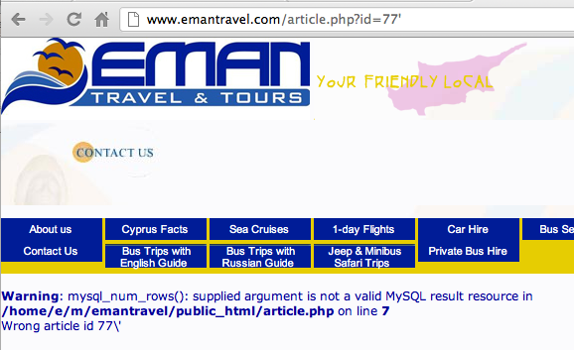

Slide 31
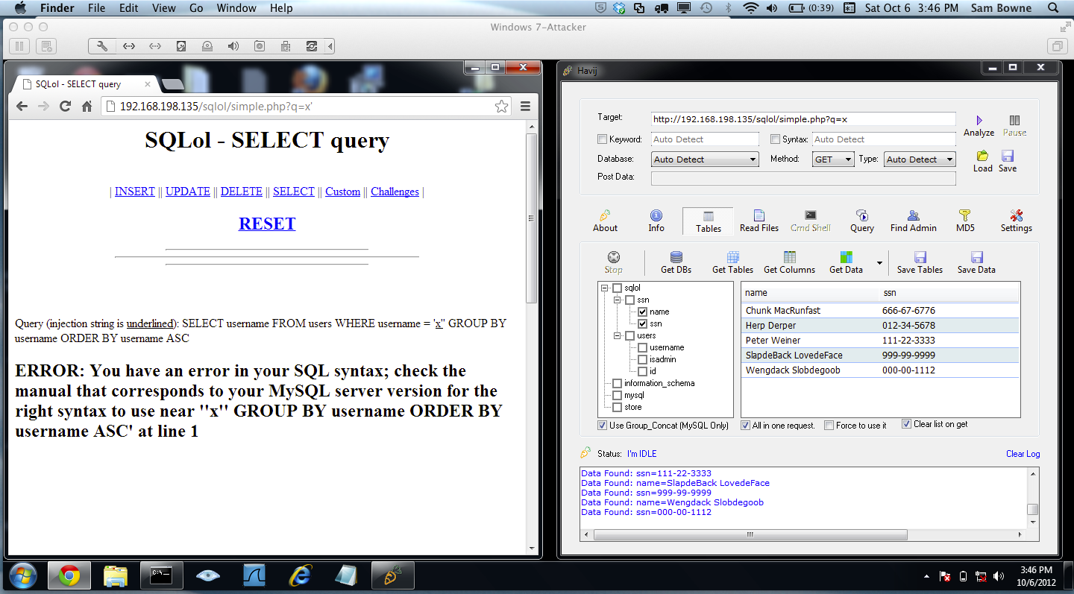
Demo

Slide 32
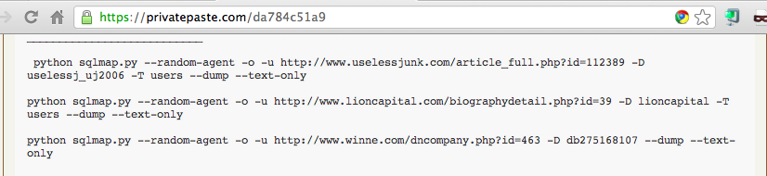
The Commands Used to Steal the Data

Slide 33
Analysis of Stolen Data Dumped by TEAMGHOSTSHELL on Aug 25, 2012

Slide 34
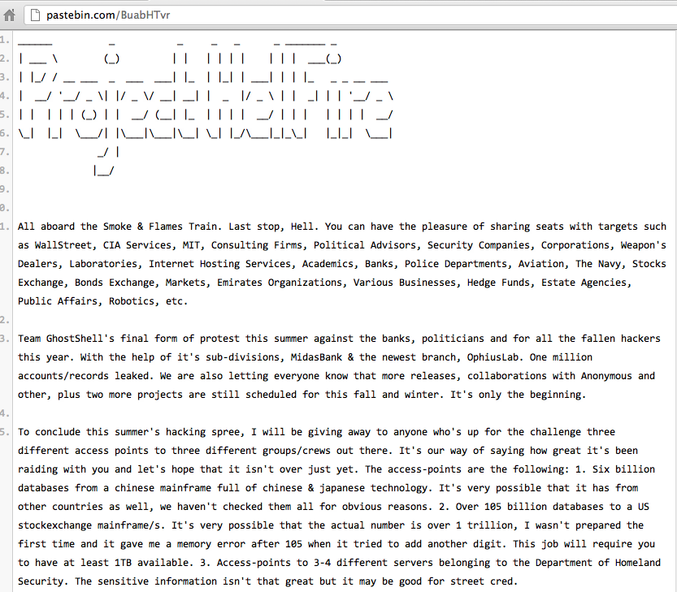

Slide 35
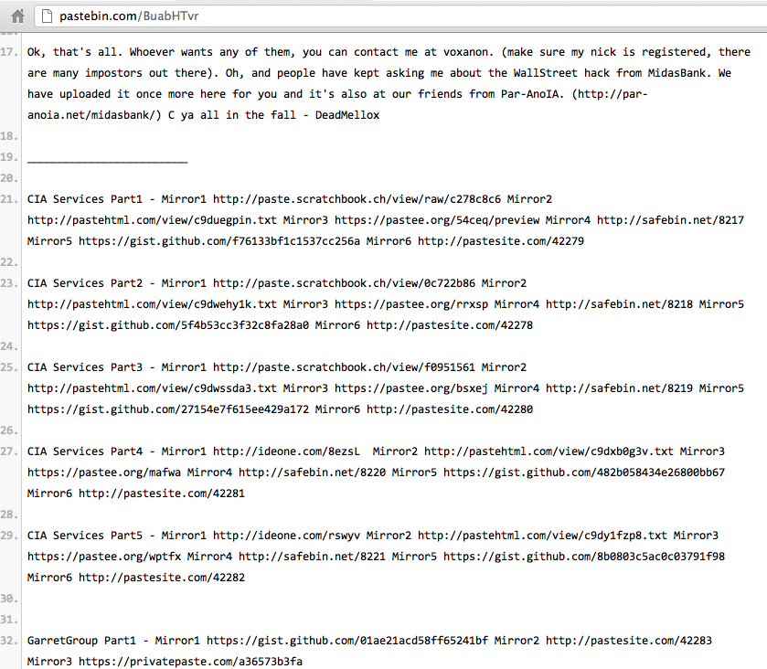

Slide 36
Password Storage:
Awful Beyond Belief
Plaintext, obvious, all the same

Slide 37
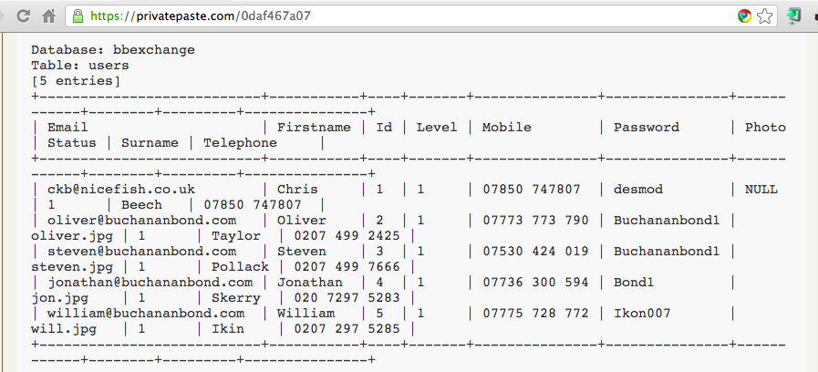
Plaintext Passwords, Easily Guessed

Slide 38
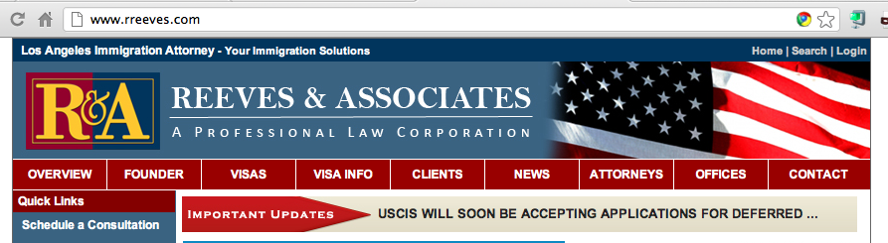
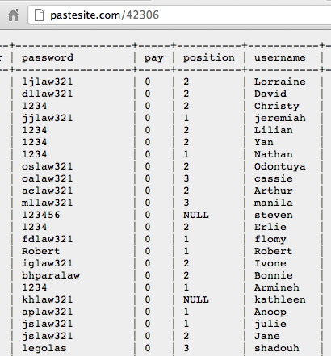

Slide 39
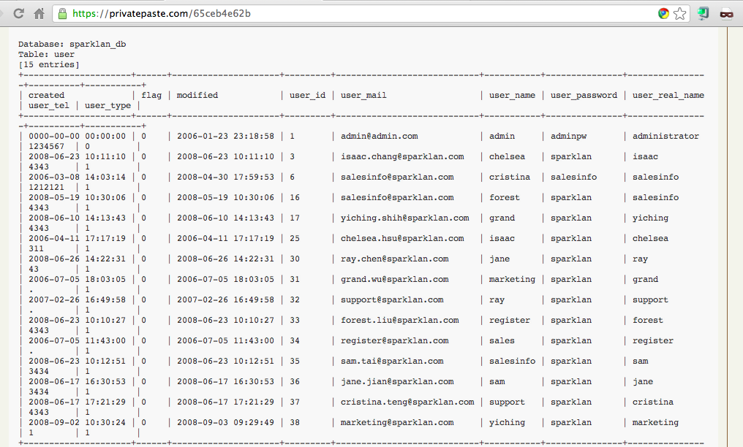
Sparklan Passwords

Slide 40
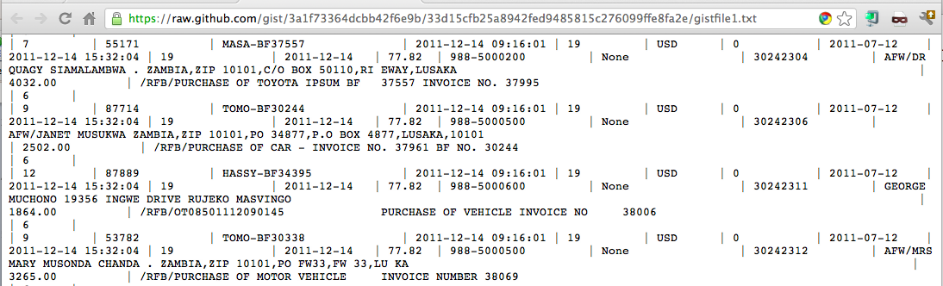
Beforward Transactions with PII

Slide 41
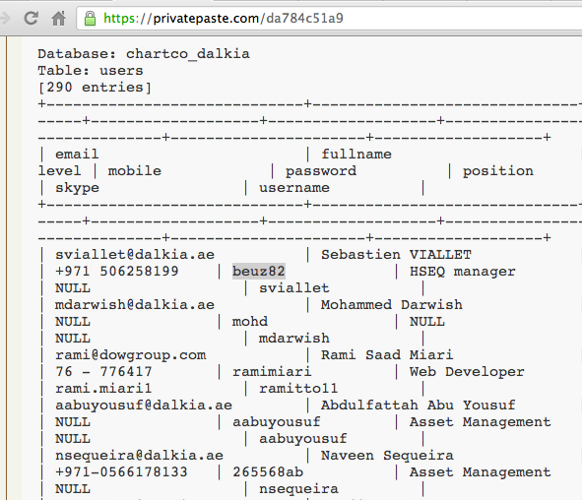
Plaintext Passwords

Slide 42
Password Storage:
BASE64
Obfuscated, not hashed

Slide 43
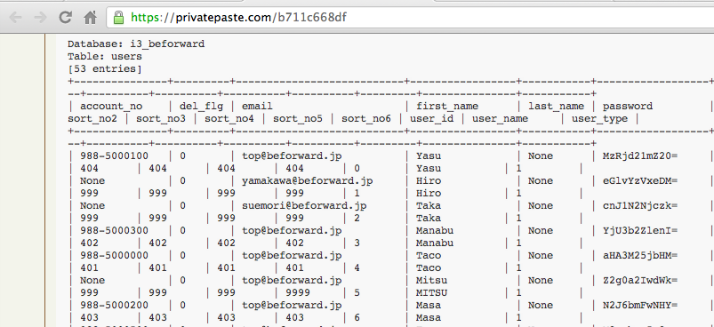
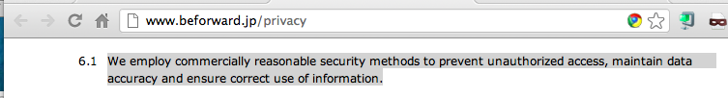
Beforward.jp

Slide 44
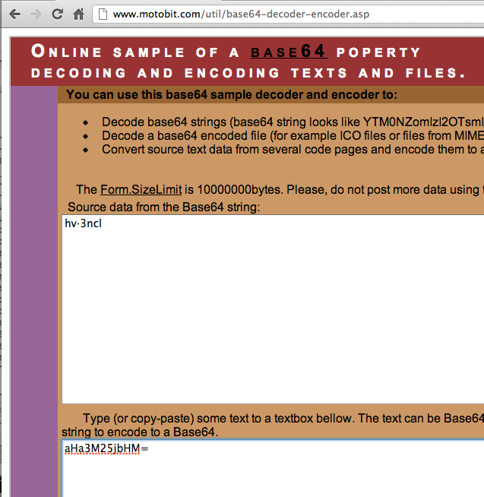
BASE64 Encoding

Slide 45
Password Storage:
Unsalted MD5 or SHA-1
Real hashing, but very easy to crack

Slide 46
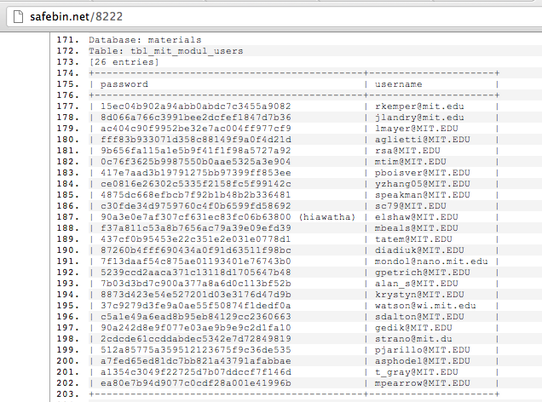
MIT – MD5 Password Hashes

Slide 47
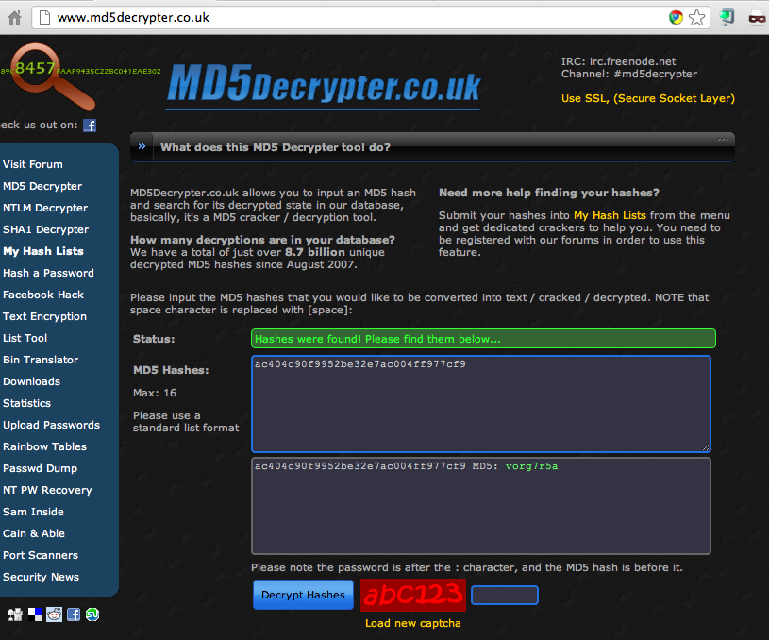

Slide 48
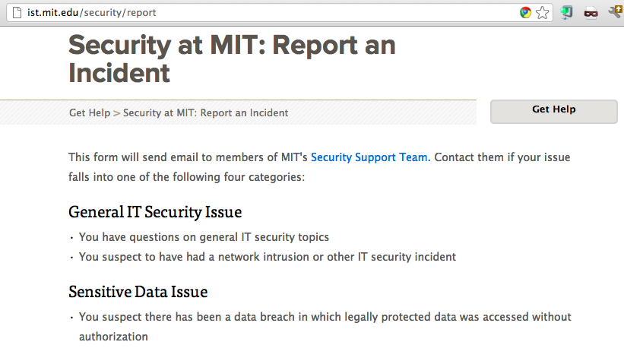

Slide 49
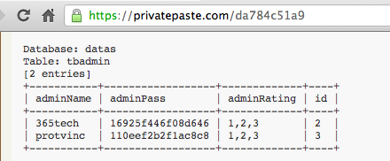
MySQL323 Password Hashes

Slide 50
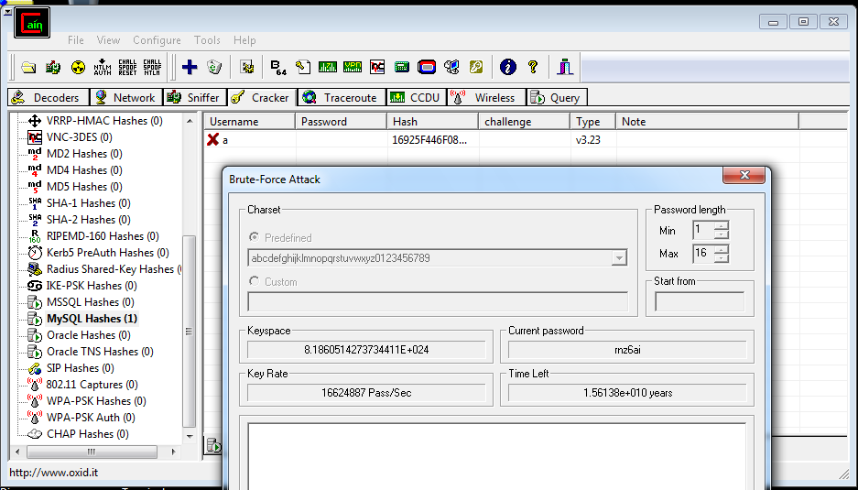
Cracking Hashes with Cain

Slide 51
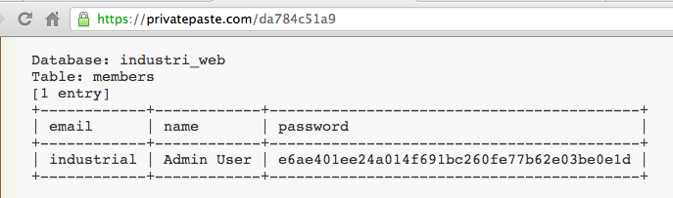
SHA-1 Hash

Slide 52
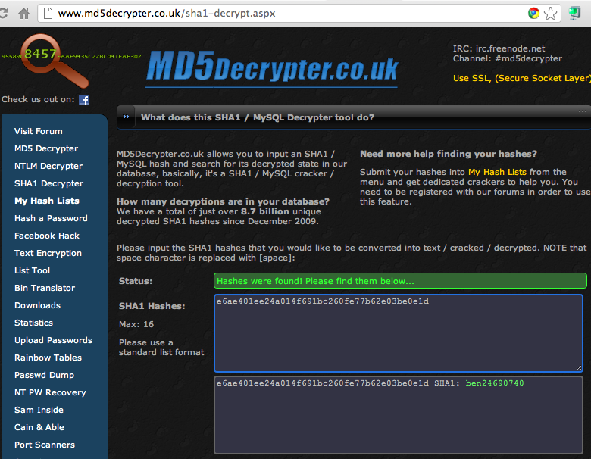
Cracked!

Slide 53
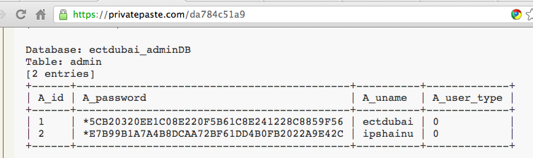
MySQL 5 Password Hashes

Slide 54
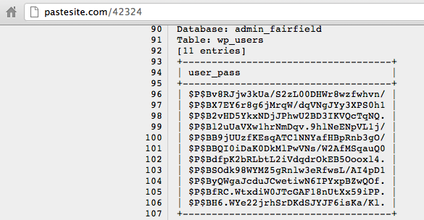
Wordpress Password Hashes

Slide 55
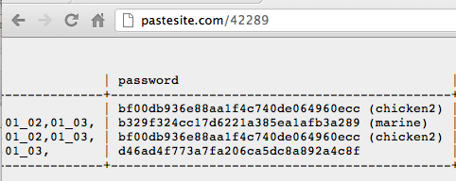
Relative Space

Slide 56
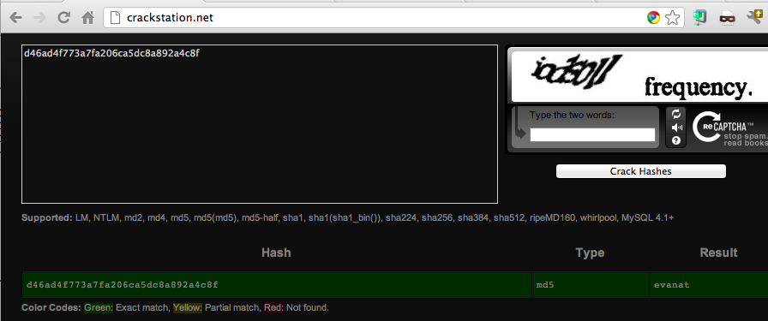
Cracked!

Slide 57


Slide 58




Slide 59
Password Hashing Algorithms

Slide 60


Slide 61

The Right Way

