Slide 1

When Vulnerability Disclosure Gets Ugly
Oct 10, 2014

Slide 2
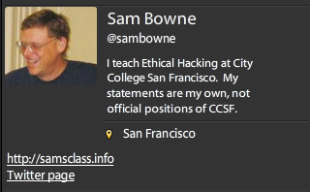

Slide 3
Obvious Security Problems
Cold Calls

Slide 4

Old Wordpress Version
Wall Street Journal
  Wordpress version from 2012
  Ty Ryan Satterfield (@I_am_ryan_S)

Slide 5
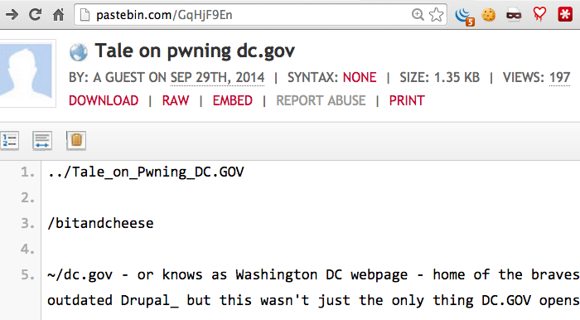
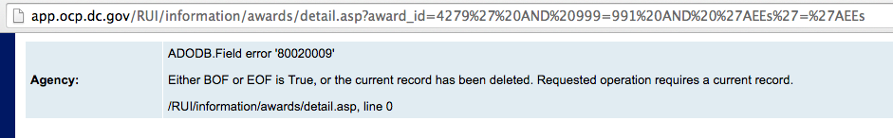
SQLi on Pastebin

Slide 6
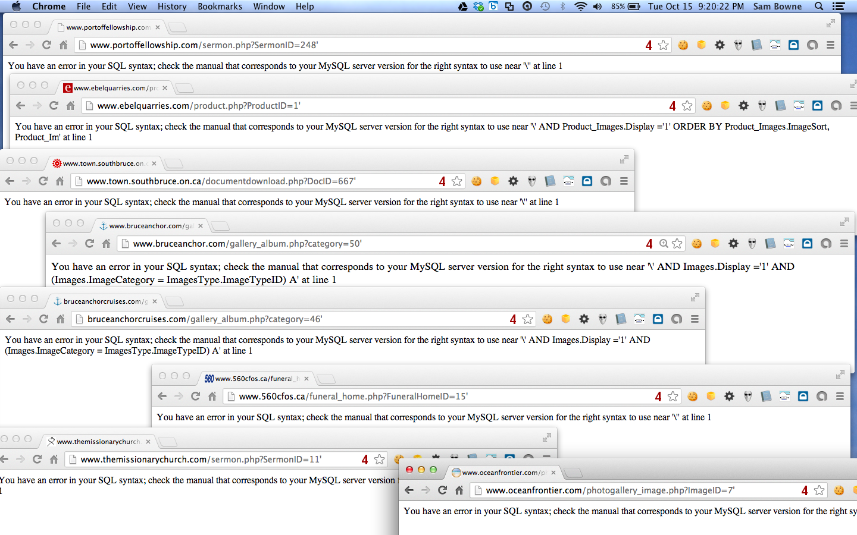
Websmart, Inc. and 100,000 Vulnerable Websites

Slide 7
Pharma Infections at Colleges

Slide 8
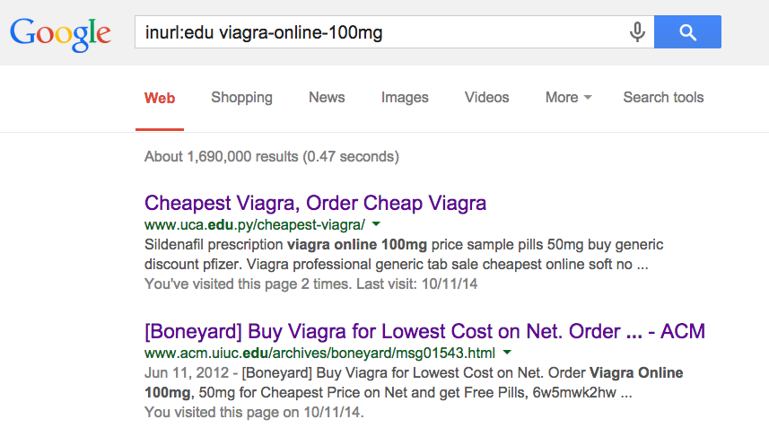

Slide 9
19 Colleges Infected with Pharma
5 Fixed within a few weeks
7 Fixed within 8 months
7 Still Infected on 7-19-14
http://samsclass.info/125/proj11/subtle-infect.htm#19more

Slide 10
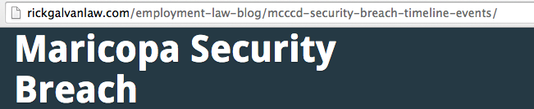
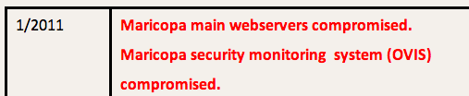
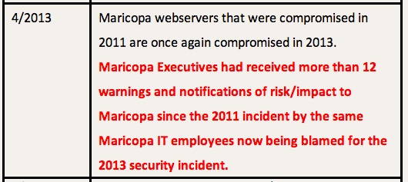

Slide 11
Infections at UC Santa Cruz

Slide 12
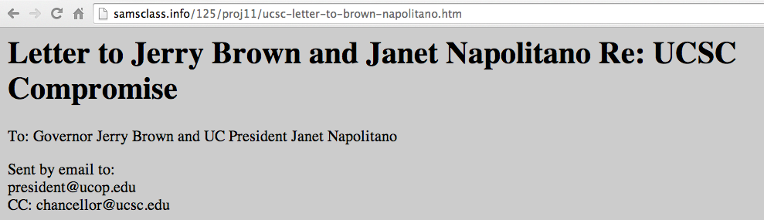
UCSC cleaned their server
Re-infected a week later
NEED ROOT CAUSE ANALYSIS

Slide 13
Many More Pharma Infections
Dozens of other schools, businesses, foreign sites, etc.
http://samsclass.info/125/proj11/subtle-infect.htm#19more

Slide 14
Exposed Data

Slide 15
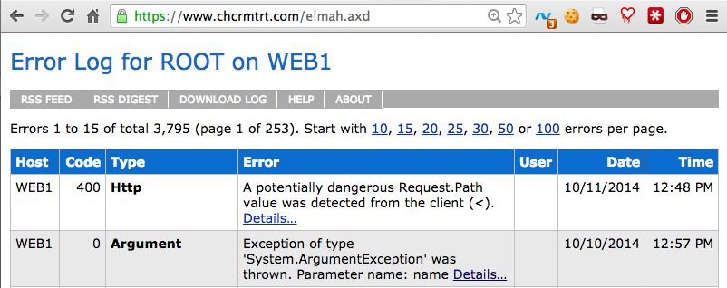
Exposed Error Logs
Can leak cookies
Even when secured by HTTPS

Slide 16
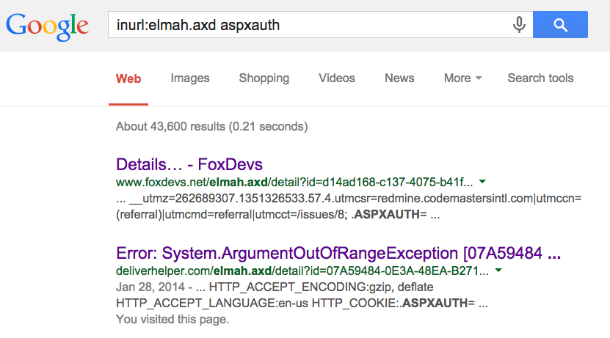
Google Dork for Exposed ELMAH Pages

Slide 17
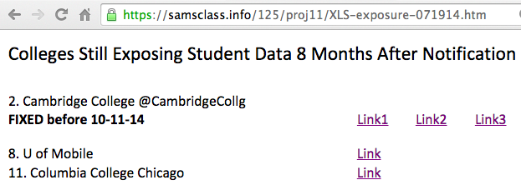
Exposed Student Data

Slide 18
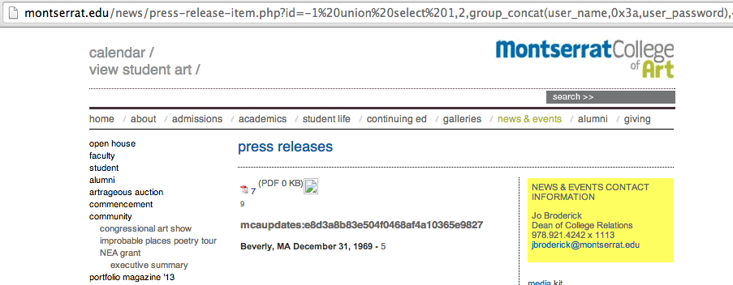
Exposed Password Hash

Slide 19
Plaintext Login Pages at Colleges

Slide 20
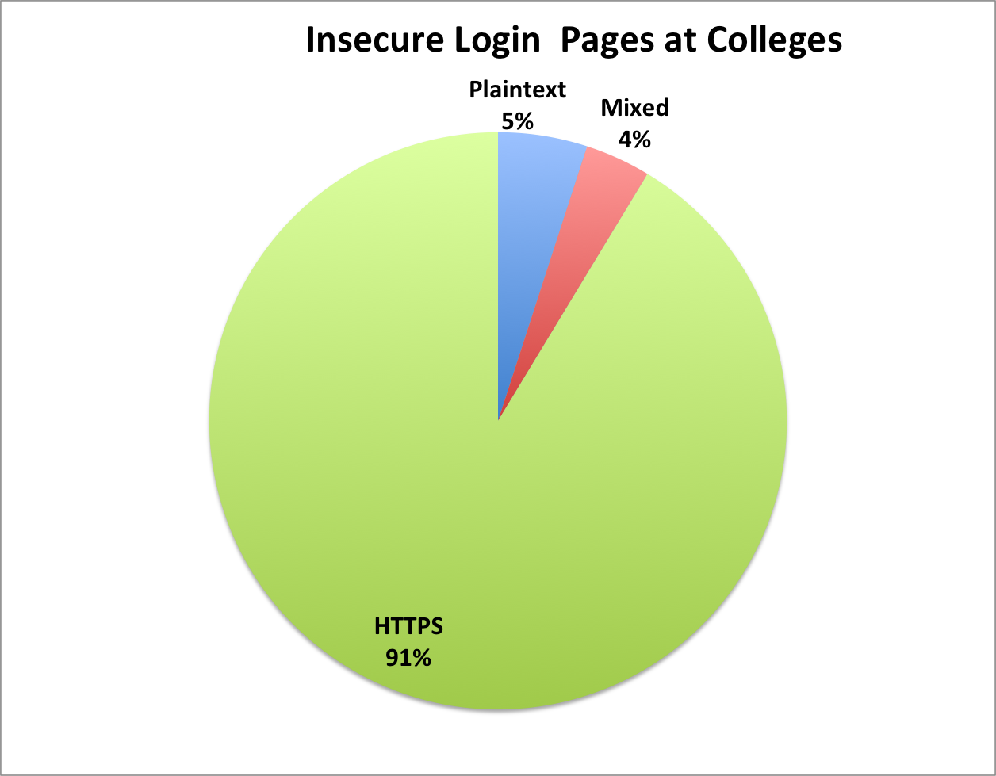
Insecure Login Pages at Colleges
90 colleges notified in Dec, 2013

Slide 21
Big Names
Cornell
Johns Hopkins
Stanford
UC Berkeley

Slide 22
Results
7 months after notification:
16/57 plaintext login pages fixed or improved (28%)
8/33 mixed login pages fixed or improved (24%)

Slide 23
Other Problems

Slide 24
ActiveMQ
Free open-source middleware from Apache
A Defcon talk said it was often insecure, so I looked on SHODAN to see

Slide 25
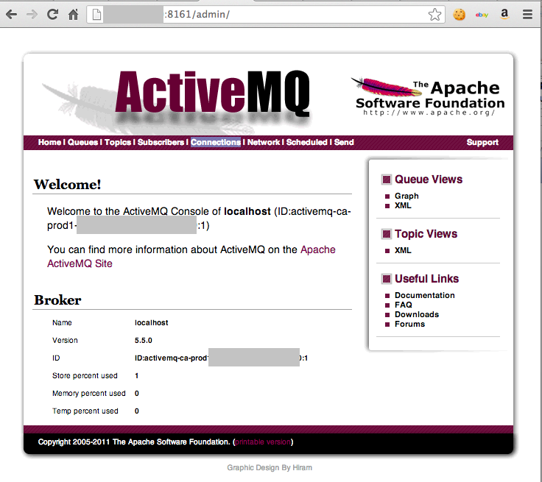

Slide 26
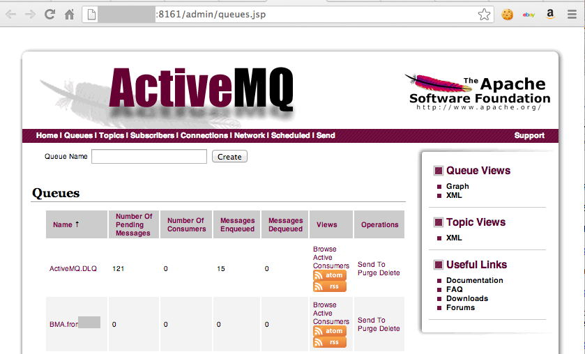

Slide 27
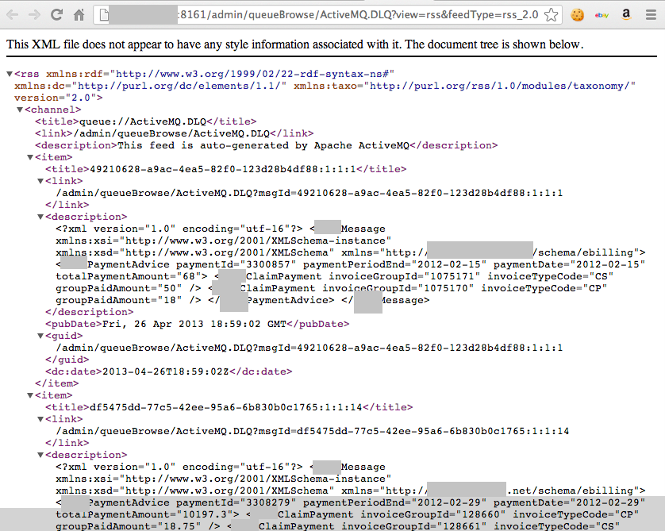
Real Check Data?

Slide 28
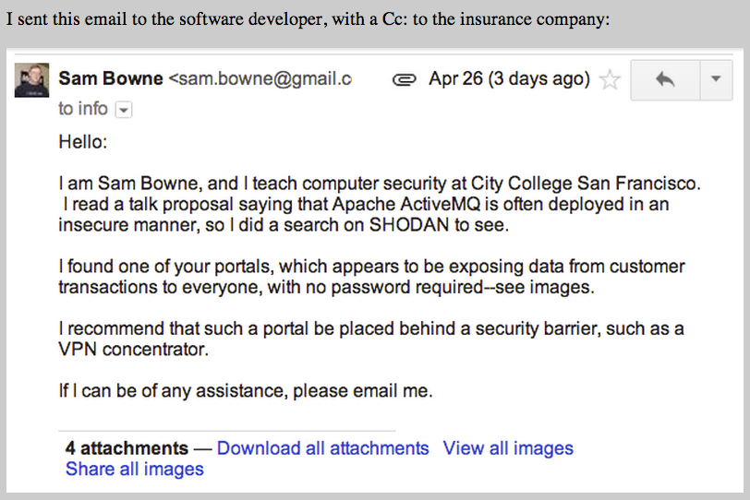

Slide 29
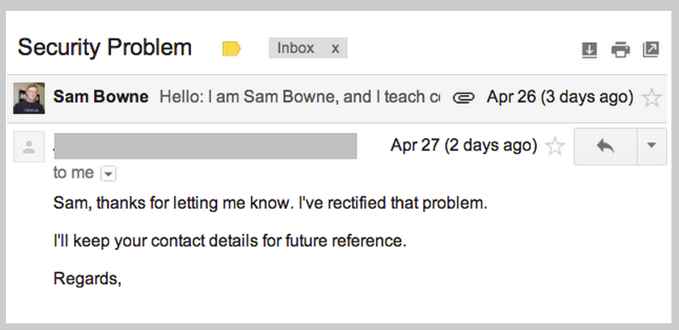

Slide 30
Wordpress Bots

Slide 31
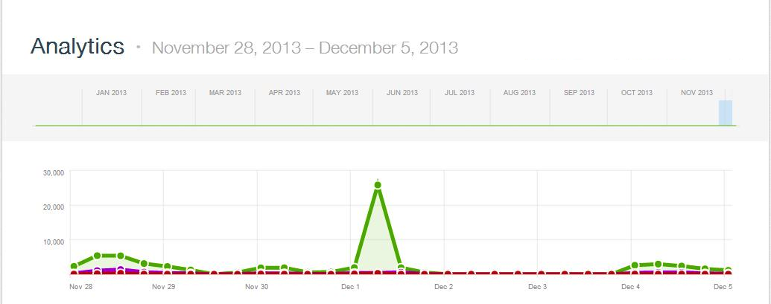
>2000 WordPress Bots
Thanks to Steven Veldkamp

Slide 32
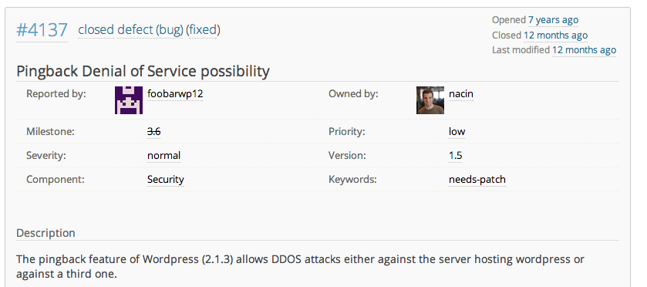
WordPress Has Known for 7 Years

Slide 33
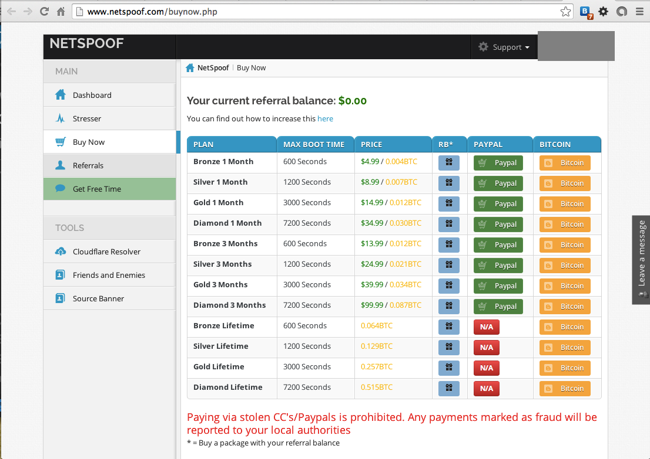

Slide 34
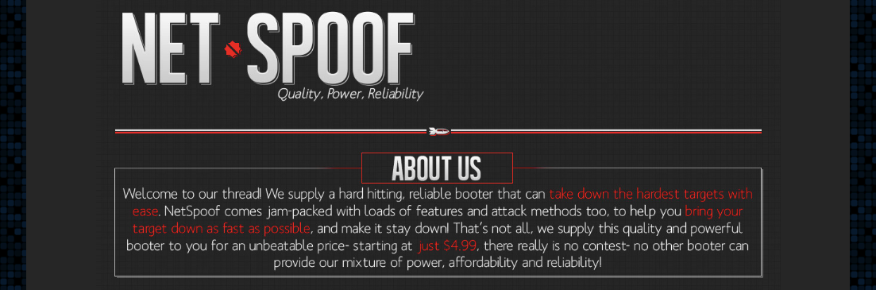

Slide 35
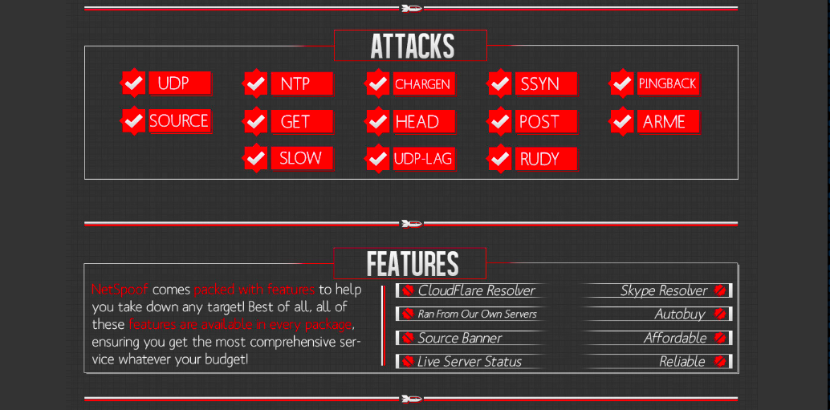

Slide 36
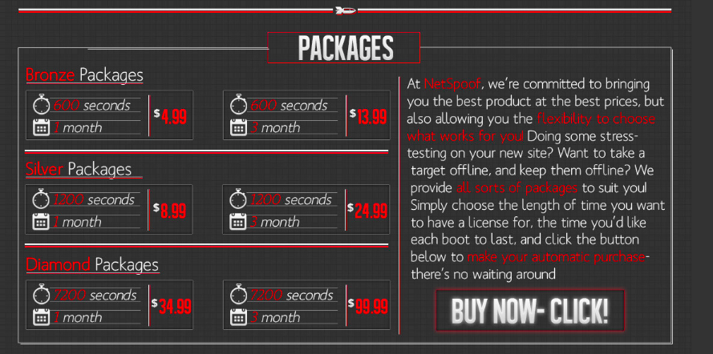

Slide 37
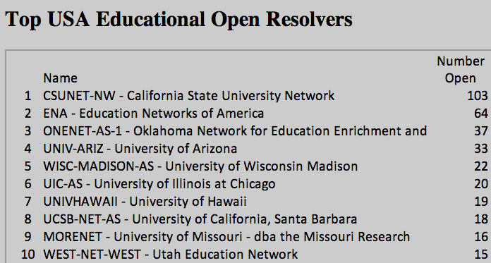
Open DNS Resolvers at Colleges

Slide 38
Results
Seven months after notification
38% decrease in open resolvers, from a total of 682 to 421

Slide 39
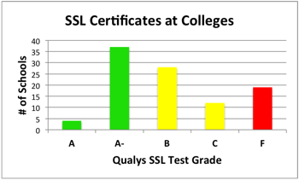

Slide 40
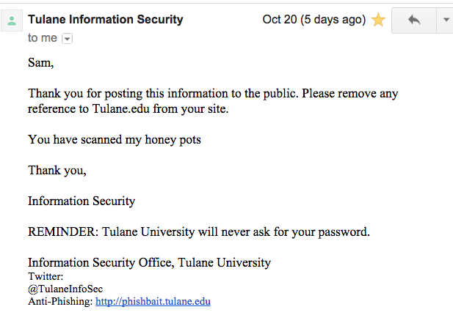

Slide 41
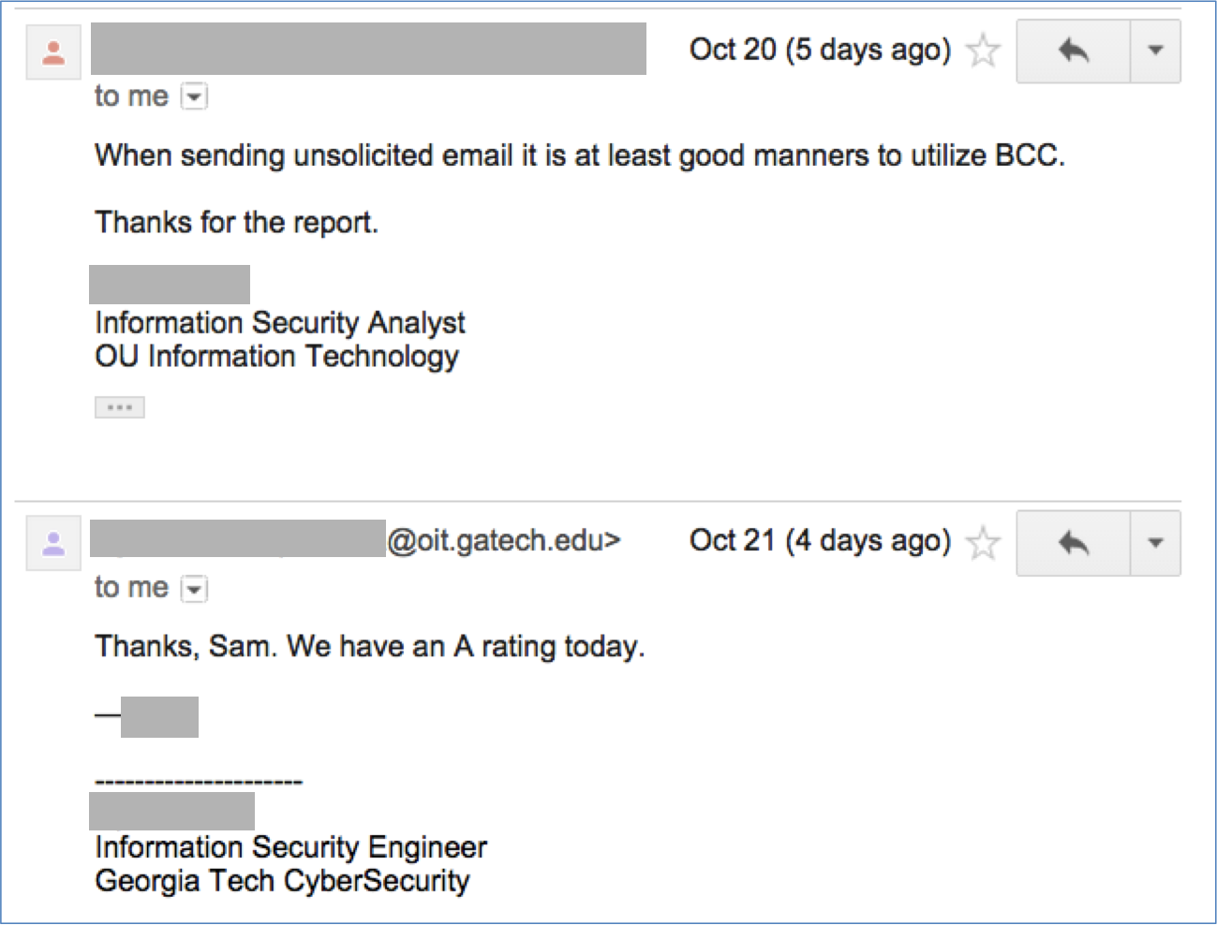

Slide 42
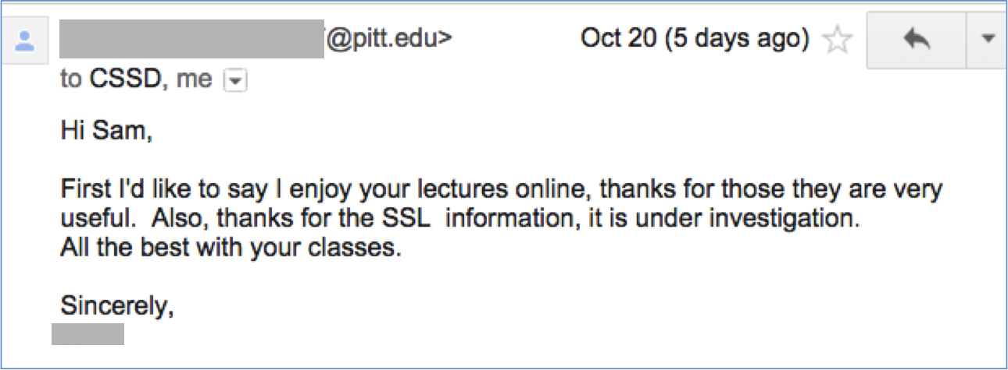

Slide 43
Results After 4 Days
4/19 colleges improved their rating
3 emails returned (but one of them improved)
4 responses, 2 hostile, 2 friendly

Slide 44
HIPAA Violation at LSU

Slide 45
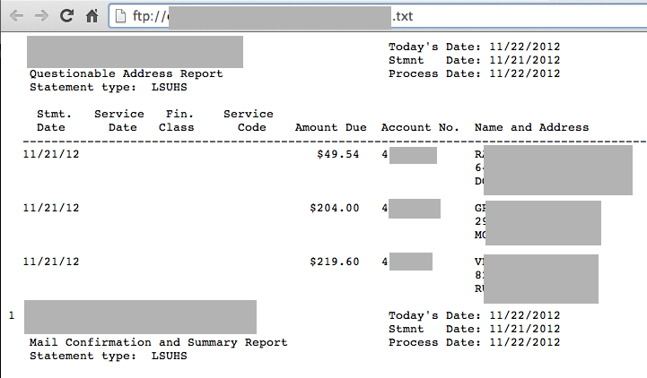
Open FTP Server with Medical Data

Slide 46
Reaction
I notified them on June 17, 2014
No reply, but server was down 4 hours later
Then on Aug. 28...

Slide 47
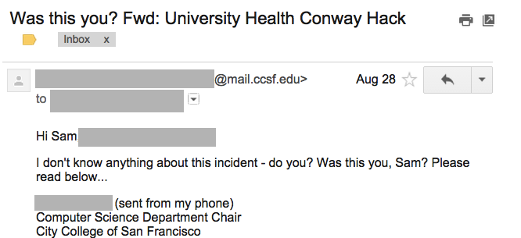
Reaction

Slide 48
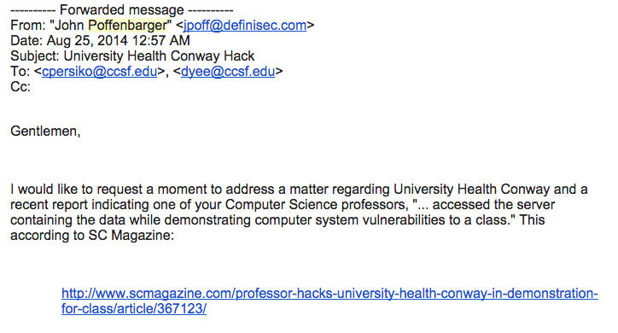
John Poffenbarger

Slide 49
John Poffenbarger
I encourage you to promptly investigate after publicly denouncing any such behaviors, as I would not expect an institution to accept, endorse, or tolerate any such actions.
I would have to wonder how this would affect the moral judgment of your graduating students entering the workforce.

Slide 50
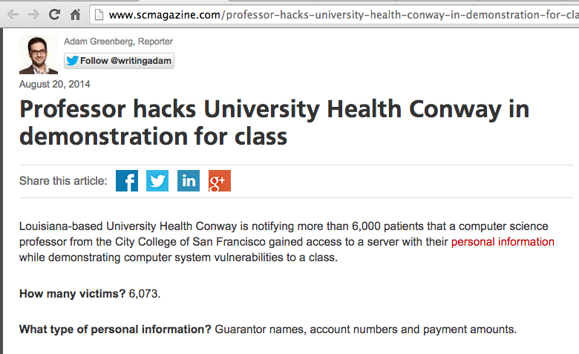

Slide 51
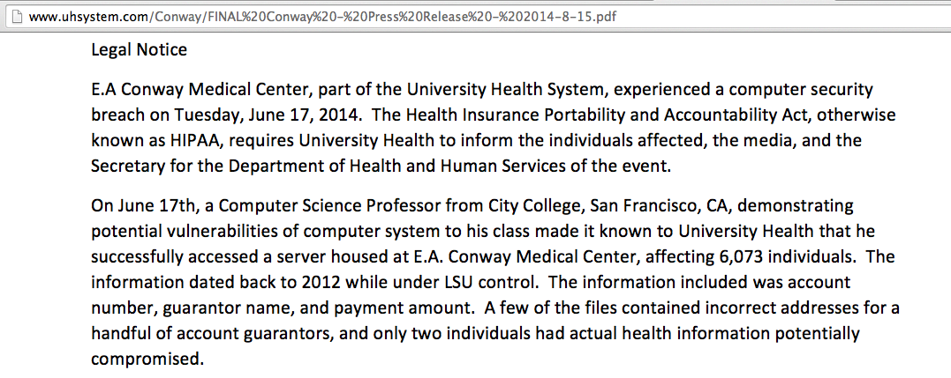
LSU Legal Notice

Slide 52
I Protested
  To the reporter
  To the CEO of his newspaper
  To the Feds, against LSU, for HIPAA whistleblower retaliation
After a few days, it was clear that none of this was going to do any good

Slide 53
I Believed
My actions were 100% lawful
Newspapers can't just publish complete lies and get away with it
I enjoyed HIPAA whistleblower protection
I'm in real trouble now, time to call a lawyer

Slide 54
Part 2: Alex Muentz

