Slide 1
Real Hacking
Sam Bowne
City College San Francisco
All materials available at samsclass.info

Slide 2
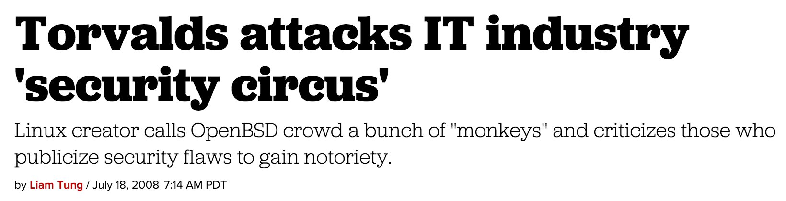

Hacking is indeed a circus
Is that supposed to be a bad thing?

Slide 3
Challenging Students

Slide 4
Student Diversity
Beginners
Old-school mainframe programmers upgrading skills
Amateurs from hackerspaces
Professional IT workers
Professional infosec workers

Slide 5
Levels of Achievement
Memorize definitions of terms
Hands-on projects with step-by-step instructions
Challenges without instructions
Capture the Flag Competitions
Professional information security employment

Slide 6

Violent Python
Step-by-step project
Challenges
  No instructions
  Increasing difficulty
ty @mqaissaunee

Slide 7
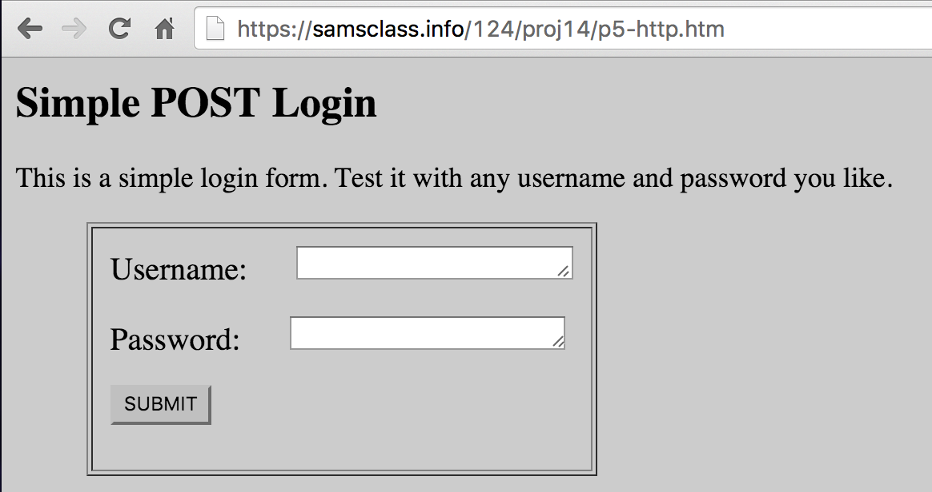

Slide 8
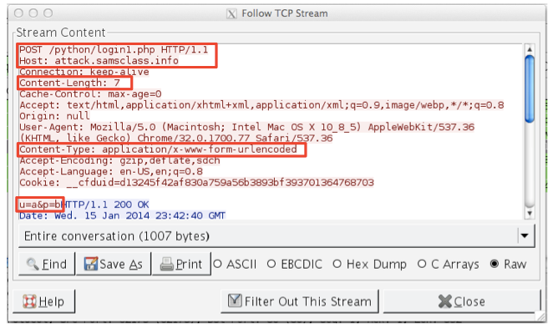

Slide 9
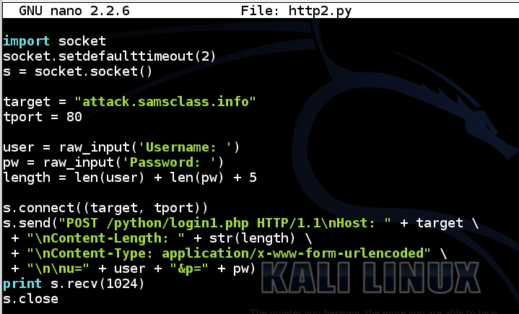

Slide 10
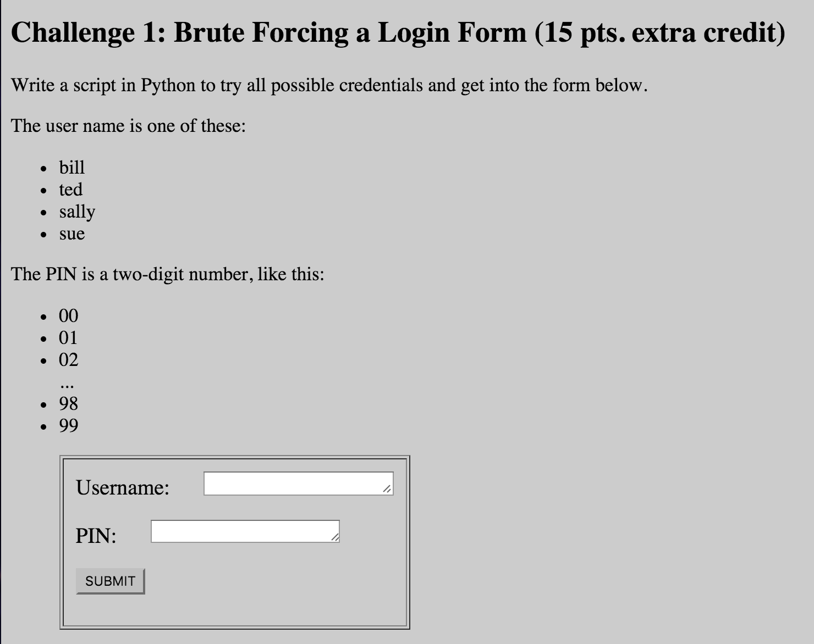

Slide 11
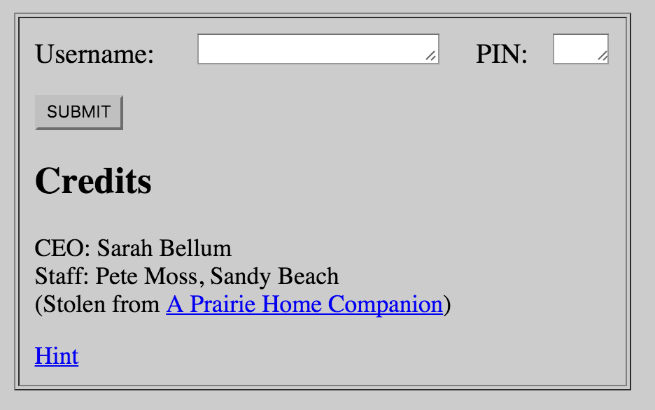

Slide 12
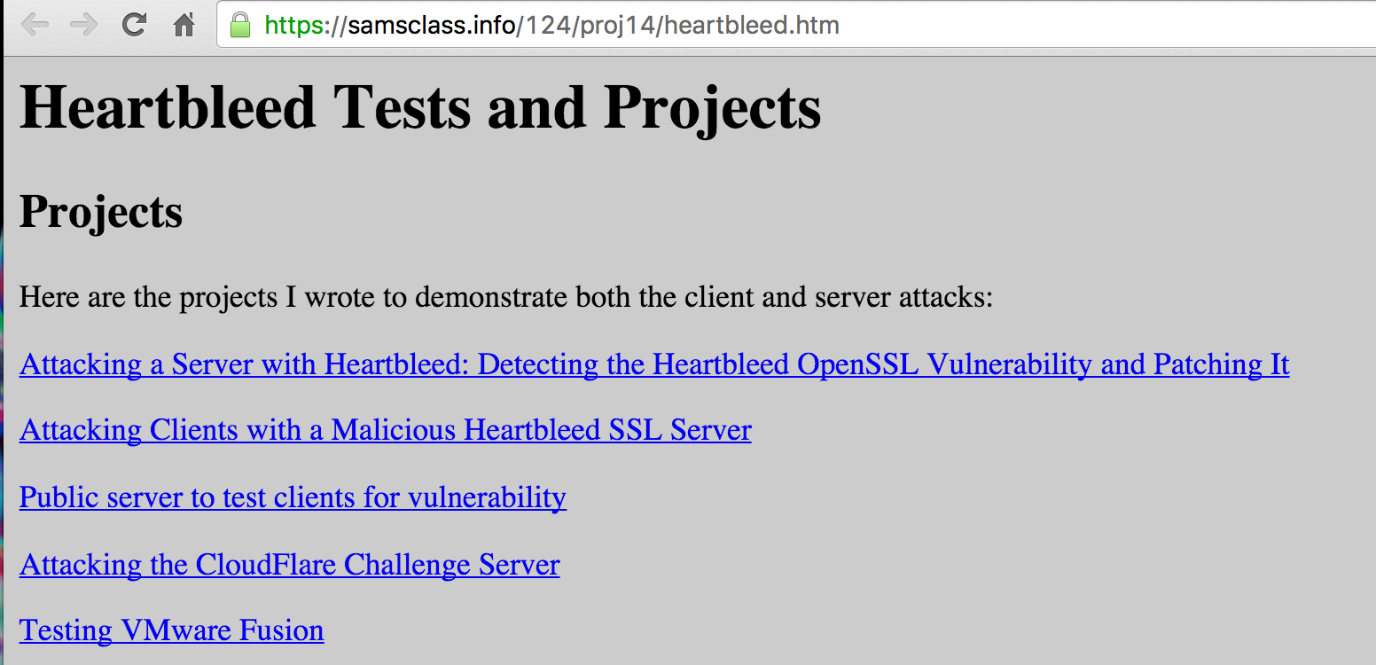
April 2014: Heartbleed

Slide 13
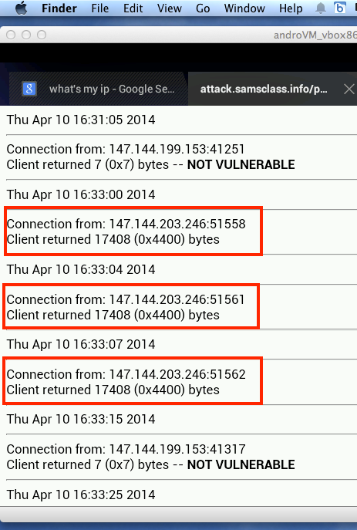
Vulnerable Android Devices

Slide 14
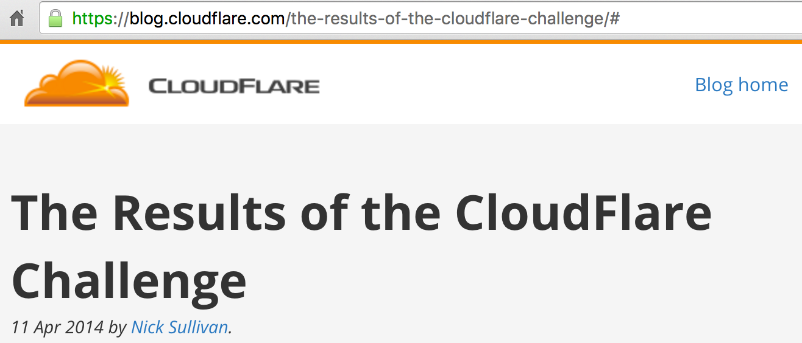
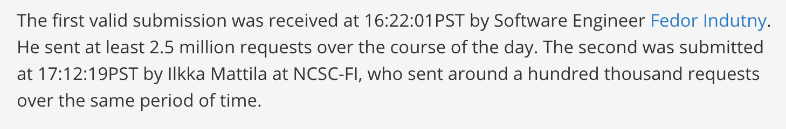

Slide 15
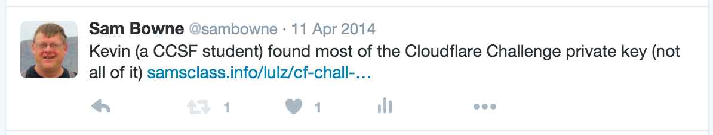
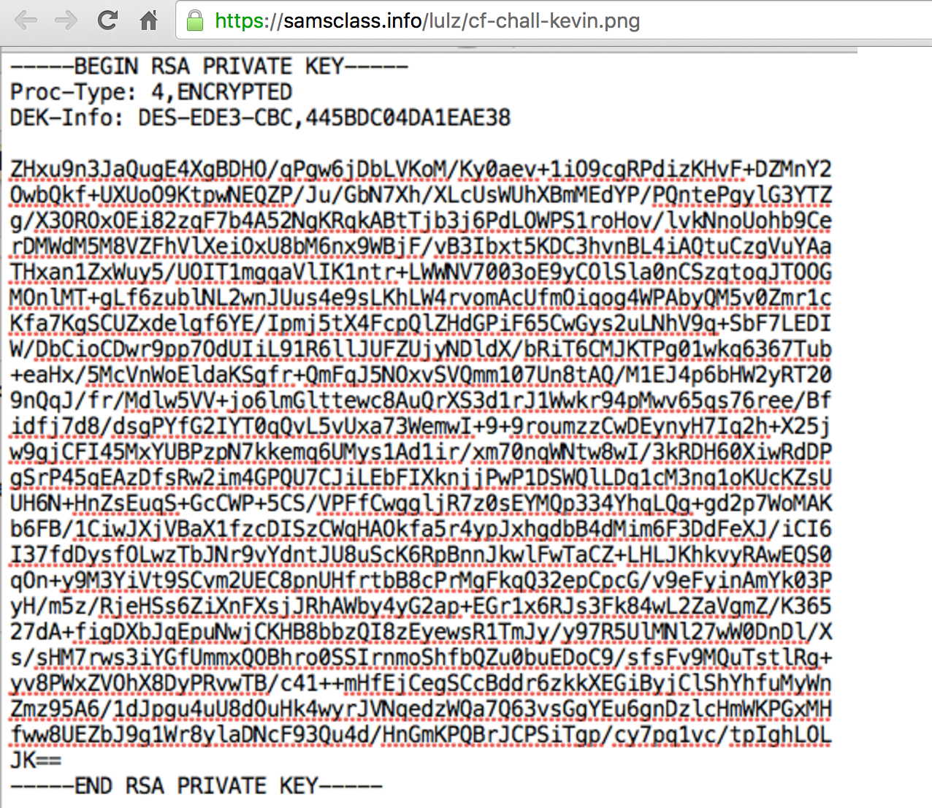
A Job from One Tweet

Slide 16
Exploit Development Class

Slide 17

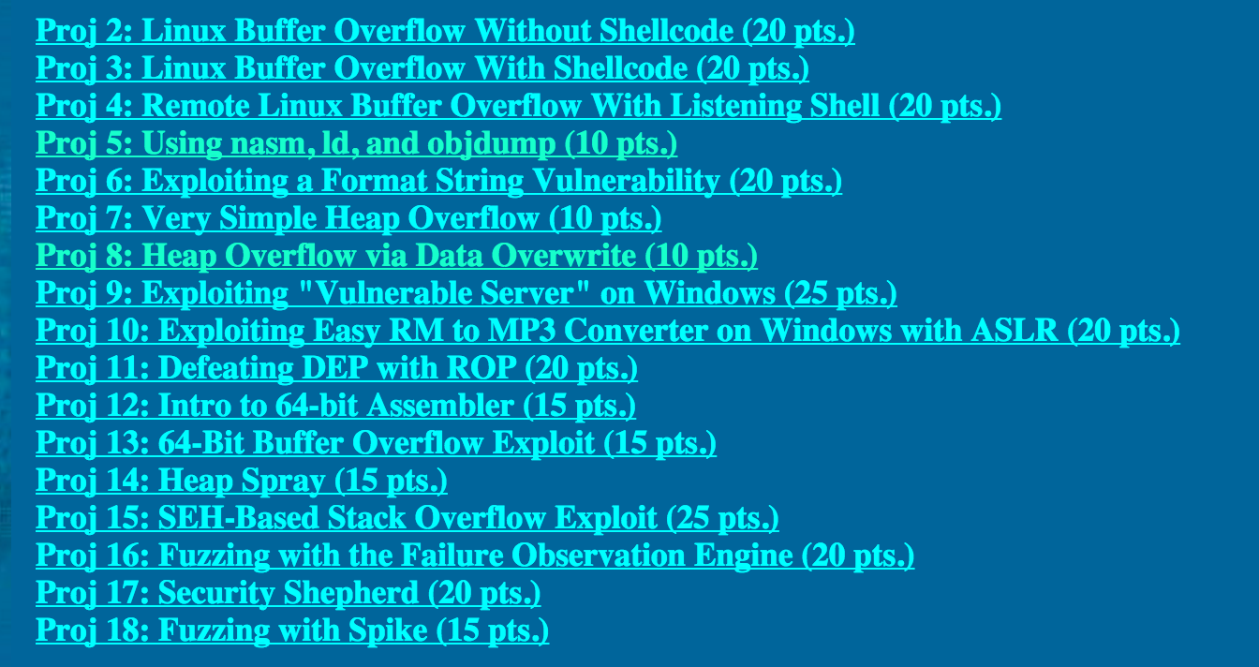
CNIT 127: Exploit Development

Slide 18
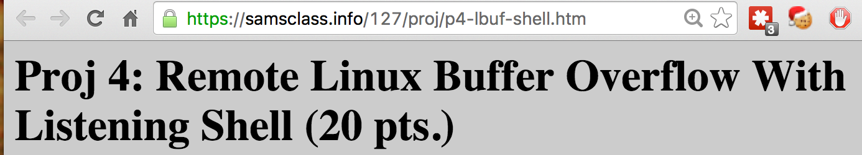
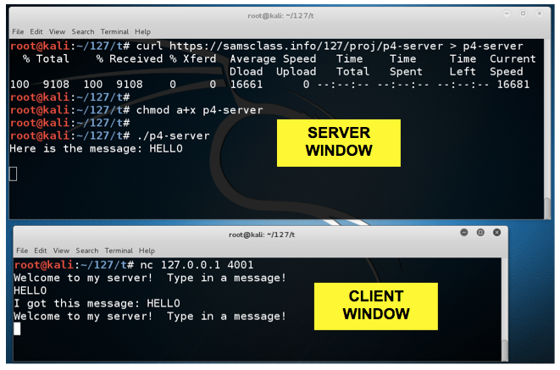

Slide 19
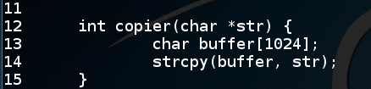
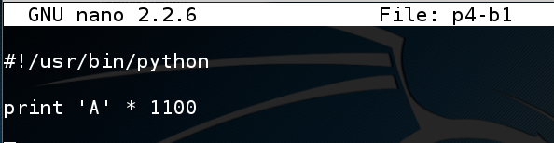
Buffer Overflow Vulnerability
Input more than 1024 bytes will overflow the buffer

Slide 20
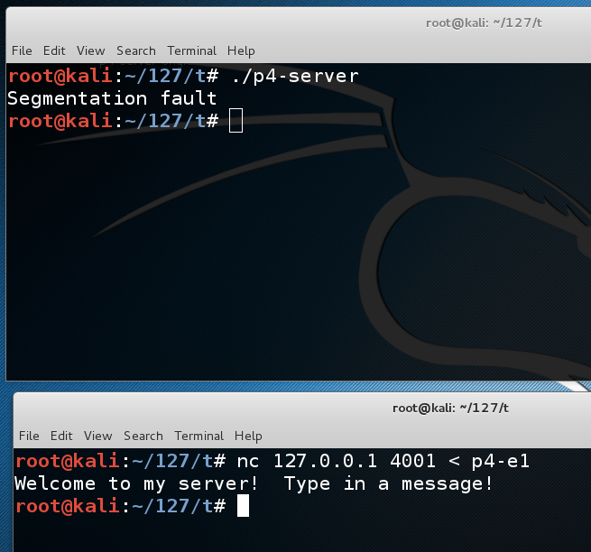
DoS Exploit

Slide 21
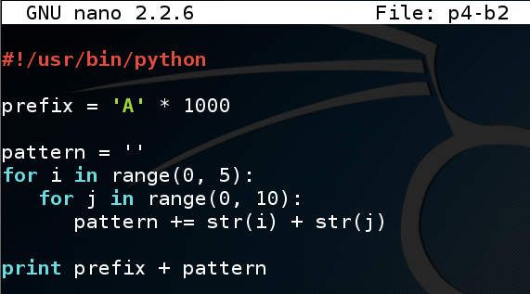
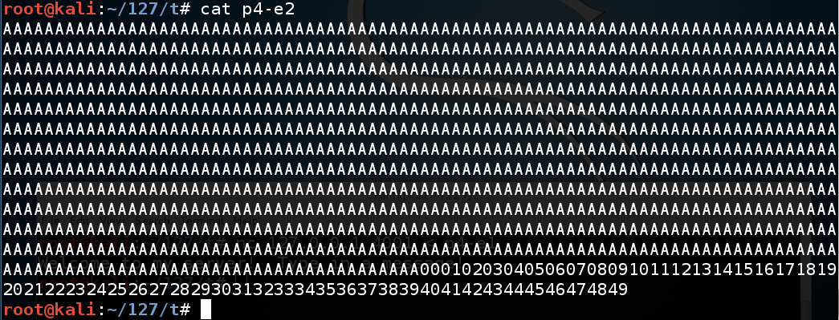
Nonrepeating Pattern

Slide 22
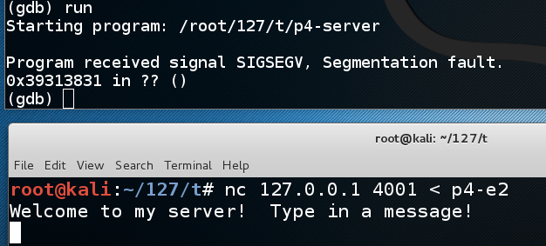
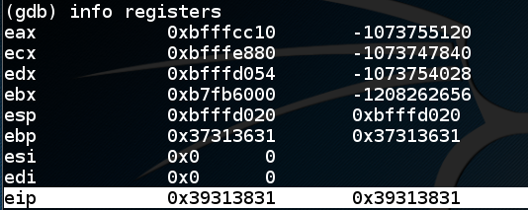
Gnu Debugger

Slide 23
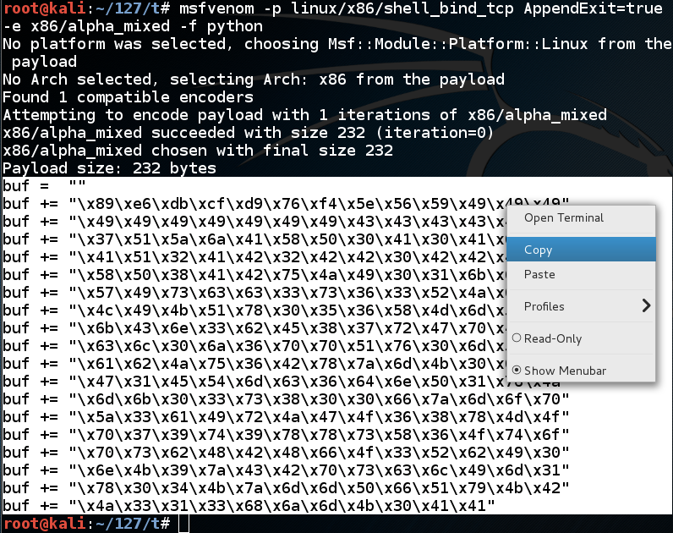
Generate Shellcode with msfvenom

Slide 24
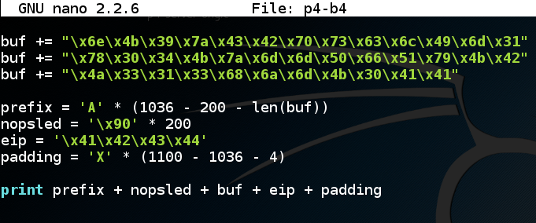
Construct Exploit

Slide 25
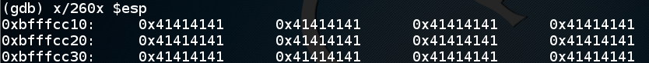
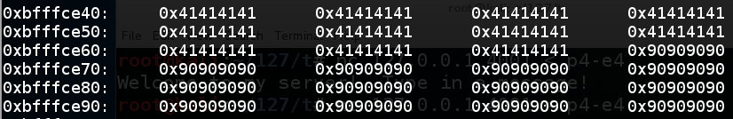
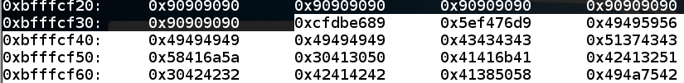
The Stack Frame
The last word is the return value
Must jump into the NOP sled

Slide 26
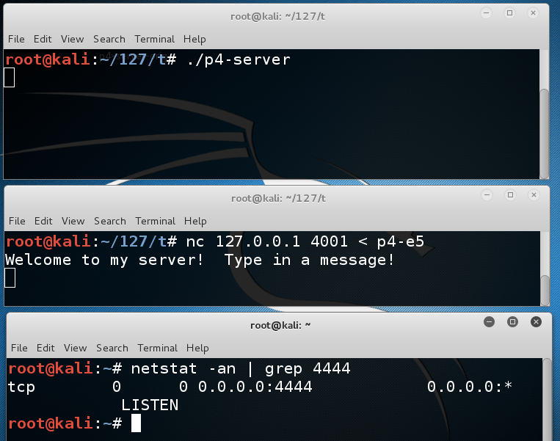
Listening Shell

Slide 27
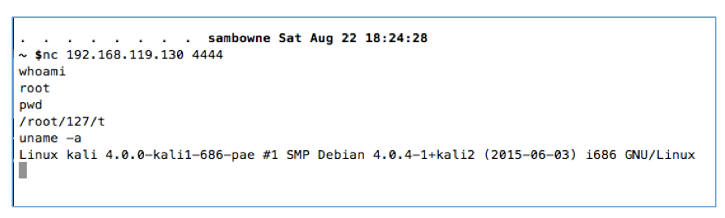
Pwnage
Remote Code Execution

Slide 28
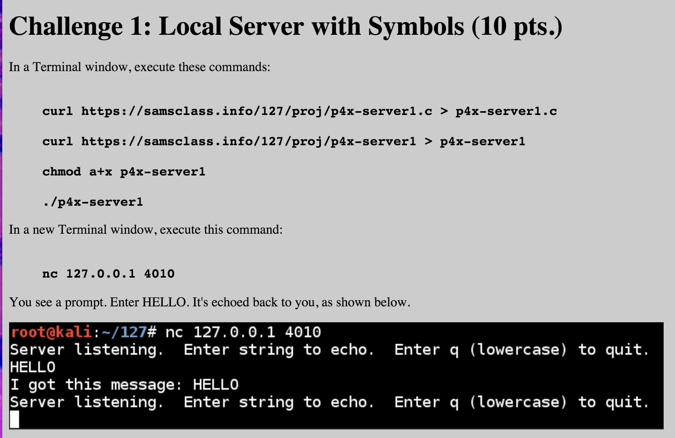

Slide 29
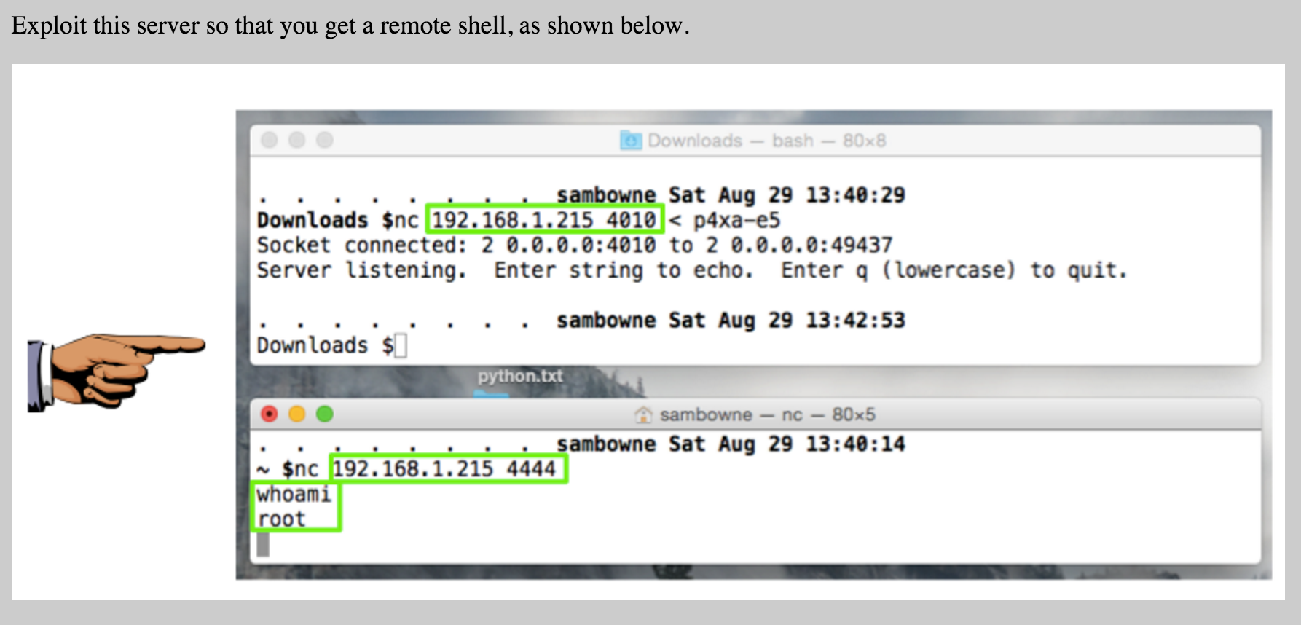

Slide 30
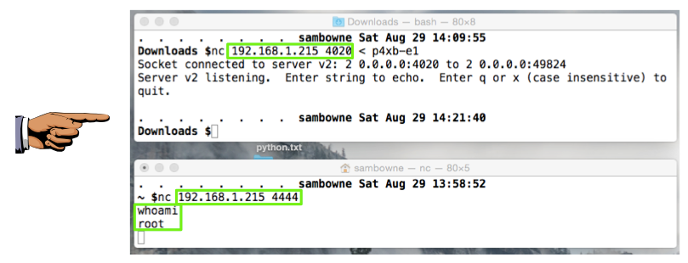

Slide 31
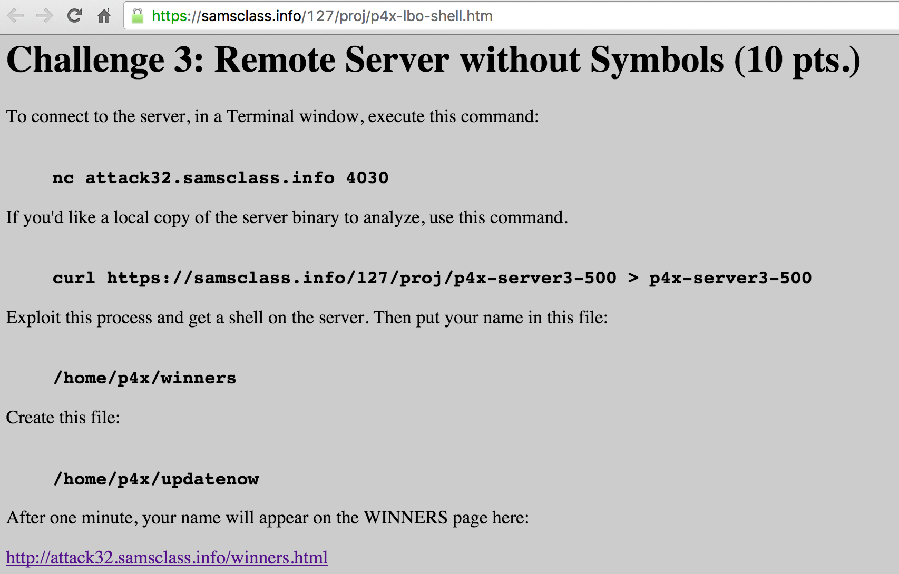

Slide 32
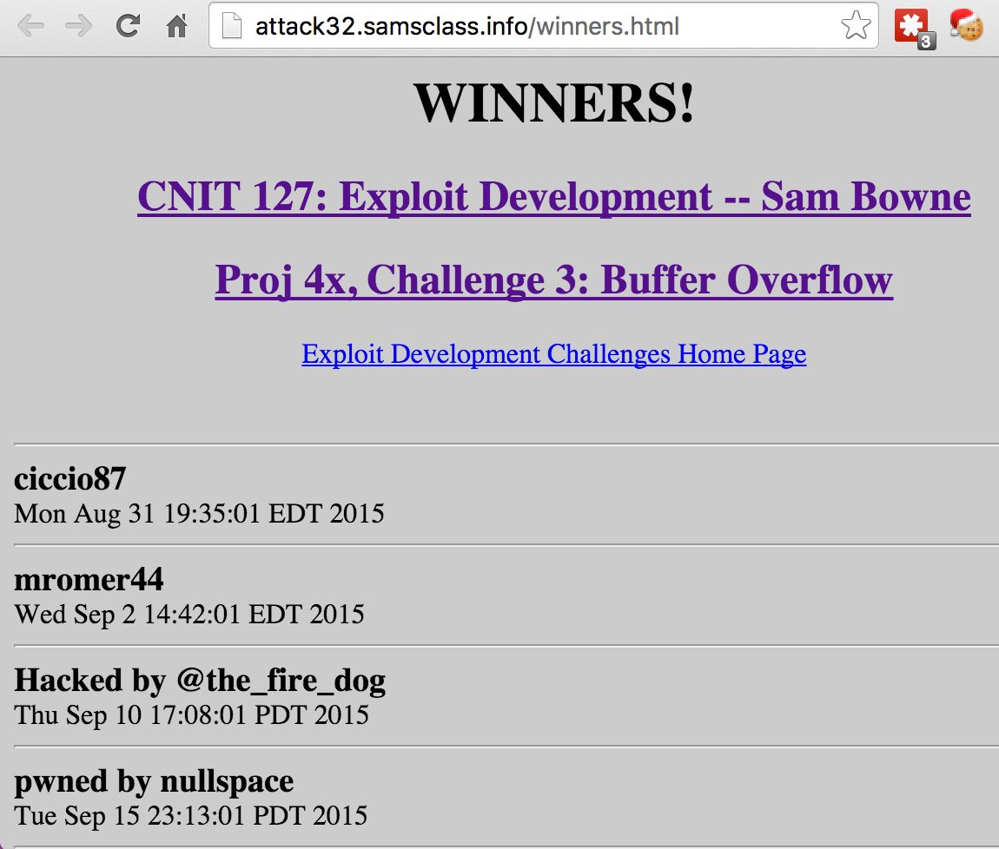

Slide 33
Vulnerability Disclosure

Slide 34
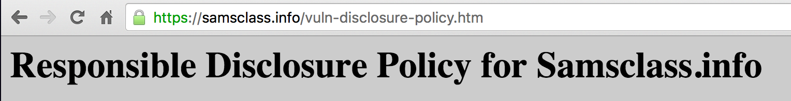
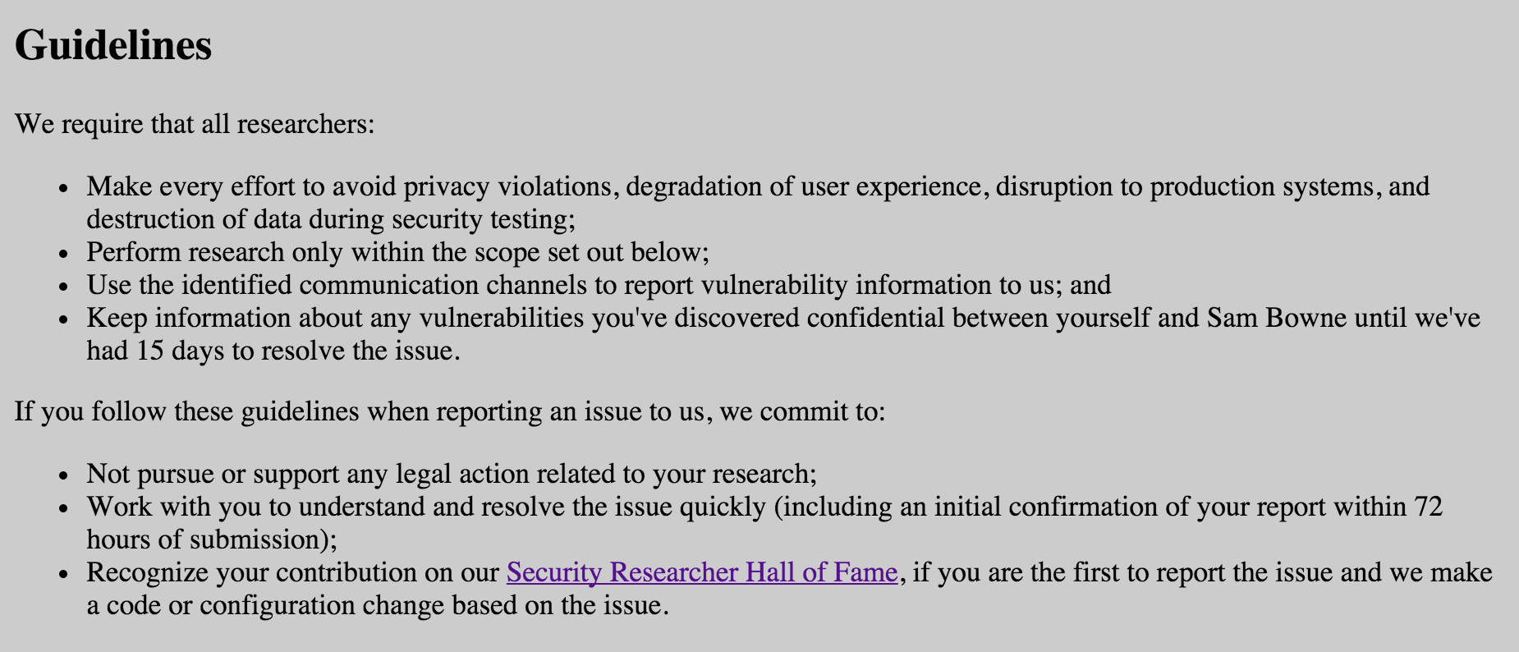
ty @bugcrowd

Slide 35
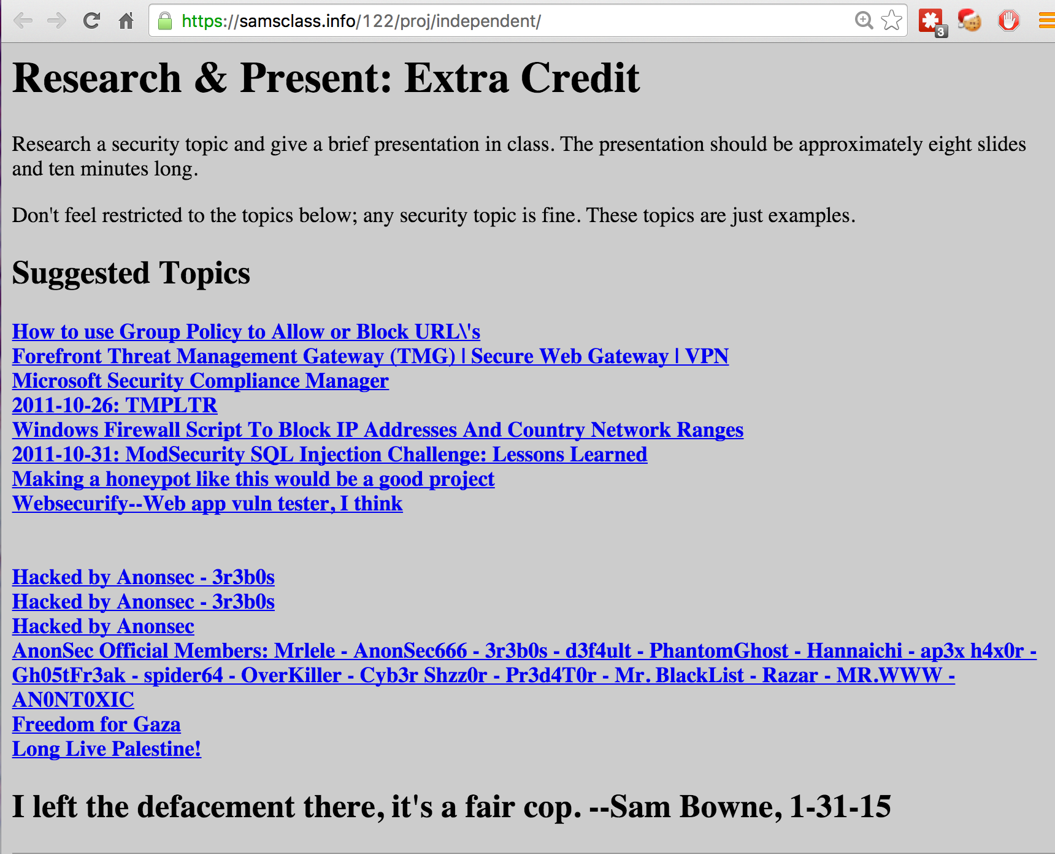
Hacked by Anonsec

Slide 36
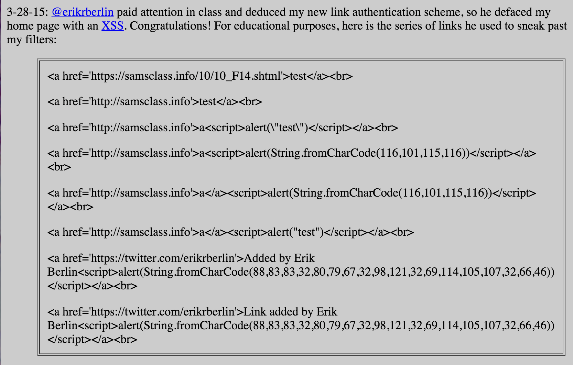
XSS

Slide 37
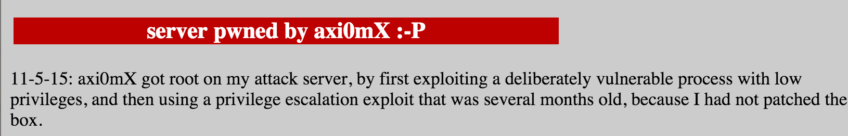
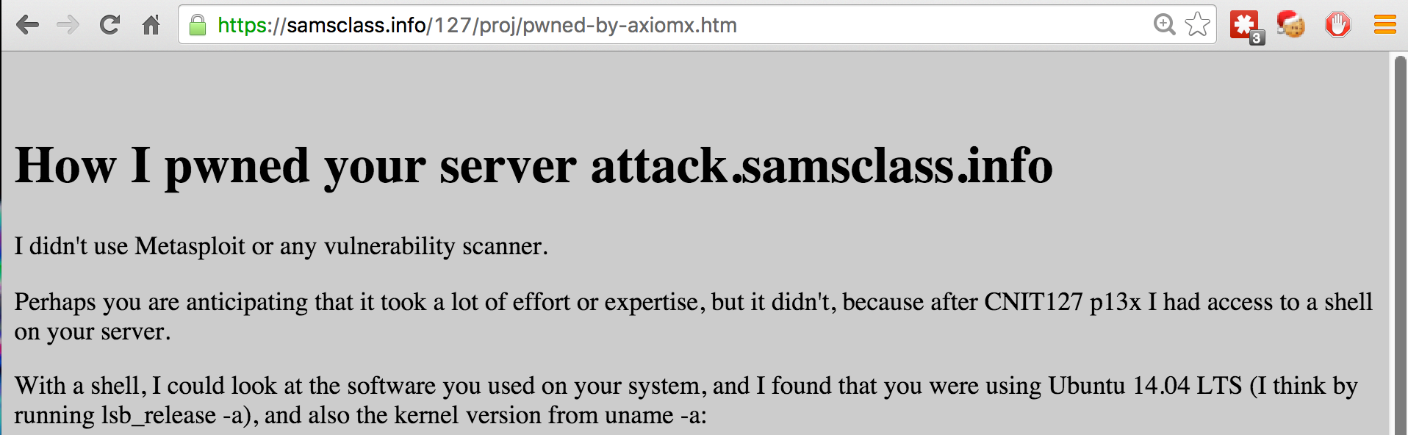
Rooted My Server

Slide 38
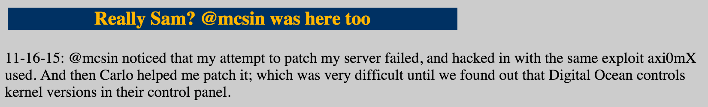
Rooted Twice the Same Way
My first attempt to patch the vulnerability failed
With the help of a student, I got my kernel updated after this

Slide 39
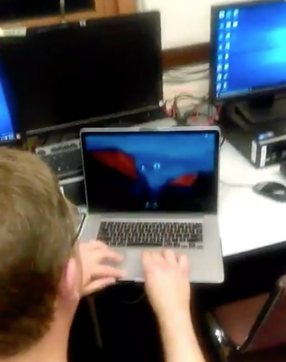
Stealing My Password
Shoulder surfing
http://tinyurl.com/samspw

Slide 40
CTFs

Slide 41
How to Start
PicoCTF
EasyCTF
CTFTime

Slide 42

Many levels, from very easy to very hard
Complete walkthroughs

Slide 43
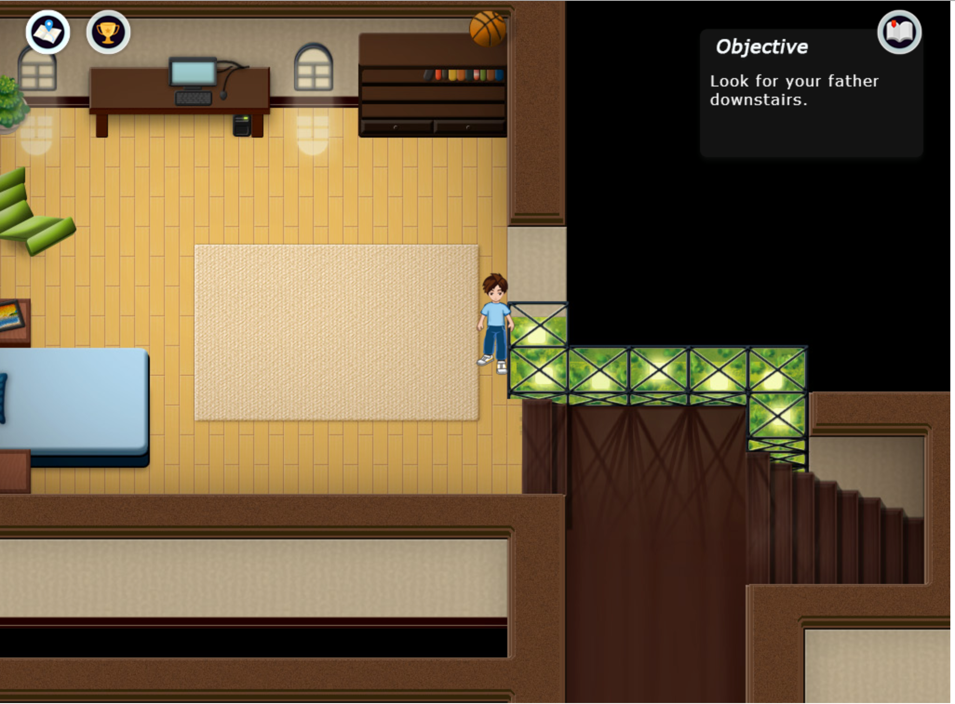
Graphical Gameboard

Slide 44
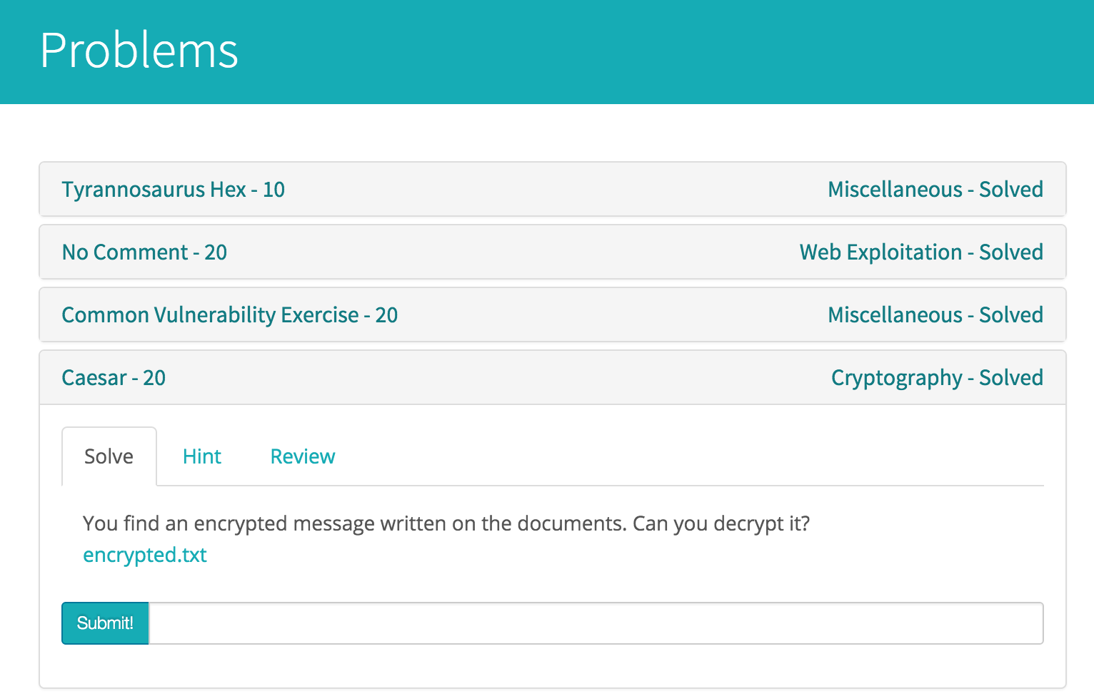

Slide 45
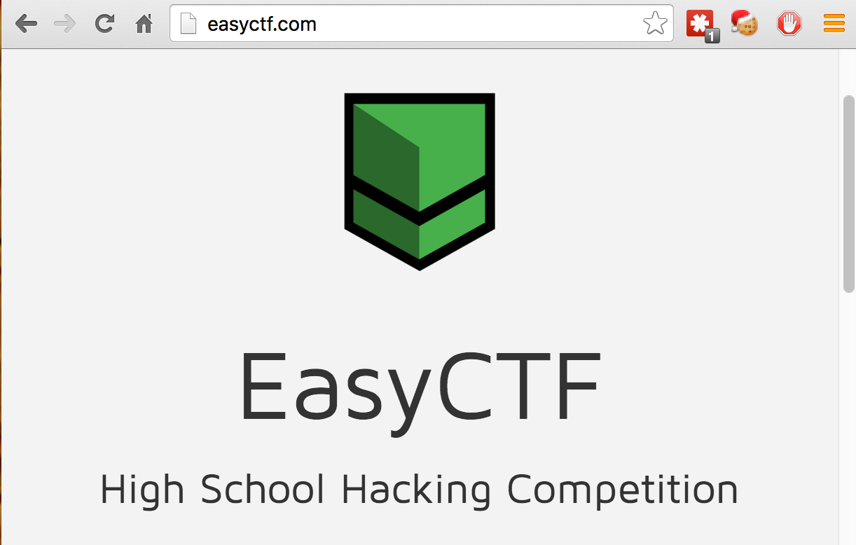
1 week long
Many easy problems, but also hard ones
Sign up to hear about other easy CTFs

Slide 46
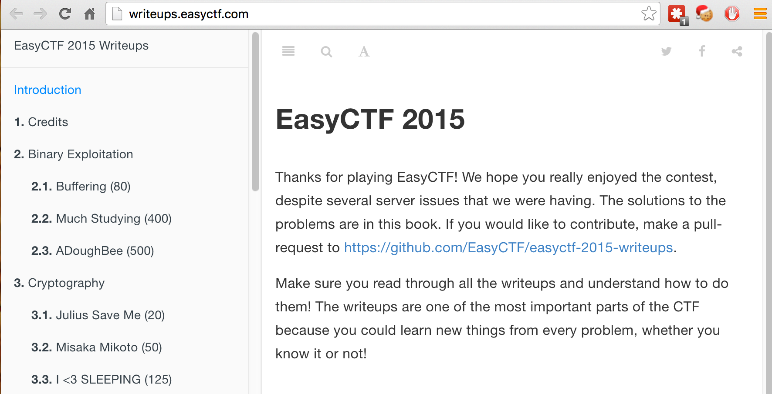
Write-Ups

Slide 47
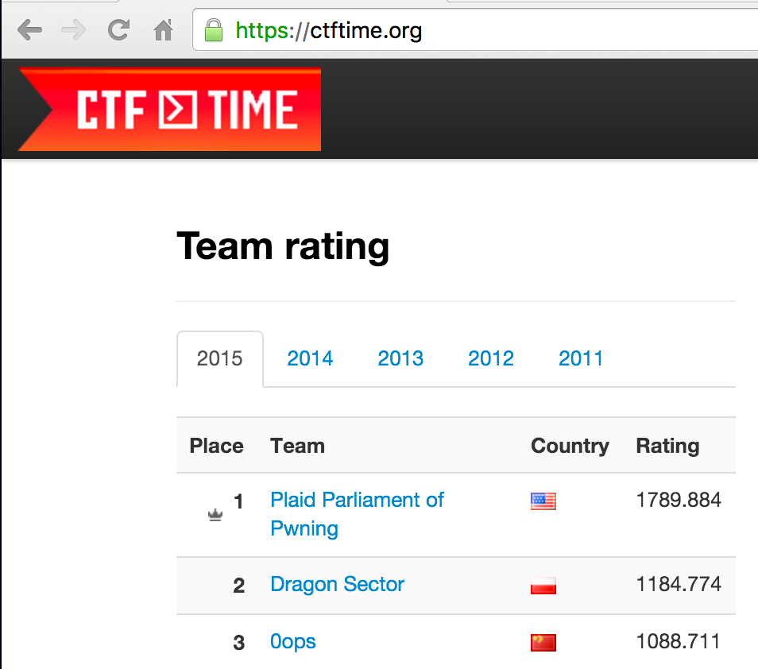

Slide 48
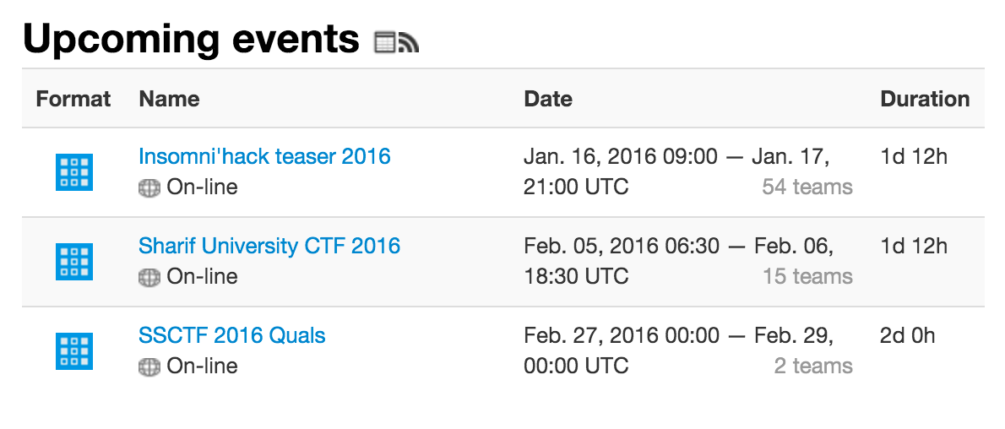
Find CTFs

Slide 49
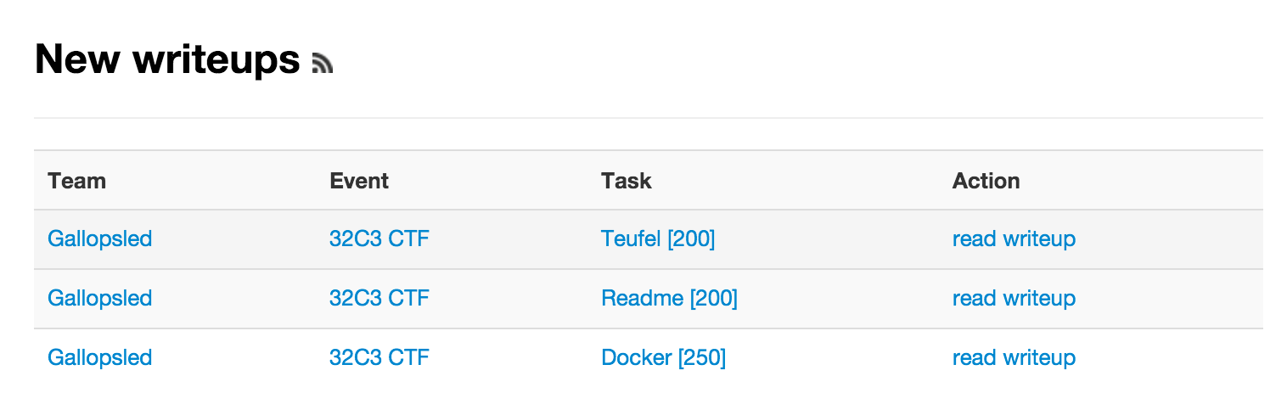
Walk-Throughs!

Slide 50
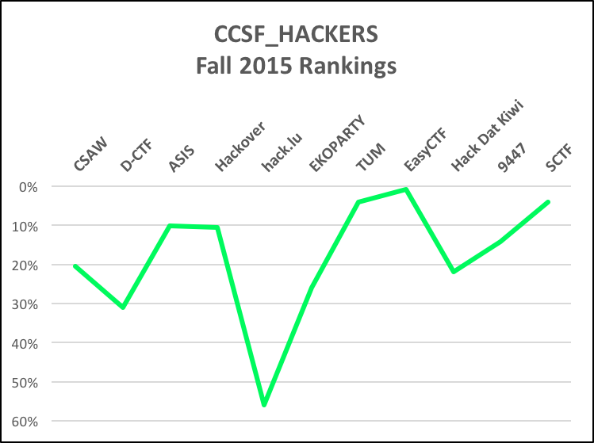

Slide 51
CVEs

Slide 52
Fuzzing
Feeding randomly-mutated files to a program
Find crashes
Triage them for exploitability
https://samsclass.info/127/proj/p16-fuzz.htm

Slide 53

Failure Observation Engine

Slide 54

Written in Python :)

Slide 55
A Slow Process
One student has had the whole hacking lab fuzzing nights and weekends for a month or two
No new vulnerabilities found yet

Slide 56
Hacking Club

Slide 57


Slide 58
Remote Speakers
Projector, webcam, Skype, speakers
Two talks from professional penetration testers

Slide 59
Student Contributions
Cleaning up the lab to make an inviting hangout space
Bridging to the CCSF_Coders club
Technical expertise from Google vuln labs
Hacker contacts from Defcon, etc.

Slide 60
Hacking Lab
Free Fire Zone

Slide 61


Slide 62

Signs on Wall

Slide 63
Keylogger
One student wrote a Python keylogger and installed it on the lab machines

Slide 64


Slide 65
Lockpicking

Slide 66
Make Easy Locks
Get cheap locks at Home Depot
2 for $11
Normal lock has 5 pins
Remove pins to make locks with 1, 2, 3, 4 pins

Slide 67

Cheap Locks are Fine

Slide 68

Re-Keying Kit ($11)

Slide 69

Remove the Clip

Slide 70

Insert Key, Turn to 45°

Slide 71

Slide Cylinder Out

Slide 72
Root Canal
Actual re-keying involves carefully removing pins and replacing them with pins of different length
But all we need is to remove pins & springs entirely, making the lock easier to pick

Slide 73

Lockpick Training Set

Slide 74



Slide 75
Internships

Slide 76
Employers
OpenDNS
NASA Ames
Lawrence Berkeley Lab
San Francisco Housing Authority
UCSF Medical Center

Slide 77
Job Fair
Students bring resumes at first (and only) class meeting
Employers describe jobs and grab applicants on the spot
Everyone welcome, including ex-students, students from the Computer Science department, students not enrolled in the internship class

Slide 78
Administrative Resistance
CCSF administrators cancelled the entire program in Spring 2015
I only saved it by appealing directly to the Chancellor and threatening to resign
However, the person who cancelled it is now the Chancellor

Slide 79
Administrative Resistance
The new curriculum review process doesn't allow any class without lectures, textbook, final exam, etc.
This blocks seminar classes and Internship classes
The solution is to just break the rules--this is what tenure is for

Slide 80
Guest Speakers
At least one per class per semester
"Careers" class consisting of visiting industry speakers

Slide 81





