Slide 1
IPv6 RA DoS Attacks
Sam Bowne
gogoNET Live 4
Nov 13, 2013

Slide 2


Slide 3
IPv4 Exhaustion

Slide 4
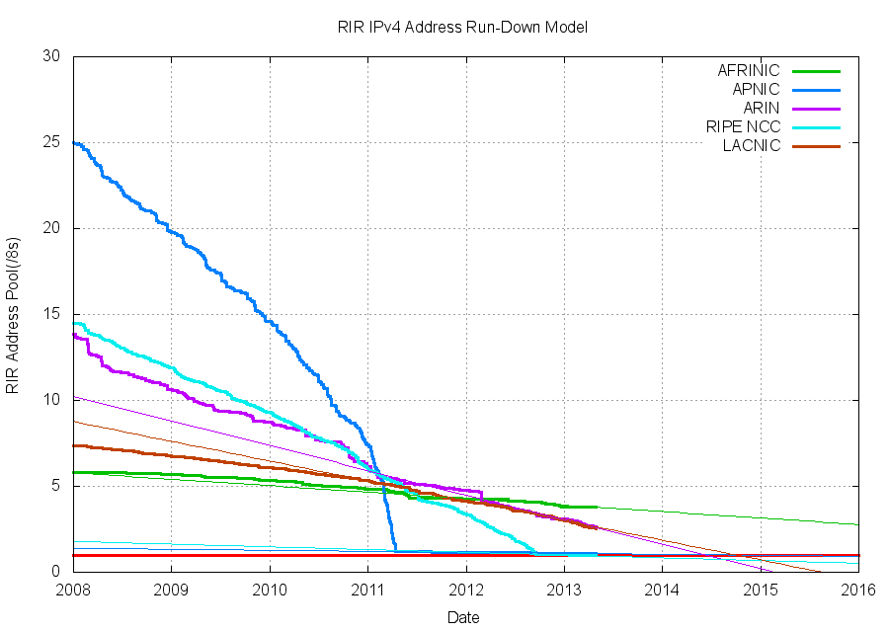
IPv4 Exhaustion

Slide 5
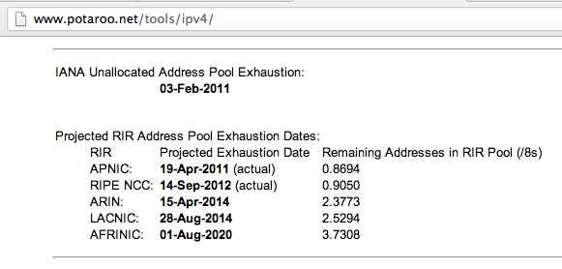
One Year Left

Slide 6
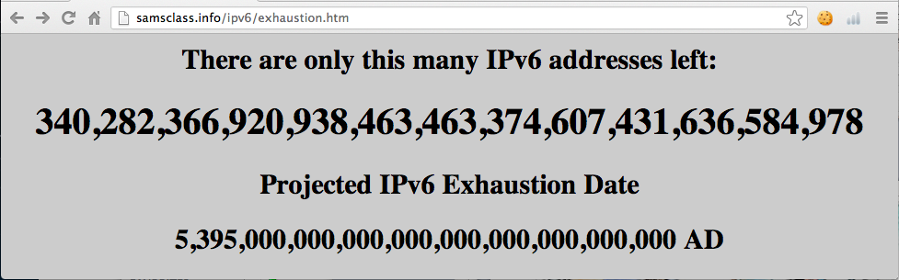
IPv6 Exhaustion

Slide 7
Link-Local DoS
IPv6 Router Advertisements

Slide 8

Old Attack (from 2011)

Slide 9
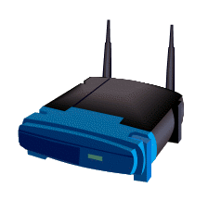

IPv4: DHCP
PULL process
Client requests an IP
Router provides one
I need an IP
Use this IP
Host
Router

Slide 10
IPv6: Router Advertisements
PUSH process
Router announces its presence
Every client on the LAN creates an address and joins the network
JOIN MY NETWORK
Yes, SIR
Host
Router

Slide 11
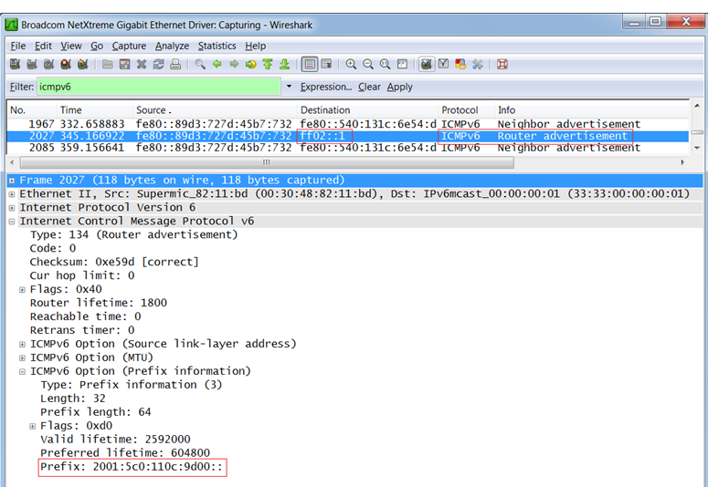
Router Advertisement Packet

Slide 12
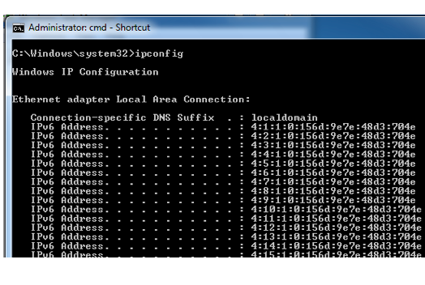
RA Flood (from 2011) flood_router6

Slide 13
Effects of flood_router6
Drives Windows to 100% CPU
Also affects FreeBSD
No effect on Mac OS X or Ubuntu Linux

Slide 14

The New RA Flood

Slide 15
MORE IS BETTER
Each RA now contains
  17 Route Information sections
  18 Prefix Information sections

Slide 16
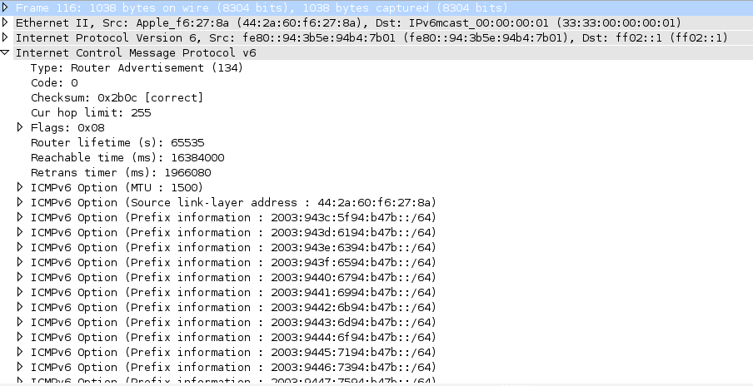

Slide 17
Flood Does Not Work Alone
Before the flood, you must send some normal RA packets
This puts Windows into a vulnerable state

Slide 18
How to Perform this Attack
For best results, use a gigabit Ethernet NIC on attacker and a gigabit switch
Use thc-ipv6 2.3 on Kali
Two Terminal windows:
  ./fake_router6 eth1 a::/64
  ./flood_router26 eth1
Windows dies within 30 seconds

Slide 19
Effects of New RA Flood
Win 8 & Server 2012 die (BSOD)
Microsoft Surface RT dies (BSOD)
Mac OS X dies
Win 7 & Server 2008 R2, with the "IPv6 Readiness Update" freeze during attack
iPad 3 slows and sometimes crashes
Android phone slows and sometimes crashes
Ubuntu Linux suffers no harm

Slide 20
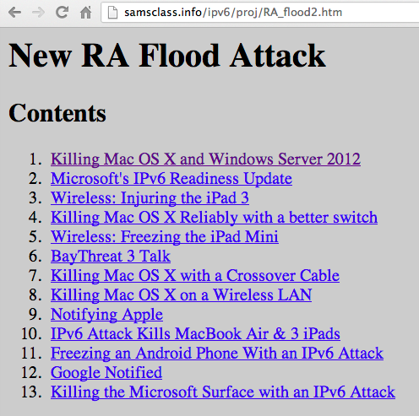
Videos and Details

Slide 21
Mitigation
Disable IPv6
Turn off Router Discovery with netsh
Use a firewall to block rogue RAs
Get a switch with RA Guard
Microsoft's "IPv6 Readiness Update" provides some protection for Win 7 & Server 2008 R2
  Released Nov. 13, 2012
  KB 2750841
  But NOT for Win 8 or Server 2012!!

Slide 22
DEMO

Slide 23
More Info
Slides, instructions for the attacks, and more at
Samsclass.info

Slide 24
Speculations

Slide 25
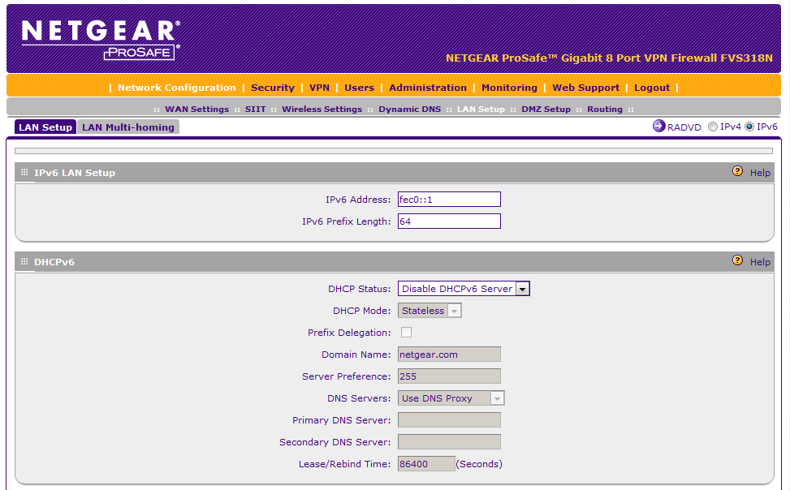
Why are Devices so Vulnerable?

Slide 26
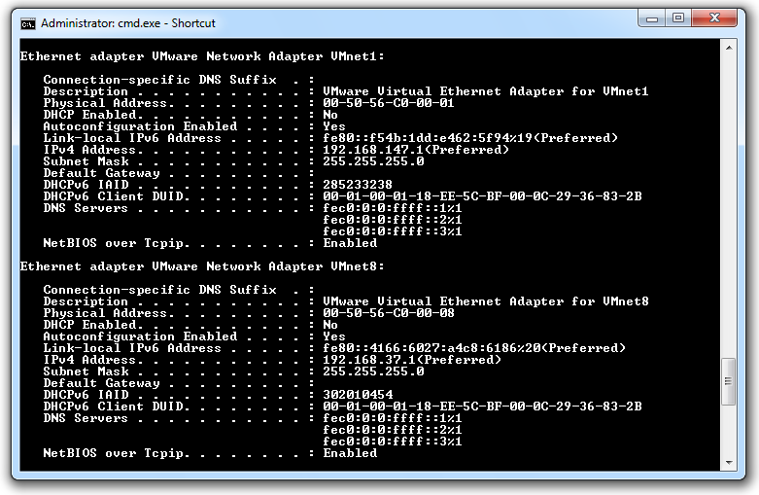

Slide 27
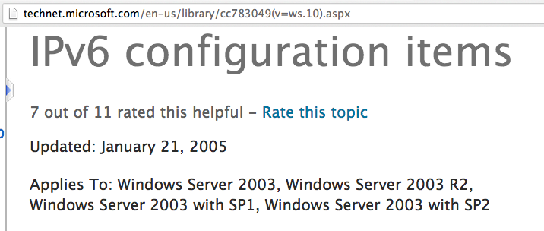
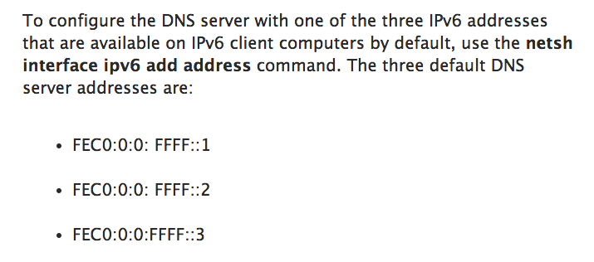
Microsoft, 2005

Slide 28
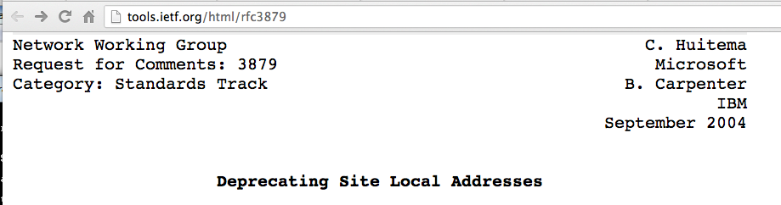
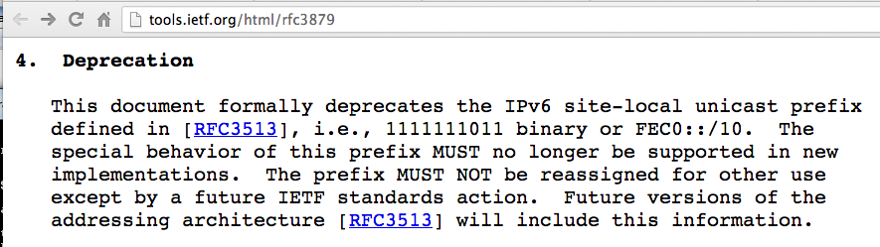
Microsoft, 2004

Slide 29
Patching

Slide 30
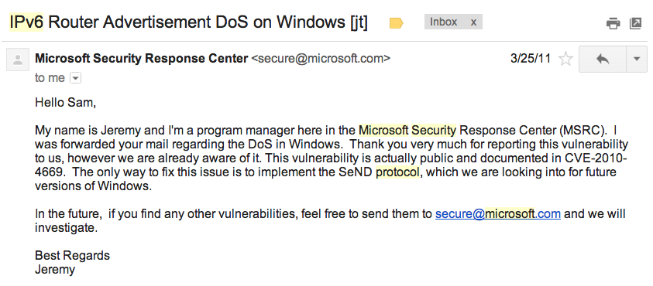
Microsoft Timeline
Marc Hause informed them of the original RA flood vuln on July 10, 2010
In March, 2011, I also warned Microsoft

Slide 31
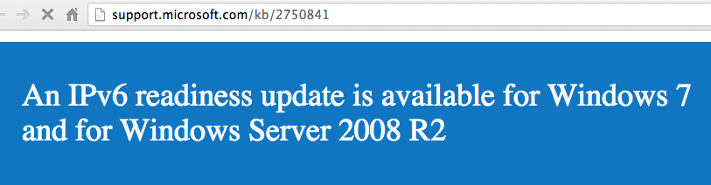
Microsoft IPv6 Readiness Update
Released in Nov., 2012

Slide 32
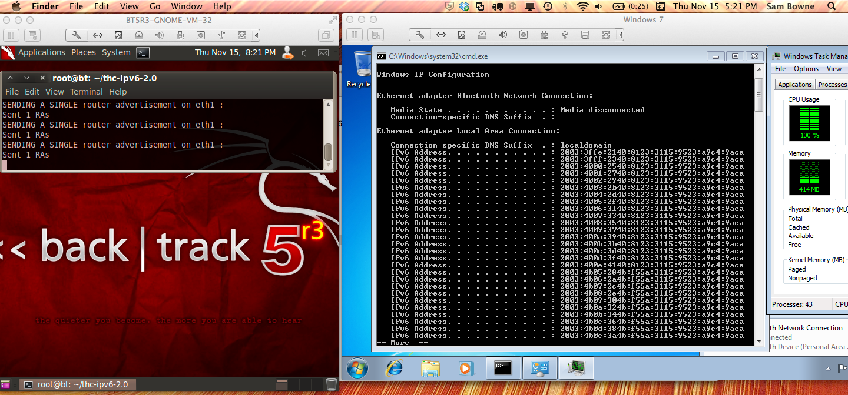
Windows 7
Without the IPv6 Readiness Update

Slide 33
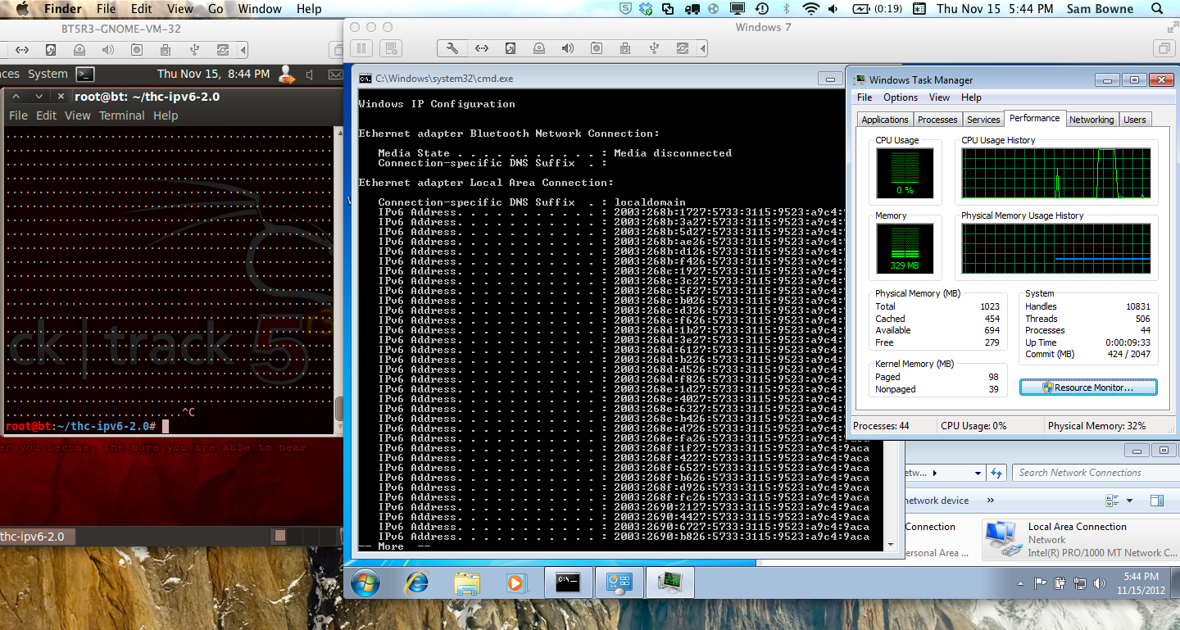
Windows 7
With the IPv6 Readiness Update

Slide 34
Limitations of the IPv6 Readiness Update
Does not eliminate the DoS
Windows 7 freezes during the attack, but recovers quickly when it stops
Only available for Win 7 and Server 2008 R2
Windows Server 2012 and Windows 8 are vulnerable to flood_router26 when preceded by a few normal RAs

Slide 35
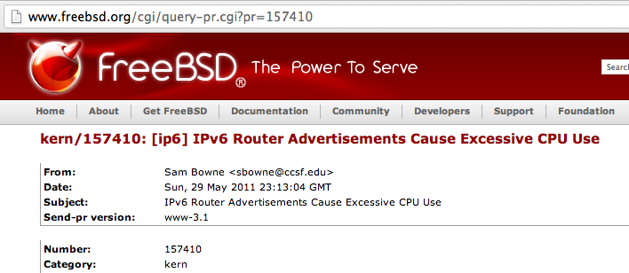
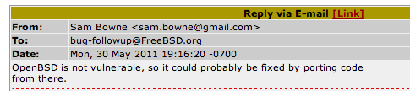
FreeBSD Timeline
Feb 5, 2011: Marc Hause warned them of the original RA vulnerability
I filed a bug report in May, 2011

Slide 36
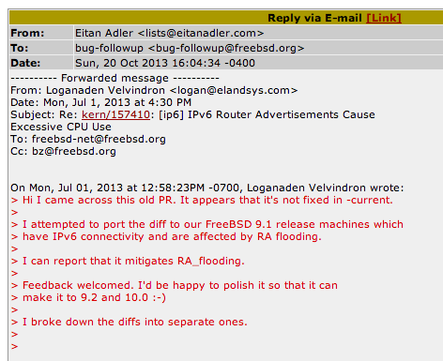
Possibly Patched in 2013

